Slide 1
Local Option Tax
Public Information Meeting
February 9, 2026

Slide 2
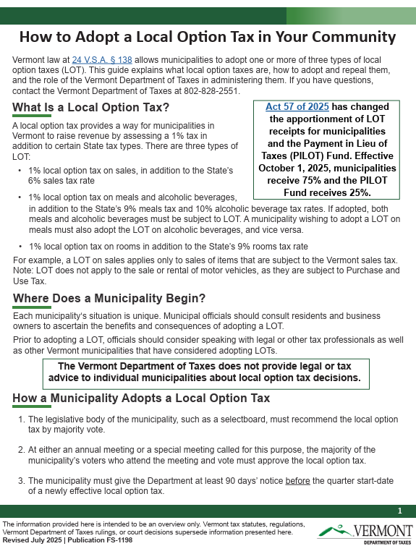

Slide 3
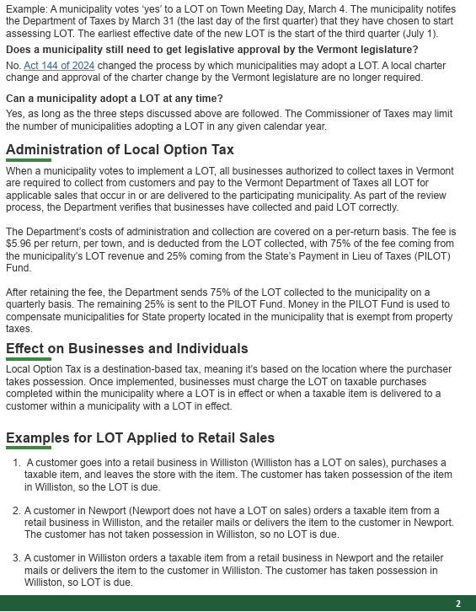

Slide 4
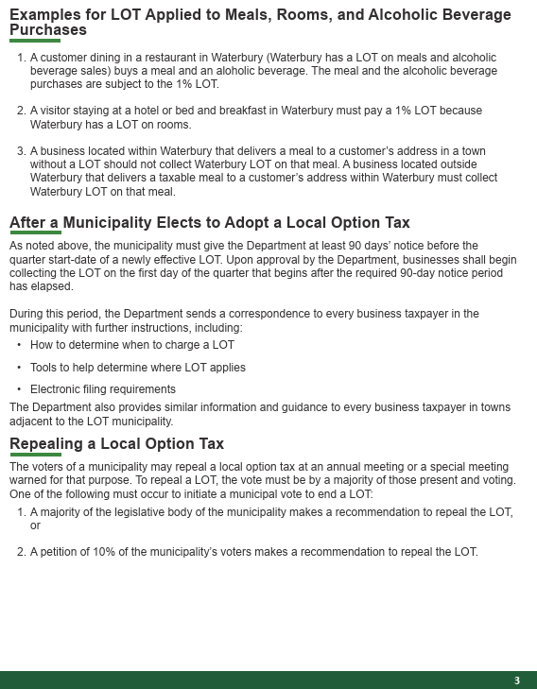

Slide 5
HISTORICAL DATA ON SALES AND MEALS
Town of Swanton
 |  | SALES |  | MEAL |  | TOTAL |  | LOT | NET | TOWN | VILLAGE
2025 |  | $34,535,764 |  | $9,266,775 |  | $43,802,539 |  | $438,025 | $328,519 | $252,960 | $75,559
2024 |  | $35,767,891 |  | $8,484,665 |  | $44,252,556 |  | $442,526 | $331,894 | $255,559 | $76,336
2023 |  | $31,153,092 |  | $7,999,483 |  | $39,152,575
2022 |  | $31,742,239 |  | $7,464,752 |  | $39,206,991
2021 |  | $32,422,227 |  | $6,623,804 |  | $39,046,031

Slide 6
ARTICLE 11 – TOWN MEETING WARNING
Article 11: Shall the Town of Swanton assess a one percent
(1%) tax on sales, room, meals and alcoholic beverages pursuant to
24 V.S.A.§138 (b), to be used for Capital Projects and Capital repairs.
Please remember to VOTE, March 3rd. 7:00 am – 7:00 pm
THANK-YOU FOR COMING THIS EVENING!

