Slide 1

2025 Wastewater & Maintenance

Slide 2
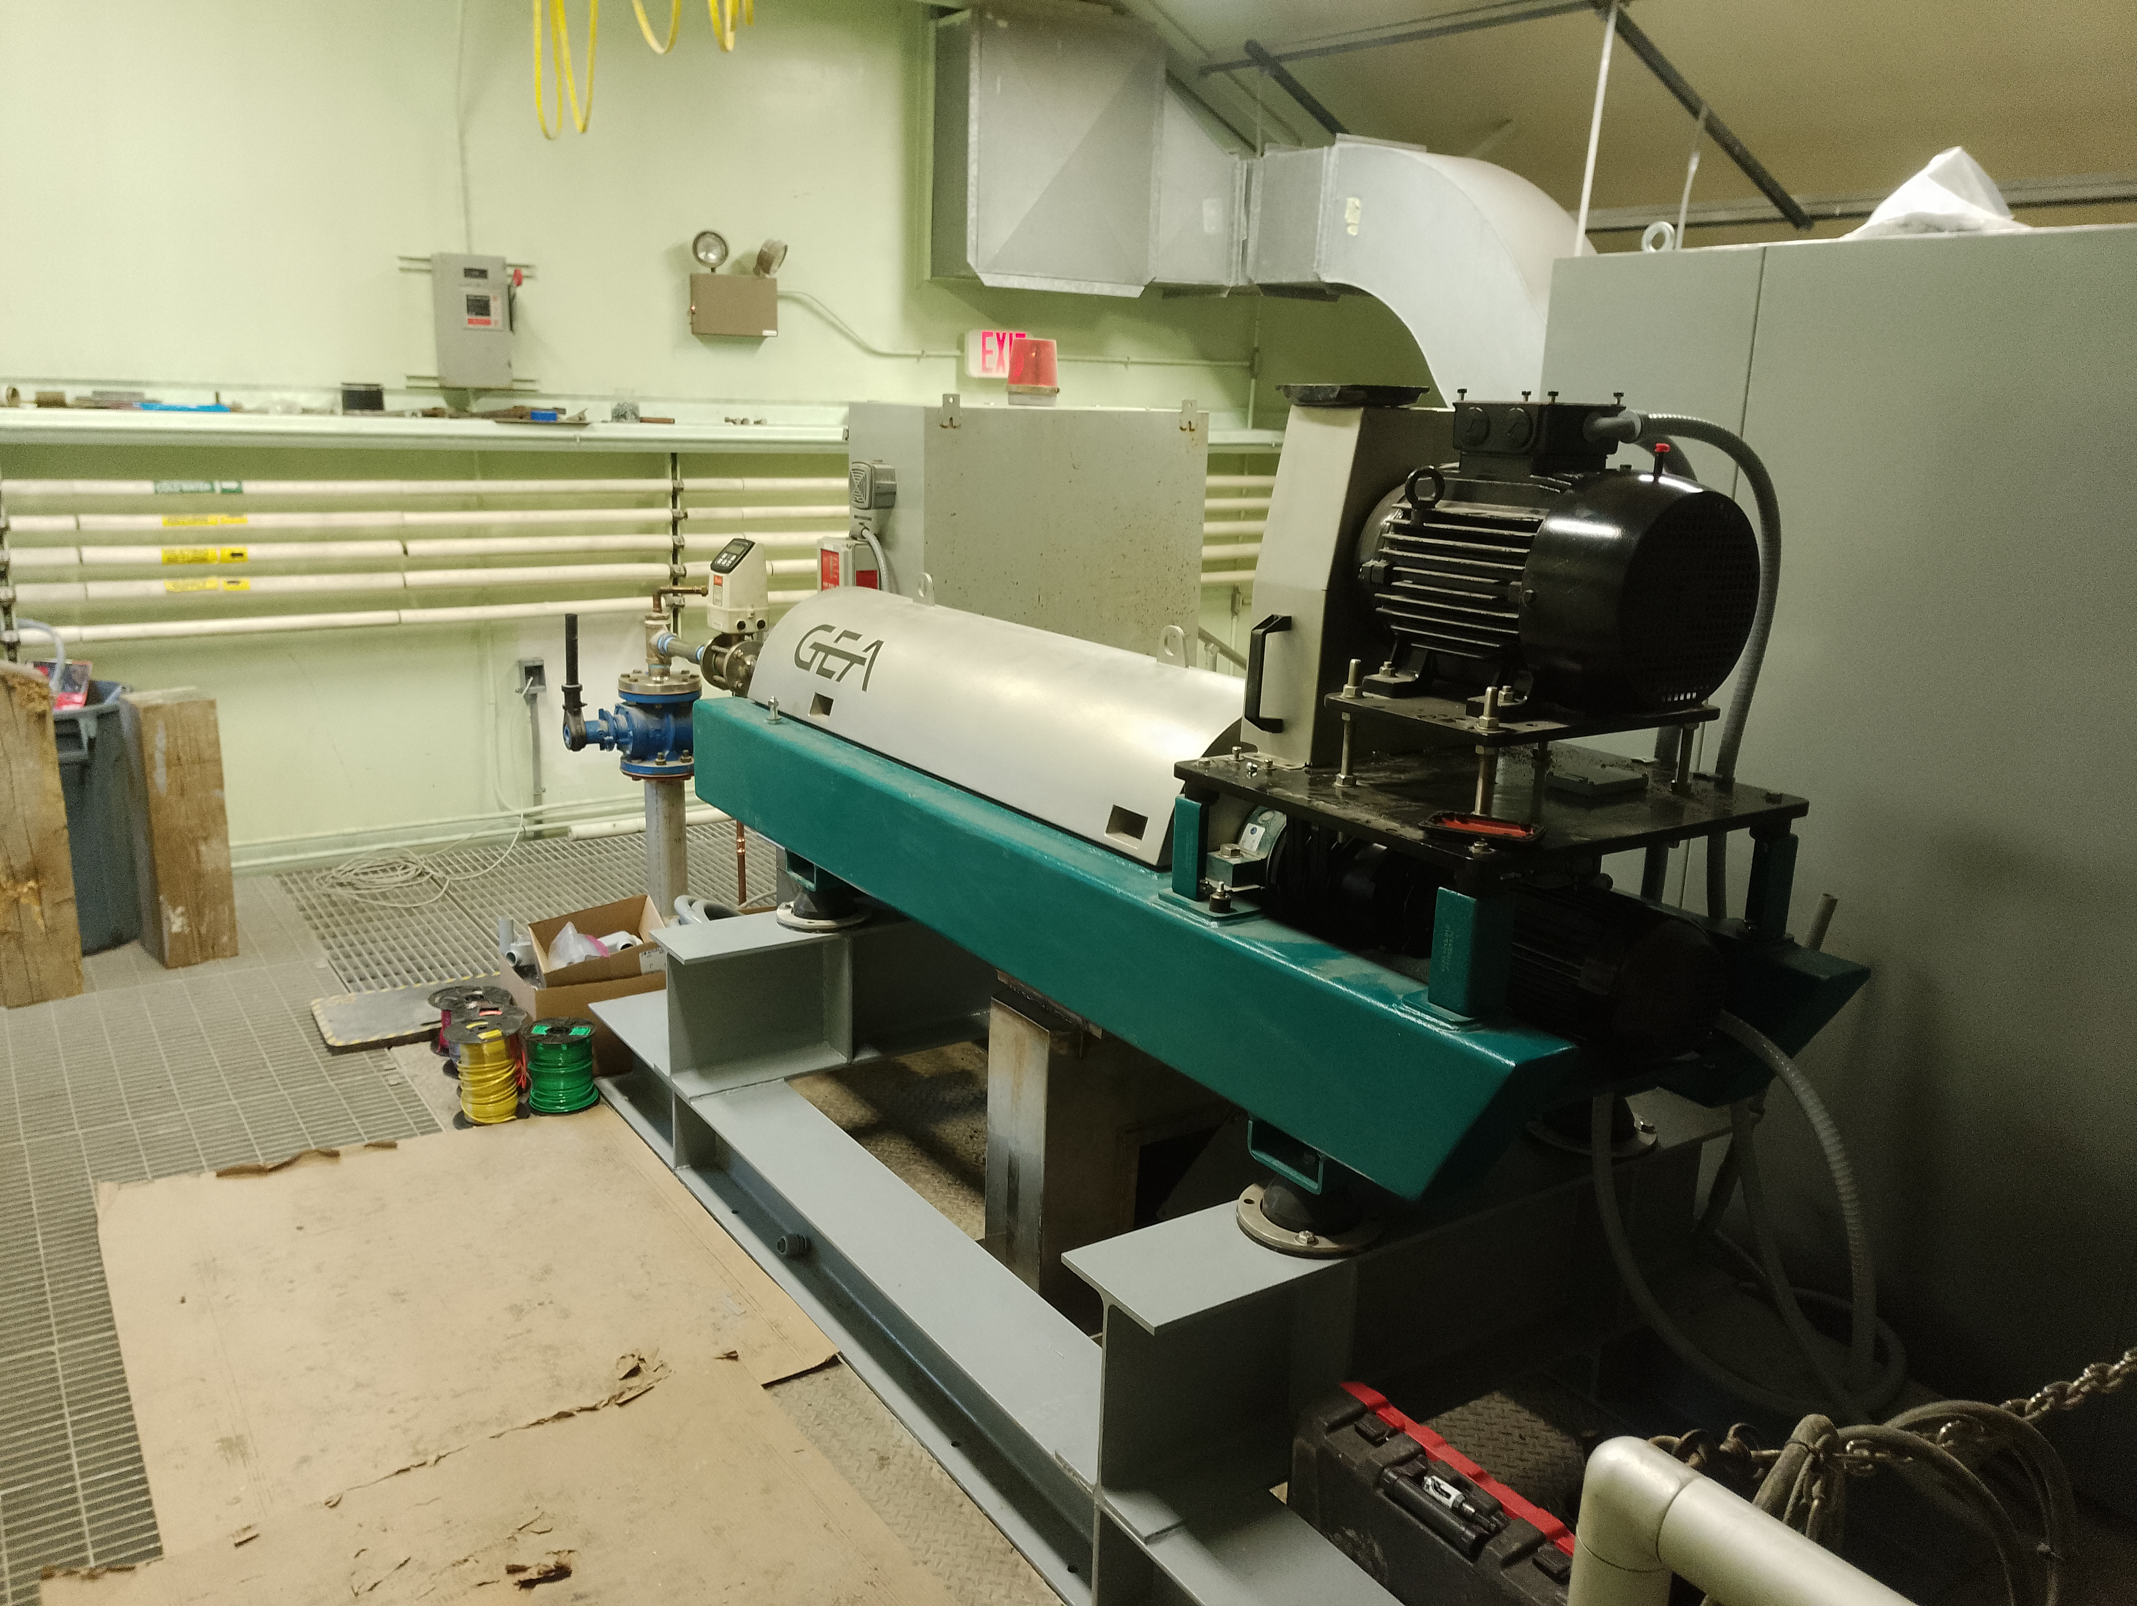
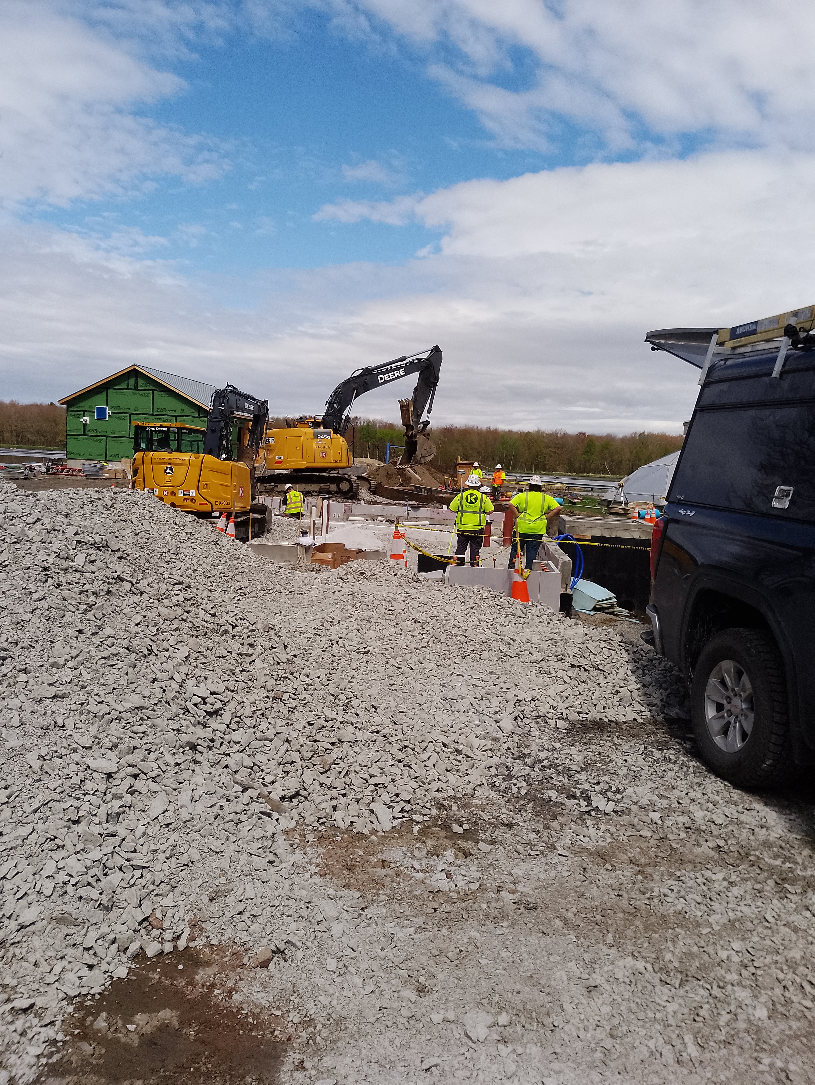
Wastewater Plant Upgrade
Wastewater Crew
Dillon Dupont Assistant Operator
Jason Starr Chief Operator
Foundry Street Upgrade
New Centrifuge Install

Slide 3
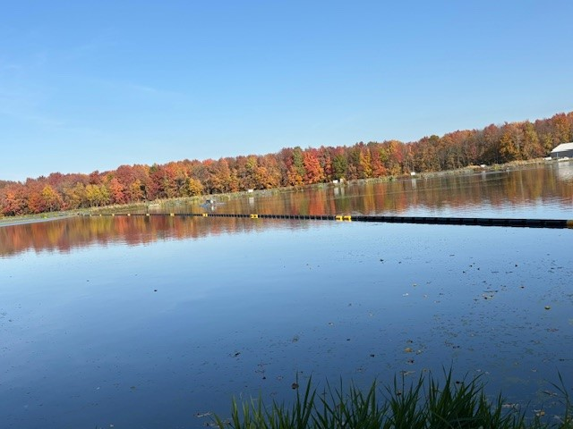
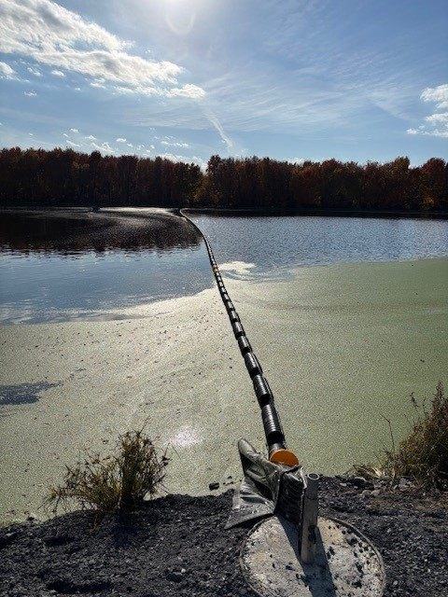
New Baffle Curtains

Slide 4
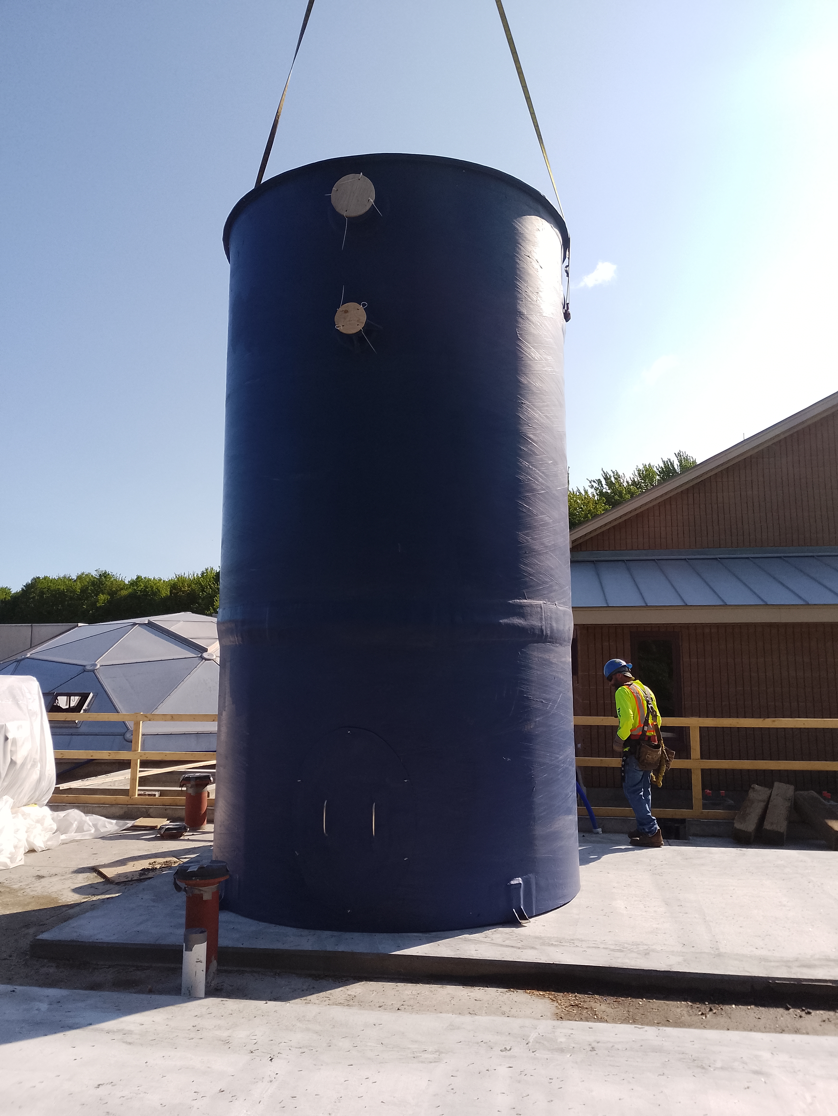
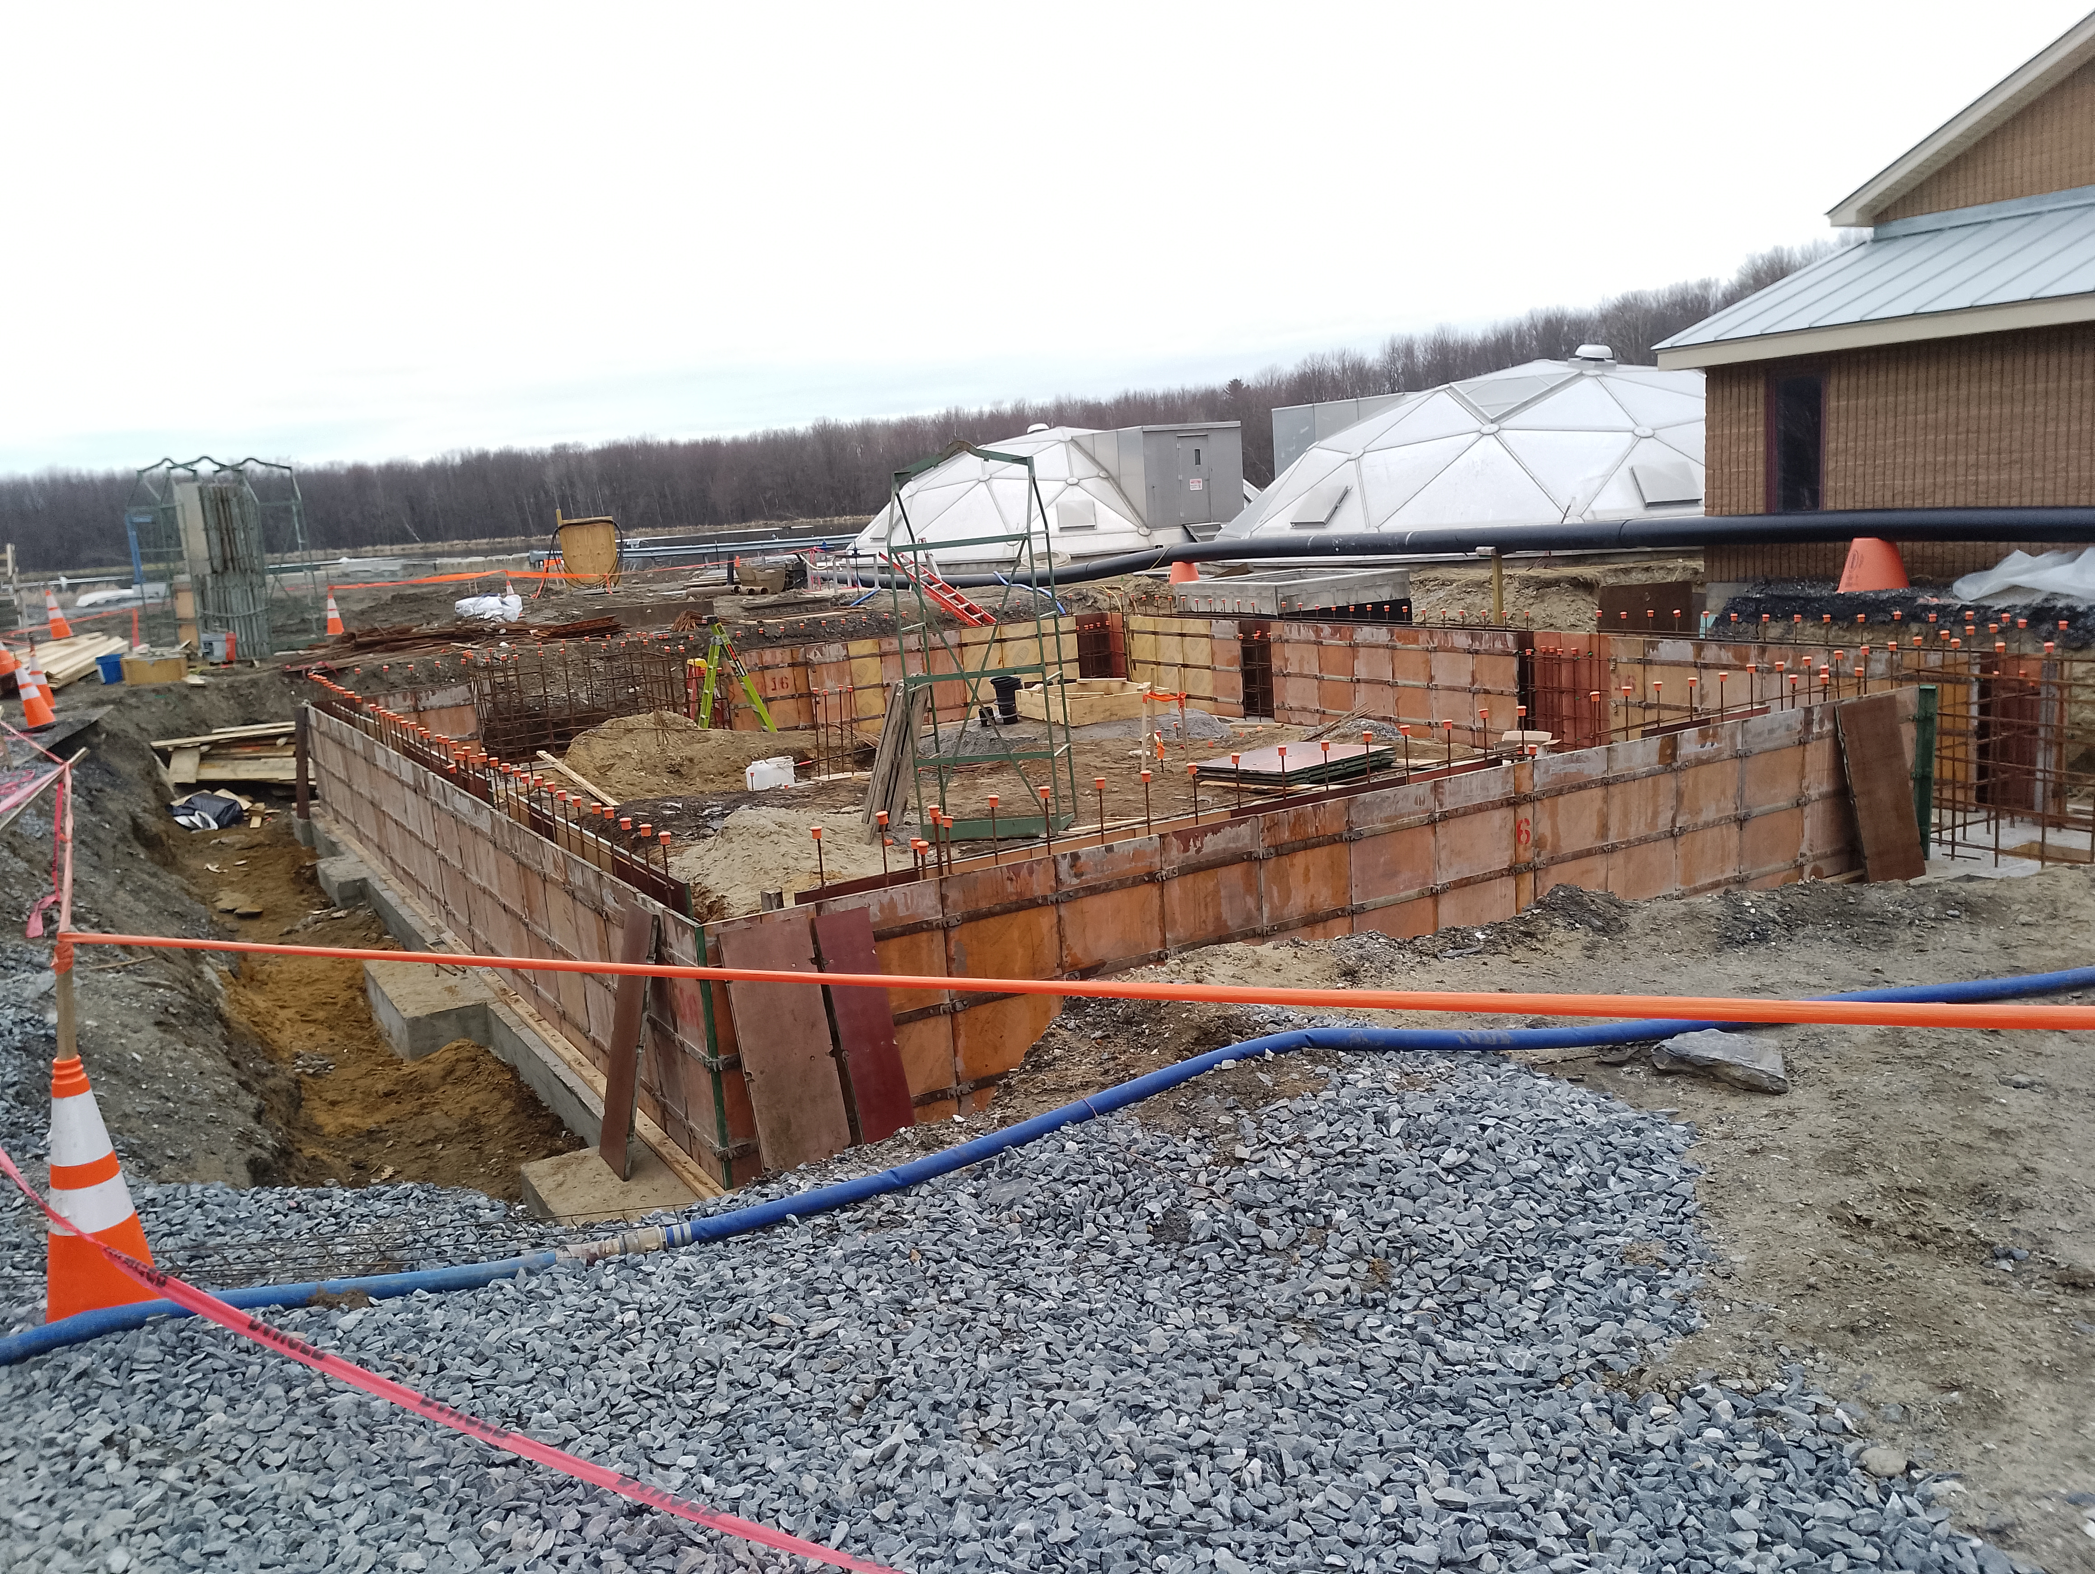
Construction of Filter Building and Installation of Filters

Slide 5
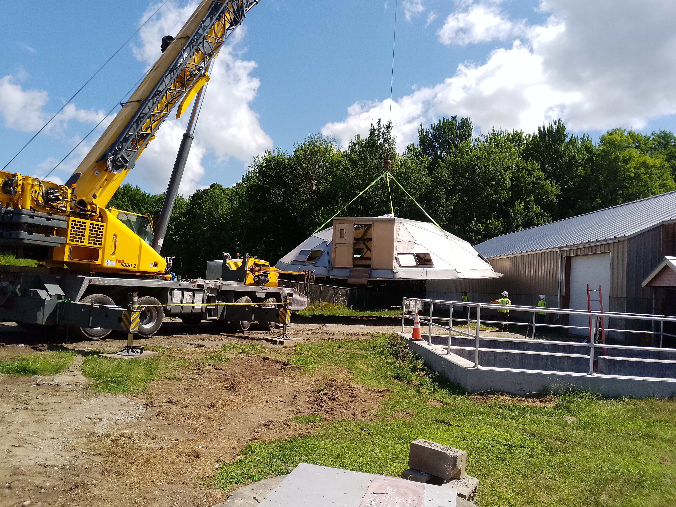
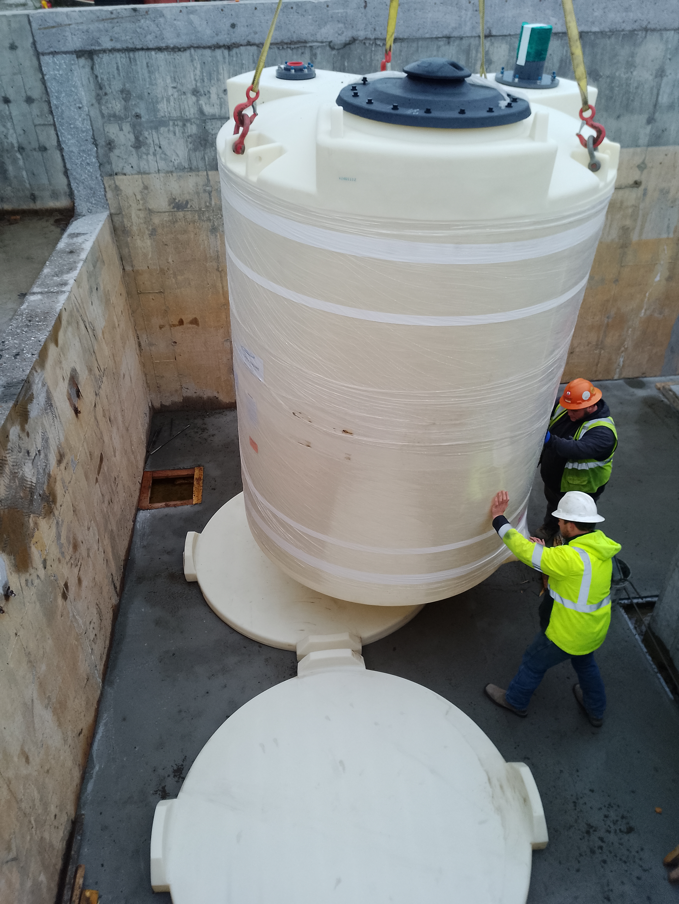
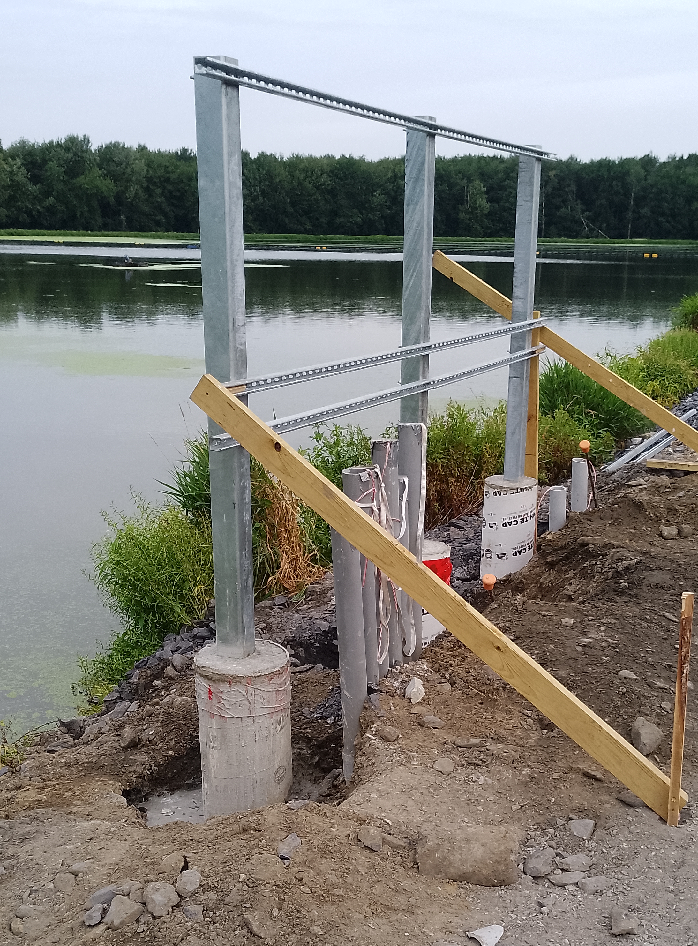
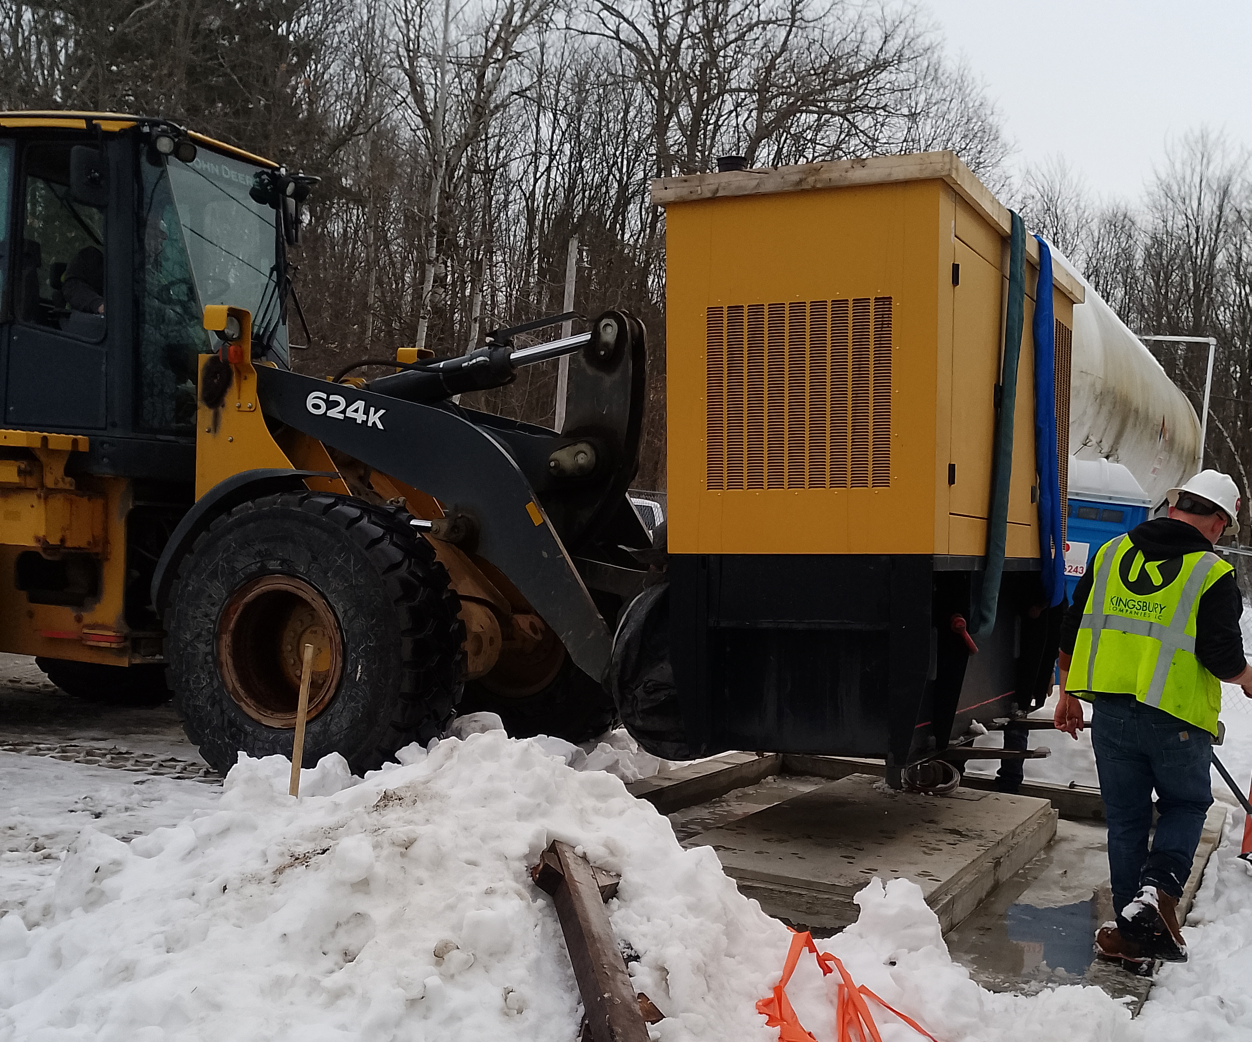

Slide 6
2025 Maintenance Projects
WW UV Racks Refurbished
New Foundry St Storage Shed Built by BFA Students
Fiber Installed Throughout the Village for Camera System

Slide 7
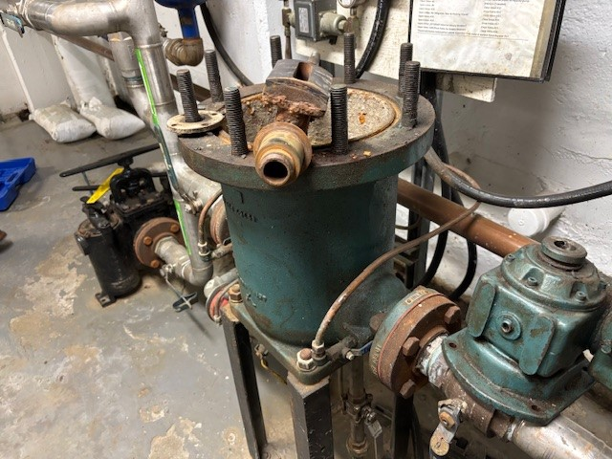
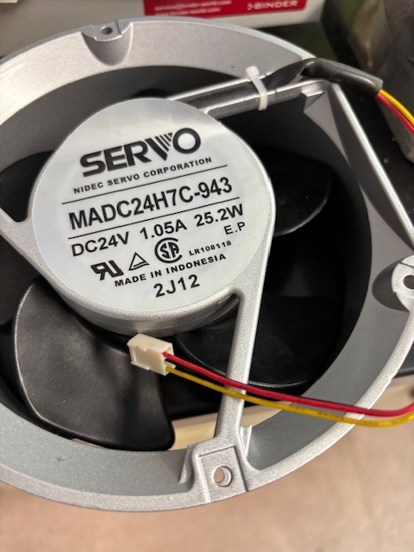
Maintenance Team
Josh Packard
Nick Williams
Replacing electric parts at the Water Treatment plant
New rotary strainer for the Hydro

Slide 8
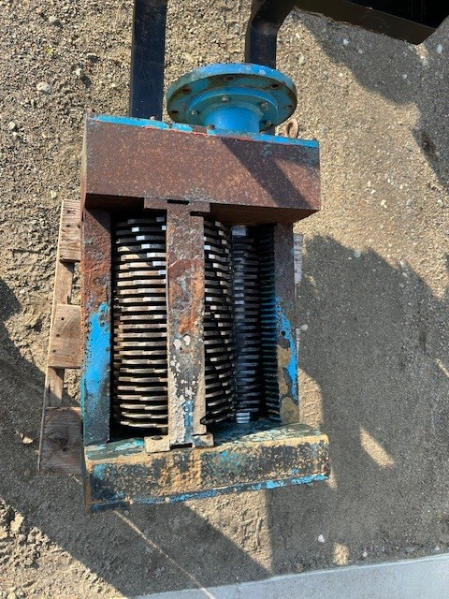
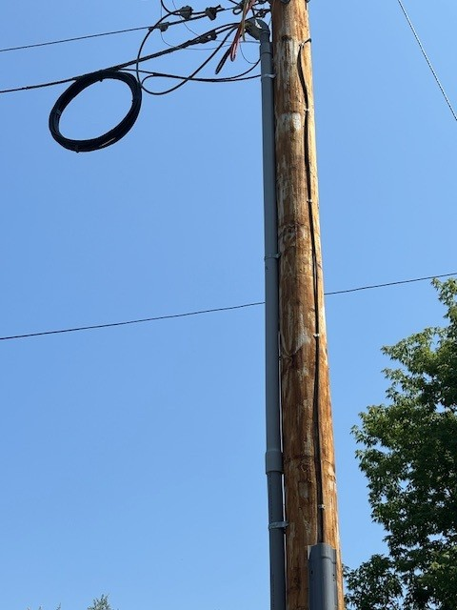
Rebuilt Grinder at Foundry Street Pump Station
Moved Fiber From overhead to under ground

Slide 9
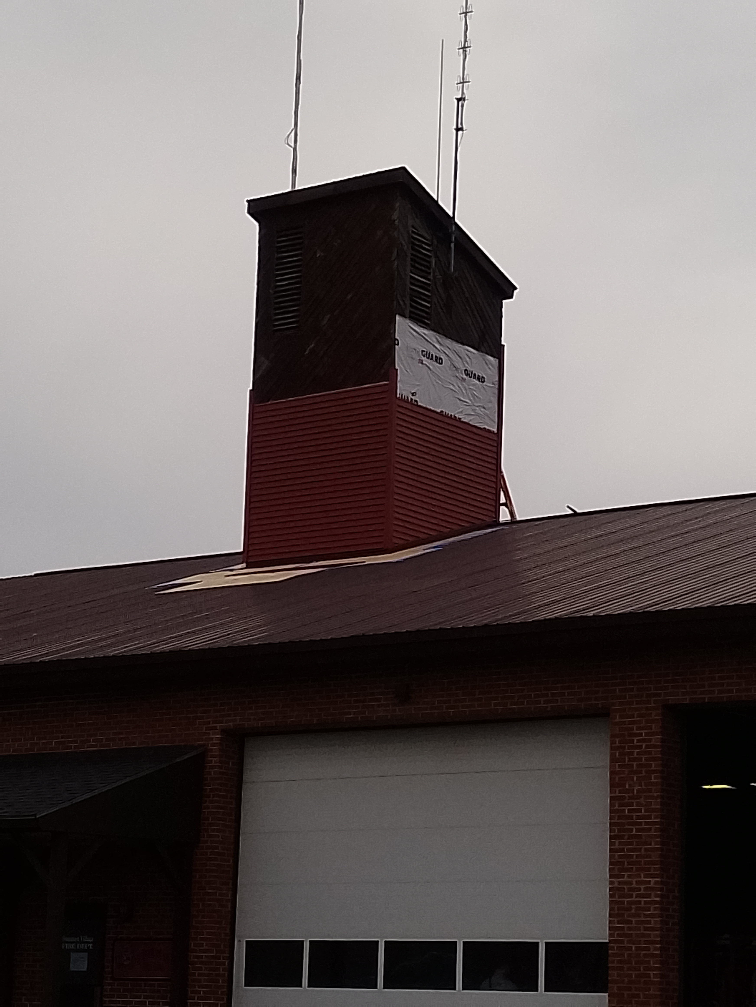
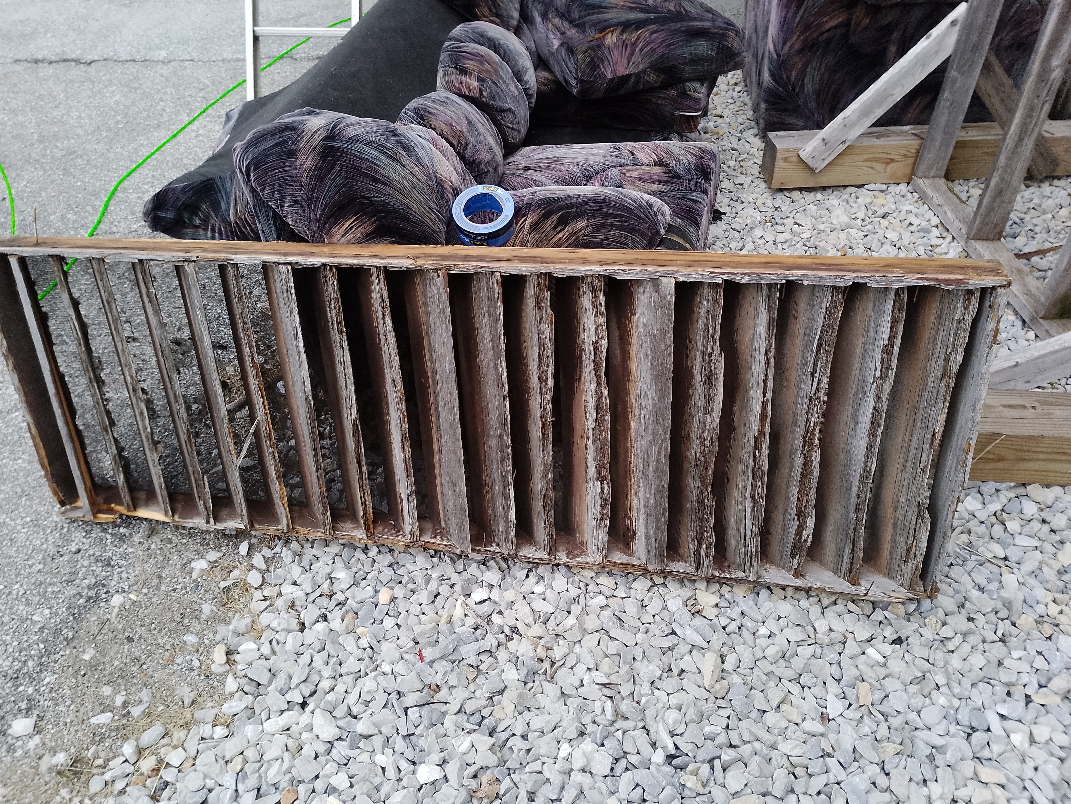
Sided hose tower and jet outs on Village Complex

Slide 10
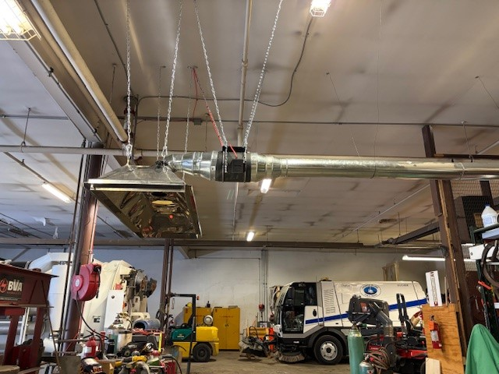
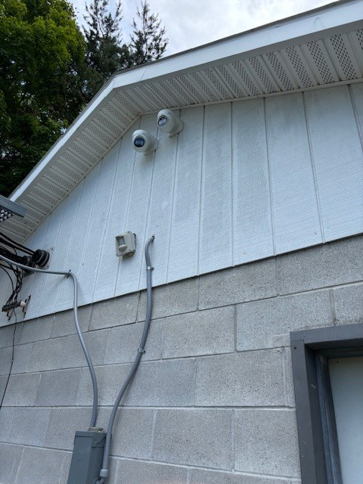
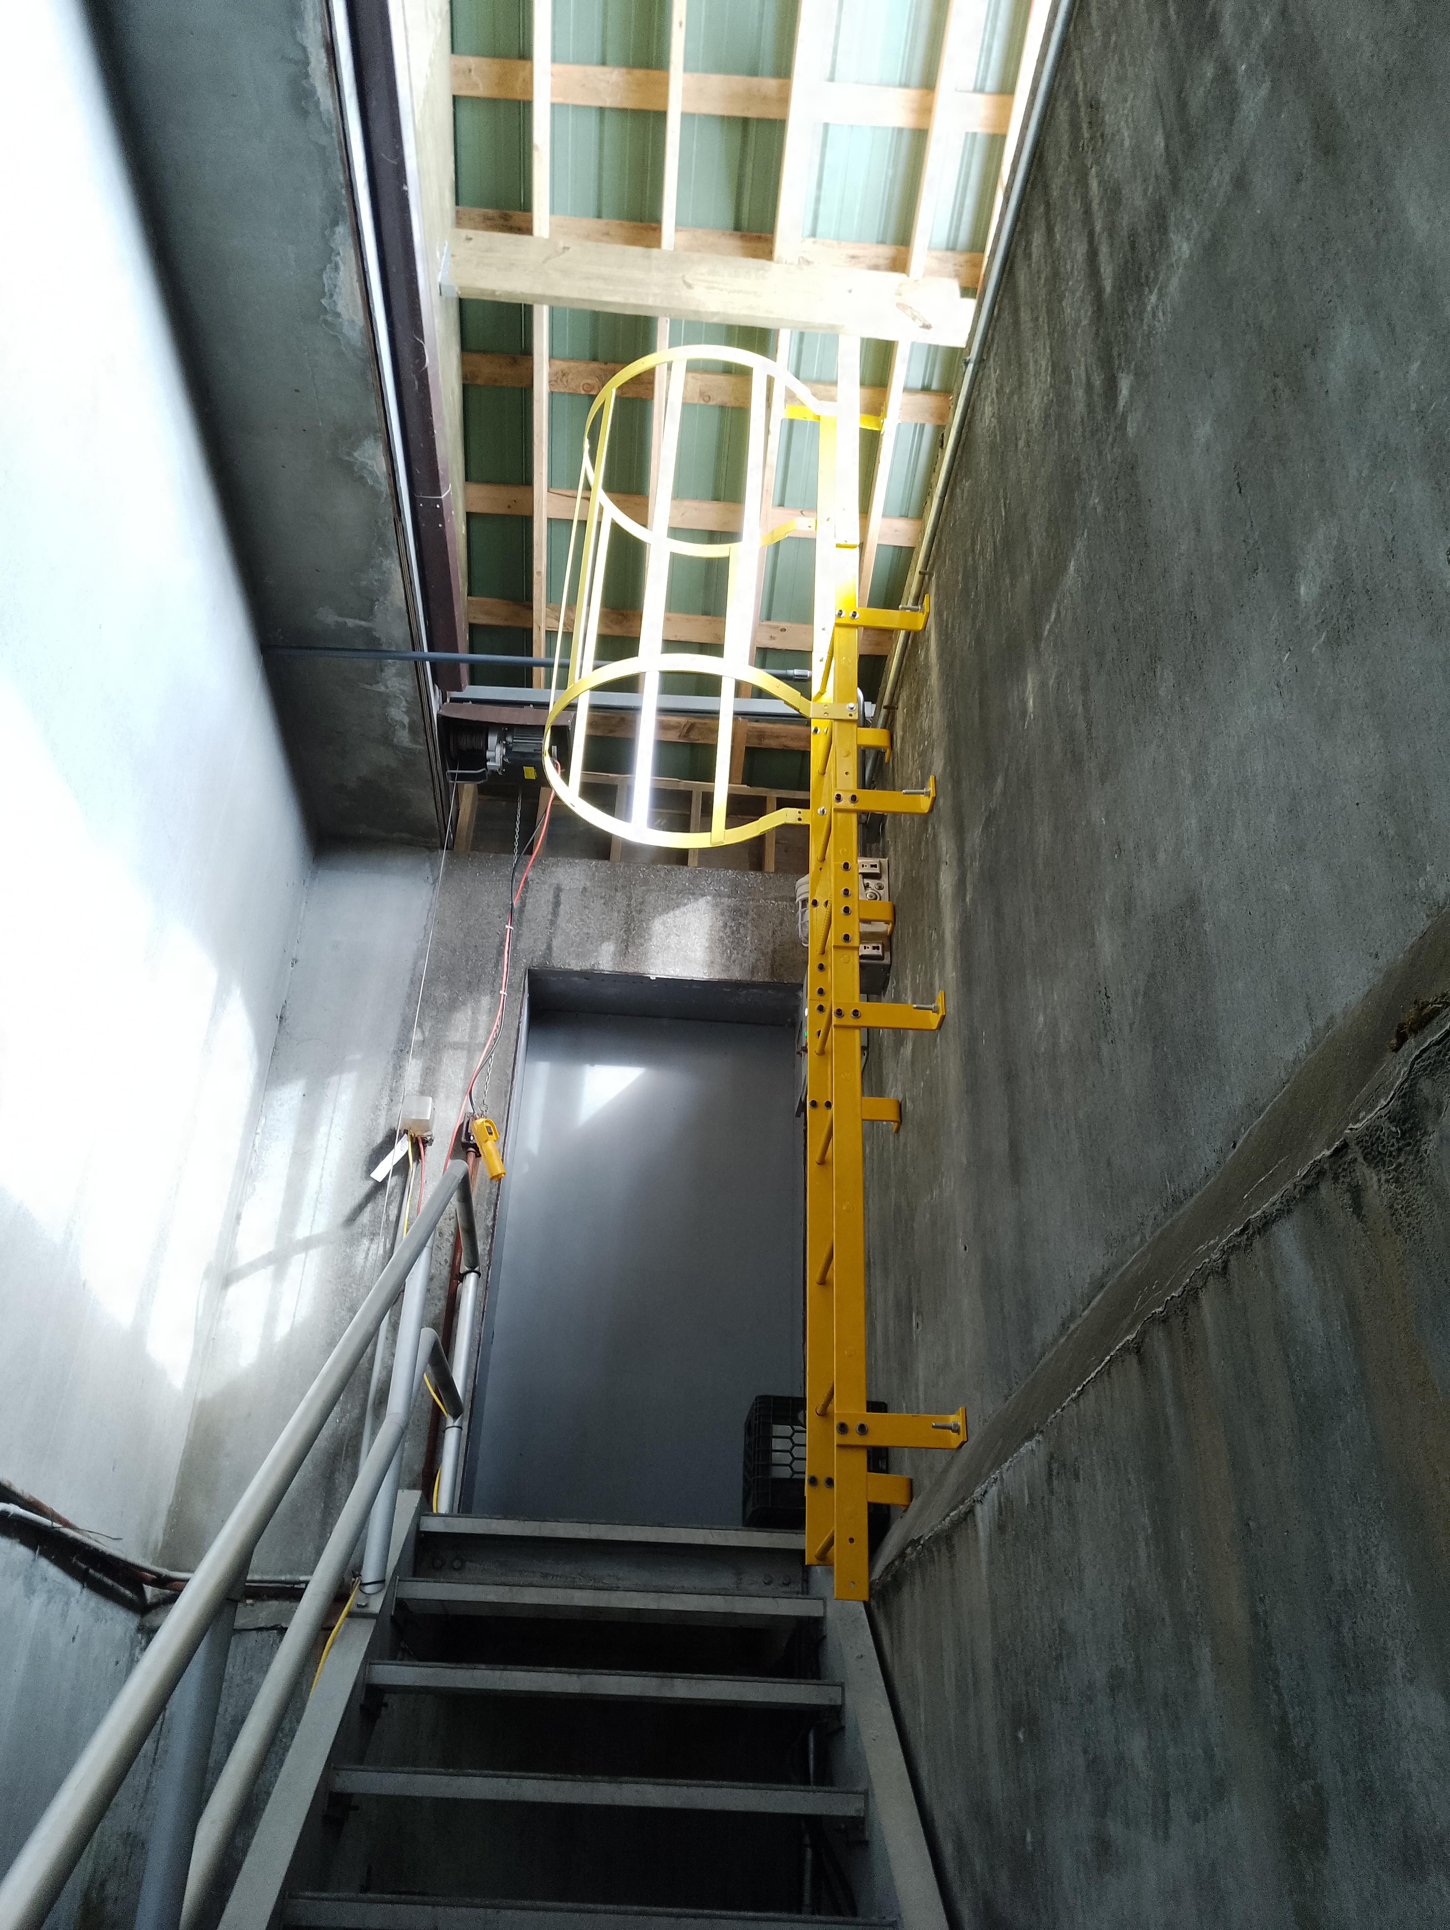
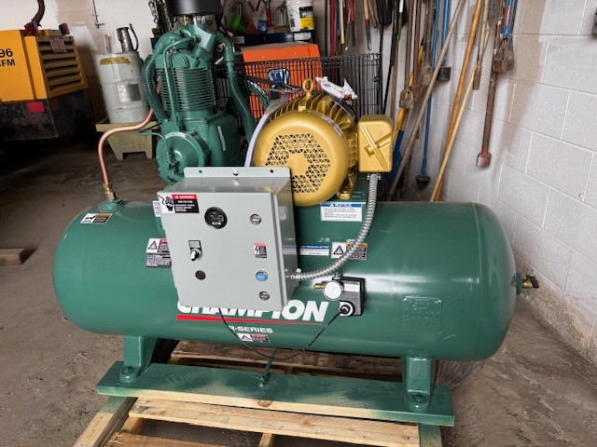
Installed Wielding Hood
Installed New Compressor
Installed Camera System
Installed Emergency Ladder

Slide 11
Work Orders and Corrective Actions for 2025
Corrective actions
Wastewater 16
Water Treatment 9
Hydro 15
Complex 32
Work orders
Wastewater 325
Water treatment 300
Hydro 900
Complex 250
Wastewater Installing fiber for the alarm system.
Water Treatment Installed new cooling fan in high lift VFD cabinet.
Hydro Replacing nonfunctional rotary strainer with a new one.
Complex Rehabbing the Hose tower and jet outs on roof.

Slide 12
THANK YOU!

