Slide 1
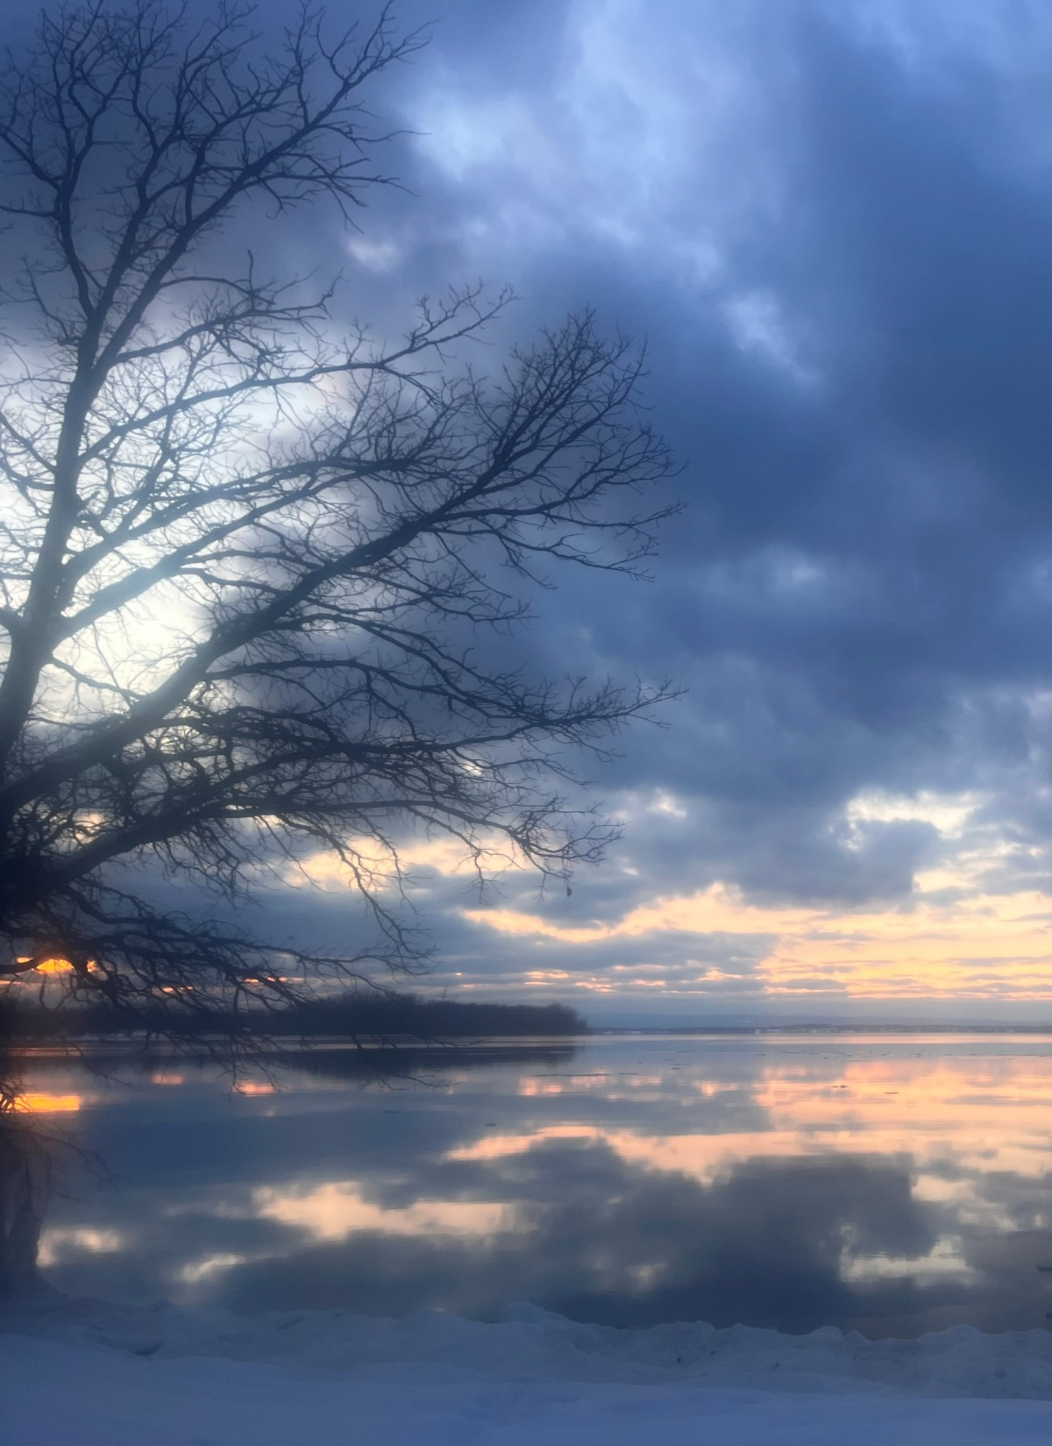

Our Mission
Friends of Northern Lake Champlain is a non-profit organization that acts to clean the waters of northern Lake Champlain and its watershed by working collaboratively with citizens, businesses, farmers and government in order to reduce land-use pollution.
Our focus is on catalyzing the actions and accountability needed to reduce land-use pollution and securing the essential local, state, and federal funding necessary for successful implementation.
Photo Kilkare State Park by Denise Smith
Notes:
The organization was formed close to 20 years ago by several Highgate Springs and Swanton residents who were focused on removing the causeways thought to be obstructing the natural flow between Missisquoi Bay and the Inland Sea of Lake Champlain.
Their work was critical in informing the Clean Water Act of 2015 also known as the Clean Water Initiative/Act 64

Slide 2
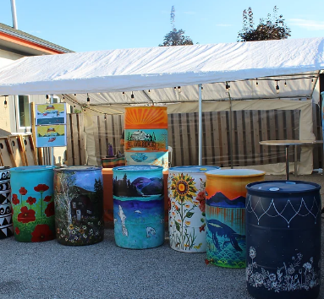
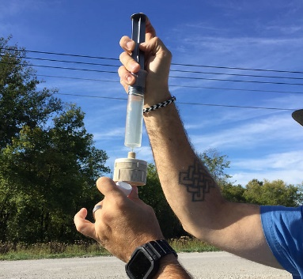
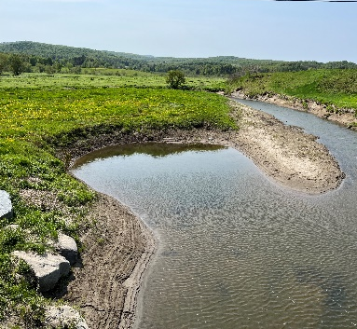
Community Outreach
How We’re Taking on Phosphorus
Engaging the public in connecting & understanding
Monitoring Water Quality
Bringing consistent data to our work to inform our projects
Bridget Butler, Executive Director
bbutler@friendsofnorthernlakechamplain.org
Water Quality Projects
Josh Serpe, Project Manager
Finding & supporting non-regulatory solutions
jserpe@friendsofnorthernlakechamplain.org

Slide 3
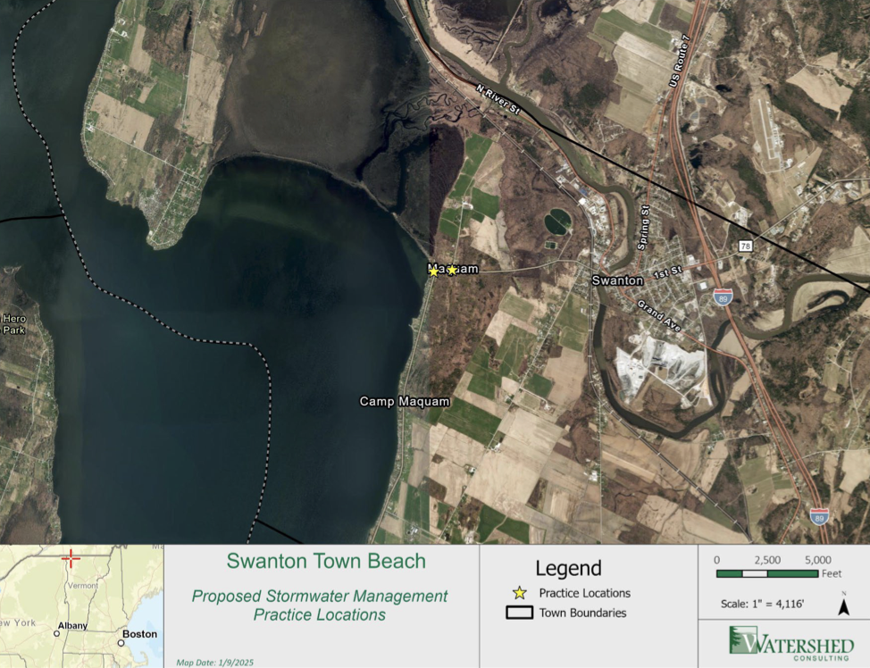
Swanton Town Beach (STB) Clean Water Project

Slide 4
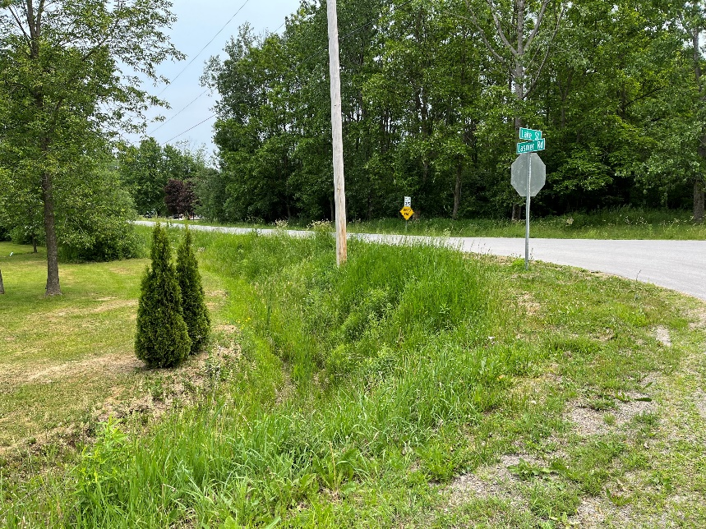
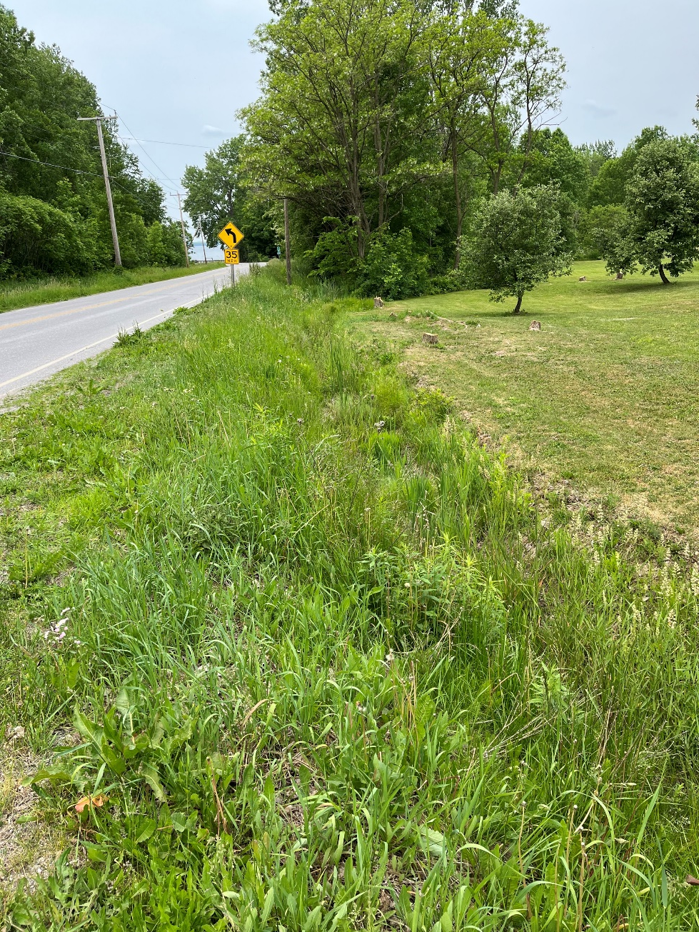
STB Project Update
Project type: Stormwater
Project components
Swanton Beach: Bioretention area with native planting to the west of the parking area at the public park.
Town ROW: Roadside sand filter at the corner of Maquam Shore Road/Lasnier Road
Project goal: Manage stormwater and convey the benefit of clean water projects to the community

Slide 5





What is an Operations and Maintenance Plan?
Goal:
To ensure the stormwater project functions as intended, according to its original design.
Key Components:
Inspection Protocols: Establishes proper inspection procedures to verify that the project continues to operate as designed.
Maintenance Activities: Details the necessary maintenance tasks required to sustain the project's effectiveness.
Schedules & Procedures: Defines schedules and step-by-step procedures to ensure long-term functionality throughout the project's design life.

Slide 6
STB Project Next Steps
Friends of Northern Lake Champlain is monitoring the risk surrounding federal funding
Sending the project out to bid, designing educational signage, and project construction.
FNLC to provide the Town & Village of Swanton with updates to implementation

