Slide 1
Orman Croft Hydro Update

Slide 2
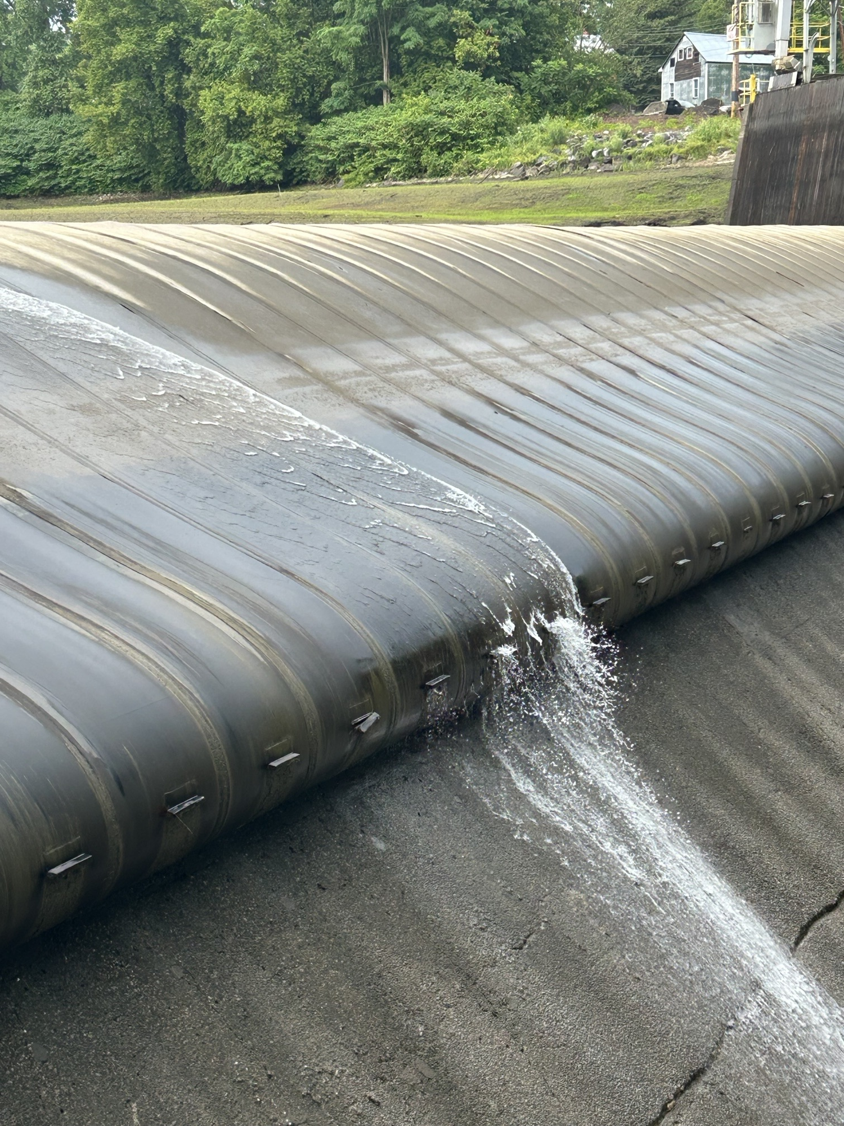

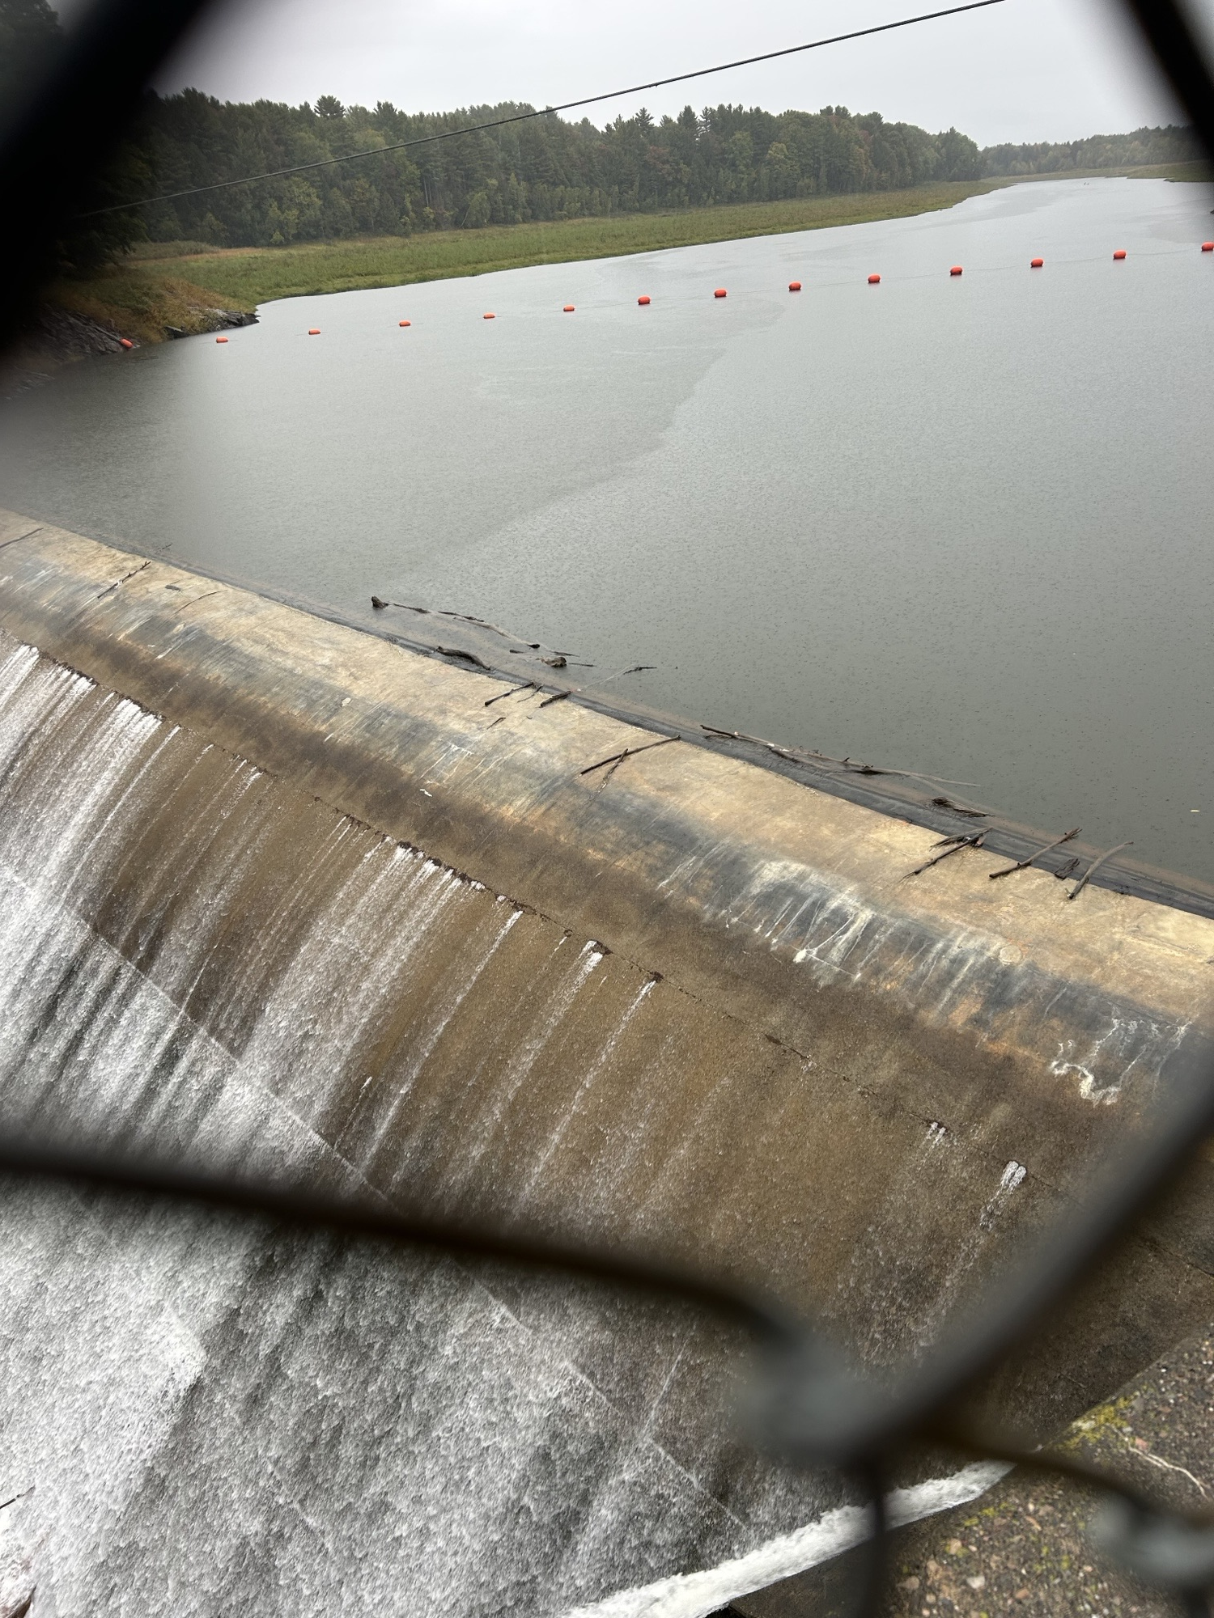
Bladder Removal
Started on time
Removal Went smoothly
Rubber is all gone.

Slide 3
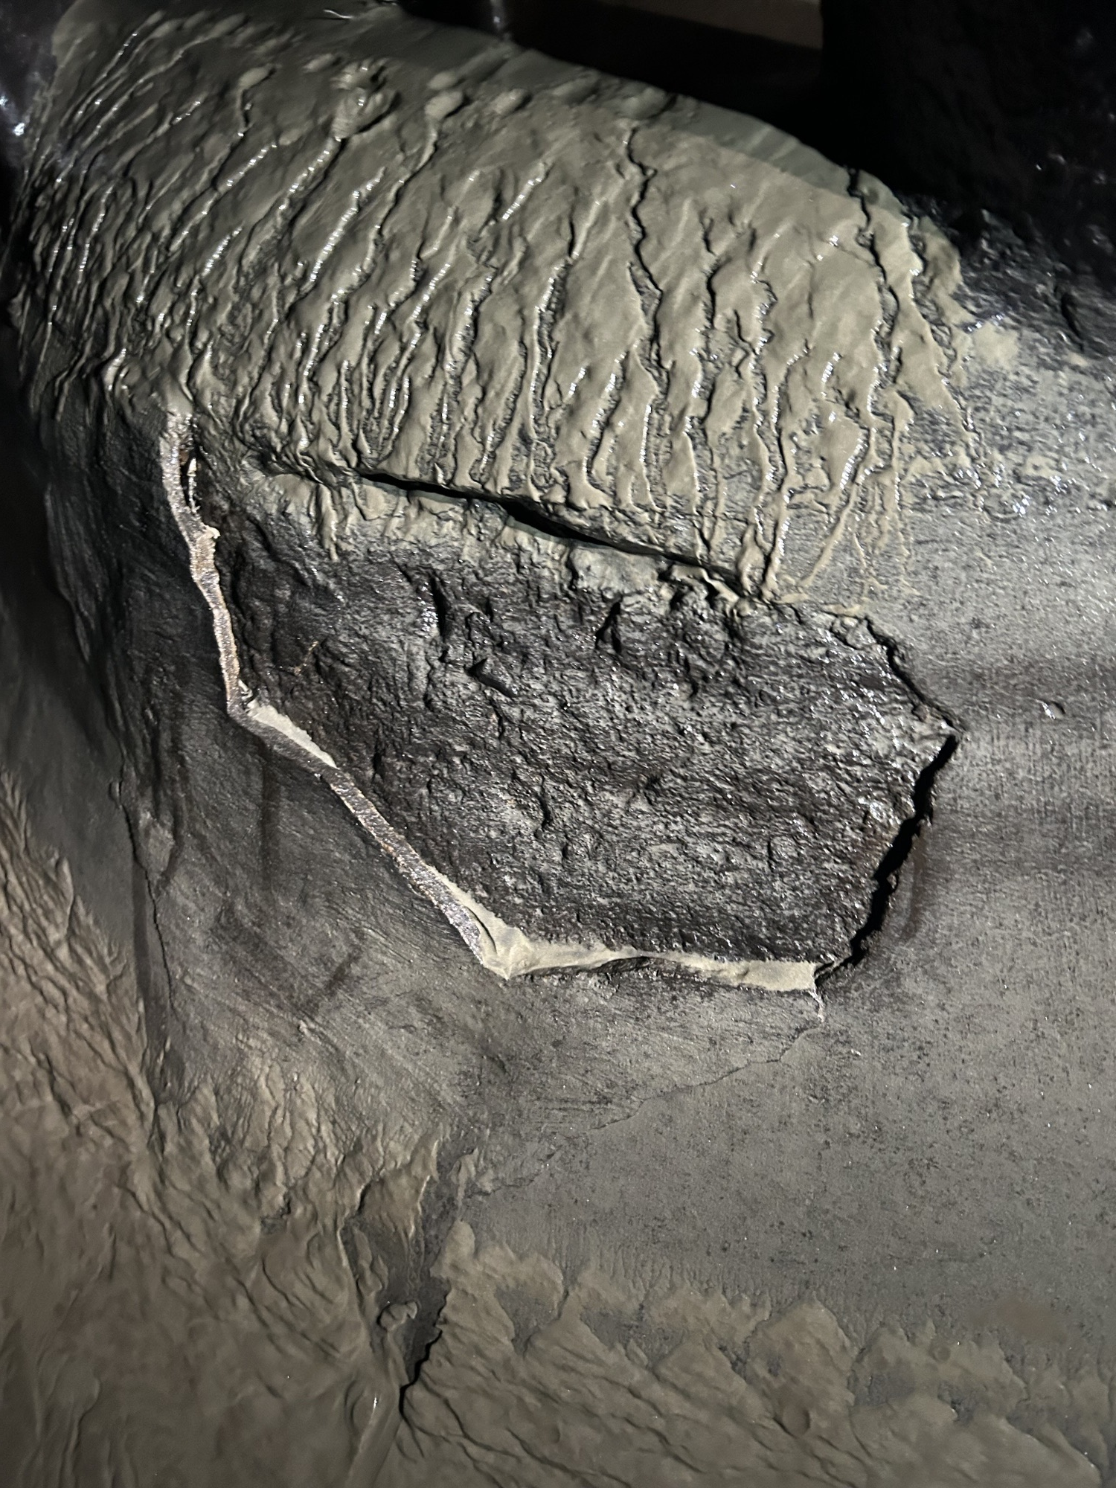
Unit 1 and 2 SCROLL Cages

Slide 4
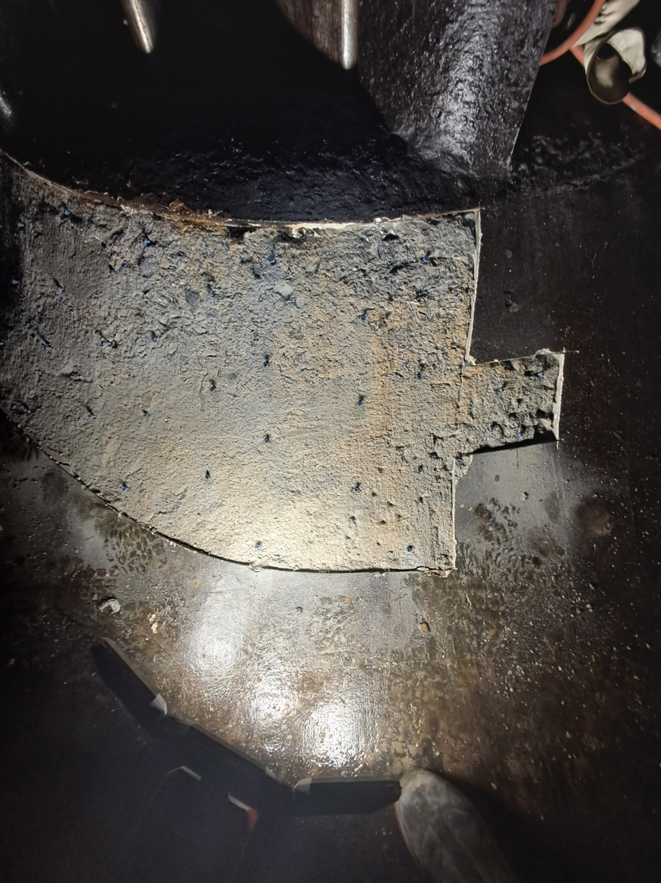
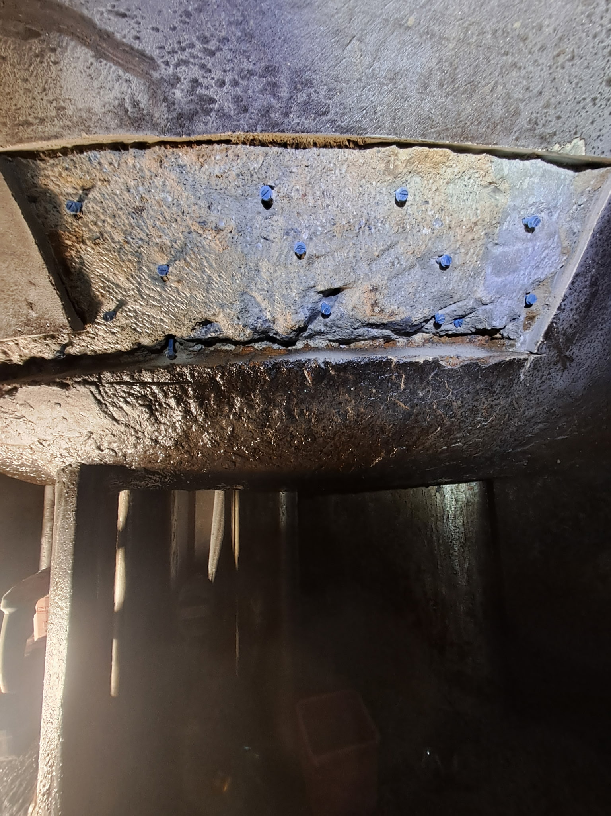
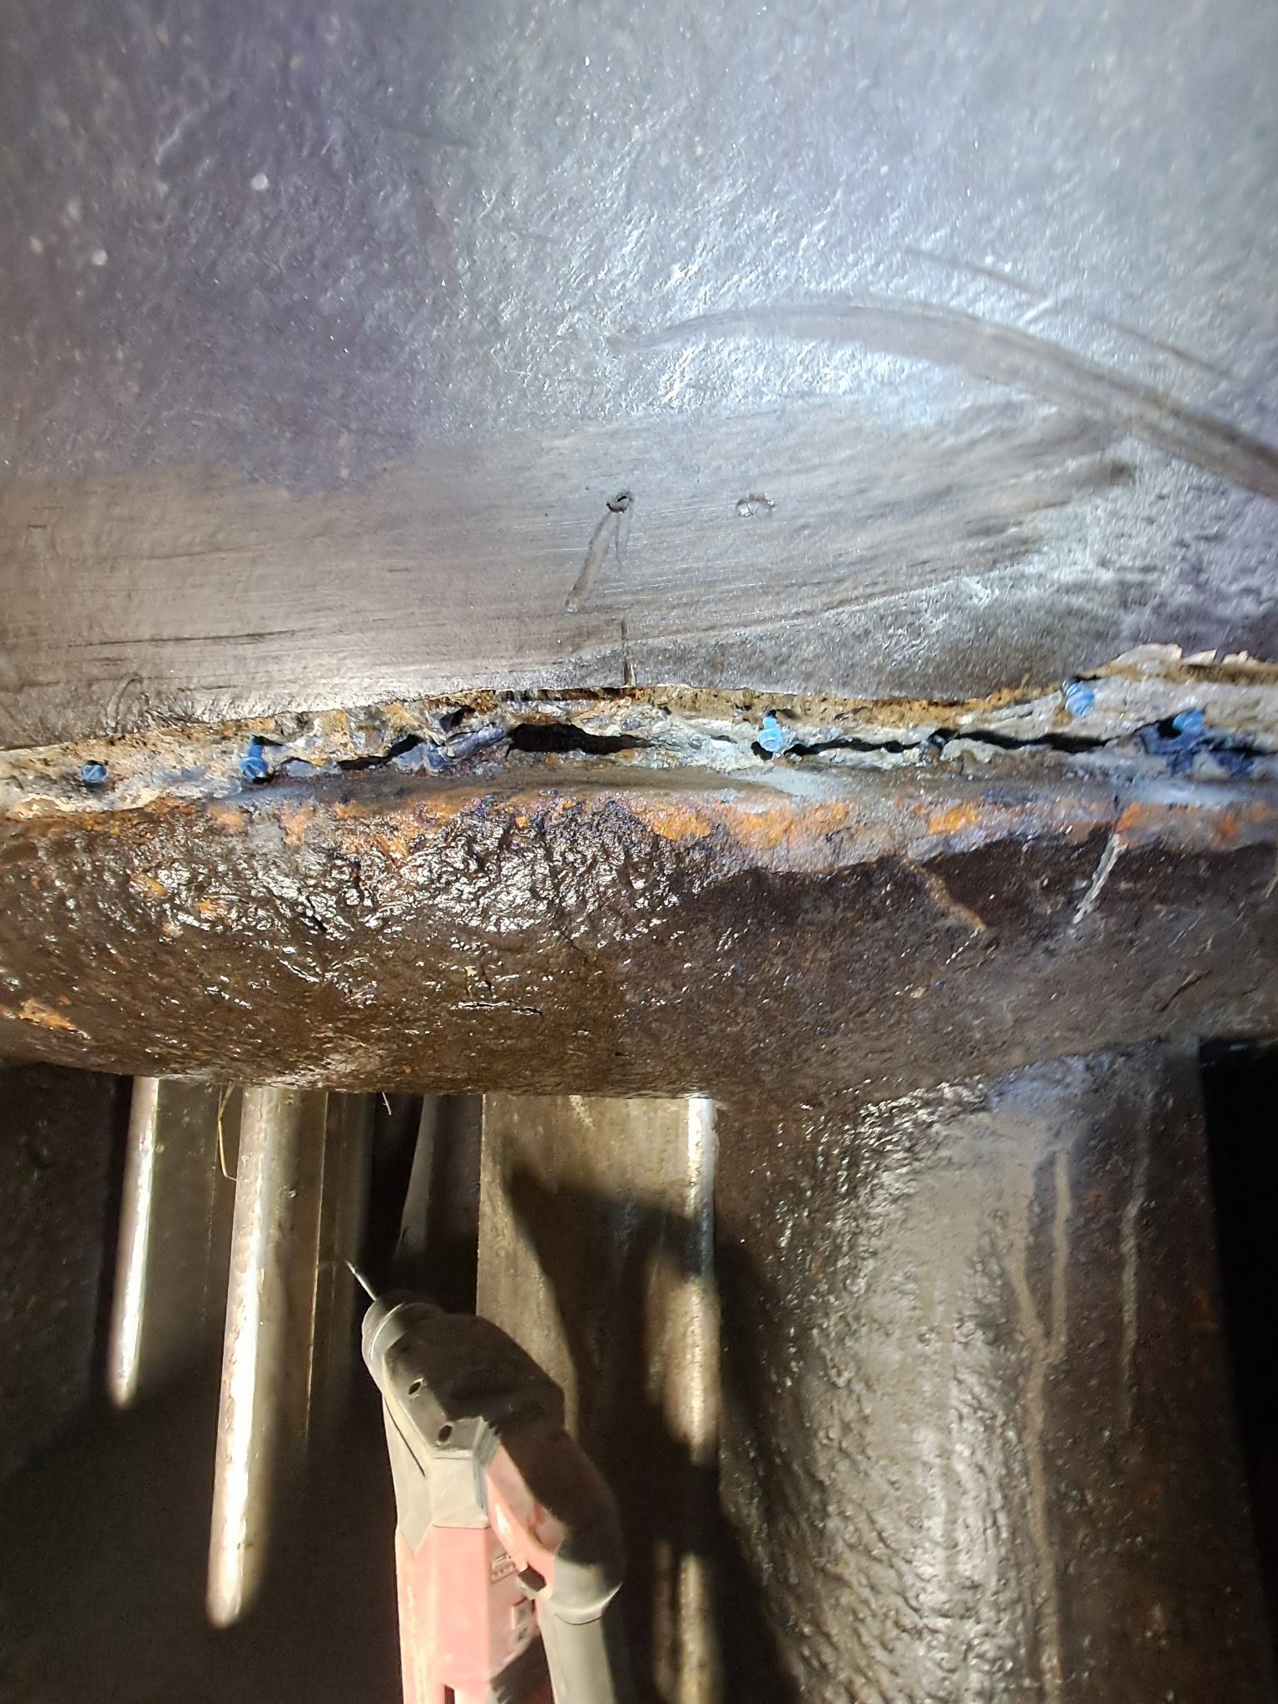
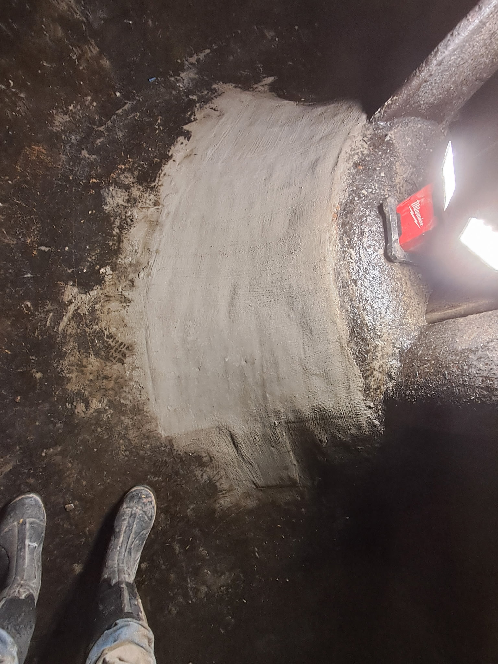
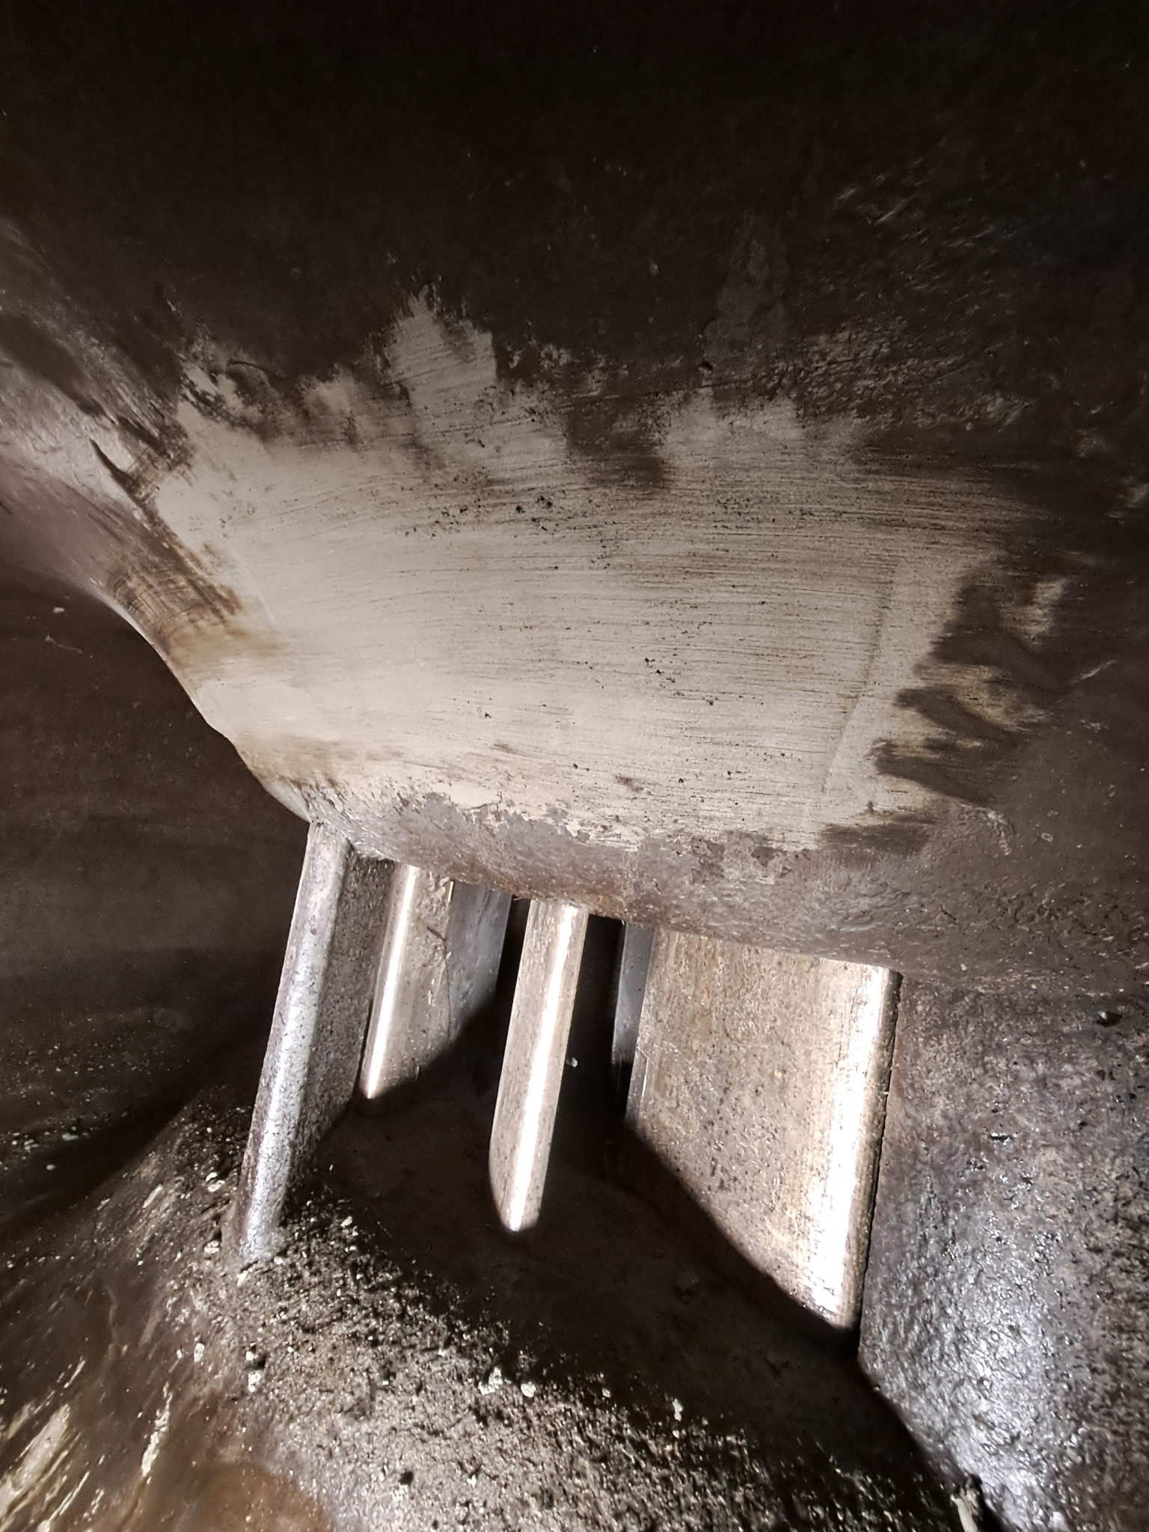
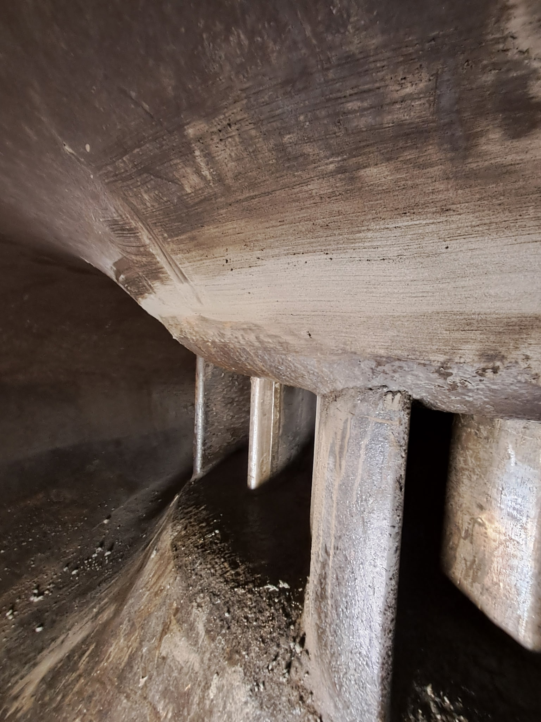

Slide 5
Unit updates:
Unit 1: up and running, Work horse of the plant. Operating at a 300 Kws lose do the lack of head pressure. ON the list to be overhauled and cleaned.
Unit 2: Down for the foreseeable future. Needs to be overhauled, cleaned and upgraded turbine.
Unit 3: Running smoothly. Lose of 600 kws lack of head pressure. On the list for a cleaning. Overhaul possible in the future.
Unit 4: Down for repairs. Short term. Not enough water to test its new kws range.

Slide 6
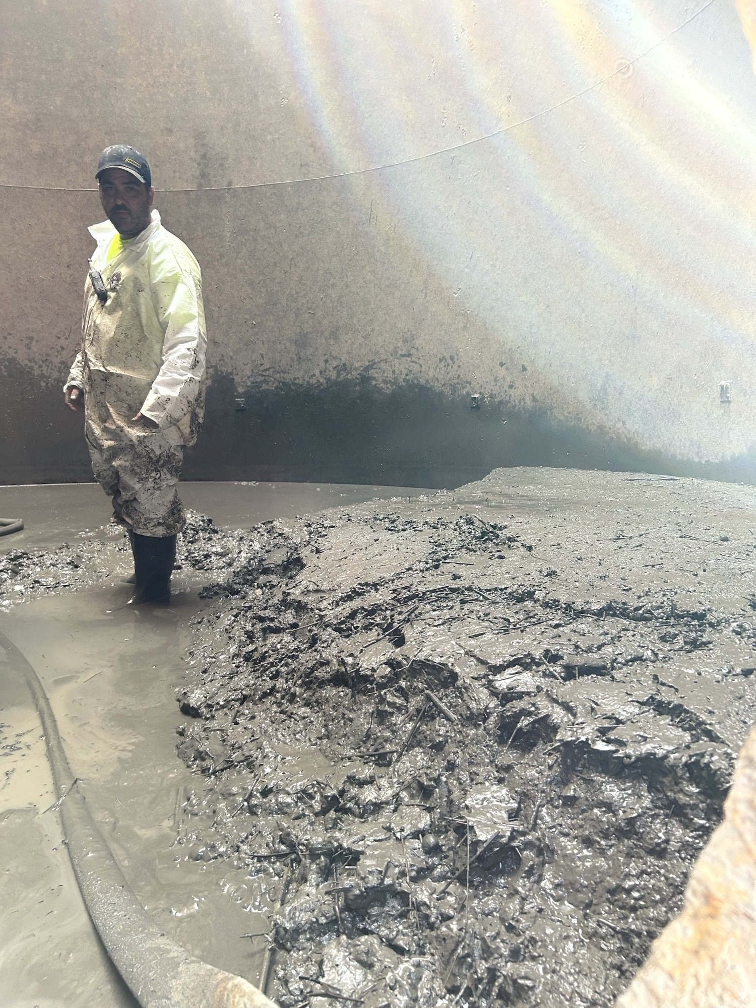
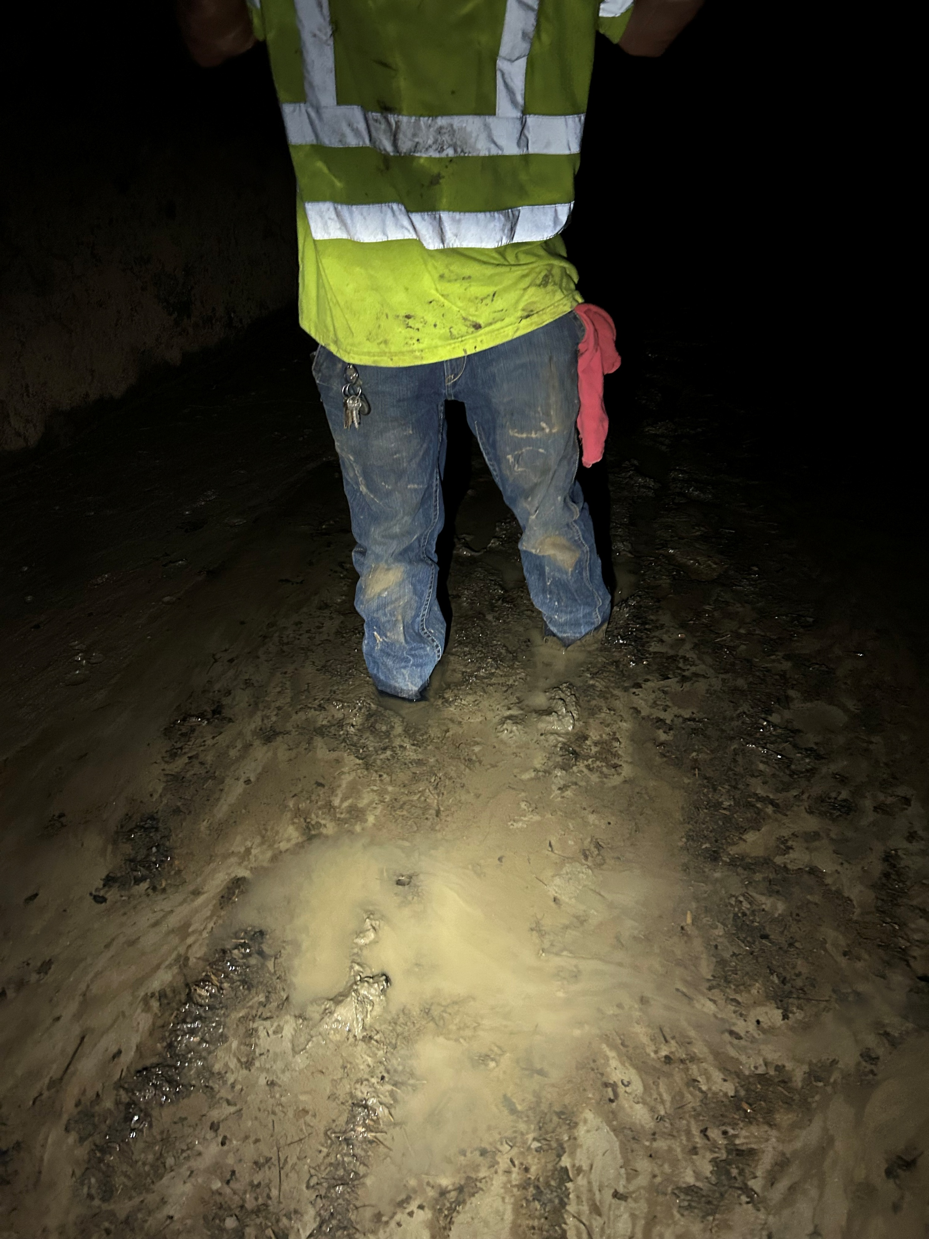
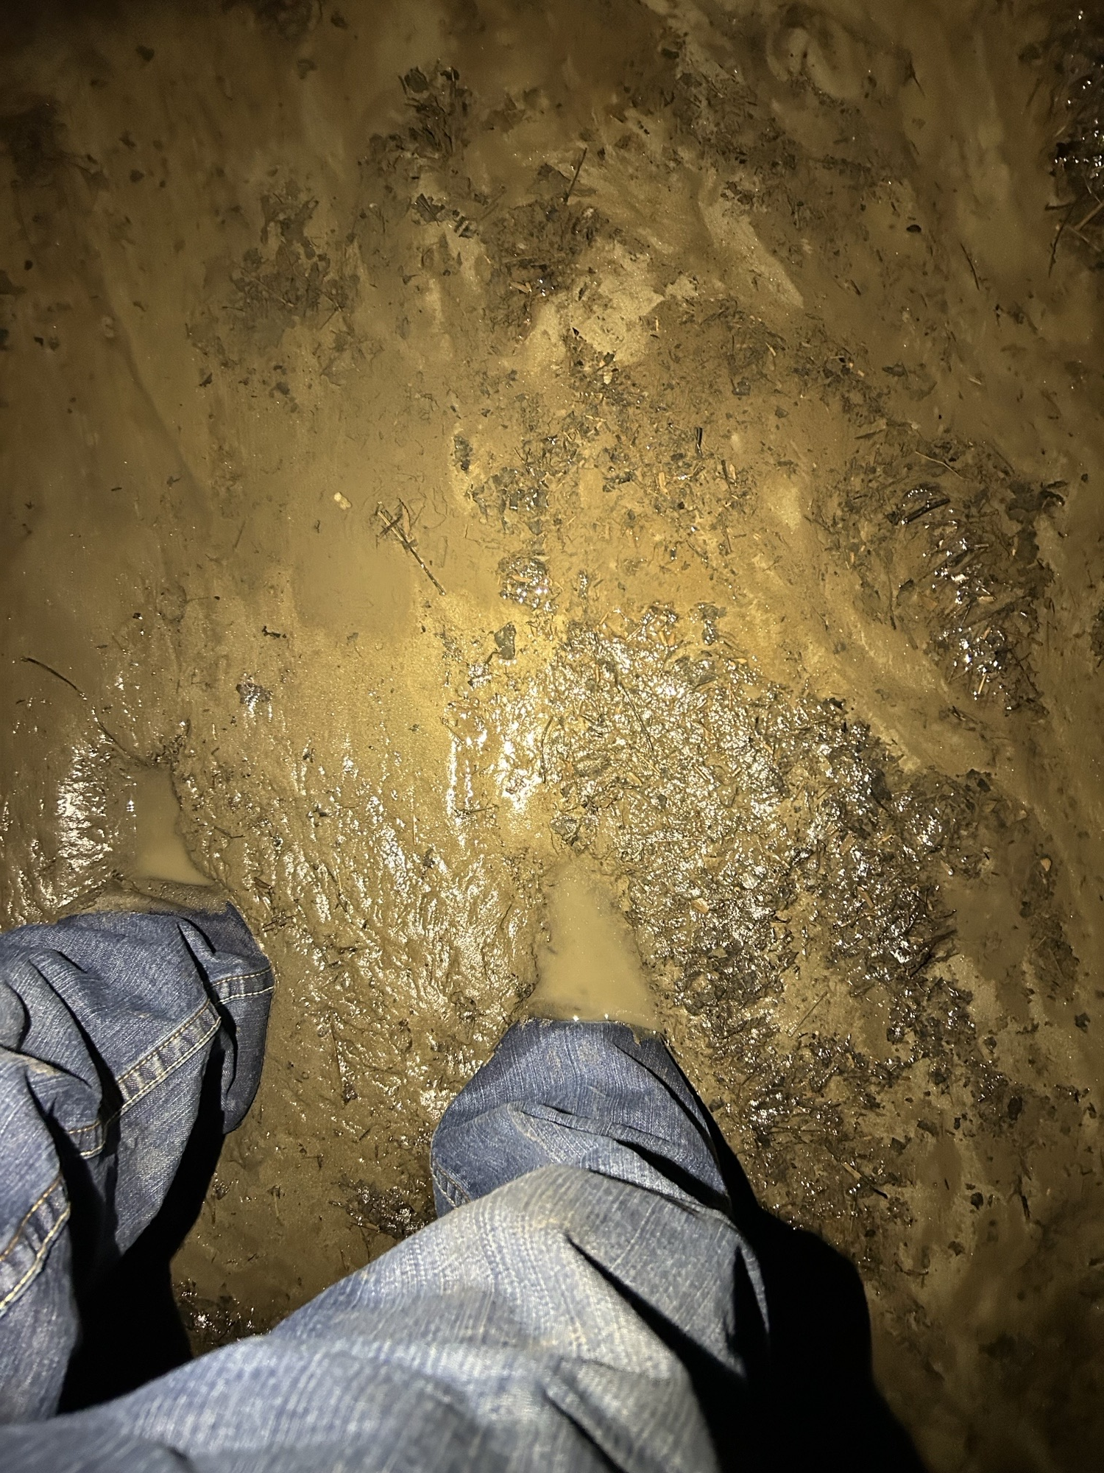
Plant shut down

Slide 7
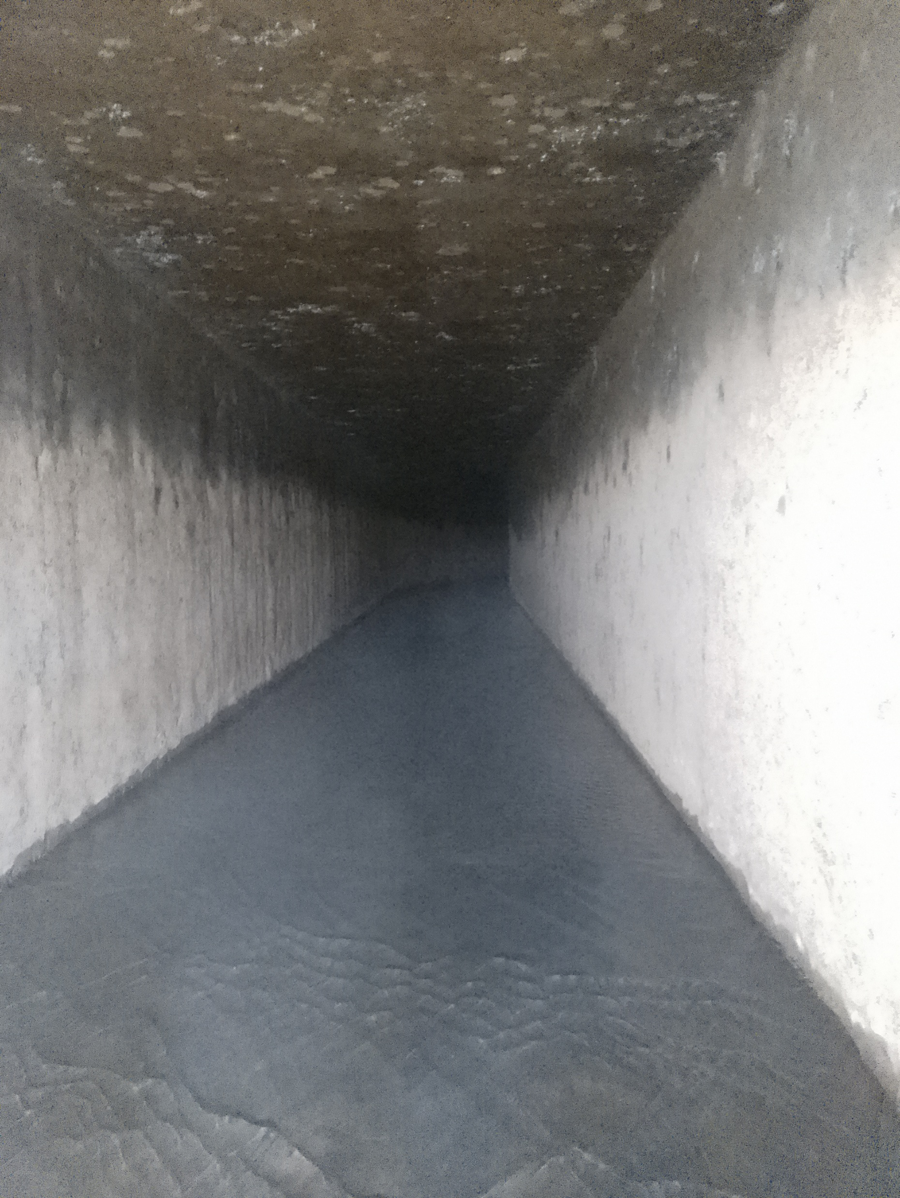
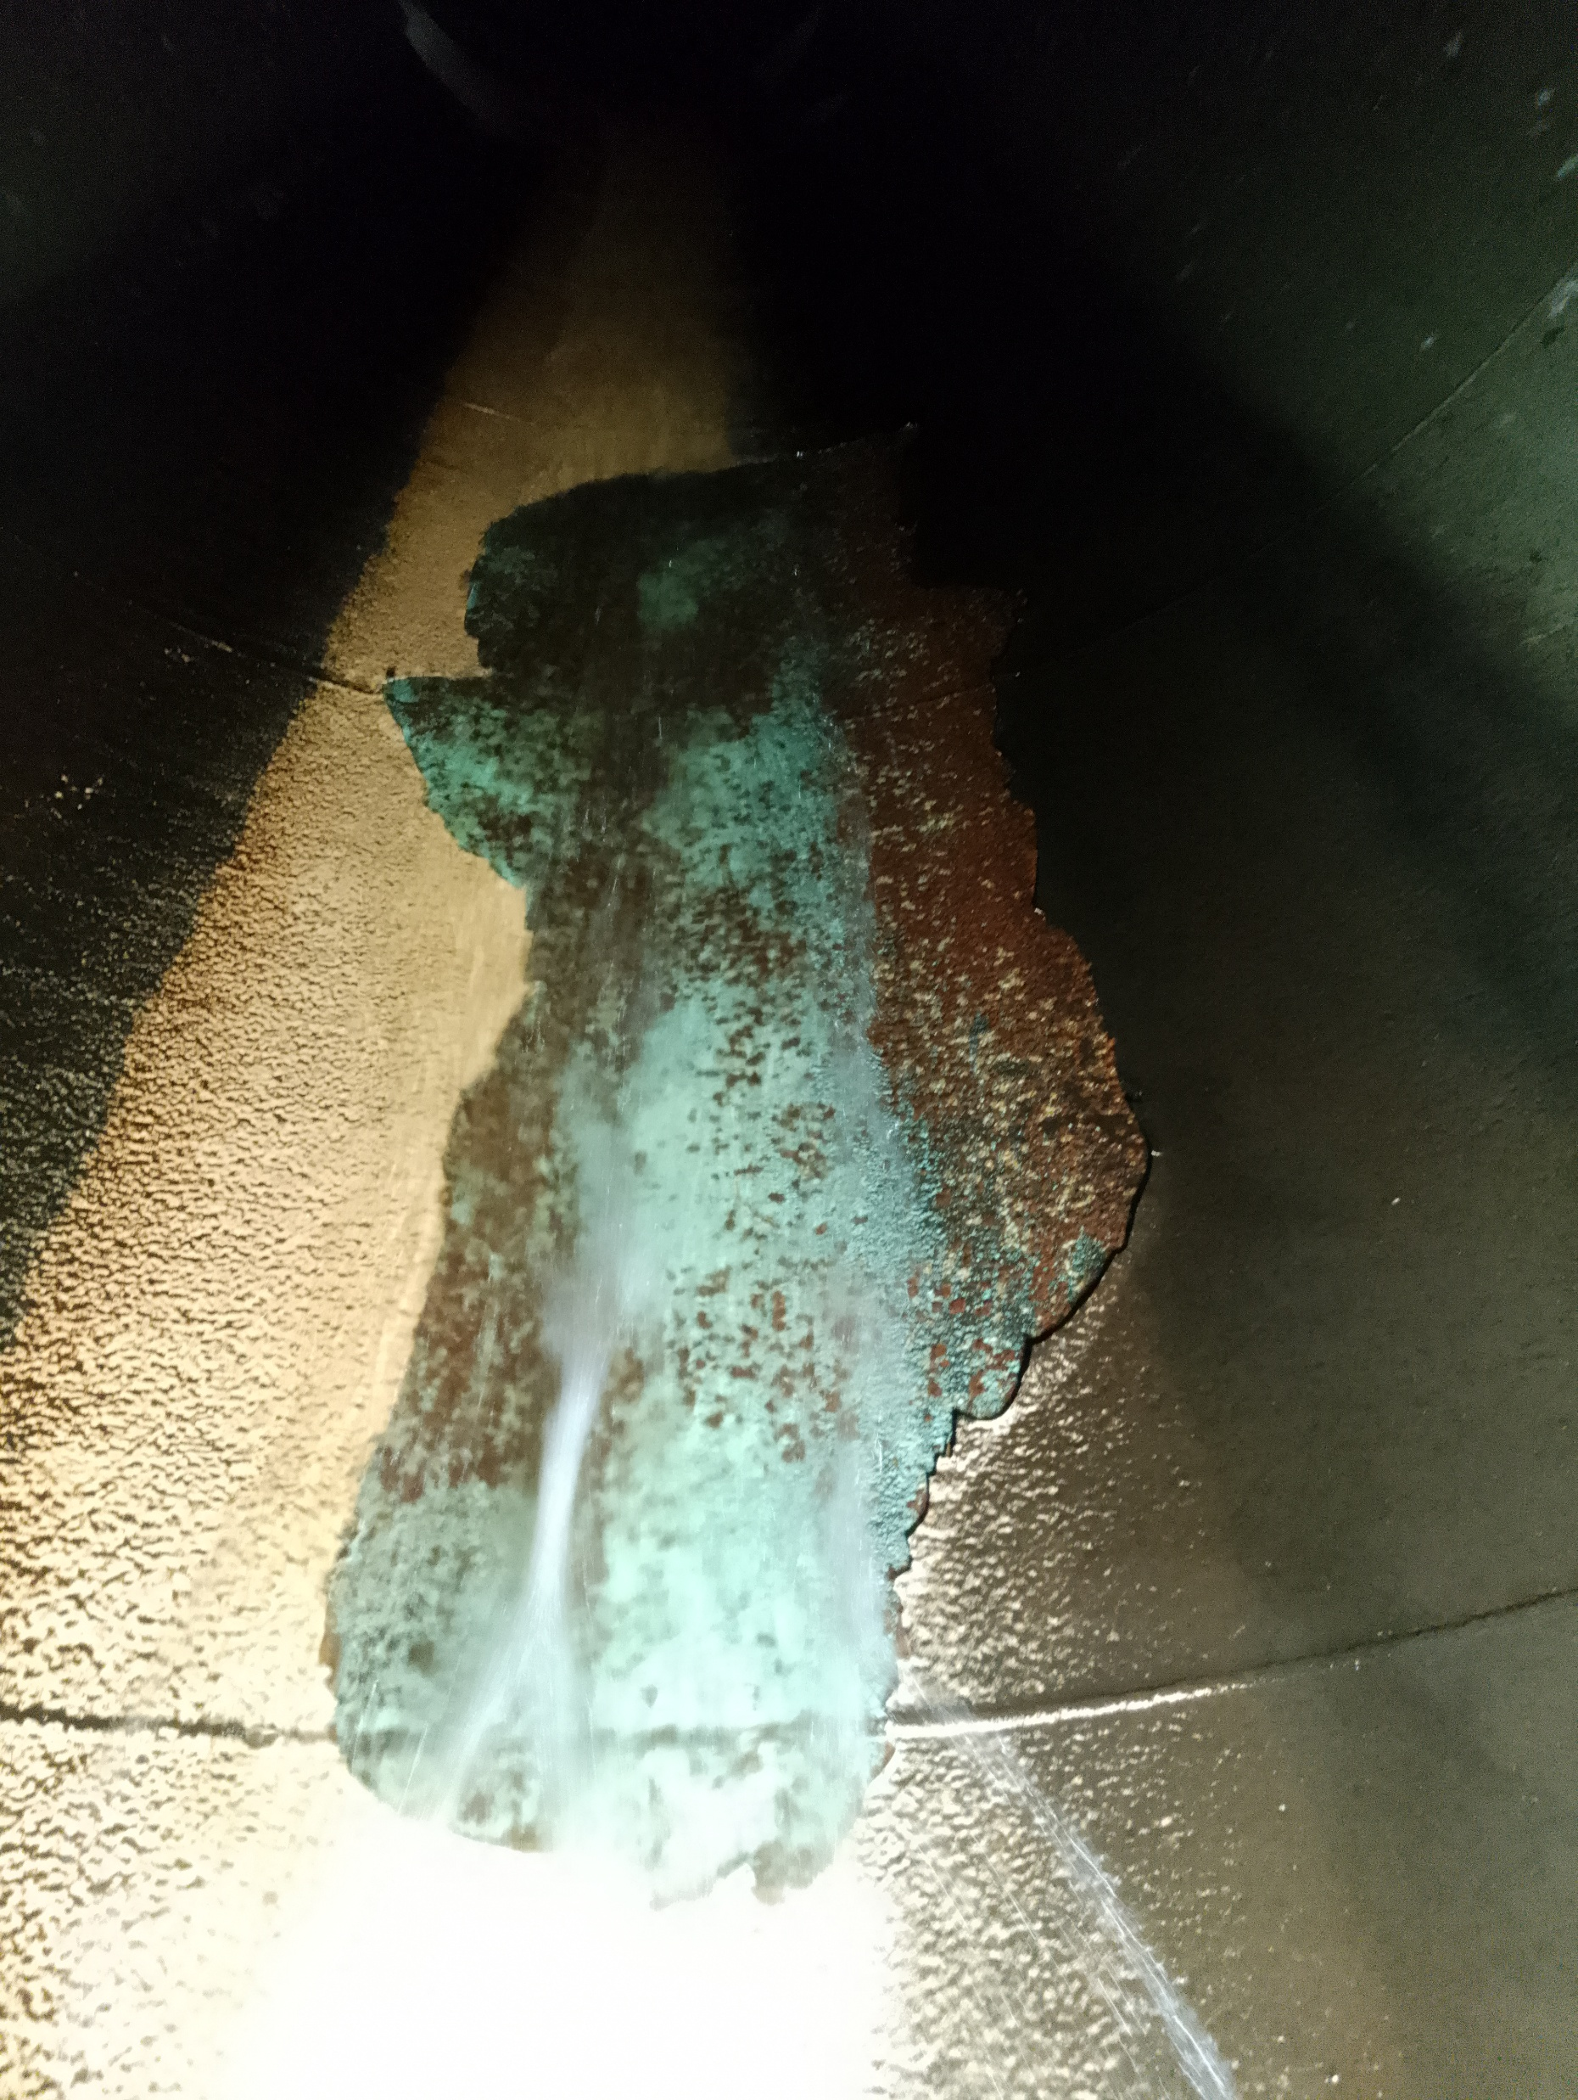
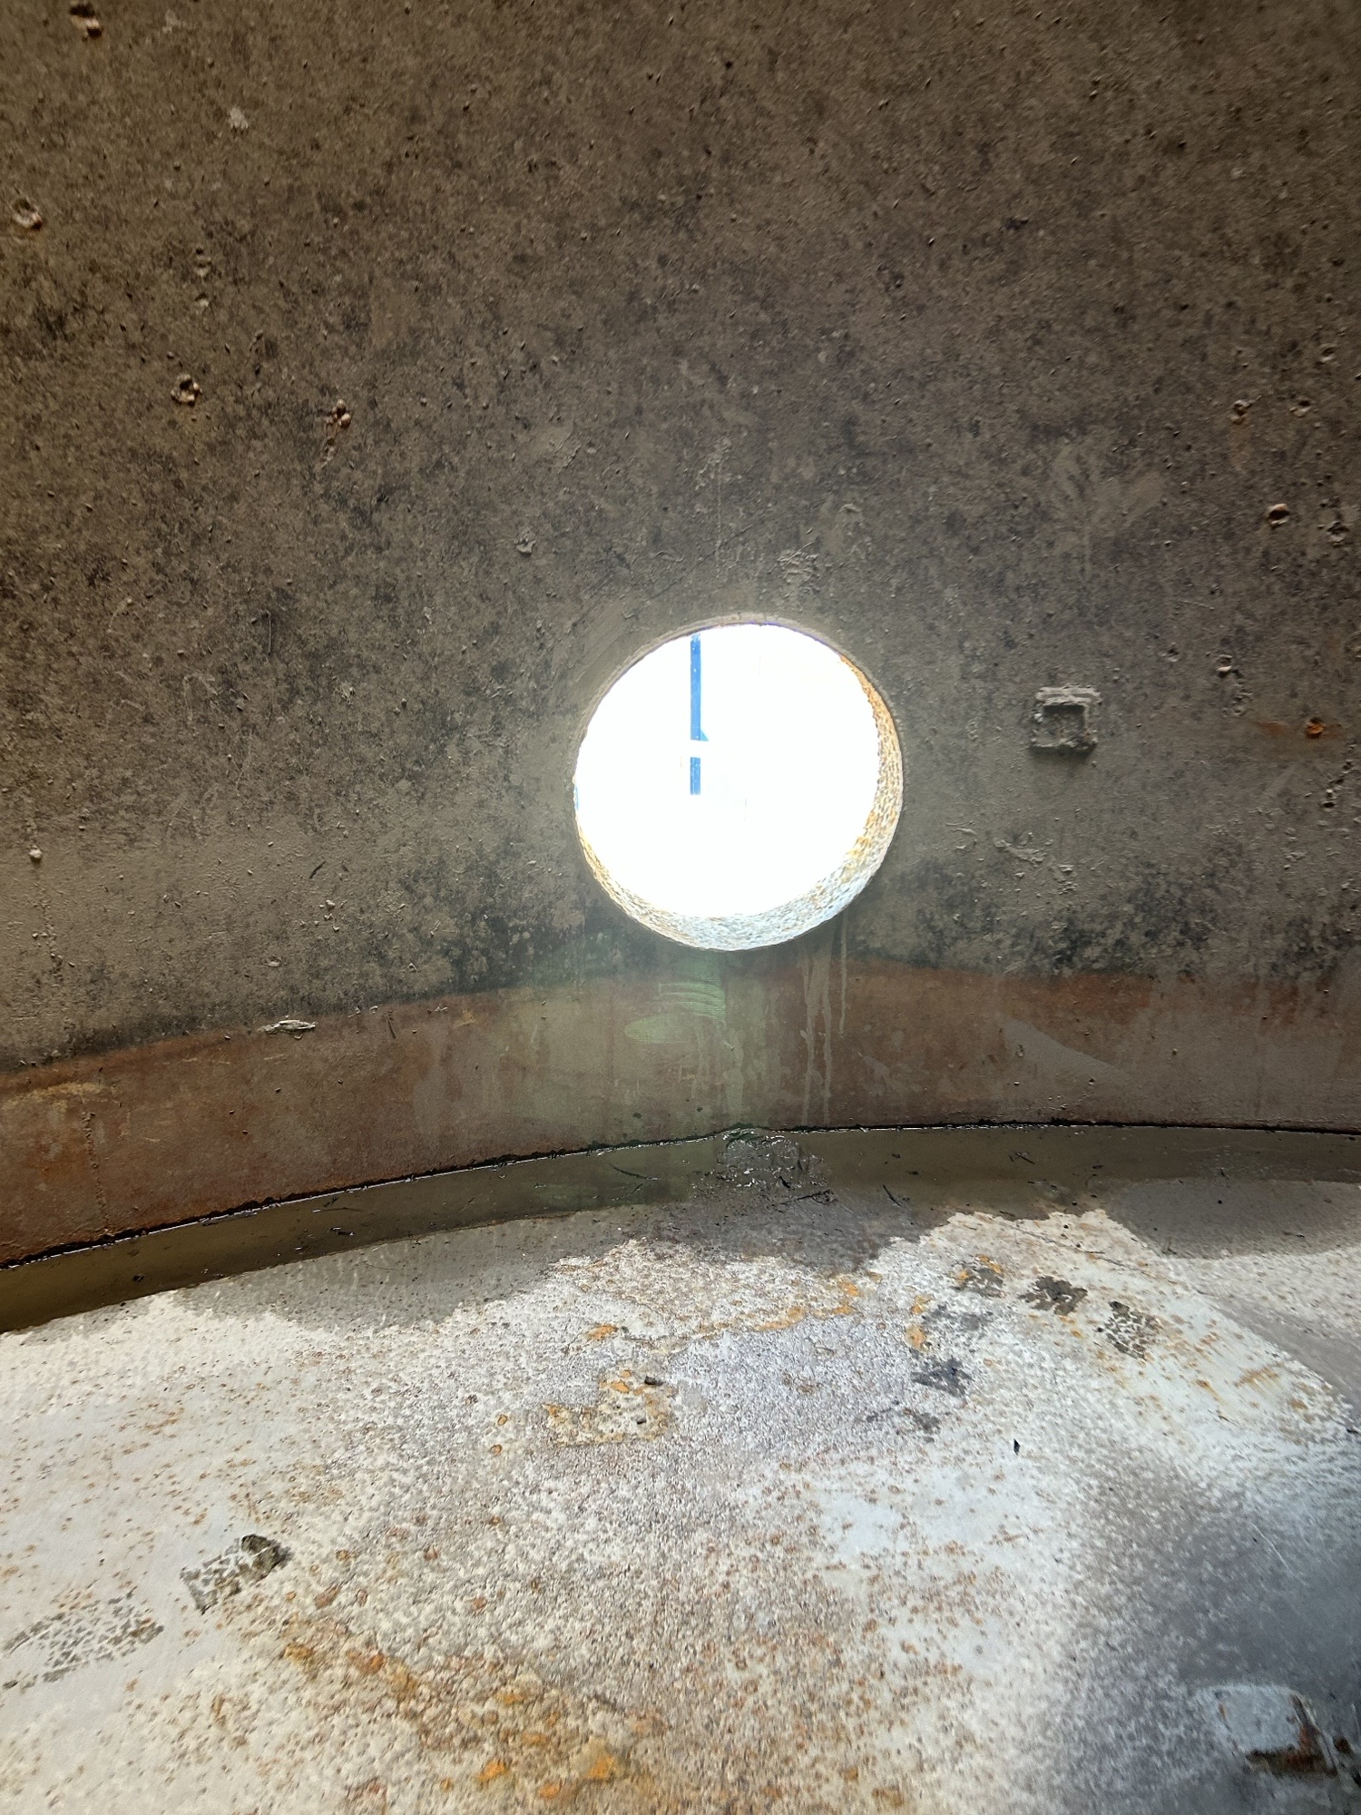

Slide 8
Generation Update:
 | 2022 | 2023 | 2024 | 2025
Jan. | 1,779,198 | 5,024,988 | 4,650,979 | 3,297,600
Feb. | 3,331,956 | 4,125,687 | 3,465,096 | 1,655,341
Mar | 6,234,722 | 4,682,257 | 5,485,376 | 5,316,154
Apr | 6,635,646 | 6,415,680 | 5,163,013 | 5,954,113
May | 5,626,600 | 3,065,025 | 4,706,361 | 6,006,281
Jun | 4,072,000 | 2,101,322 | 3,566,715 | 2,713,545
Jul | 2,005,700 | 4,546,138 | 2,489,026 | 1,506,482
Aug | 746,939 | 4,216,312 | 3,523,104 | 157,697
Sep | 2,622,000 | 2,206,770 | 923,140 | 138,000
Oct | 3,439,147 | 3,169,869 | 1,581,280 | 124,813
Nov | 5,074,720 | 4,252,969 | 2,721,792
Dec | 5,535,842 | 4,618,251 | 4,247,194
Total | 47,104,470 | 48,425,268 | 42,523,076 | 26,870,026

Slide 9
 | 2019 | 2020 | 2021 | 2022 | 2023 | 2024 | 2025 | 7 year Average
Jan | 4,383,305 | 4,416,768 | 1,896,084 | 1,779,198 | 5,024,800 | 4,650,979 | 3,297,600 | 3,691,856
Feb | 4,073,777 | 2,194,360 | 1,203,774 | 3,331,956 | 4,125,700 | 3,465,096 | 1,655,341 | 3,065,777
Mar | 4,553,630 | 6,650,904 | 4,614,358 | 6,234,722 | 4,682,000 | 5,485,376 | 5,316,154 | 5,370,165
Apr | 6,234,585 | 5,918,104 | 5,345,449 | 6,635,646 | 6,415,680 | 5,163,013 | 5,954,113 | 5,952,080
May | 6,670,036 | 4,092,748 | 3,268,811 | 5,626,600 | 3,065,025 | 4,706,361 | 6,006,281 | 4,571,597
Jun | 3,185,053 | 945,474 | 192,050 | 4,072,000 | 2,101,322 | 3,566,715 | 2,713,545 | 2,343,769
July | 1,138,500 | 1,081,500 | 136,857 | 2,005,700 | 4,546,138 | 2,489,026 | 1,506,482 | 1,899,620
August | 739,600 | 804,500 | 136,928 | 746,939 | 4,216,312 | 3,523,104 | 157,697 | 1,694,564
September | 1,325,400 | 232,500 | 132,864 | 2,622,000 | 2,206,770 | 923,140 | 138,000 | 1,240,446
October | 4,951,900 | 3,167,400 | 1,268,066 | 3,439,147 | 3,169,869 | 1,581,280 | 124,813 | 2,929,610
November | 5,543,000 | 3,114,400 | 4,212,818 | 5,074,720 | 4,252,969 | 2,721,792 | 0 | 4,153,283
December | 4,982,800 | 4,020,700 | 4,557,140 | 5,535,842 | 4,618,251 | 4,247,194 | 0 | 4,660,321
totals | 47,781,586 | 36,639,358 | 26,965,199 | 47,104,470 | 48,424,836 | 42,523,076 | 26,870,026 | 41,573,088

Slide 10
 | TOTAL NET
YEAR | GENERATION
1989 | 15,468,308
1990 | 26,570,391
1991 | 23,727,640
1992 | 15,996,100
1993 | 31,752,840
1994 | 34,709,840
1995 | 39,361,020
1996 | 47,412,320
1997 | 47,946,740
1998 | 49,499,260
1999 | 41,133,060
2000 | 41,957,120
2001 | 32,297,020
2002 | 50,557,920
2003 | 42,918,020
2004 | 49,562,740
2005 | 45,273,280
2006 | 58,563,415
2007 | 46,240,140
2008 | 52,392,100
2009 | 48,580,200
2010 | 51,956,600
2011 | 50,998,900
2012 | 40,940,700
2013 | 40,341,000
2014 | 39,968,045
2015 | 41,001,650
2016 | 39,058,992
2017 | 37,906,372
2018 | 31,801,156
2019 | 42,798,477
2020 | 37,690,912
2021 | 26,965,199
2022 | 47,104,470
2023 | 48,424,836
2024 | 42,523,076
2025 | 26,870,026

Slide 11
