Slide 1

Public works 2026 update

Slide 2
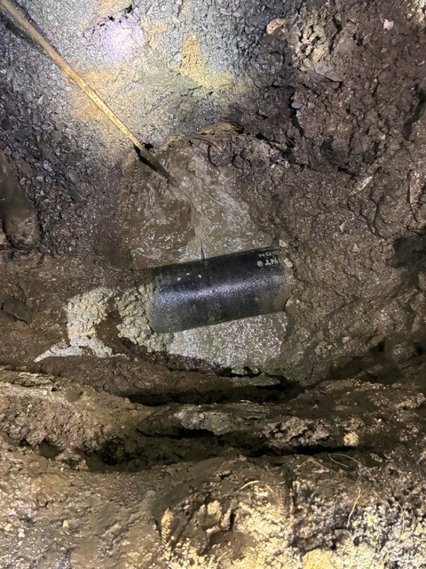
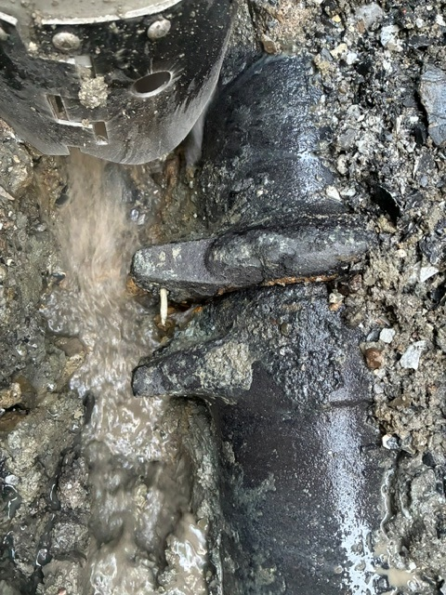
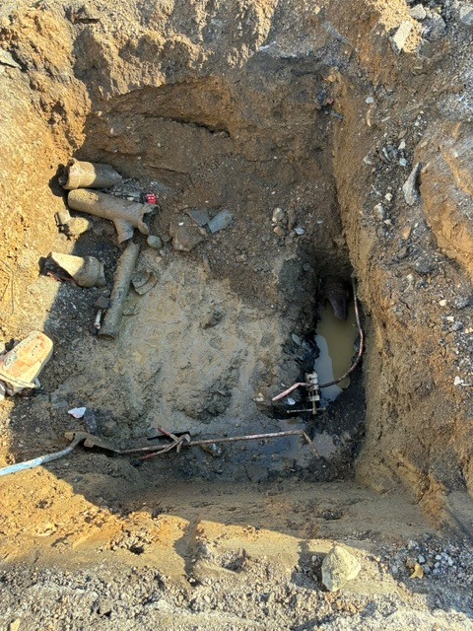
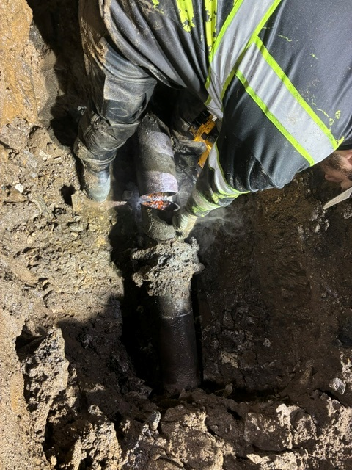
Water breaks
6 water main breaks
& 6 water service breaks

Slide 3
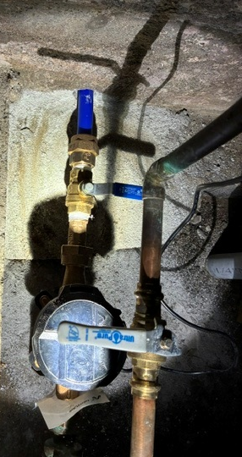
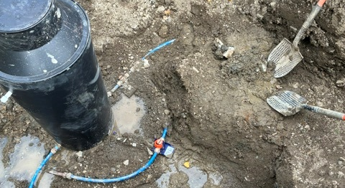
Meter pit installs
& meter installs
16 Meter pits were installed this winter.
And 6 more installed this spring
35 meters installations finished Spring/Summer.

Slide 4
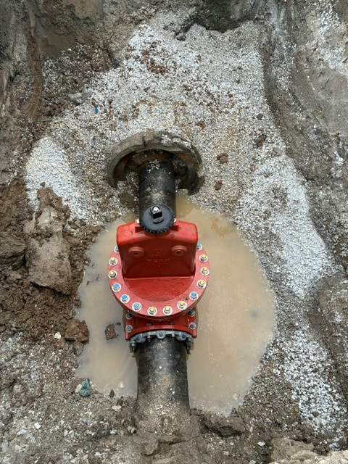
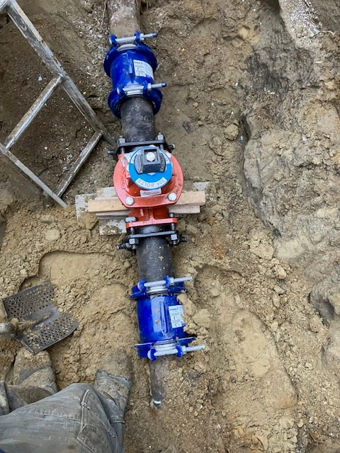
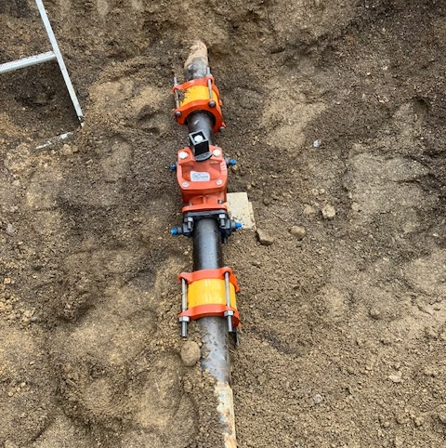
Installed 3 water main valves fall/spring
2 more valves to install this fall

Slide 5
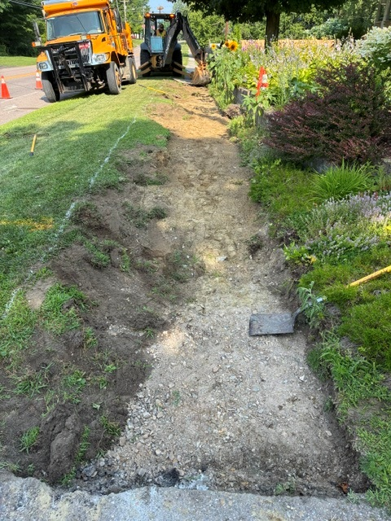
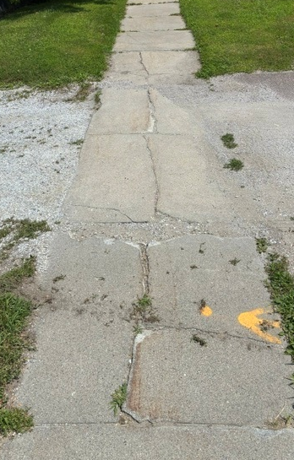
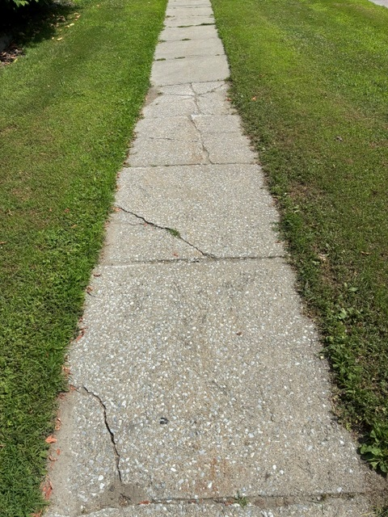
Grand avenue sidewalk grant once finished (2026 Fall) will total 1150ft.

Slide 6
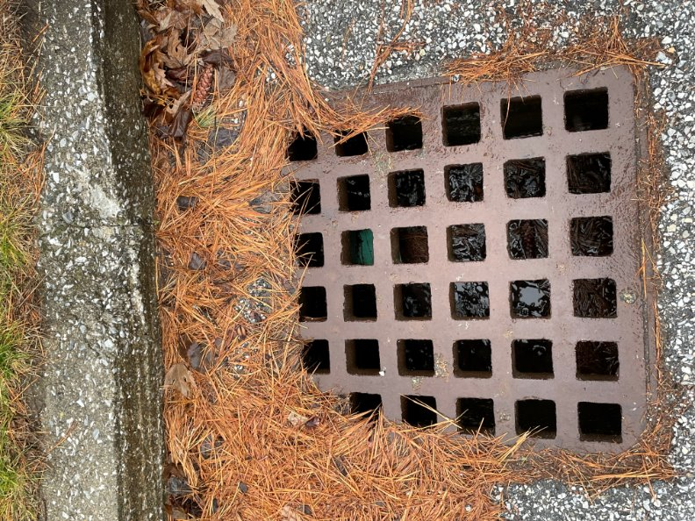
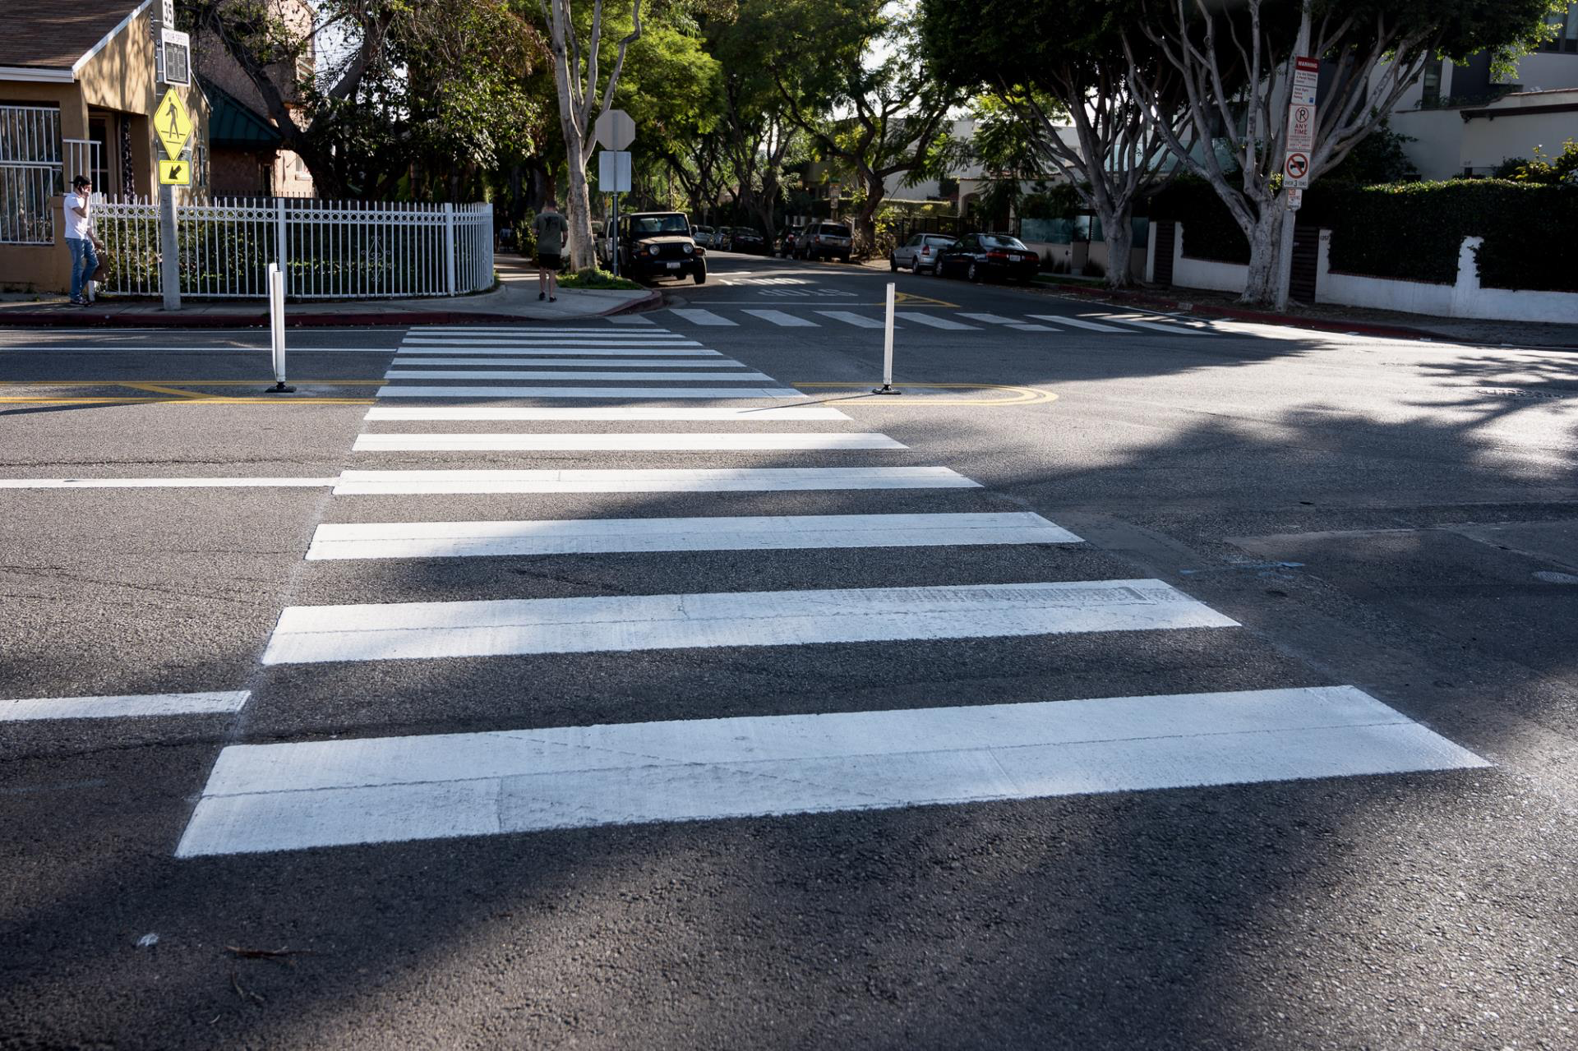
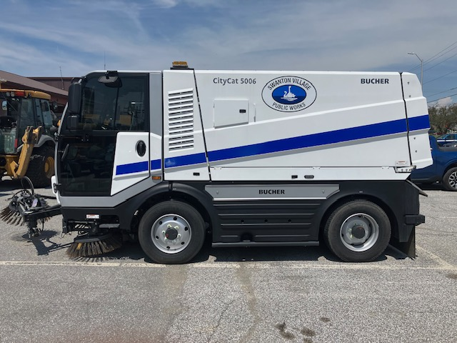
Rebuilt 6 storm structures
Street sweeping village street cleaned out numerous sewer main lines lawn repair from water breaks and winter plowing cleaned 15 storm water basins this year two hydrants to be replaced and 6 to rebuild
Started painting crosswalks & stop bars new hire (brian bouchard)

Slide 7
Thank you
Questions

