Slide 1
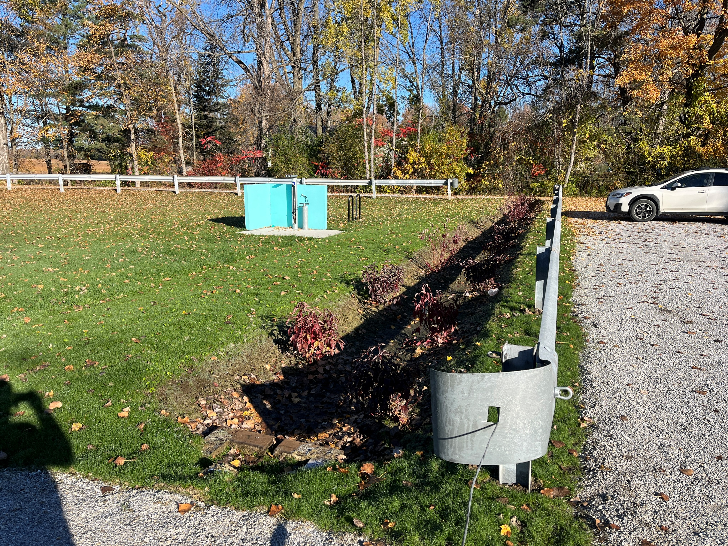

Swanton Beach Project Closeout
Notes:
Introduce yourself and Josh. Why we’re here and short slide show to catch everyone up. Selectboard members have a summary sheet as well in front of them.
"A true friendship is defined by knowing someone has your back, no matter what. A good friend will watch out for you and ensure you are safe, feel supported, and are loved. A good friend will never purposely lead you into making decisions or taking actions that aren't good for you. A true friend will always have your best interests at heart." ~Lia Miller
The definition above from writer Lia Miller reveals that friendship is about feeling safe, supported, and loved. When I apply this definition to our work throughout the watershed here in northern Vermont, I see a number of parallels to our work as the Friends of Northern Lake Champlain.

Slide 2
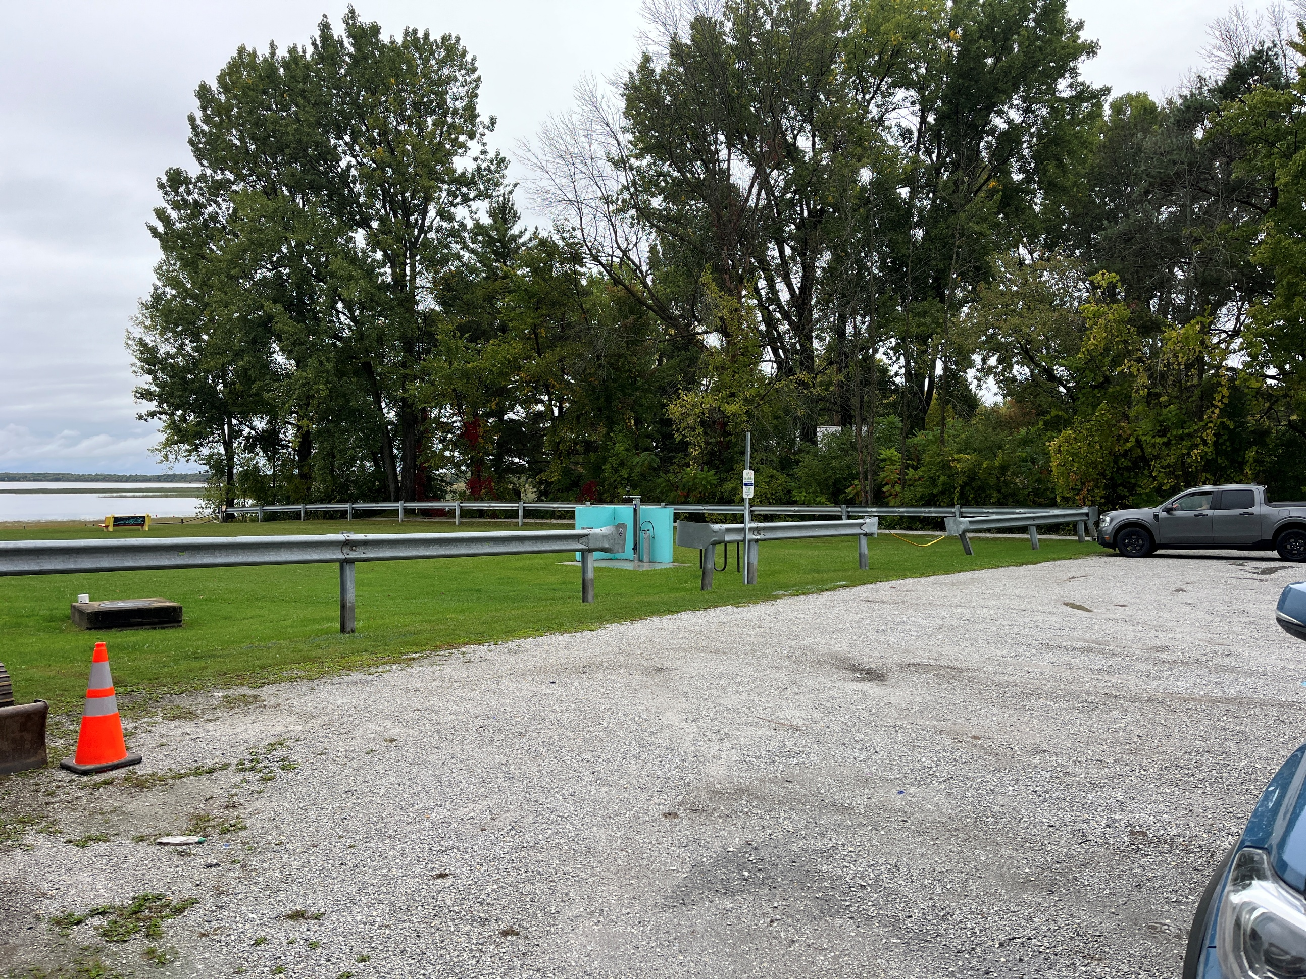
Pre-Construction
Swanton Beach Project Closeout
Notes:
Introduce yourself and Josh. Why we’re here and short slide show to catch everyone up. Selectboard members have a summary sheet as well in front of them.
"A true friendship is defined by knowing someone has your back, no matter what. A good friend will watch out for you and ensure you are safe, feel supported, and are loved. A good friend will never purposely lead you into making decisions or taking actions that aren't good for you. A true friend will always have your best interests at heart." ~Lia Miller
The definition above from writer Lia Miller reveals that friendship is about feeling safe, supported, and loved. When I apply this definition to our work throughout the watershed here in northern Vermont, I see a number of parallels to our work as the Friends of Northern Lake Champlain.

Slide 3
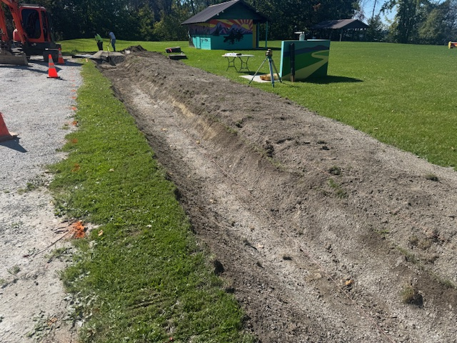
Construction
Swanton Beach Project Closeout
Notes:
Introduce yourself and Josh. Why we’re here and short slide show to catch everyone up. Selectboard members have a summary sheet as well in front of them.
"A true friendship is defined by knowing someone has your back, no matter what. A good friend will watch out for you and ensure you are safe, feel supported, and are loved. A good friend will never purposely lead you into making decisions or taking actions that aren't good for you. A true friend will always have your best interests at heart." ~Lia Miller
The definition above from writer Lia Miller reveals that friendship is about feeling safe, supported, and loved. When I apply this definition to our work throughout the watershed here in northern Vermont, I see a number of parallels to our work as the Friends of Northern Lake Champlain.

Slide 4
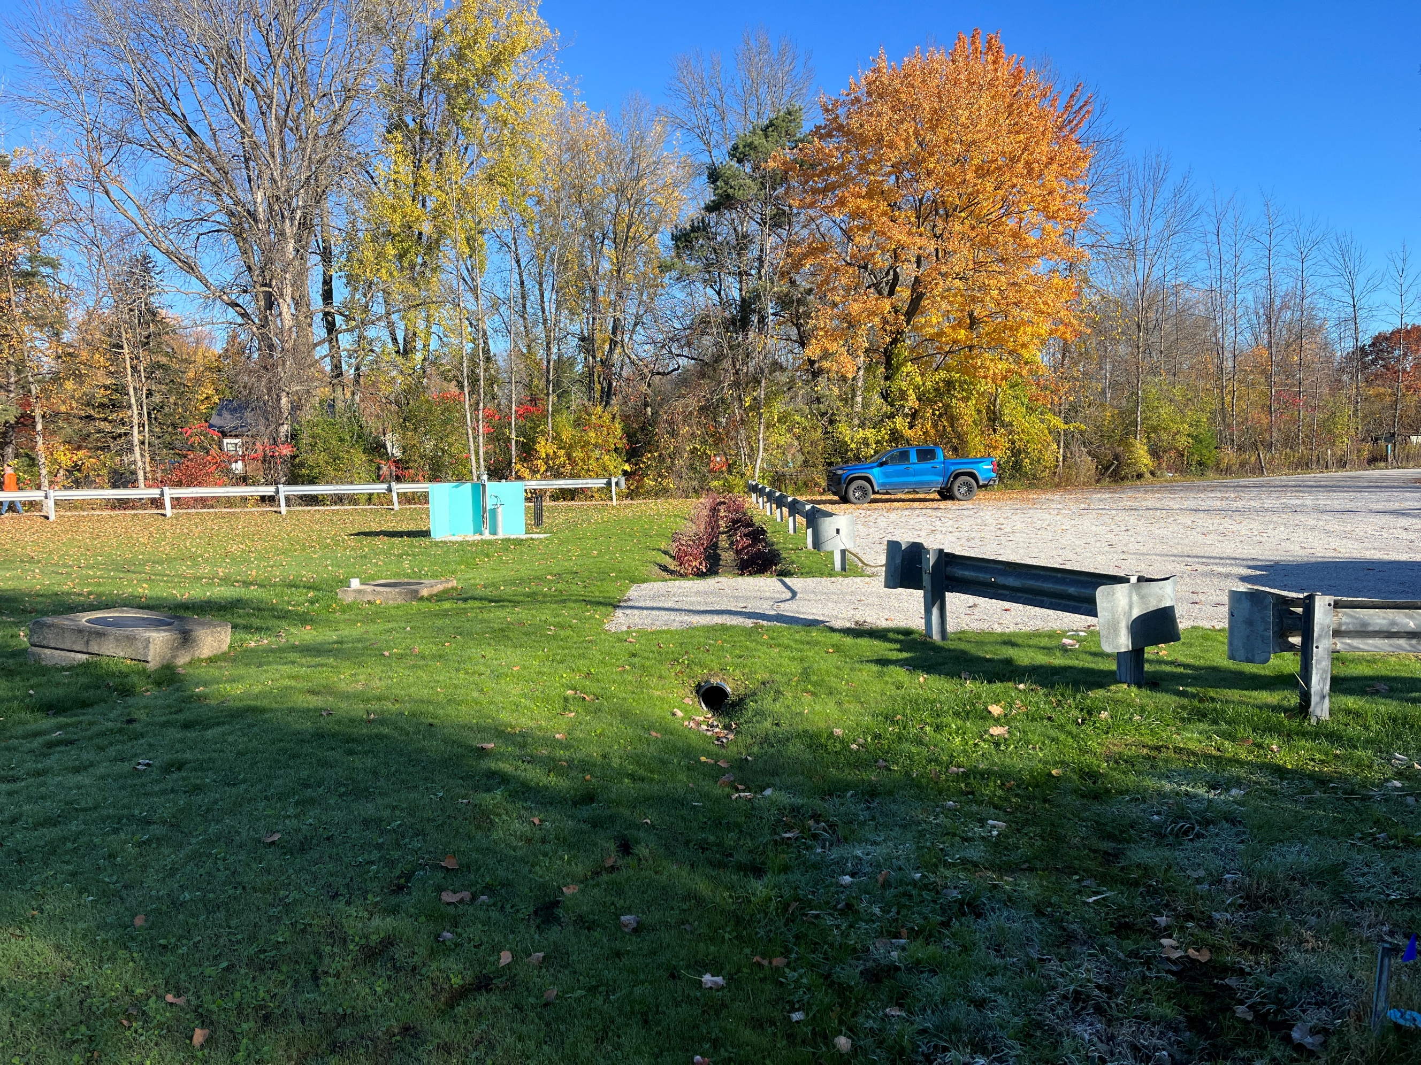
Post-Construction
Swanton Beach Project Closeout
Notes:
Introduce yourself and Josh. Why we’re here and short slide show to catch everyone up. Selectboard members have a summary sheet as well in front of them.
"A true friendship is defined by knowing someone has your back, no matter what. A good friend will watch out for you and ensure you are safe, feel supported, and are loved. A good friend will never purposely lead you into making decisions or taking actions that aren't good for you. A true friend will always have your best interests at heart." ~Lia Miller
The definition above from writer Lia Miller reveals that friendship is about feeling safe, supported, and loved. When I apply this definition to our work throughout the watershed here in northern Vermont, I see a number of parallels to our work as the Friends of Northern Lake Champlain.

Slide 5
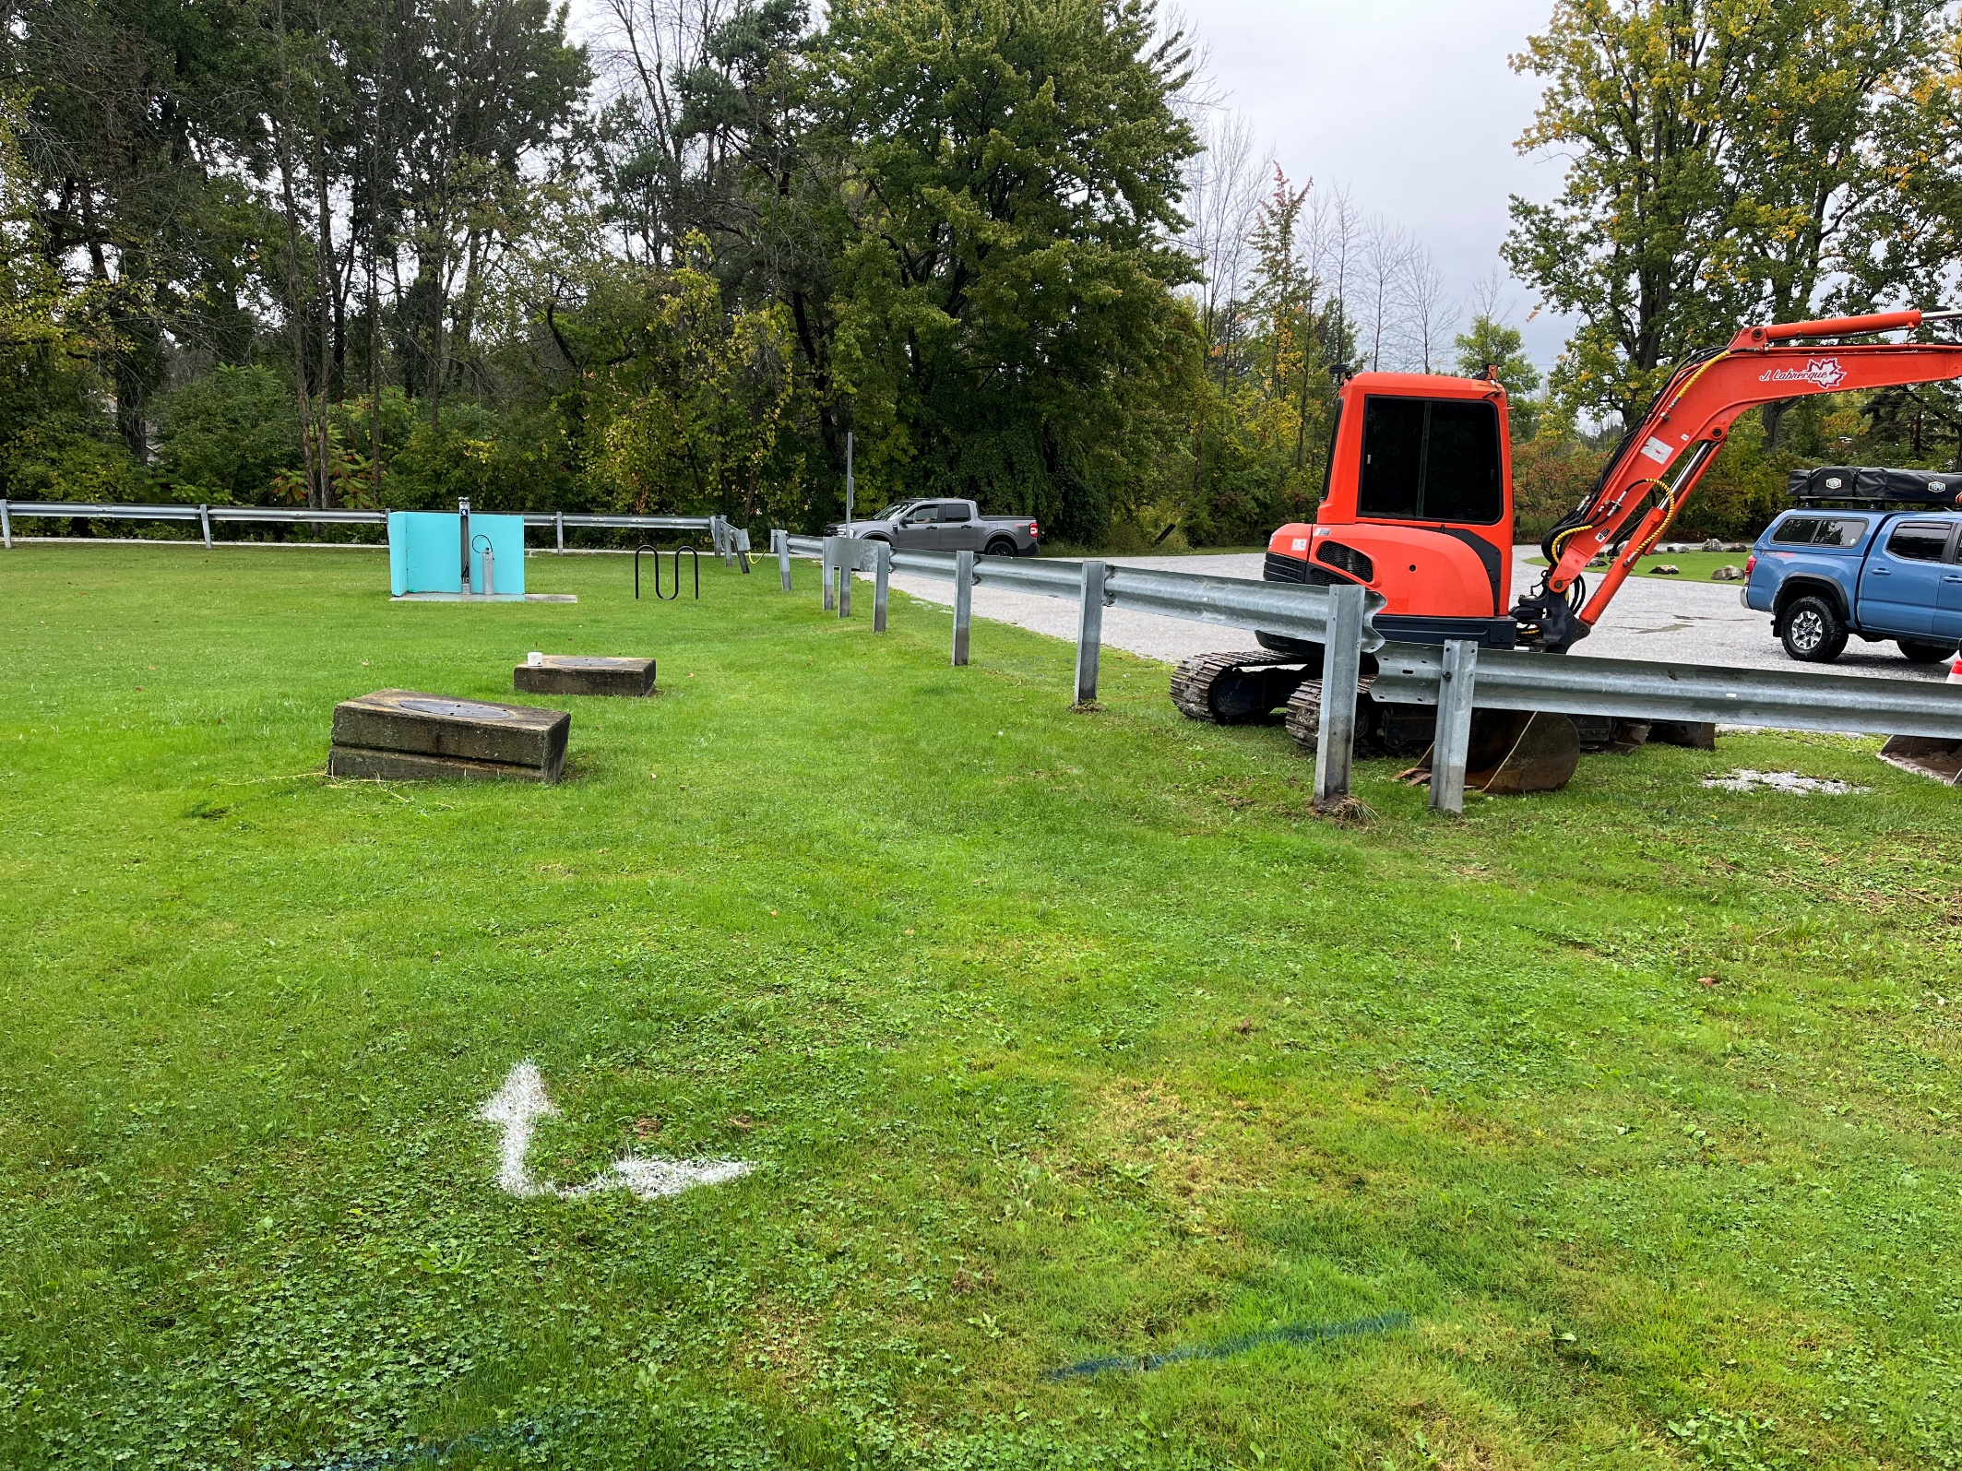
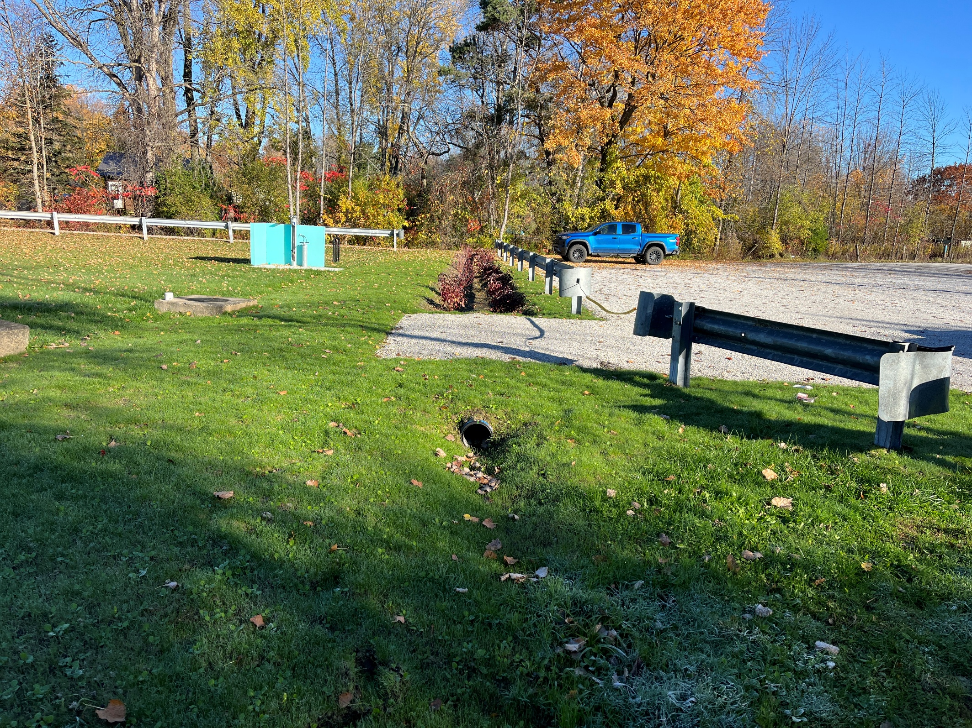
Before & After
Notes:
Introduce yourself and Josh. Why we’re here and short slide show to catch everyone up. Selectboard members have a summary sheet as well in front of them.
"A true friendship is defined by knowing someone has your back, no matter what. A good friend will watch out for you and ensure you are safe, feel supported, and are loved. A good friend will never purposely lead you into making decisions or taking actions that aren't good for you. A true friend will always have your best interests at heart." ~Lia Miller
The definition above from writer Lia Miller reveals that friendship is about feeling safe, supported, and loved. When I apply this definition to our work throughout the watershed here in northern Vermont, I see a number of parallels to our work as the Friends of Northern Lake Champlain.

Slide 6
Stay in Touch
www.friendsofnorthernlakechamplain.org
Bridget Butler, Executive Director: bbutler@friendsofnorthernlakechamplain.org
Josh Serpe, Project Manager: jserpe@friendsofnorthernlakechamplain.org

