Slide 1
Swanton Electric
Swanton Electric has been serving its customers since 1894. We serve approximately 3,800 customers in Swanton Village and parts of Swanton Town, Highgate and St. Albans Town. We are one of 14 municipal electric utilities in Vermont. Swanton Electric has some of the lowest rates in Vermont and has not had a rate increase since 2016. We are proud to serve our customers with 100% renewable electricity.

Slide 2
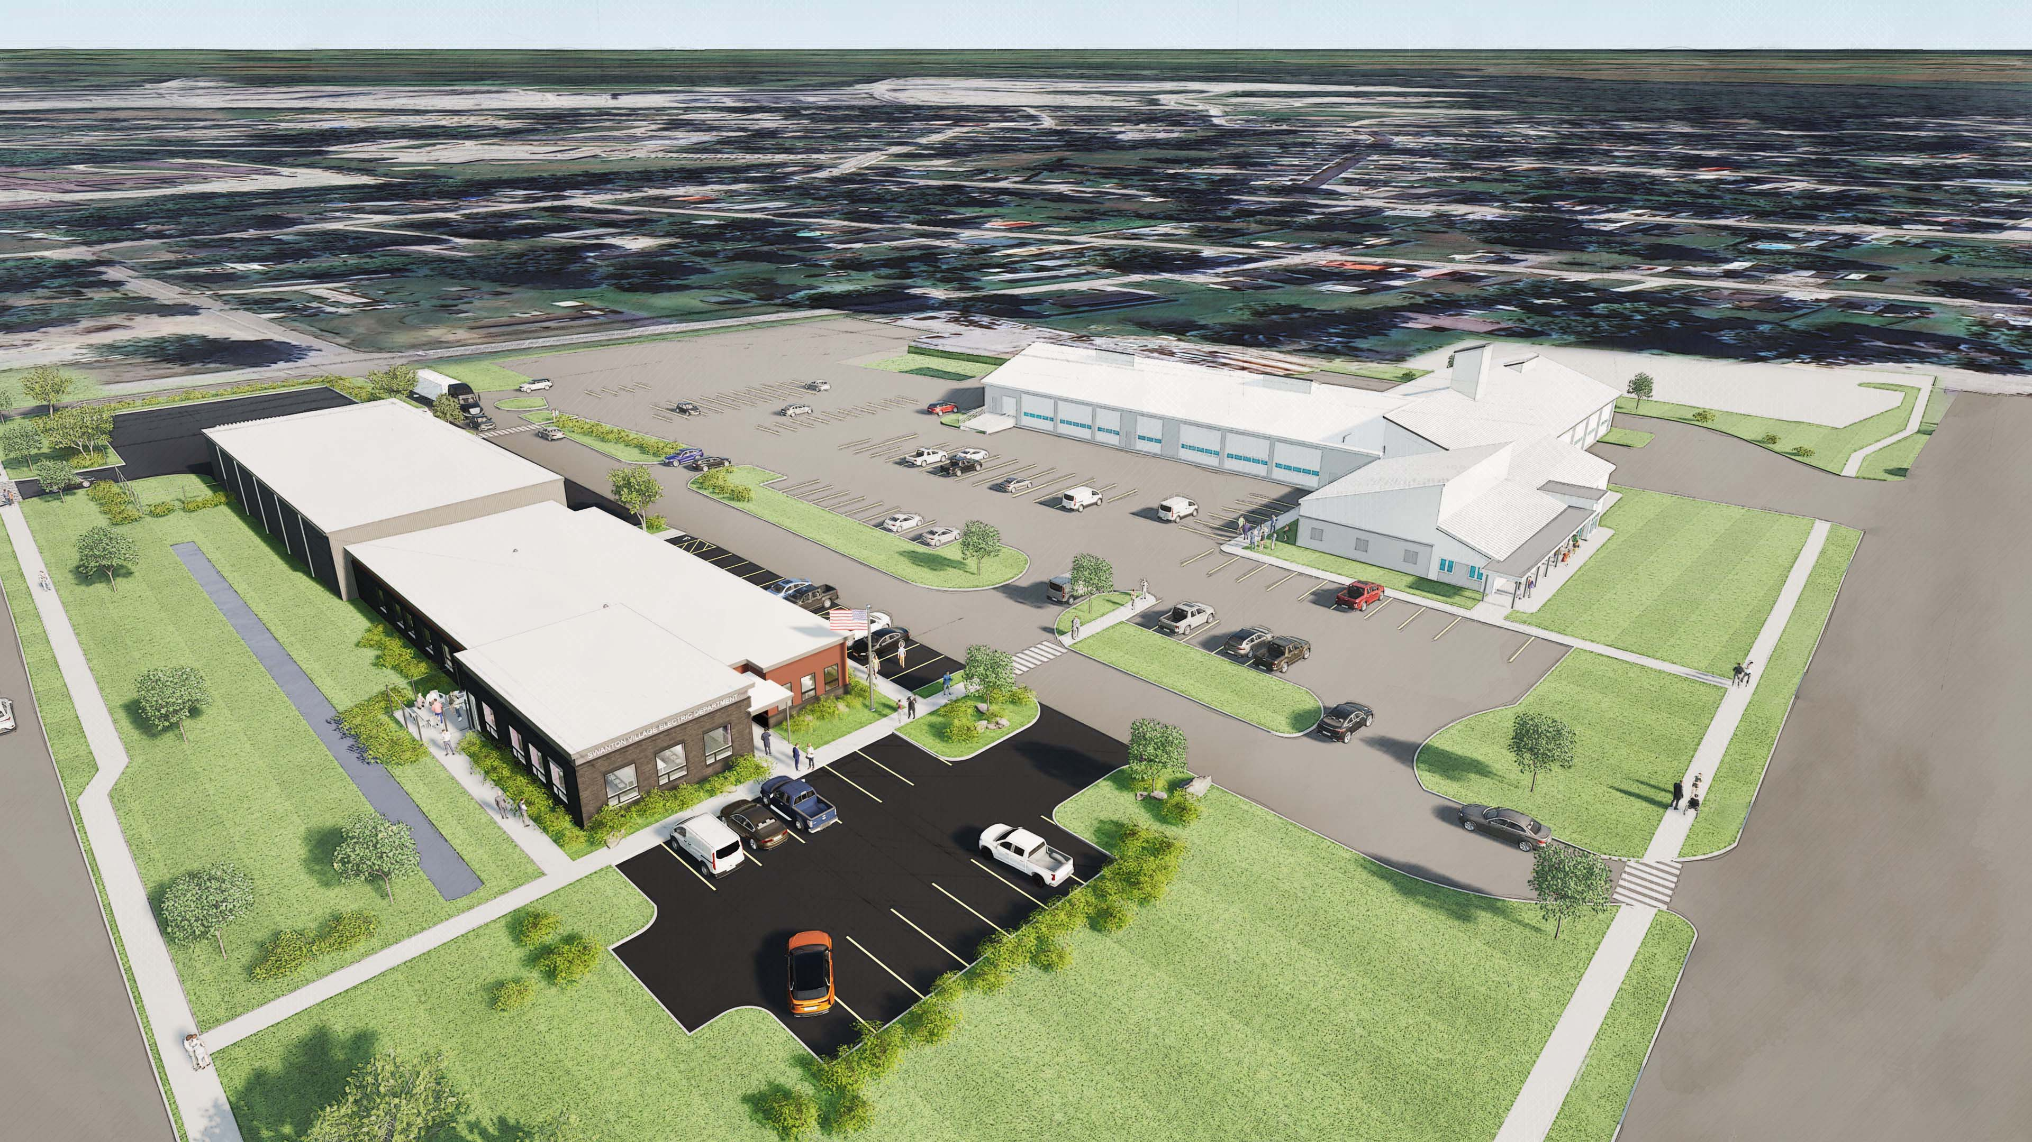
Swanton Village Electric Dept.
WELCOME!

Slide 3
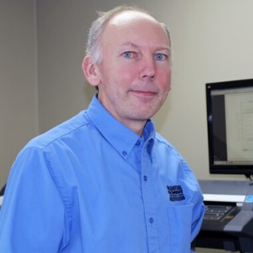
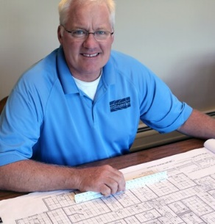
Swanton Village Electric Dept.
The Project Team
William Sheets, Village Manager
Lynn Paradis, Asst. Village Manager
Duane Couture, Electric Dept. Supervisor
Daren Plouff, Head Line Technician
Suzie Kelleher, Village Trustee
David Winchester, Village President
The Design & Construction Team
Steve Roy
Vice President
Wiemann Lamphere
John Lamothe
Project Manager
Wiemann Lamphere
Mike Connor
Partner
Connor Contracting
Sean Connor
Project Manager
Connor Contracting
Chris Lynch
Project Manager
Connor Contracting
Sean Connor
Project Manager
Sean Connor
Project Manager

Slide 4
Swanton Village Electric Dept.
EXISTING AERIAL VIEW OF PROJECT SITE

Slide 5
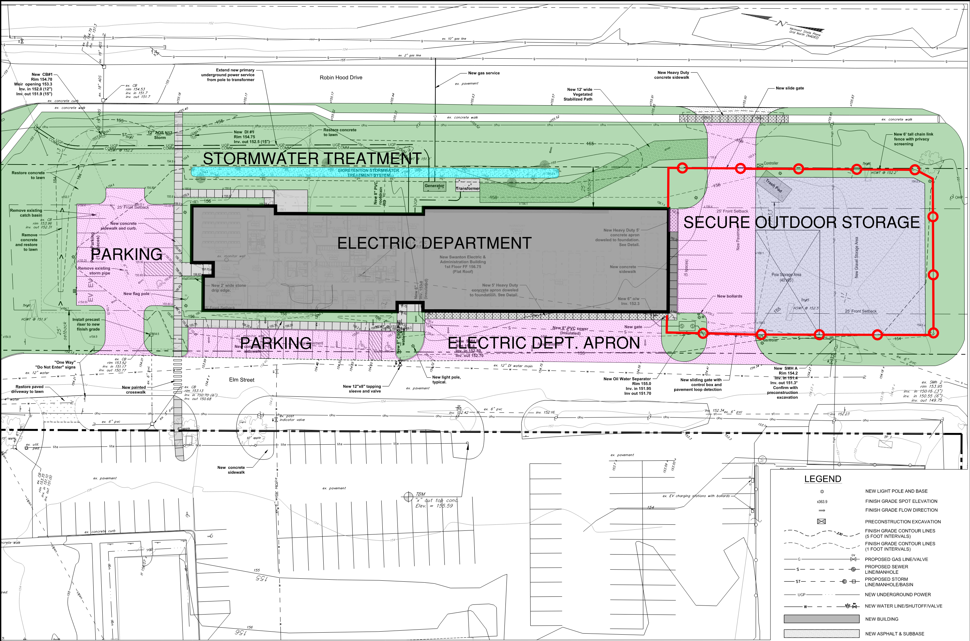
Swanton Village Electric Dept.
PROPOSED PROJECT SITE PLAN

Slide 6
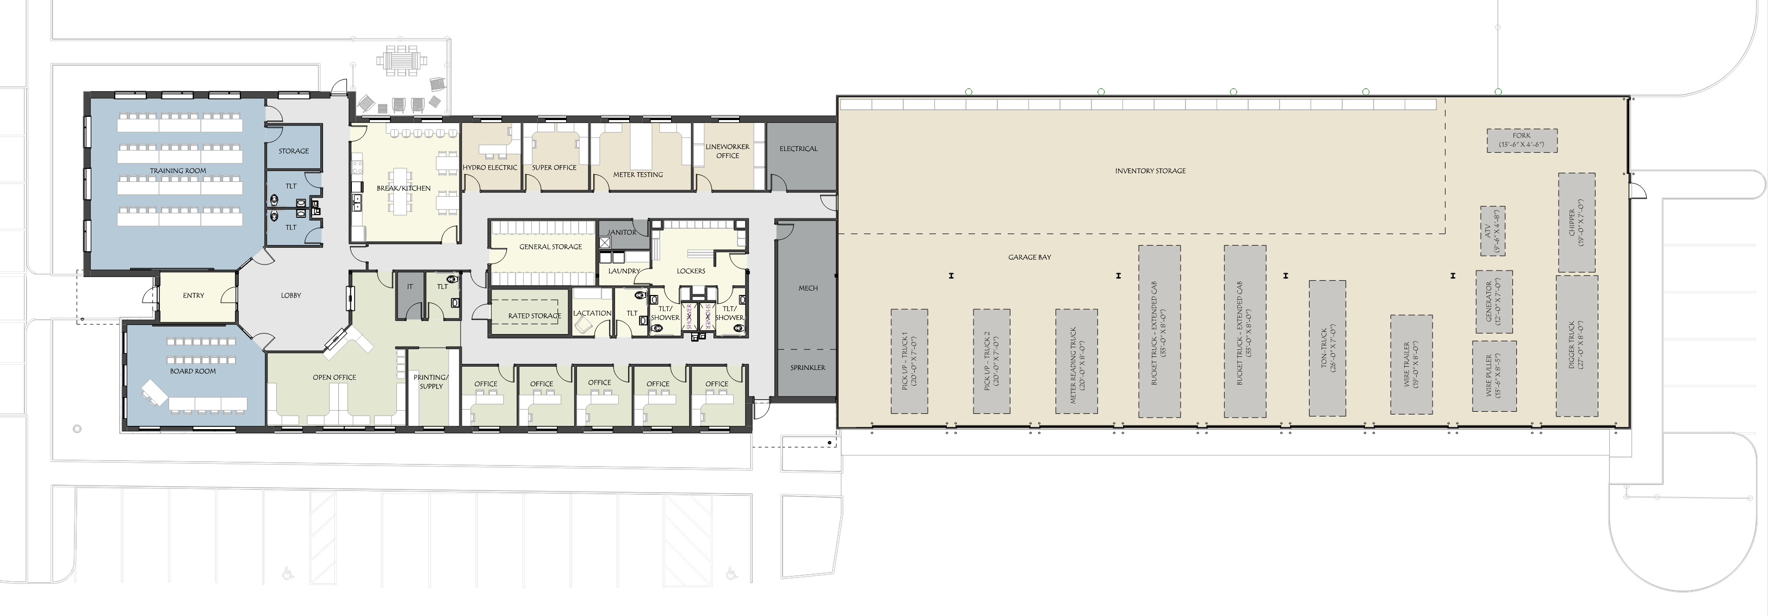
Swanton Village Electric Dept.
9,725 SF VEHICLE & EQUIPMENT STORAGE
8,650 SF OFFICE & SUPPORT SPACE
18,375 TOTAL SQUARE FOOTAGE
PROPOSED OVERALL FLOOR PLAN

Slide 7
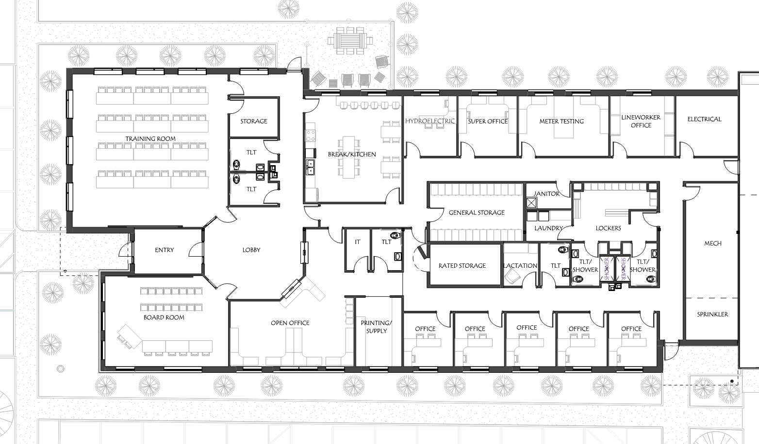
Swanton Village Electric Dept.
PROPOSED OFFICE FLOOR PLAN

Slide 8
Swanton Village Electric Dept.
CUSTOMER SERVICE /BILL PAYMENT
PROPOSED OFFICE FLOOR PLAN

Slide 9
Swanton Village Electric Dept.
CUSTOMER SERVICE / BILL PAYMENT
TRAINING & BOARD ROOM
PROPOSED OFFICE FLOOR PLAN

Slide 10
Swanton Village Electric Dept.
CUSTOMER SERVICE / BILL PAYMENT
TRAINING & BOARD ROOM
VILLAGE OFFICES
PROPOSED OFFICE FLOOR PLAN

Slide 11
Swanton Village Electric Dept.
CUSTOMER SERVICE / BILL PAYMENT
TRAINING & BOARD ROOM
VILLAGE OFFICES
ELECTRIC DEPARTMENT STAFF
PROPOSED OFFICE FLOOR PLAN

Slide 12
Swanton Village Electric Dept.
CUSTOMER SERVICE / BILL PAYMENT
TRAINING & BOARD ROOM
VILLAGE OFFICES
ELECTRIC DEPARTMENT STAFF
BREAK SPACE/ MECHANICAL / STORAGE / TOILETS
PROPOSED OFFICE FLOOR PLAN

Slide 13
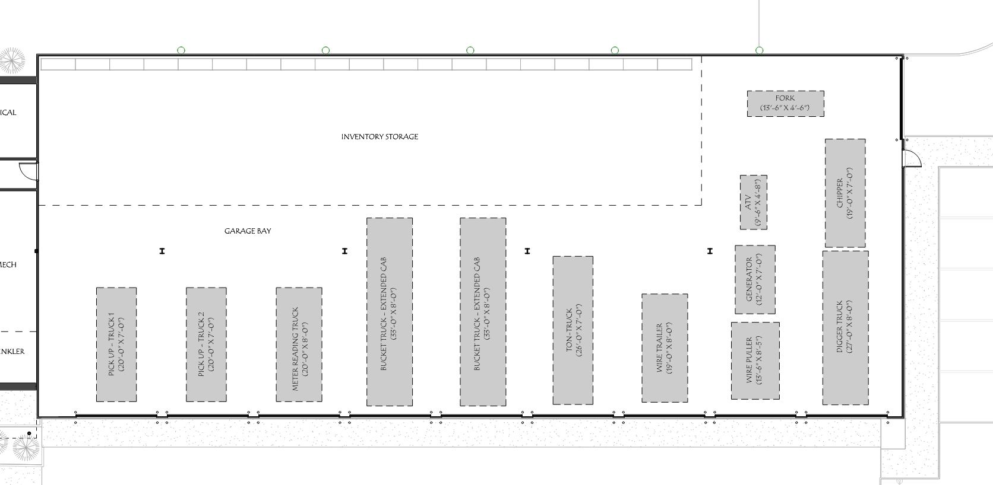
Swanton Village Electric Dept.
VEHICLE & INVENTORY STORAGE
PROPOSED GARAGE FLOOR PLAN

Slide 14
Swanton Village Electric Dept.
BIRDS EYE VIEW OF PROJECT

Slide 15
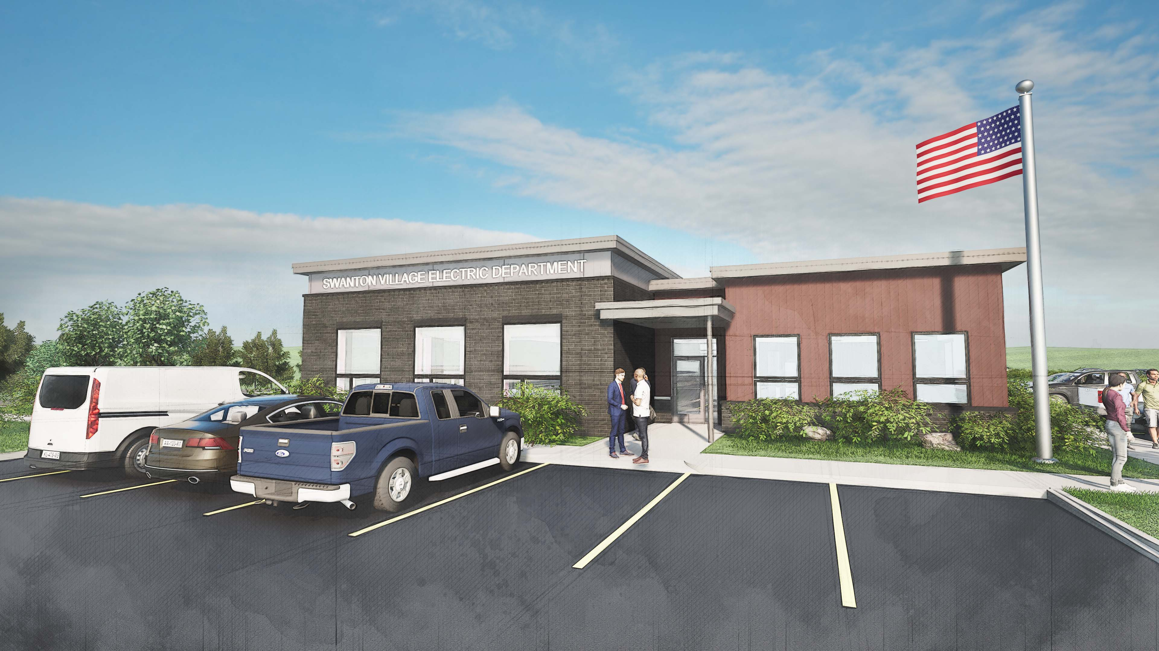
Swanton Village Electric Dept.
VIEW OF MAIN ENTRANCE FROM PARKING

Slide 16
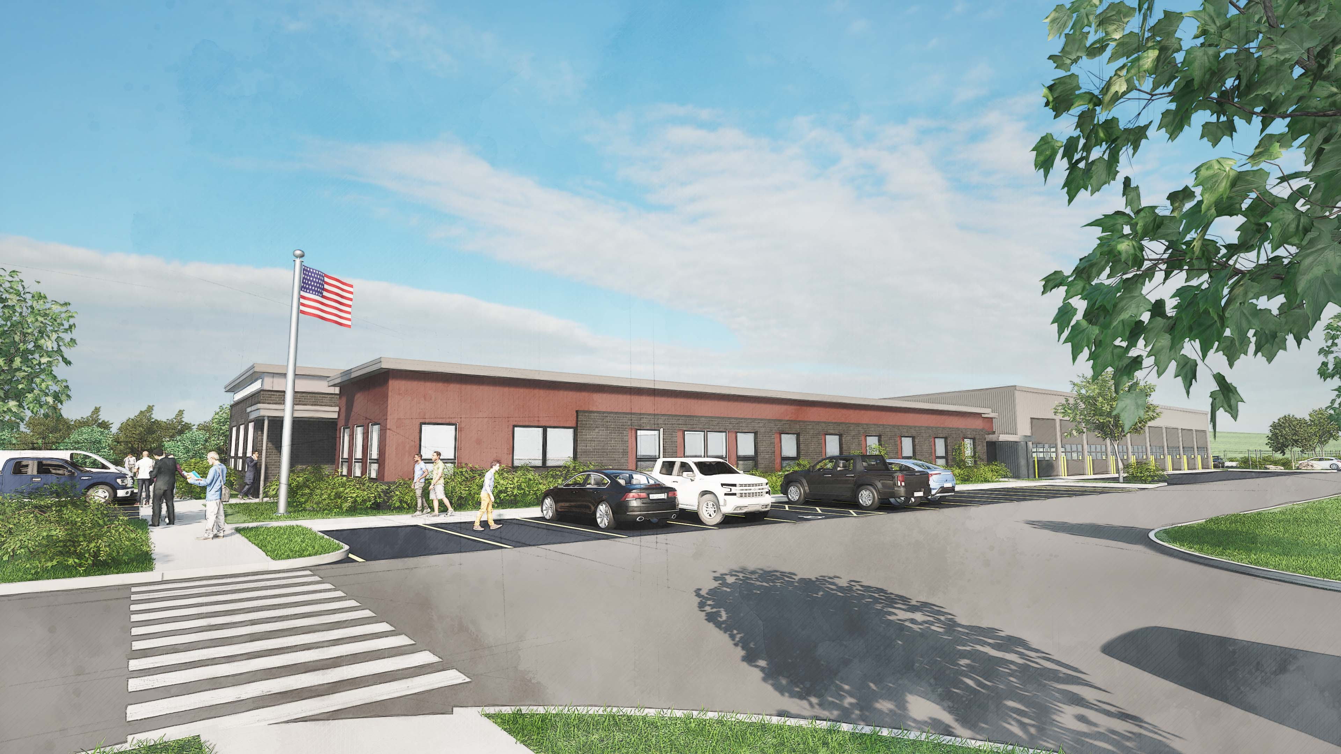
Swanton Village Electric Dept.
VIEW OF OFFICE FROM ELM STREET

Slide 17
Swanton Village Electric Dept.
CONNOR CONTRACTING HAS DEVELOPED DETAILED COST INFORMATION FOR THE PROPOSED DESIGN.

Slide 18
Swanton Village Electric Dept.
March 2025 Bond Vote Request
TOTAL PROJECT COST: $8,323,701
May 6, 2025 (New Vote)
Reduced cost by $852,886
TOTAL PROJECT COST: $7,470,815
A reduction of 10.25%

Slide 19
Swanton Village Electric Dept.
Significant Cost Savings ($852, 886)
Savings include
-Brownfields Savings (State of VT/NRPC)
-Generator (Grant Funding)
-Exterior Finish/siding changes
-Heating and Ventilating changes
-Landscaping
-Gravel storage for poles instead of paving
-Relocate EV chargers
-Security and Access Control

Slide 20
 | Swanton Village Electric
 | Bond Impact on Rates
 | $7,470,815 Bond
 | Residential |  |  |  |  | Residential
 | 600 kWH | Current | Increase | New Bill |  | 1000 kWH | Current | Increase | New Bill
 | Customer Charge | 6.85 | 0.88 | 7.73 |  | Customer Charge | 6.85 | 0.88 | 7.73
 | kWh | 72.80 | 9.39 | 82.19 |  | kWh | 121.33 | 15.65 | 136.98
 |  | 79.65 | 10.27 | 89.92 |  |  | 128.18 | 16.54 | 144.72
 | Increase per Year |  | 123.30 |  |  | Increase per Year |  | 198.42
 | Increase per Day |  | 0.34 |  |  | Increase per Day |  | 0.54
Swanton Village Electric Dept.

Slide 21
Swanton Electric Comparisons

Slide 22
Additional Benefits
Swanton Village Police Department
Immediately gains significant square footage in office space and a larger garage bay.
They will utilize the existing safe as a secure temp evidence, safely securing drugs and weapons.
They will gain a small space for secure, seized vehicle storage within the existing substation.

Slide 23
Additional Benefits
Public Works Department
Immediately gains additional garage space.
They will also gain additional, secure outdoor storage for equipment.
They will gain additional material storage space on the raised concrete platform.

Slide 24
QUESTIONS/TOUR?

