Slide 1
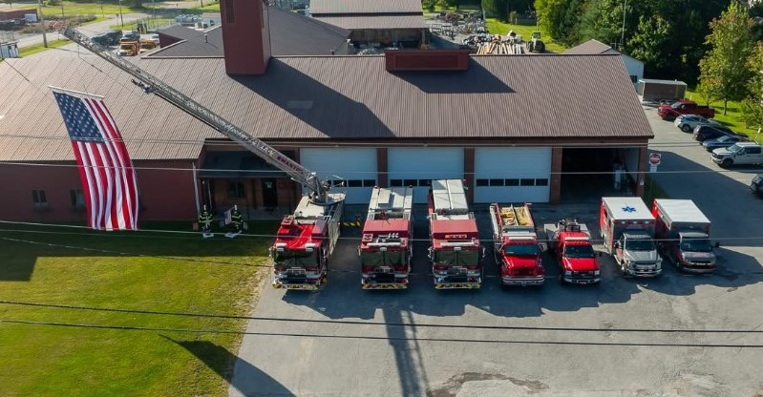
Swanton Fire

Slide 2
Village |  |  | Town |  |  |  | Total
Vehicle Accident | 6 |  | MVA | 39 |  |  | Vehical Accident | 45
Vehicle Fire | 0 |  | Vehical Fire | 4 |  |  | Vehical Fire | 4
Fire Alarms | 10 |  | Fire Alarms | 12 |  |  | Fire Alarms | 22
Struture Fire | 2 |  | Structure Fire | 3 |  |  | Struture Fire | 5
Trash/Rub | 3 |  | Trash/Rub | 1 |  |  | Trash/Rub | 4
Brush/Grass | 0 |  | Brush/Grass | 3 |  |  | Brush/Grass | 3
Gas Leak | 1 |  | Gas Leak | 6 |  |  | Gas Leak | 7
Burn Complaint | 3 |  | Burn Complaint | 2 |  |  | Burn Complaint | 5
Road Hazard | 1 |  | Road Hazard | 20 |  |  | Road Hazard | 21
C.O. Incident | 6 |  | C.O. Call | 5 |  |  | C.O. Incident | 11
Hazmat | 0 |  | Hazmat | 0 |  |  | Hazmat | 0
Med Assist | 13 |  | Med Assist | 15 |  |  | Med Assist | 28
Good Intent | 4 |  | G / I | 6 |  |  | Good Intent | 10
Boat Rescue | 0 |  | Boat Rescue | 3 |  |  | Boat Rescue | 3
Smoke Invest | 3 |  | Smoke Invest | 5 |  |  | Smoke Invest | 8
Ice Water Rescue | 0 |  | Ice Water Rescue | 1 |  |  | Ice Water Rescue | 1
 | 52 |  |  | 125 |  |  | Mutual Aid S/B | 6
 |  |  |  |  |  |  | Mutual Aid H/F | 7
 |  |  |  |  |  |  | Mutual Aid WATER | 1
 |  |  |  |  |  |  |  | 191

Slide 4
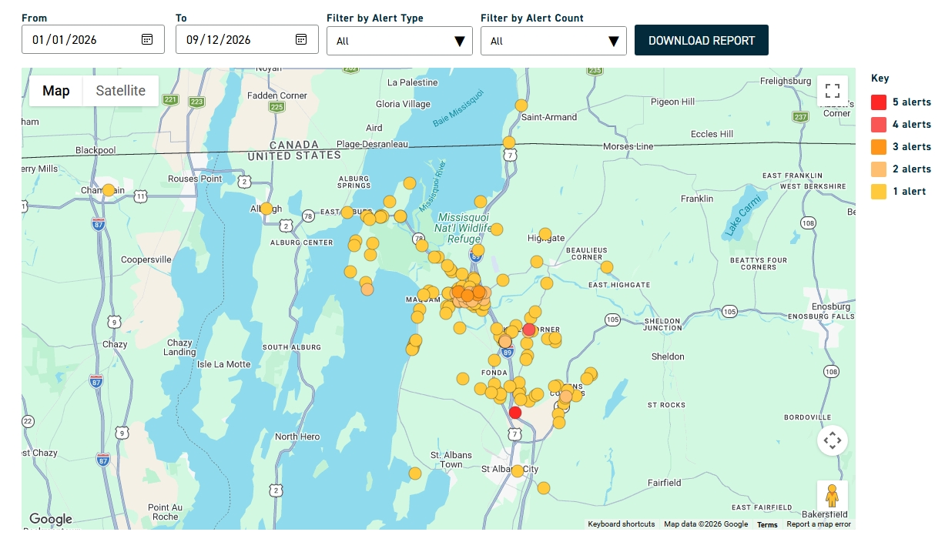

Slide 5
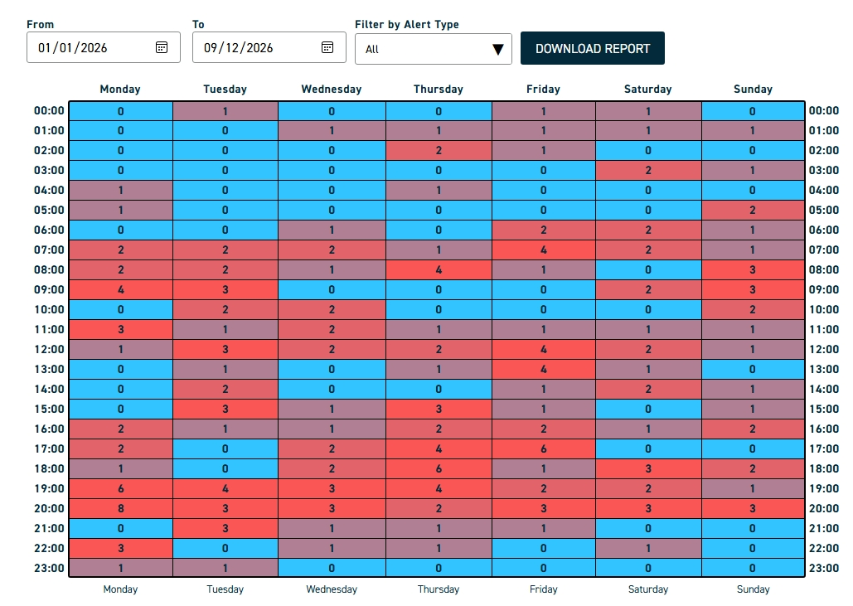

Slide 6
Truck Deployment
Car 5 | engine 2 | engine 3 | tanker | ladder | U6 |  | Total |  | Car 5 | engine 2 | engine 3 | tanker | ladder | U6 | Total |  | Total
26 | 18 | 2 | 3 | 10 | 9 | 19% | 68 |  | 72 | 77 | 27 | 17 | 18 | 52 | 263 | 81% | 331

Slide 7
Name: | Rank
Barry, Sam | FF
Bouissey, Lawrence | CAPT
Bourdeau Alexandra | FF
Bruyette, Kody | FF
Campbell, Troy | AST. CH
Chevalier, Dan | CHIEF
Depaitie, Matt | LT
Fontaine, Andre | LT
Giroux, Cody | FF
Greer, Jack JR | FF
Jaring, Keesy | FF
Longe, Gary | FF
McDonnell, Eric | FF
Mitchinson,Avery | LT
Packard, Josh | FF
Potter, Lyndsay | FF
Peloquin,Peter | FF
Robtoy, Jake | FF
Smith, Brandon | FF
Vanslette, Caleb | FF
Walker, Matt | SO
Wilcox, Abby | FF
Whalen, Bruce | FF
Warren, Keeegan | FF
24 Total Members
17 Certified
7 non-Certified
Of the 7, five are in class to become Certified.

Slide 8
Update on Mini Pumper: March 2027
Grants: One for an Exhaust System, One for station assessment.
Public events: 6 so far. New position.
Fire Warden: Updating website.
Radio Communication Upgrade: Better communication.

