Slide 1
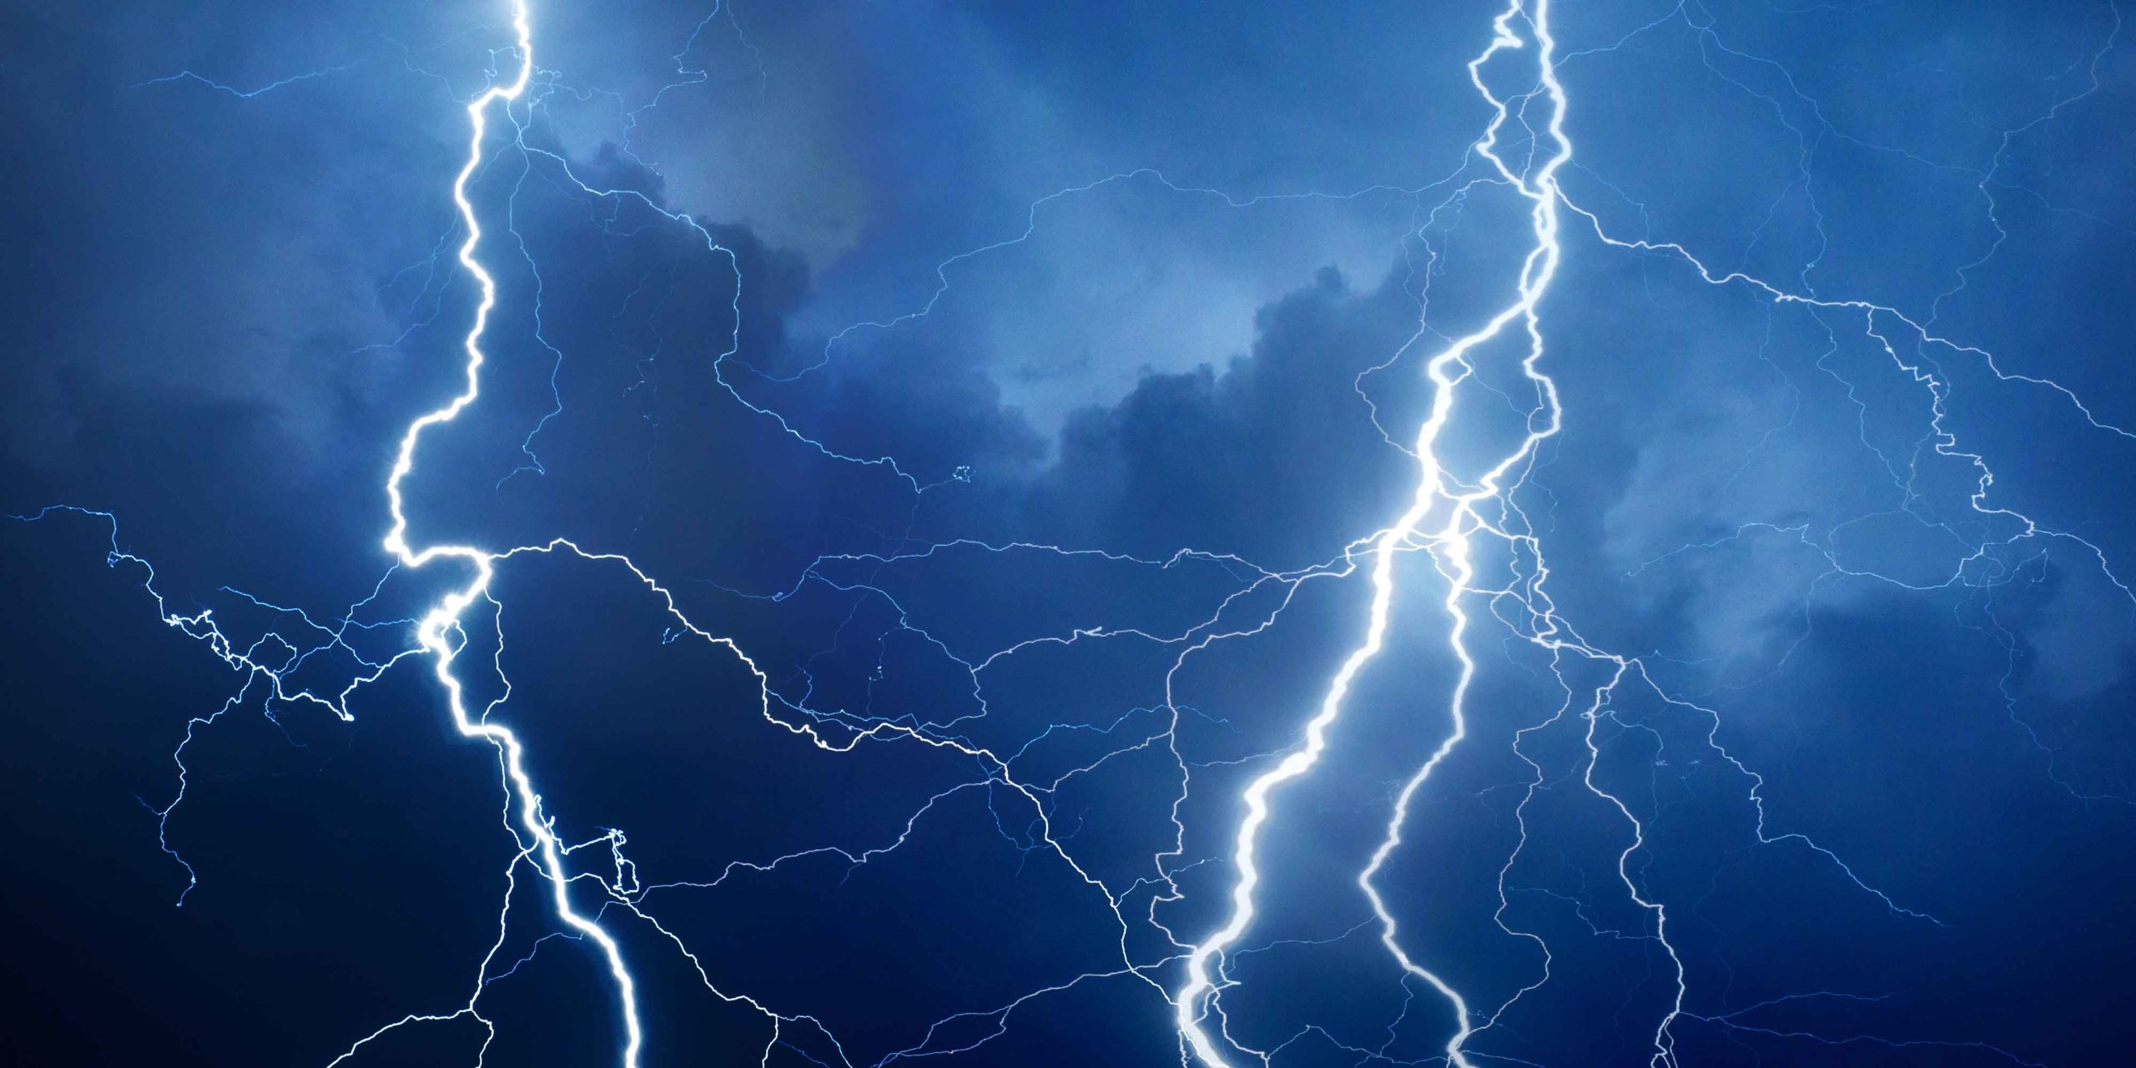
Swanton Village Light Department
Duane Couture
Line Foreman
This Photo by Unknown Author is licensed under CC BY-SA-NC

Slide 2
Swanton Village electric Organizational Chart
Al Mosher
Electrical Engineer
………..
Duane Couture
Line Foreman
Daren Plouff
Lead Lineman
Mark Longway
Meter
Jody Benoit
1st Class Lineman
Tanner Benoit
1st Class Lineman
Paul Bouchard
Lineman Apprentice
Nathan Parent
Lineman Apprentice

Slide 3
Responsibilities
Supplying power to roughly 4,000 customers and maintaining the substation and power lines for transmission and distribution
Electric Meters
Providing mutual Aid to local and non-local power companies during times of natural disaster, i.e. wind, snow, ice storms.
Maintaining a safe work environment

Slide 4
Supplying and Maintaining Power Lines
Maintaining existing lines
Line improvements
Moving power lines to increase power reliability (moving cross country lines closer to roadside)
Manage tree trimming to minimize tree related issues
Building new lines as needed
Creating Cost Estimates for New Customers
Ensuring equipment is well maintained and in working order
Ensuring a safe work environment by providing continuous safety training and ensuring working gear is in compliance with regulations and policy

Slide 5
Electric meters
Maintaining and existing current metering system, physically reading meters for approximately 4000 customers each month
Doing disconnects for non-payers as well as reconnects
Swanton Village Electric is currently working to integrate a new smart metering system which will feed the data from the meter back to the metering system eliminating the need to physically read the meter. It will also integrate with the Mapping system which will allow for outage management.

Slide 6
Mutual Aid and Support
Swanton Village Electric provides mutual aid support to local and non-local power companies during times of natural disaster.
Currently Swanton collaborates with Enosburg for on-call responsibilities supporting both utilities.

Slide 7
Safety
Maintains required safety training by providing monthly safety training sessions to include pole top rescues.
Ensures yearly CPR certifications are maintained.
Ensures work gear and equipment (rubber gloves, sleeves, bucket trucks) are in compliance with required regulations, policy and standards for electric companies.

Slide 8
projects
Continuing to upgrade the system by:
Replacing aged poles within the system
Moving cross country lines roadside to increase reliability and decrease repair time
Looking to put distribution lines underground where ever it is fiscally responsible
Implementing the Geographic Information System (GIS) to allow for the tracking of aged equipment and plan for replacements and upgrades.
Installation of the AMI electronic metering system as well as upgrading the water meters to remote reads.
In conjunction with regular tree trimming, we are addressing the impact that the Emerald Ash Bore is having on Ash within our system which has also increased the cost of the tree trimming.

Slide 9
challenges
Keeping the rates as low as possible while continuing to improve and upgrade the system keeping it reliable.
Getting materials, equipment and services timely
Increased costs of materials, equipment and services due to inflation.

Slide 10
Questions??

