Slide 1
Village of Swanton Water Distribution System Improvements
Trustee Update
April 27, 2026

Slide 2
The Problem: Aging Infrastructure & Low Fire Flow
Existing Waterlines: Singificant amount of 1940’s and older undersized cast-iron pipe that no longer meet fire flow standards
Tuberculation: Decades of mineral buildup inside cast-iron pipes dramatically reduces the internal flow area and hydraulic capacity.
Minimum fire flow standard: 500 gpm without lowering system residual pressure below 20 psi. The existing system cannot meet this standard in the Village core.
Reliability Concern: Concern with the aging water mains in the Village core that there will be more frequent water main breaks.

Slide 3
What A+E Did: Hydraulic Study Scope
Data Review: Reviewed existing records including the water system permit, sanitary surveys, mapping, usage records, ISO fire flow data, and maintenance records.
Hydraulic Model Update: Updated and calibrated the existing WaterCAD hydraulic model with current water usage data and recent system improvements.
Hydrant Flow Testing: Completed one day of hydrant flow testing to calibrate the model and document available fire flow throughout the Village core, with assistance from Village staff.
Alternatives Analysis: Used the calibrated model to evaluate multiple waterline replacement scenarios and identify the most cost-effective solution for improving fire flow.

Slide 4
Hydraulic Model Results
Village Core: Model confirmed need for improvement to meet fire flow. The 4-inch and 6-inch cast-iron mains in the center of the Village appear severely tuberculated and cannot meet the 500-gpm minimum standard.
Transmission Main: Approximately 2,700 LF of older transmission main feeding the Village core is contributing to system-wide hydraulic deficiencies.
ISO Fire Flow Standard: Model simulations confirmed multiple hydrants in the downtown area cannot meet the minimum 500 gpm fire flow without dropping residual pressure below 20 psi.

Slide 5
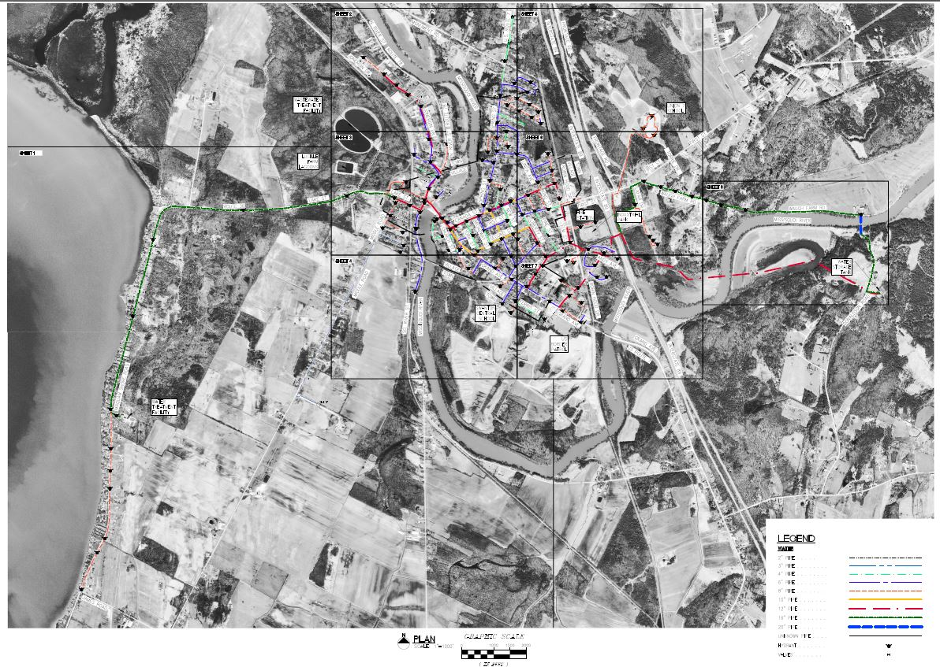
Overall Water System Map

Slide 6
Overall Water System Map

Slide 7
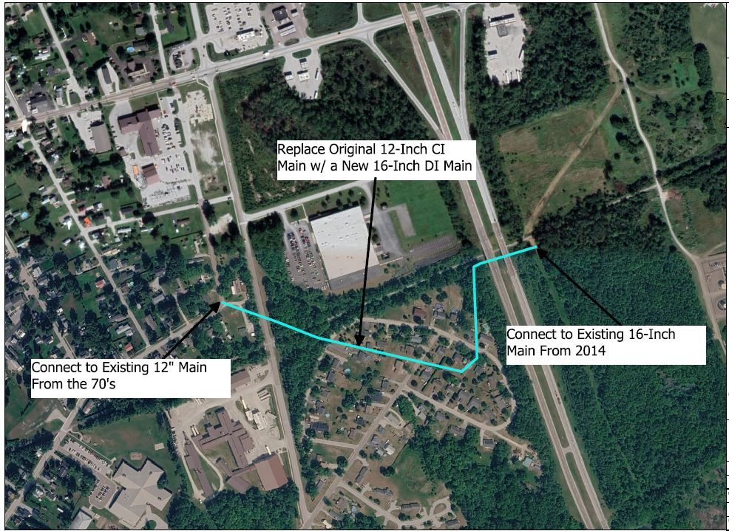
Alternative #2: Replace Part of Transmission Main
Replace 2,230 Linear Feet of Existing 12-Inch Original Cast-Iron Transmission Main
Install New 16-Inch Main
Last Original Transmission Main
Improves the Village’s Fire Flow Significantly
$1,860,000 Construction Cost Estimate

Slide 8
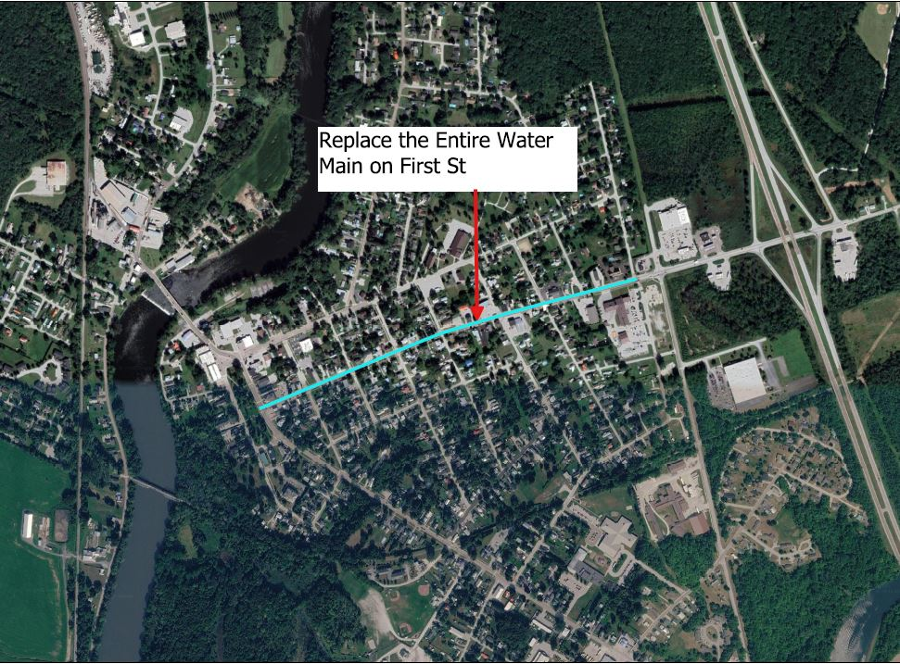
Alternative #3: Replace All of First St
Replace 3,450 Linear Feet of Existing 6 & 4-Inch Original Cast-Iron Water Mains
Connects to the 10-Inch Main on Grand Ave and the 12-Inch Main on Elm St
Improves the Village’s Fire Flow Moderately
$5,670,000 Construction Cost Estimate

Slide 9
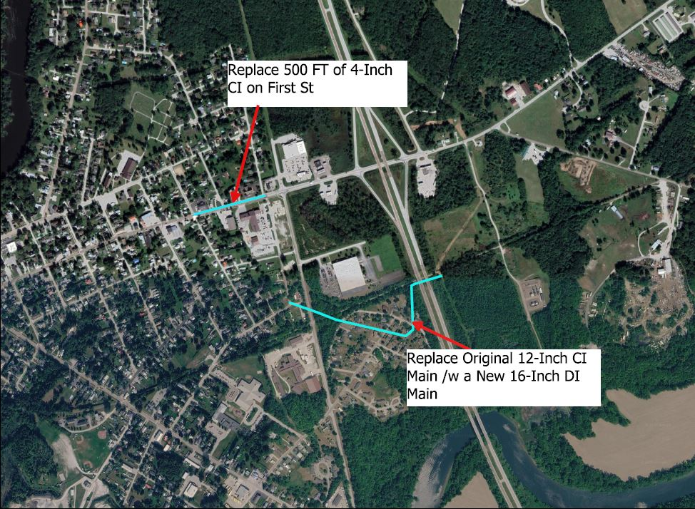
Alternative #4: Replace Transmission Main and Part of First St
Replace Transmission Main from Alternative No.1
Replace 500 Linear Feet of 4-Inch Main on First St
$2,520,000 Construction Cost Estimate

Slide 10
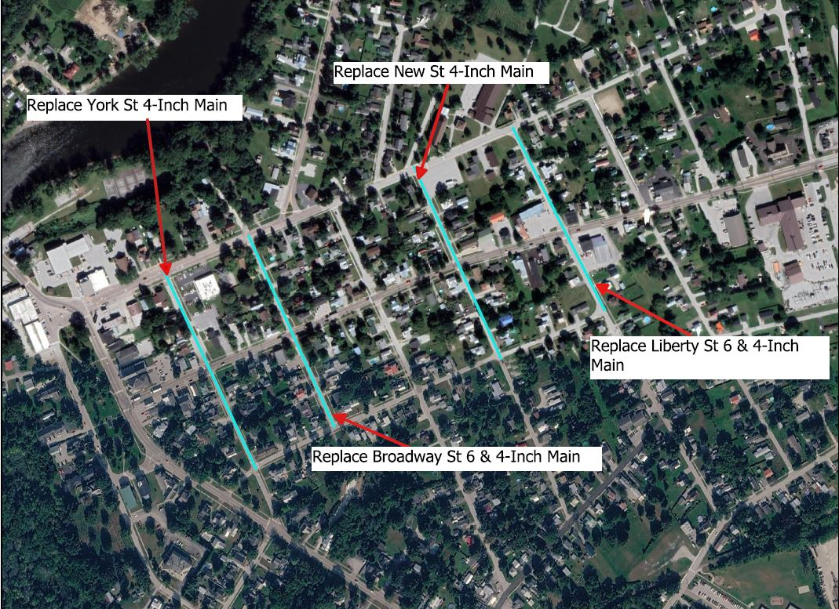
Alternative #5: Side Streets
Replace 4,000 Linear Feet of Existing 6 & 4-Inch Original Cast-Iron Water Mains
Connects to the 12-Inch Main on Canada St and the 10-Inch Main on Second St
Improves the Village’s Fire Flow Moderately
$3,940,000 Construction Cost Estimate

Slide 11
Alternatives Analysis Summary
Criteria | Alt. 1: No Action | Alt. 2: Replace Transmission Main | Alt. 3: Replace All of First Street | Alt. 4: Replace Trans. Main + First St. | Alt. 5: Side Streets
Fire Flow Improvement | None | Significantly – Comparatively | Moderately – Comparatively | Significantly – Comparatively | Moderately – Comparatively
Pipe Replaced | None | 2,230 LF | 3,450 LF | 2,300 LF of Transmission & 500 LF of First St | 3,850 LF of York, Broadway, New, and Liberty St.
Est. Construction Cost | N/A | $1,860,000 | $5,670,000 | $2,520,000 | $3,940,000
Pros | No cost | Cheaper option Significantly improve fire flow | Replacing all of First St Improve flows | Replace the Transmission Main and 4” Section of First St | Replace a significant portion of failing Village Center waterlines
Cons | More frequent waterline breaks Continued fire flow issues | Doesn’t replace aging and failing waterline in Village Center | VTrans ROW Busy road Contaminated soils Very expensive | VTrans ROW Busy road Contaminated soils Additional cost | Doesn’t improve fire flow as much as the transmission main

Slide 12
Recommended Next Steps
Select Preferred Alternatives: Village Board direction needed on preferred improvement alternative to move forward with final design.
Finalize PER: Complete and submit the Preliminary Engineering Report to the Village and Vermont Drinking Water & Groundwater Protection Division (DWGPD) for review and approval.
DWSRF Funding Application: The completed PER satisfies VT DWSRF PER requirements, enabling the Village to apply for Step II (design) and Step III (construction) funding.
Design & Construction: Following PER approval and funding authorization, proceed with final design, bidding, and construction of the selected improvements.

Slide 13

QUESTIONS?

