Slide 1
Village Of Swanton
Water Treatment Facility
Annual Update 2026
Presented By:
Dillon Dupont Chief Operator
Avery Mitchinson Assistant Chief Operator

Slide 2
Agenda
2026 work completed update
Current ongoing projects
Some fun facts about the Water Treatment Facility
Reminder
Questions?

Slide 3
2026 Water Treatment Facility Interior and Exterior Updates
Cleaned and Painted walls, floors and doors.
Painted main hallway to entrance
Painted stairwell by main entrance
Painted bathroom
Painted main office and laboratory
Ground and painted all exterior doors
Ground and painted new Gate to Main Entrance
Ground and painted handrail to entrance of the plant

Slide 4
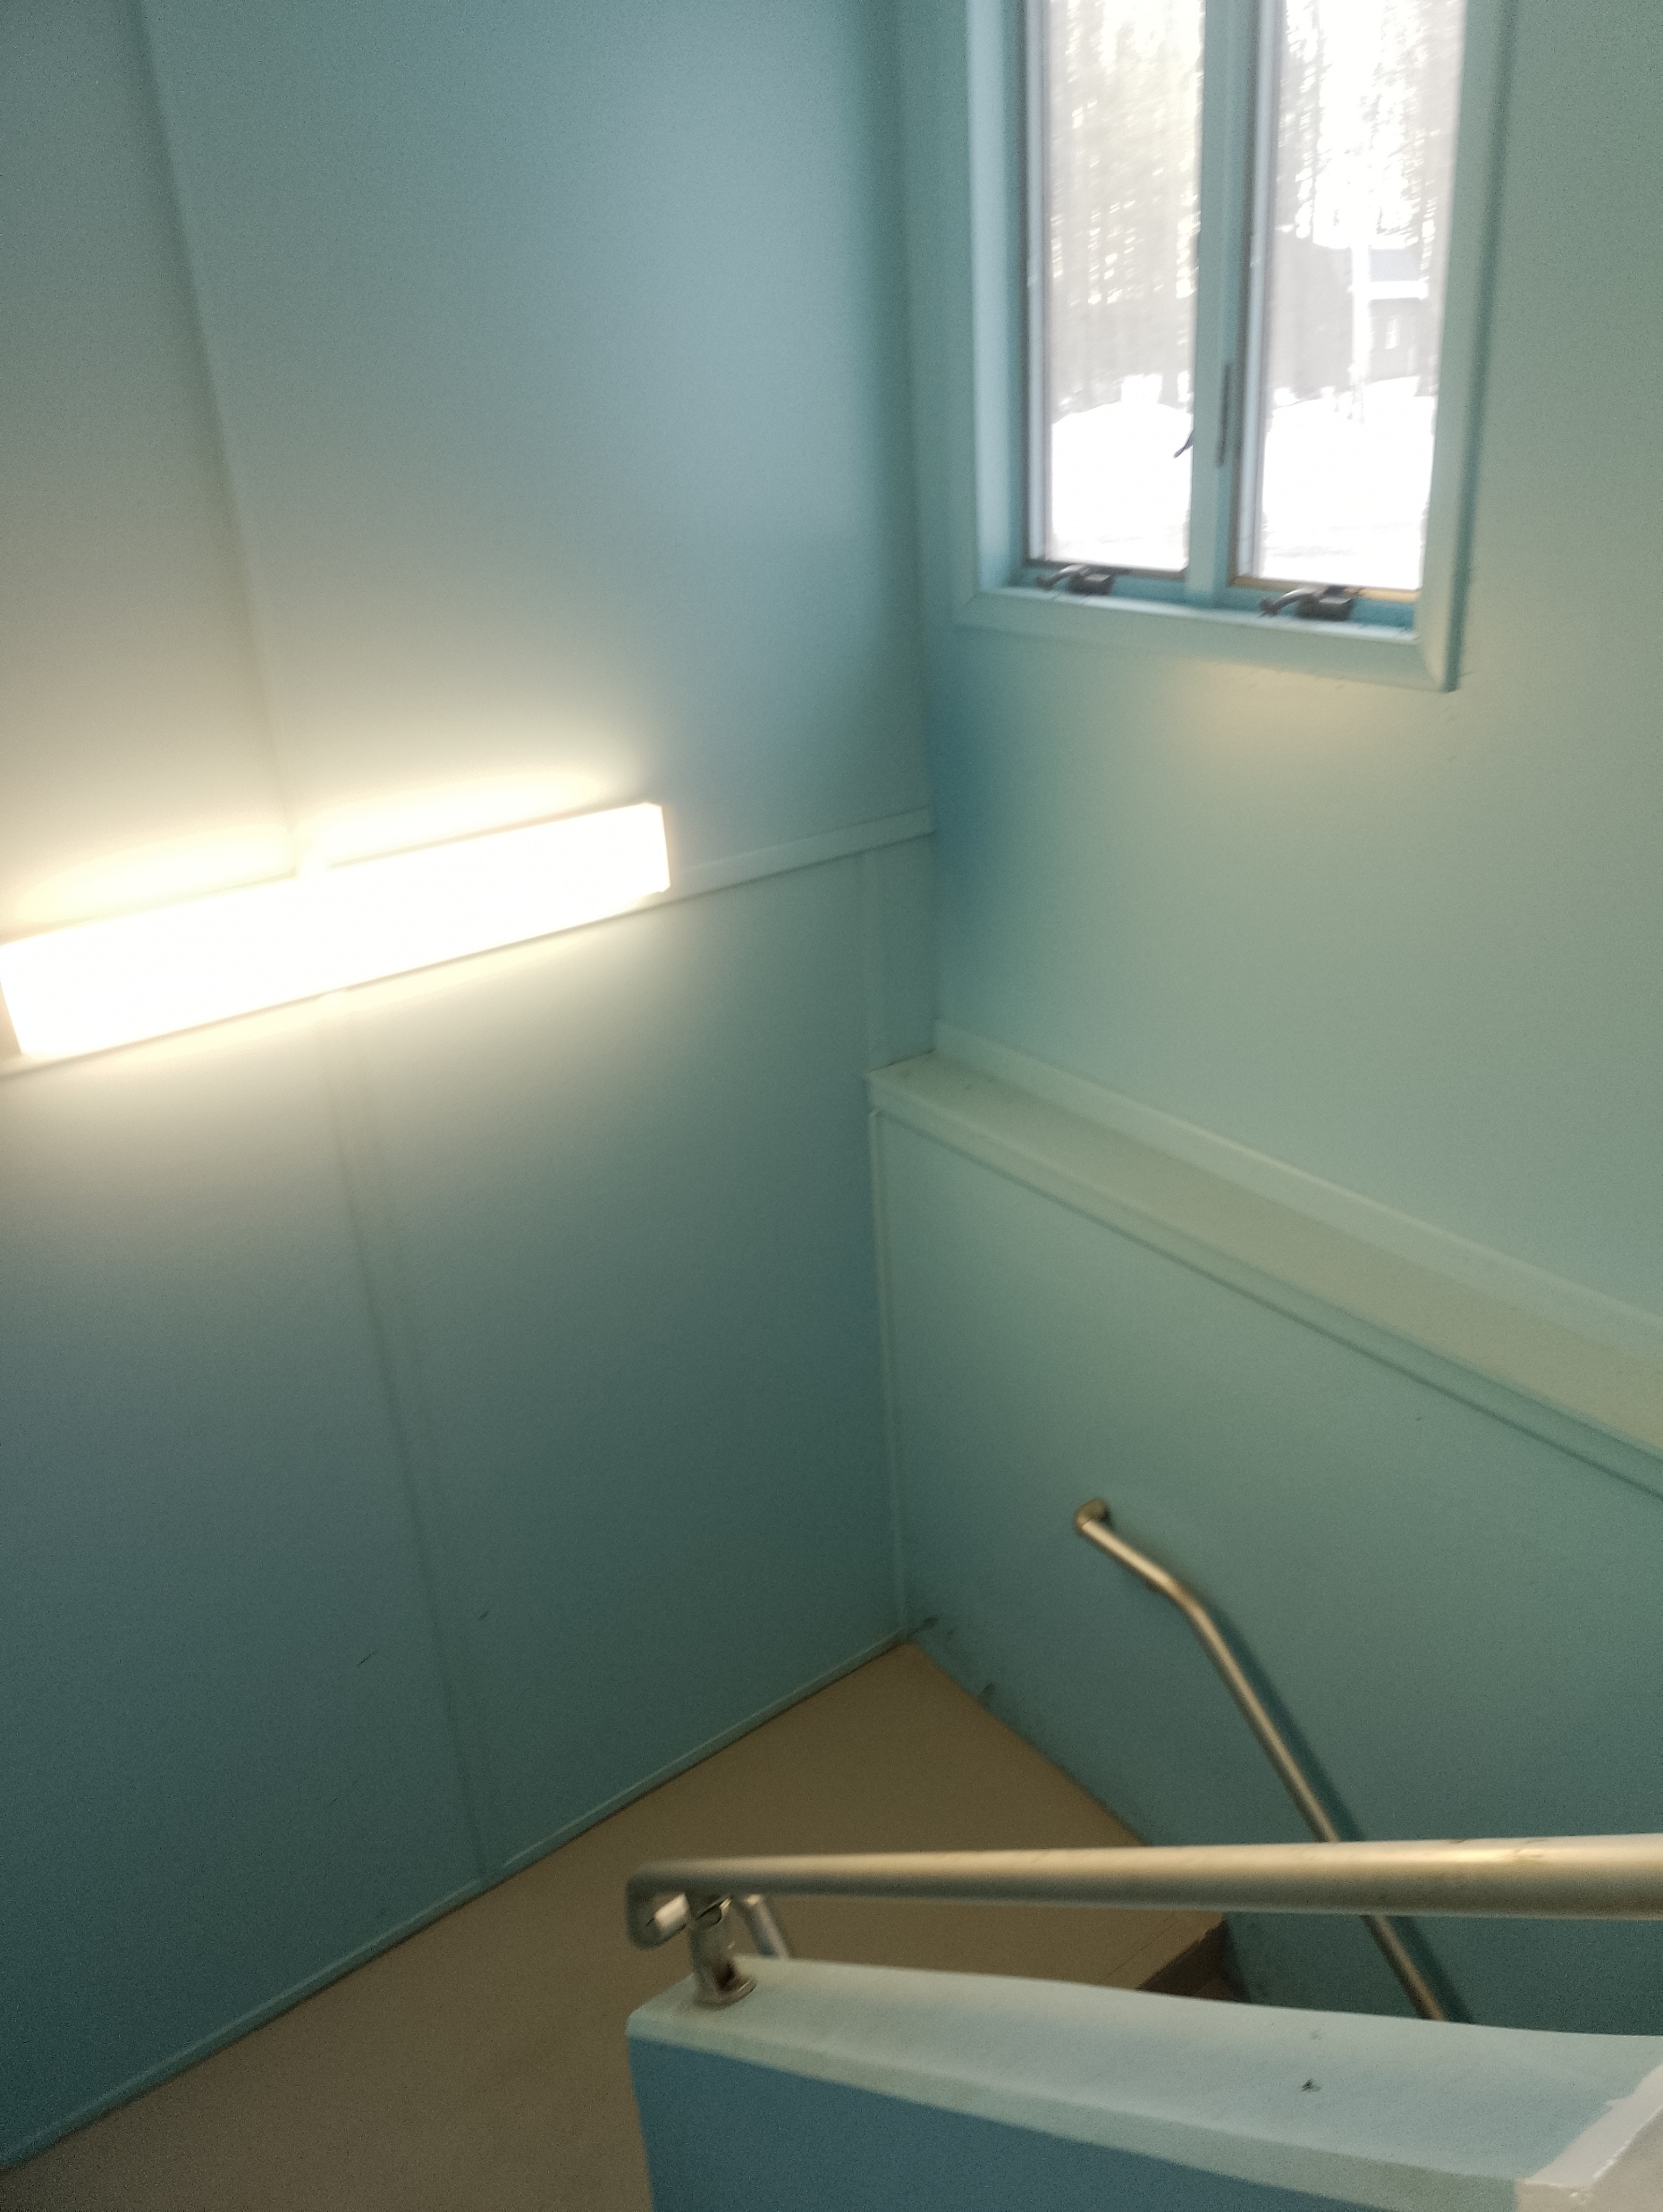
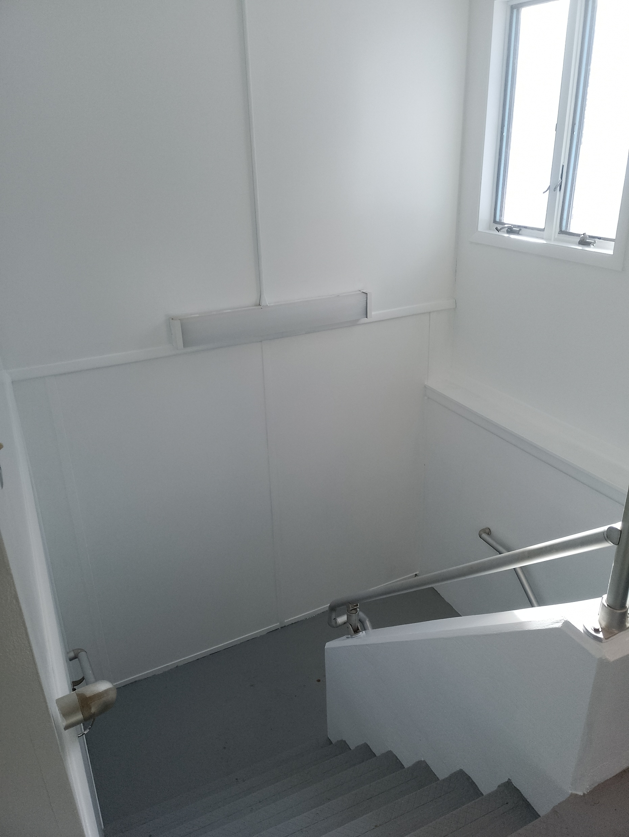
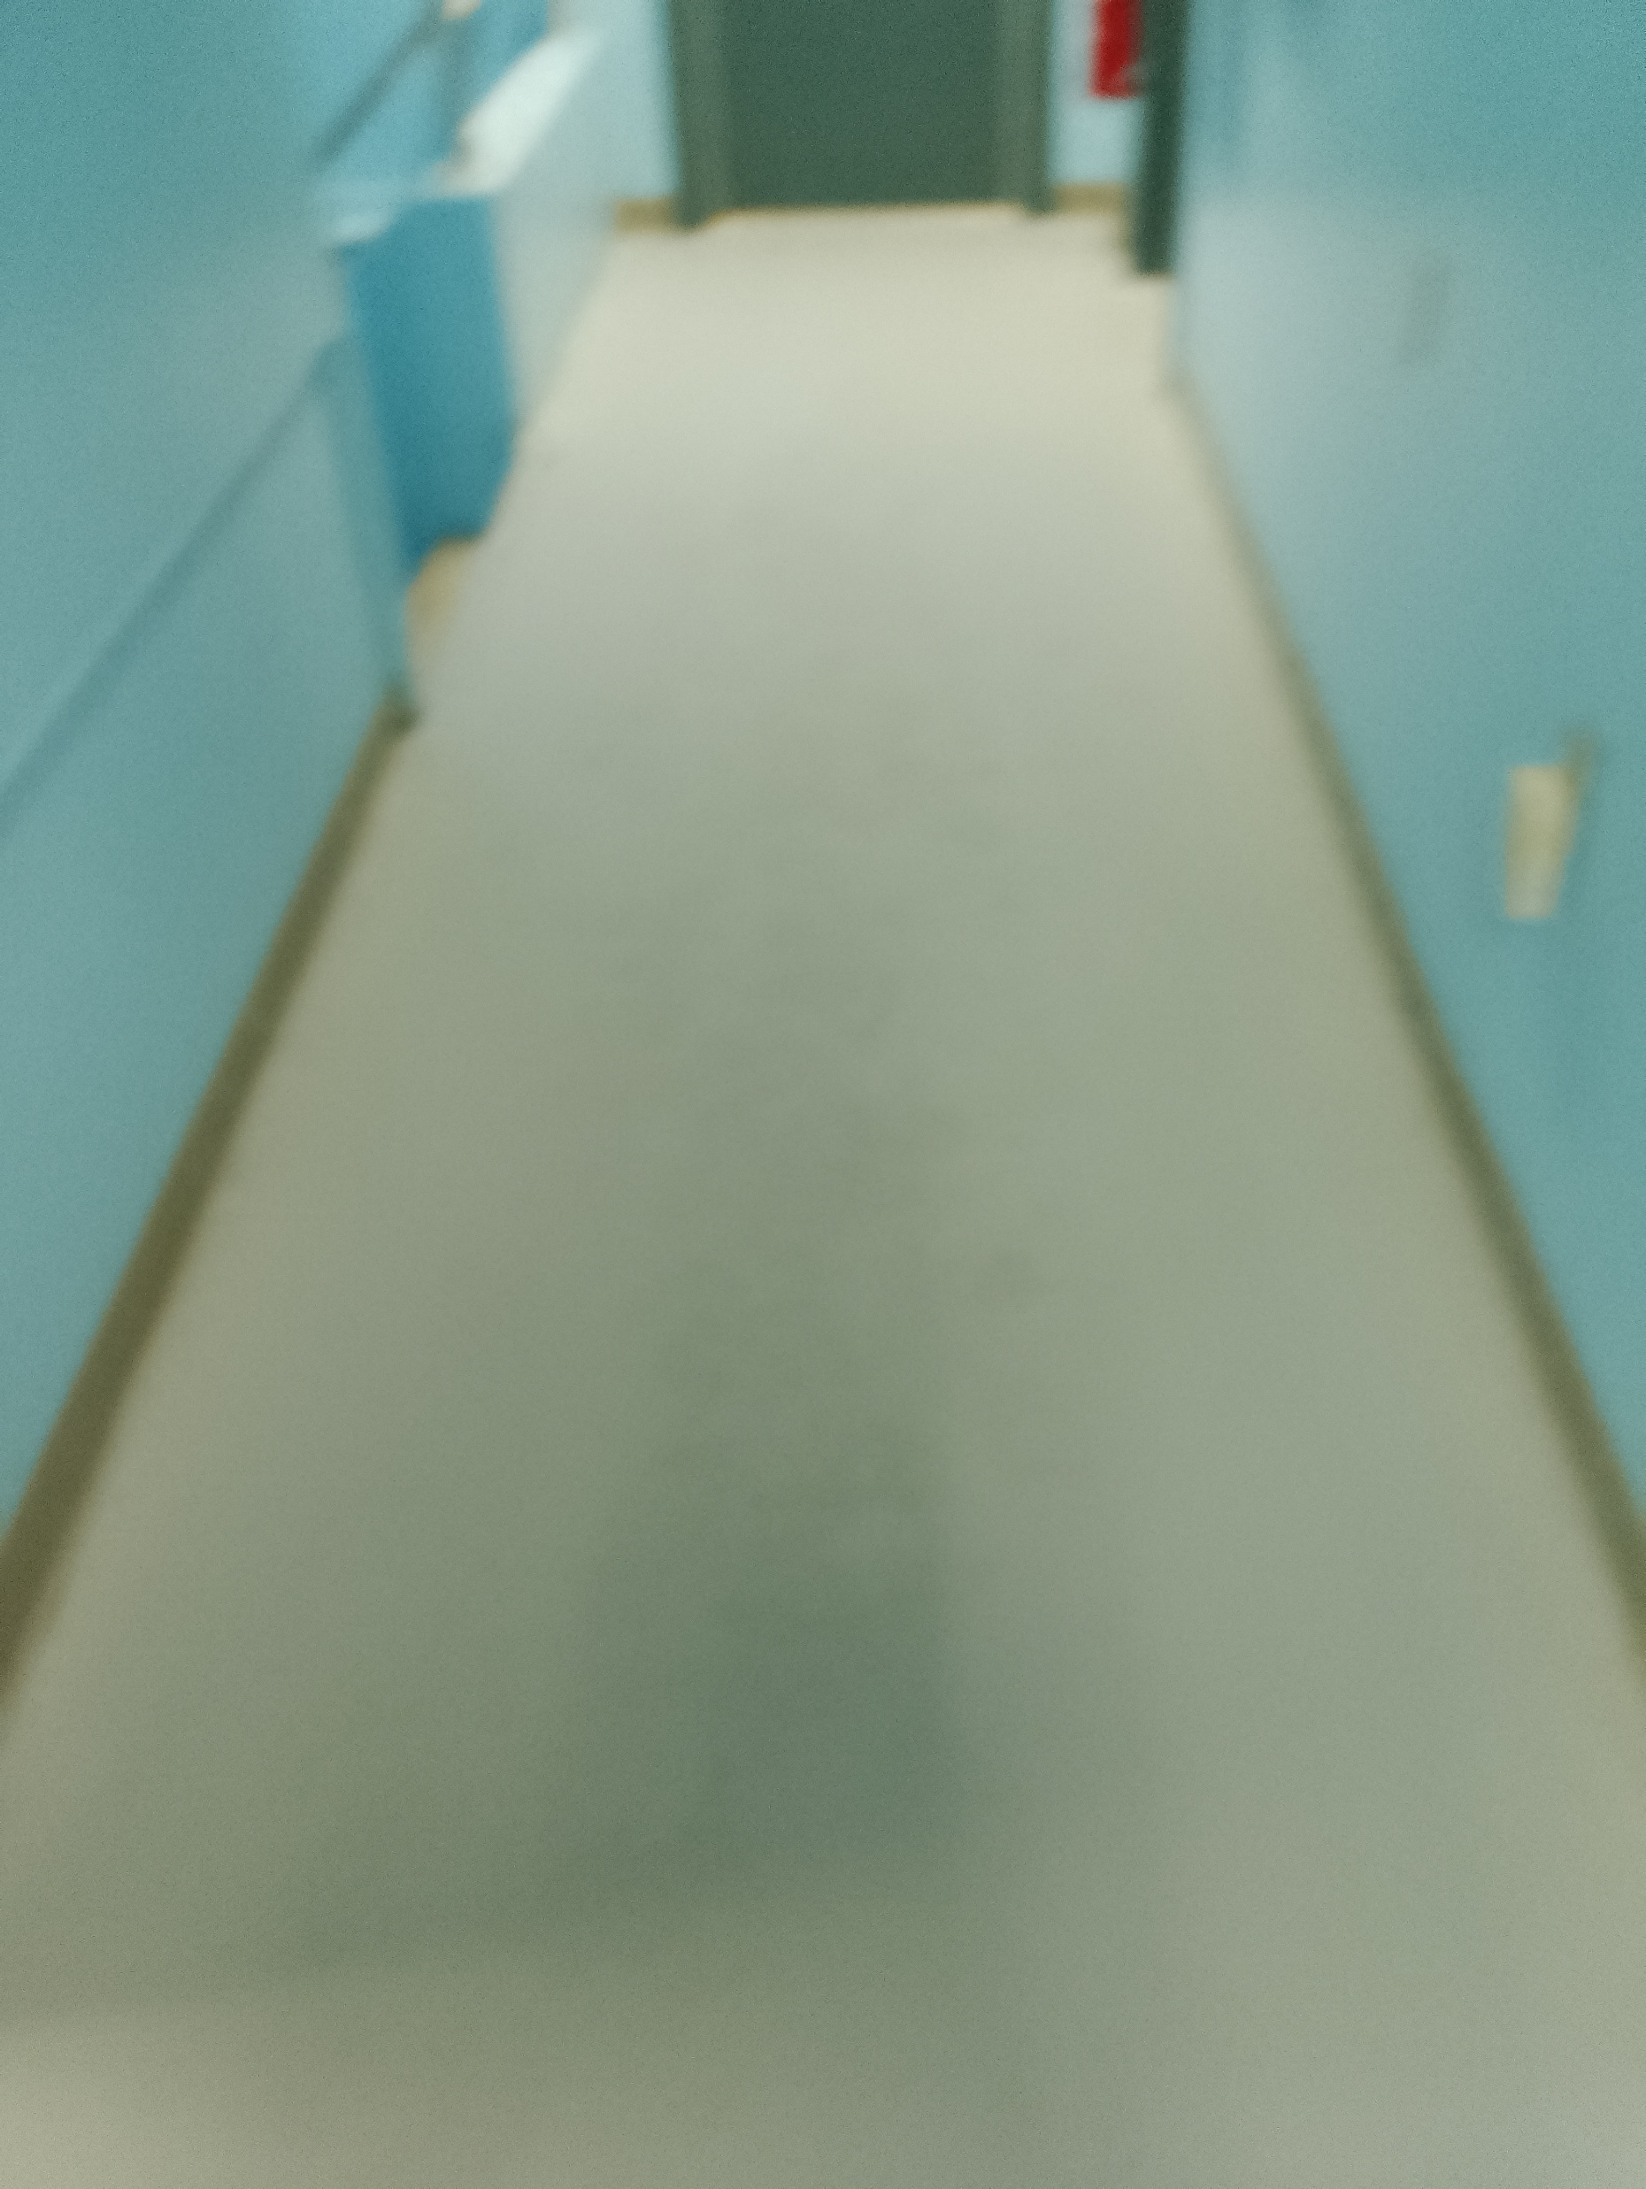
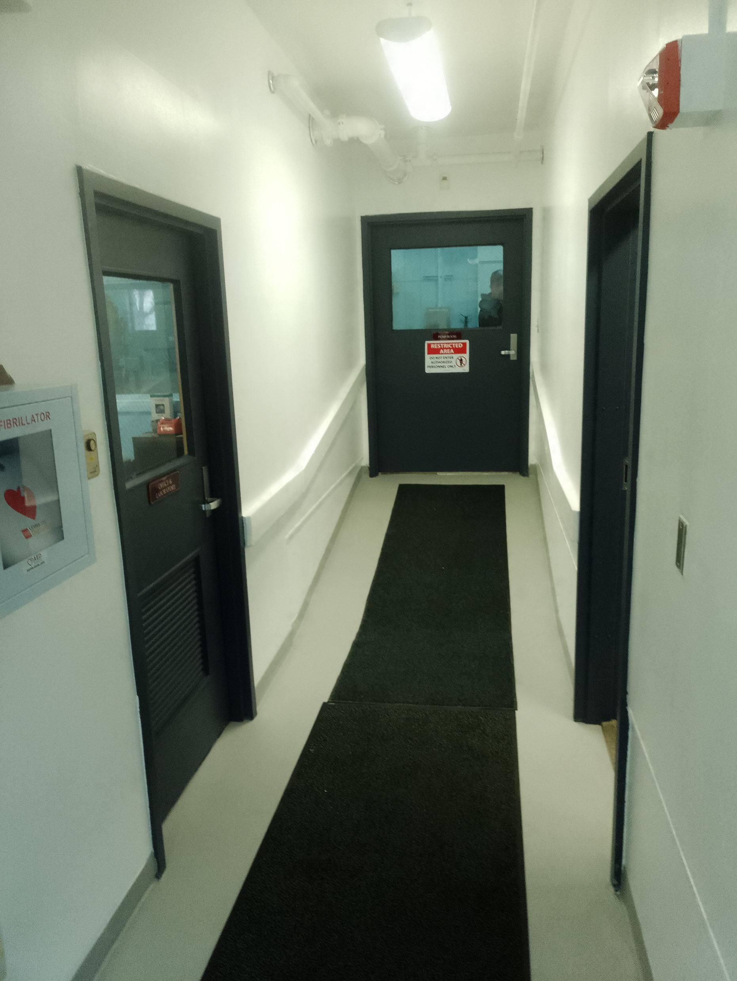
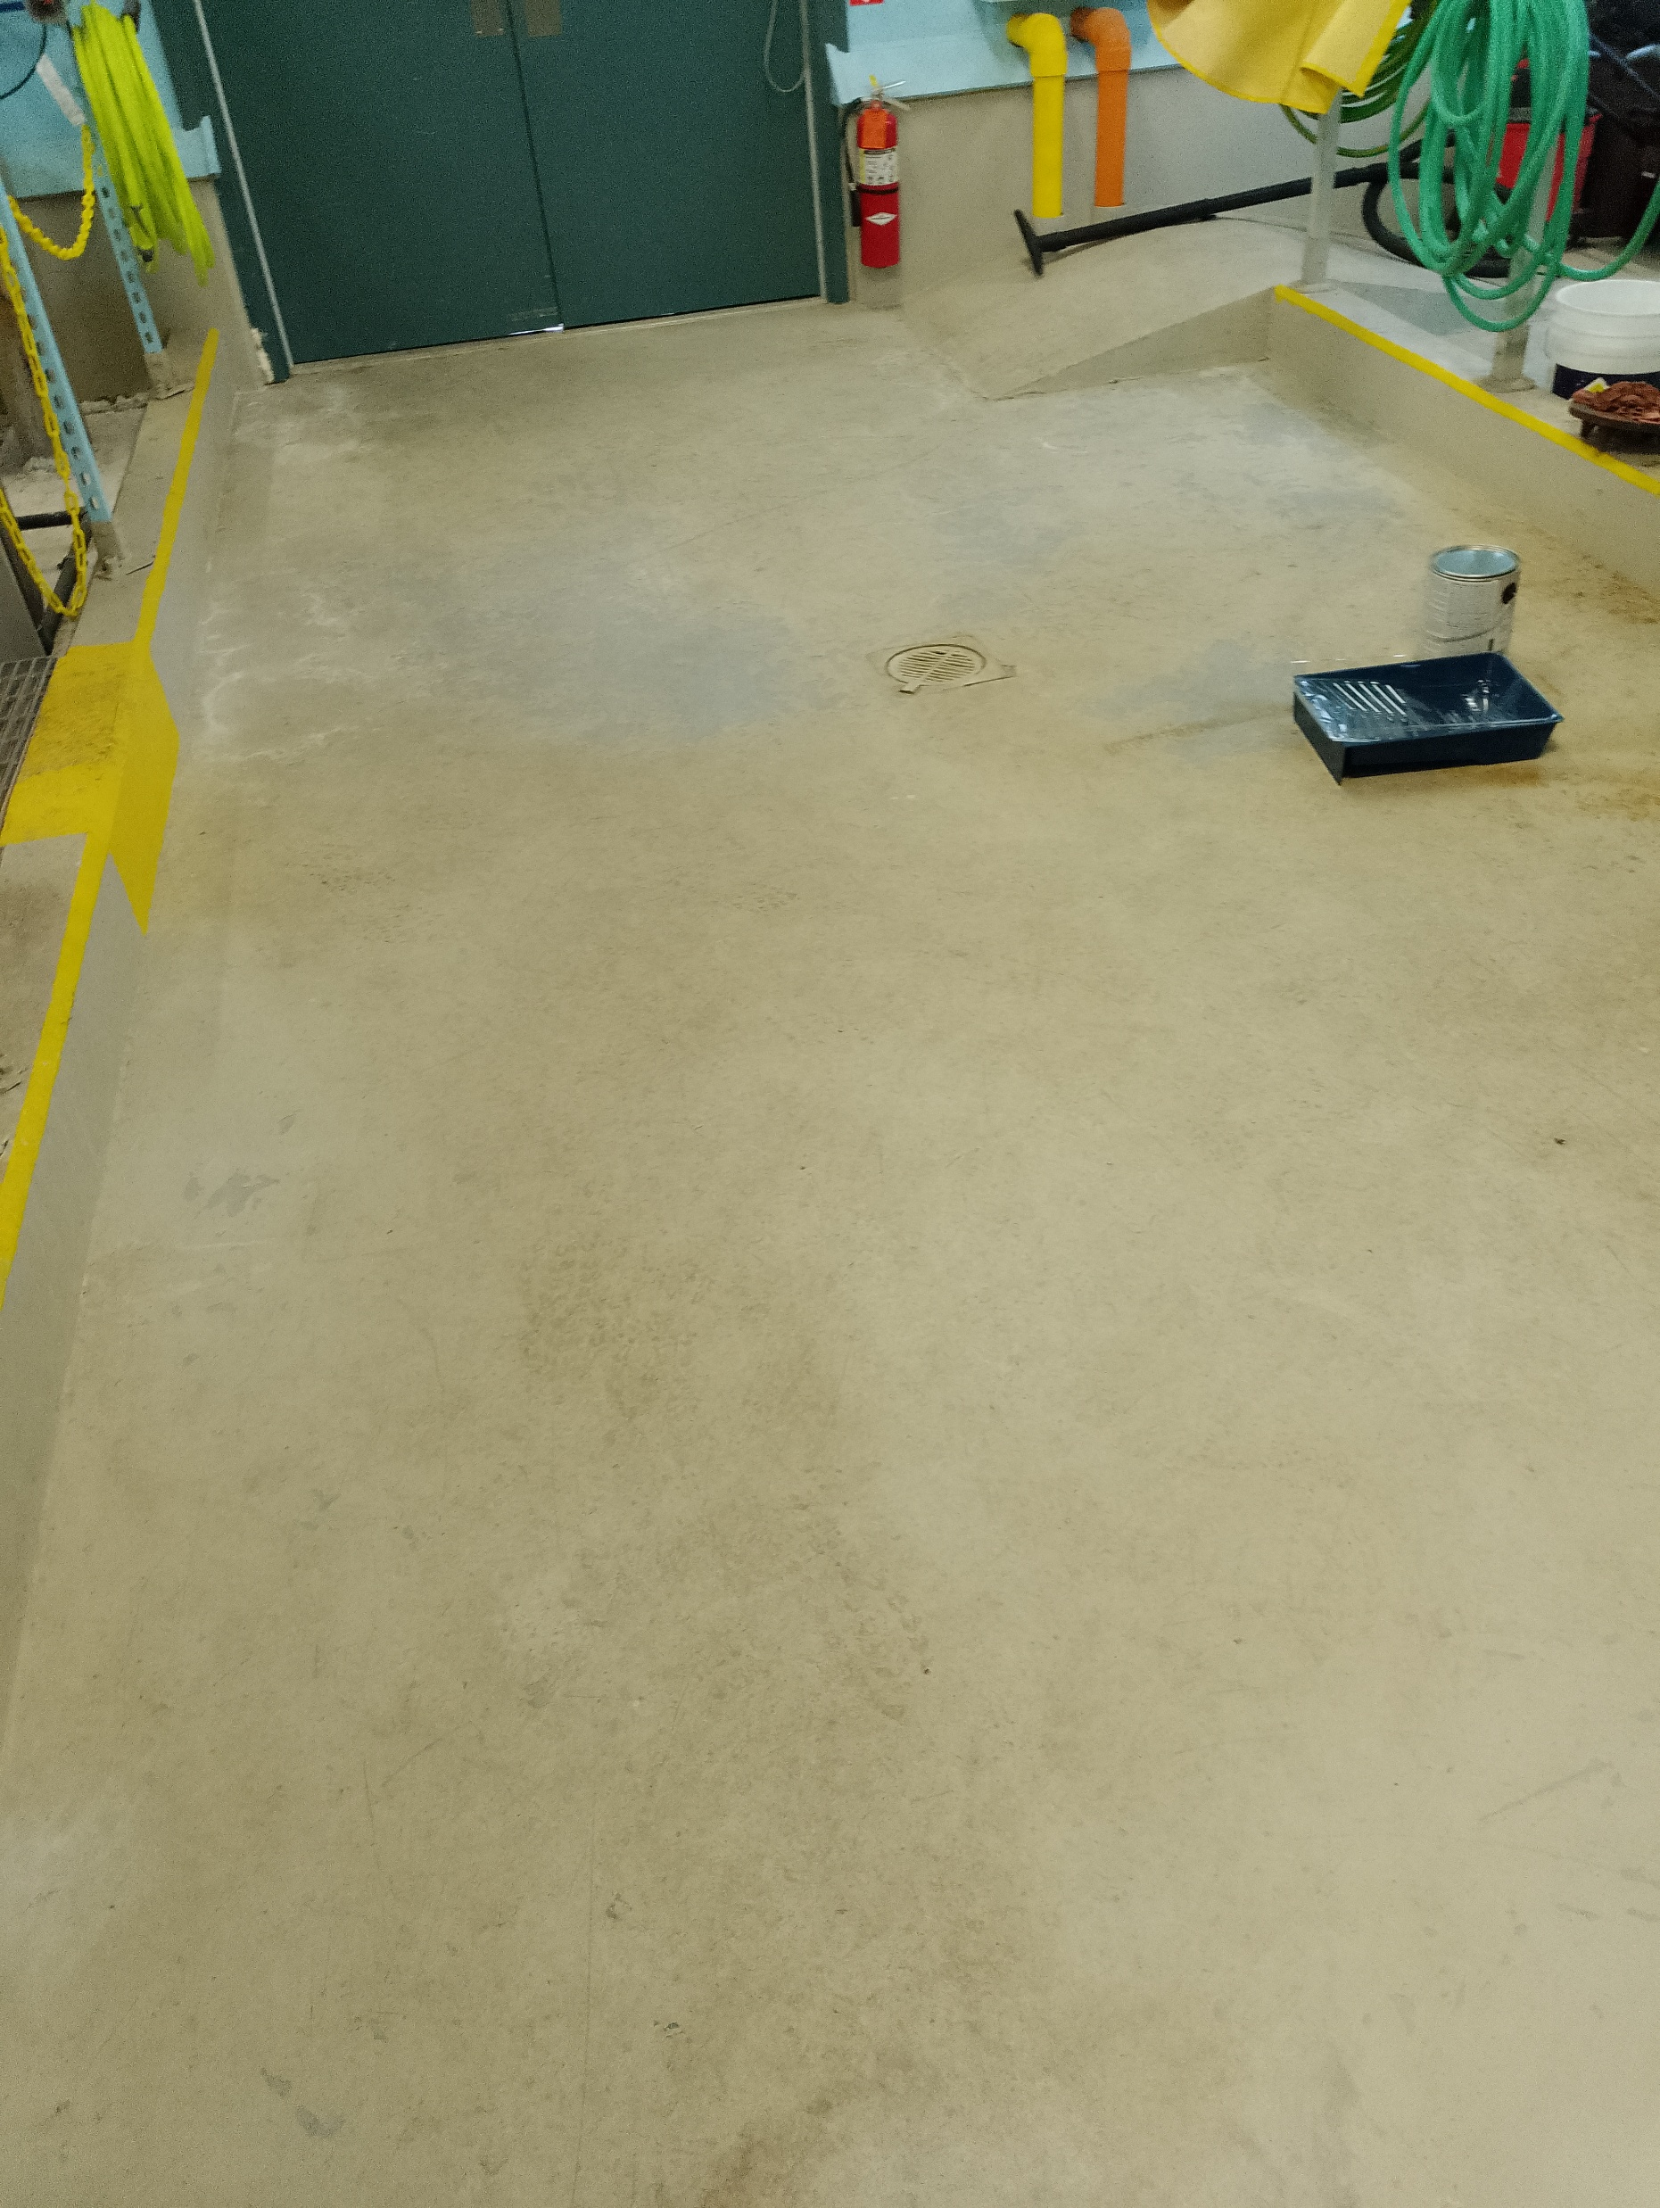
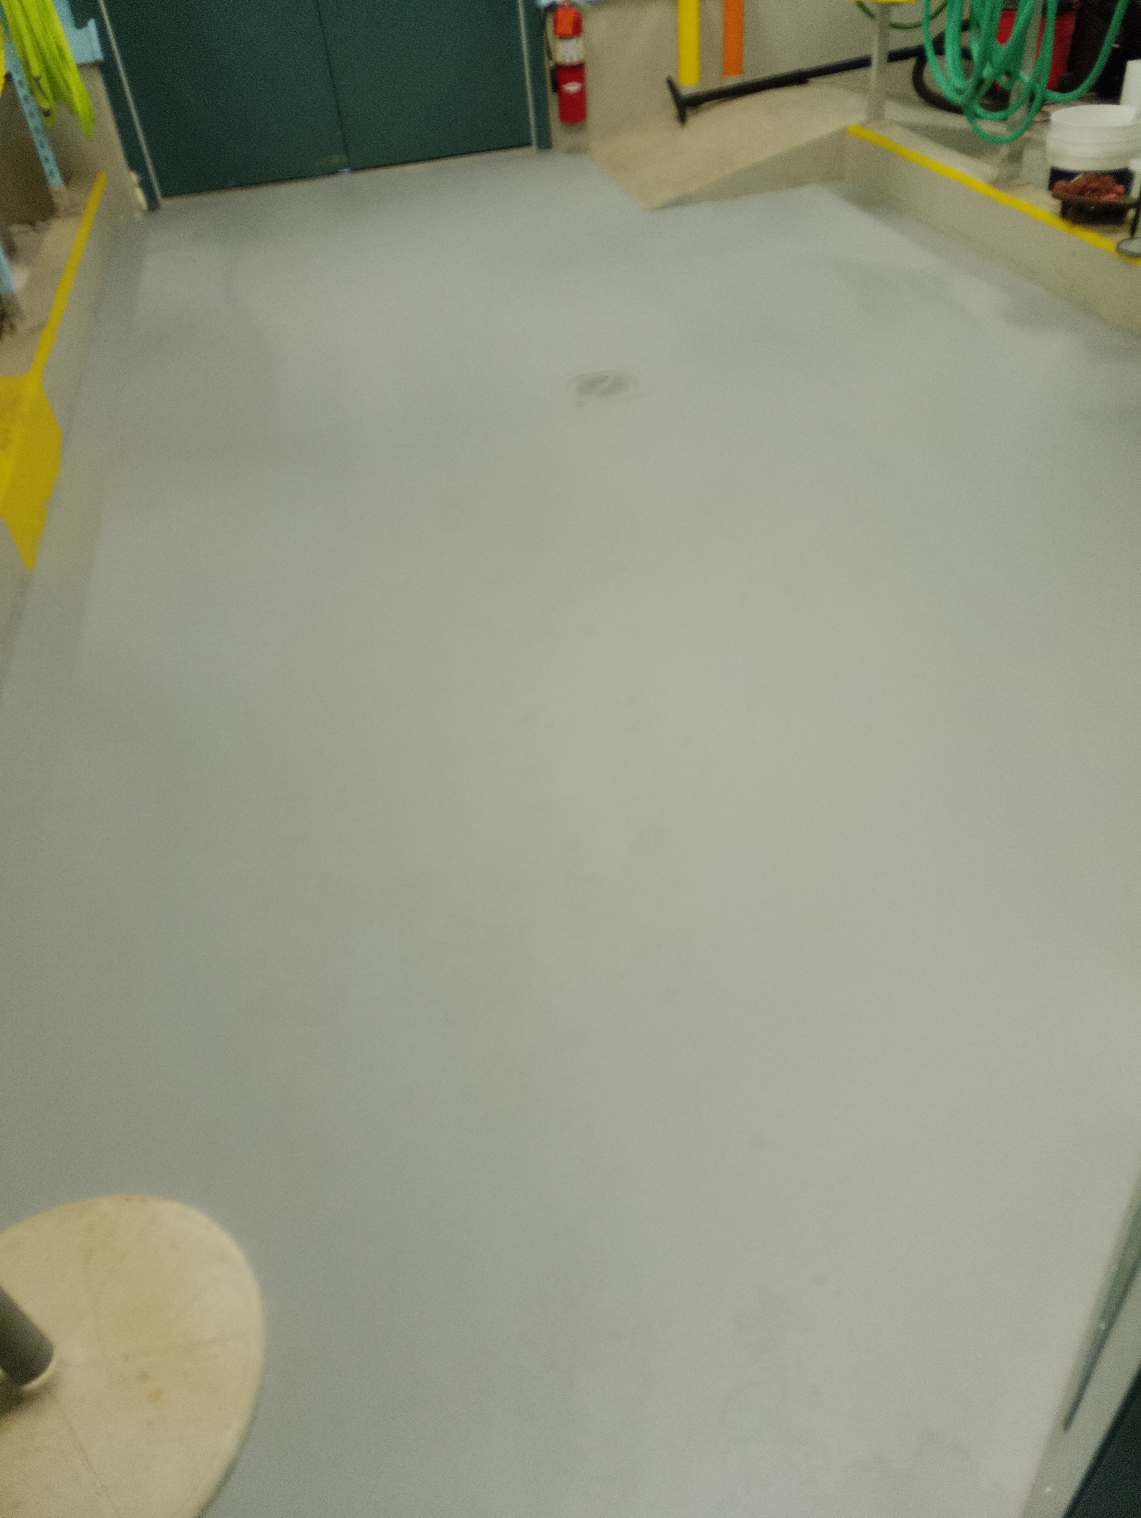
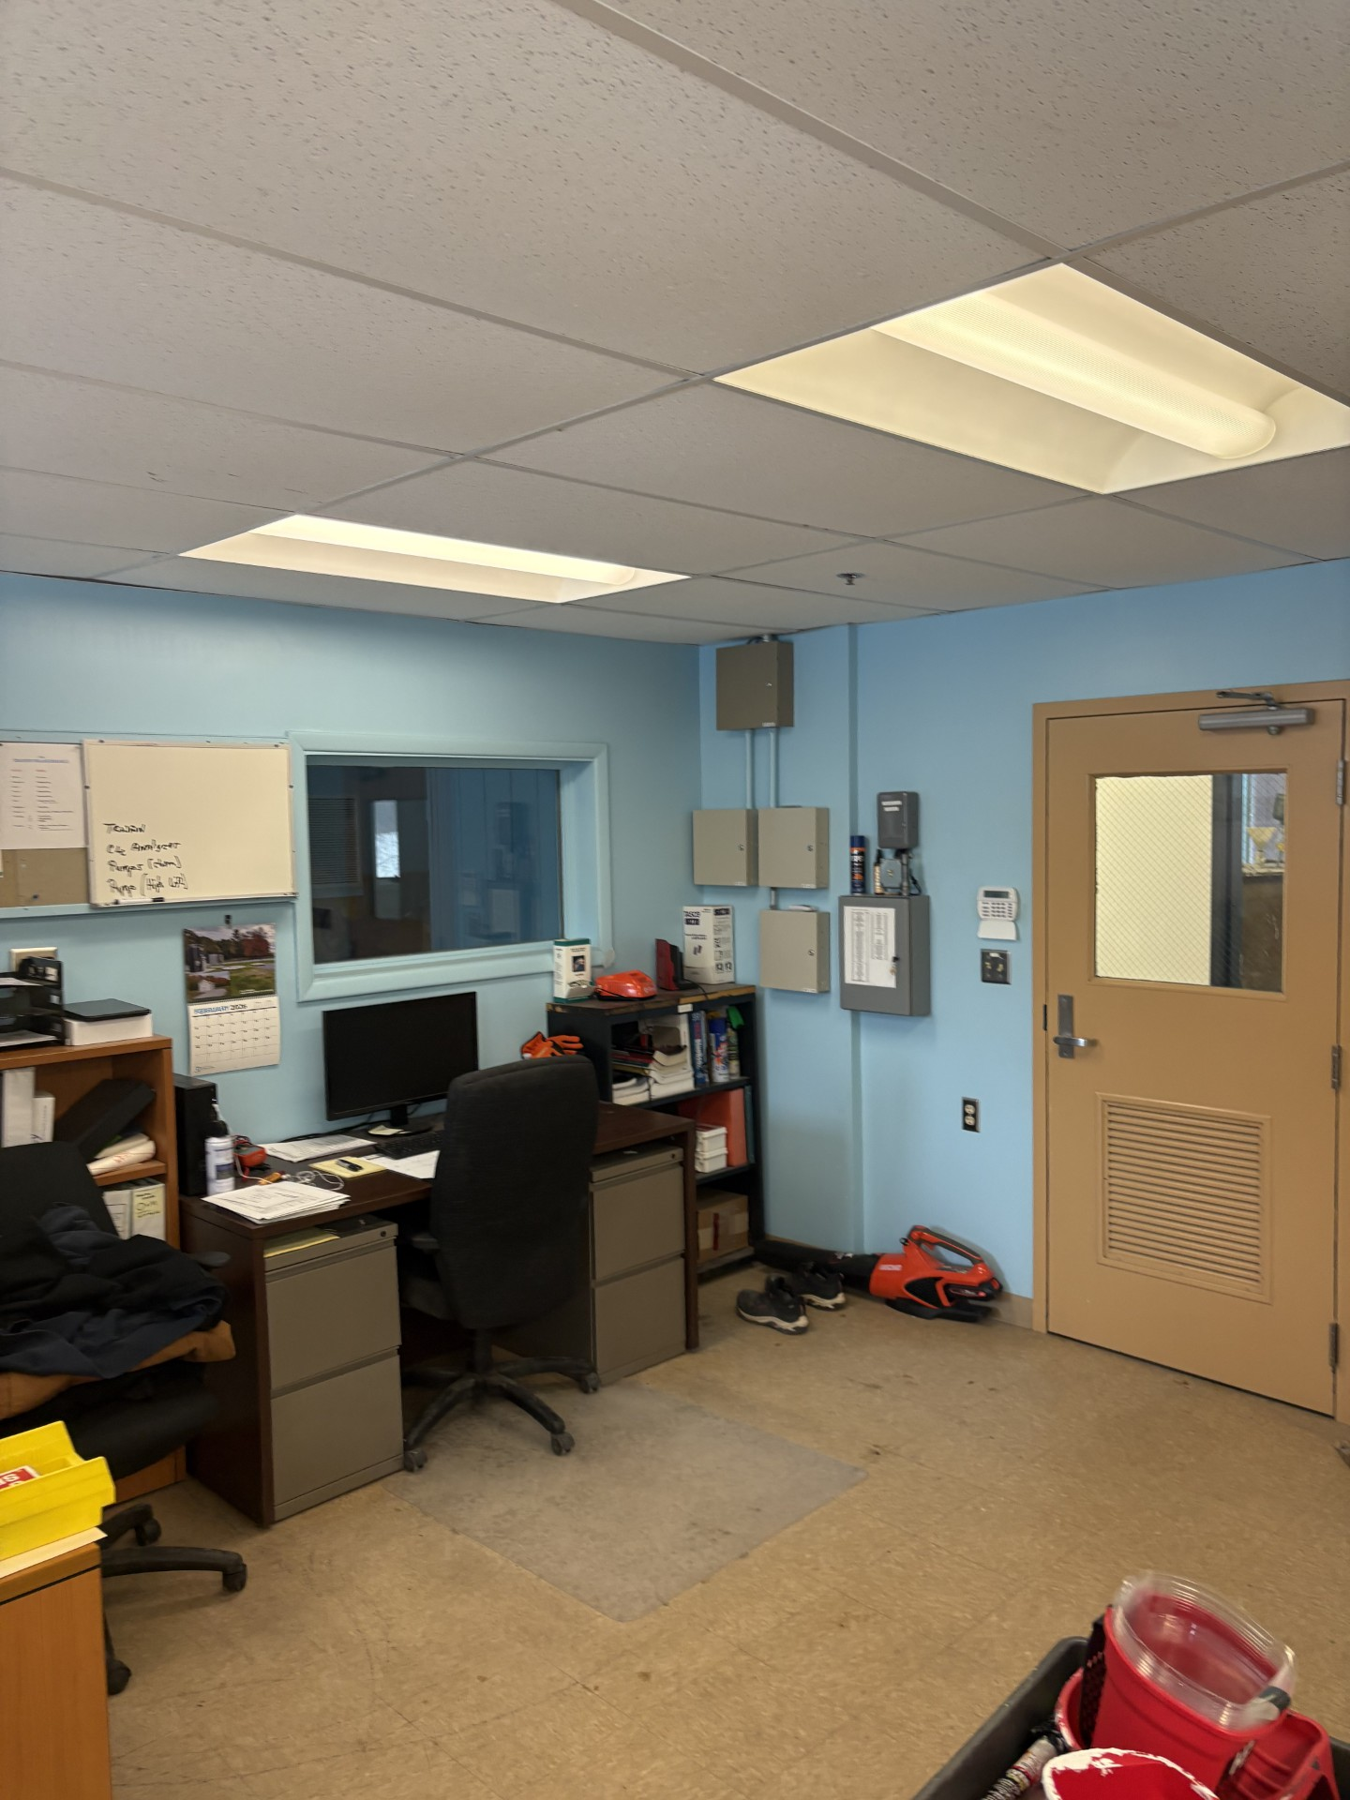
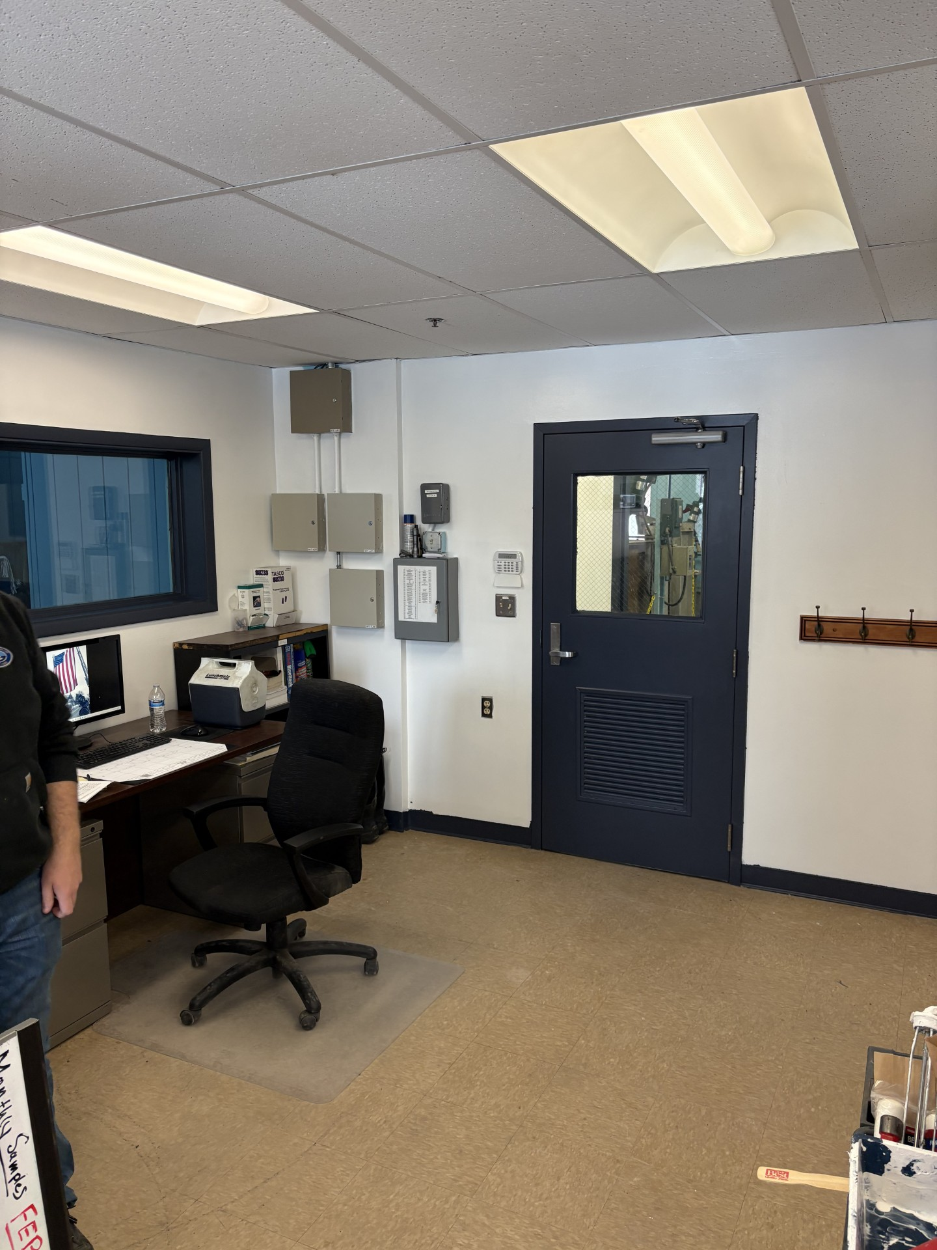
Interior Updates
Main Entrance Stairwell
Main Entrance Hallway
Chemical Room Floor
Office and Laboratory

Slide 5
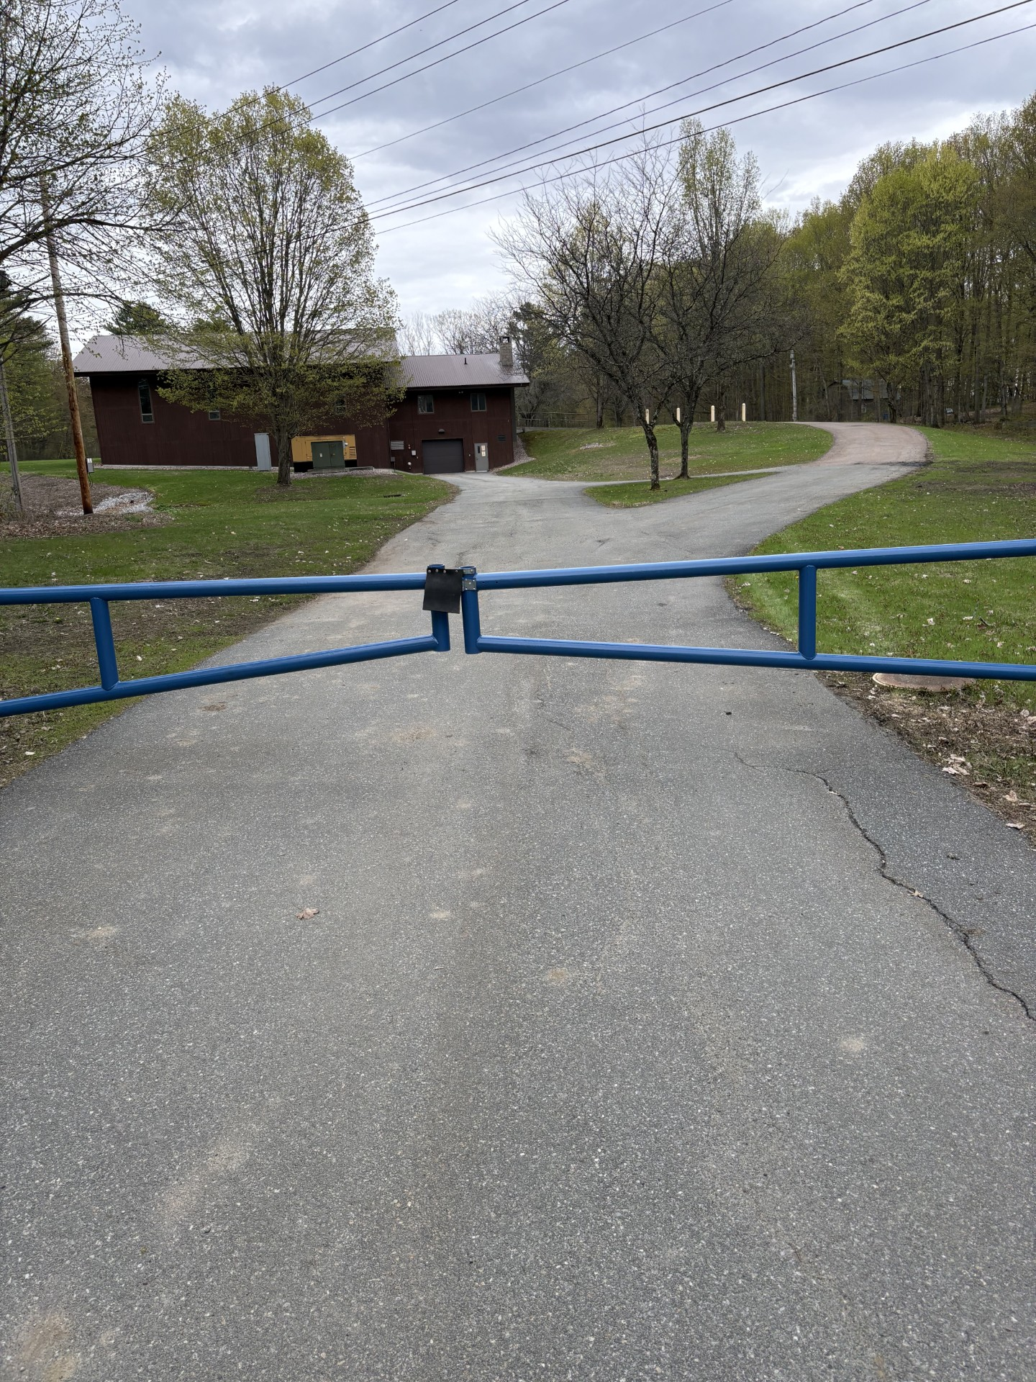
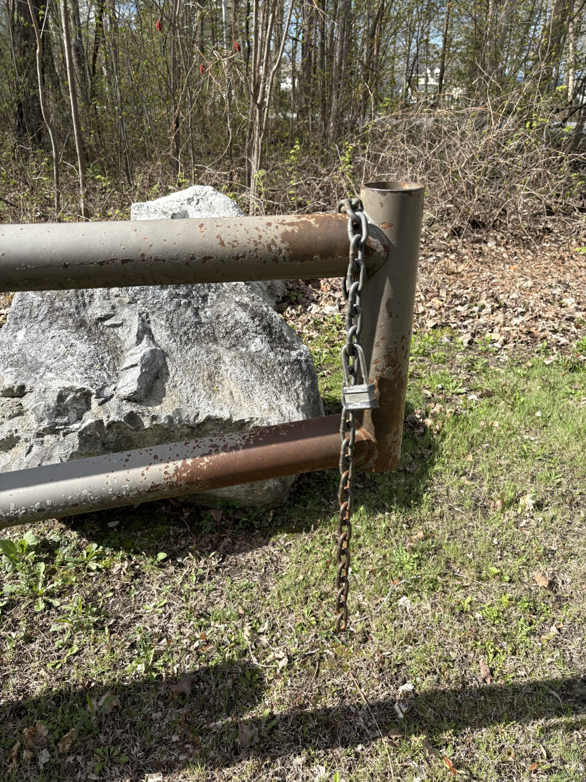
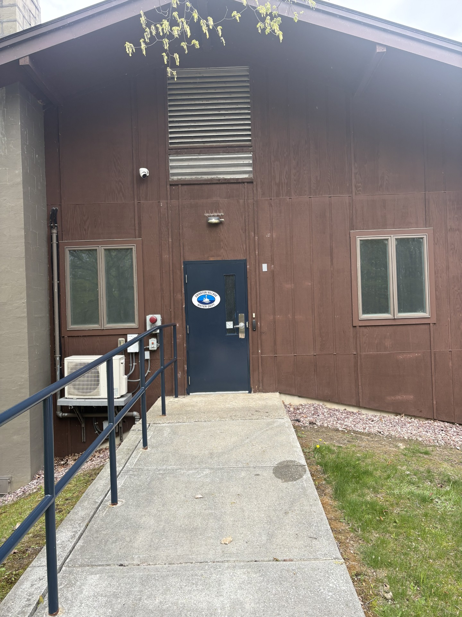
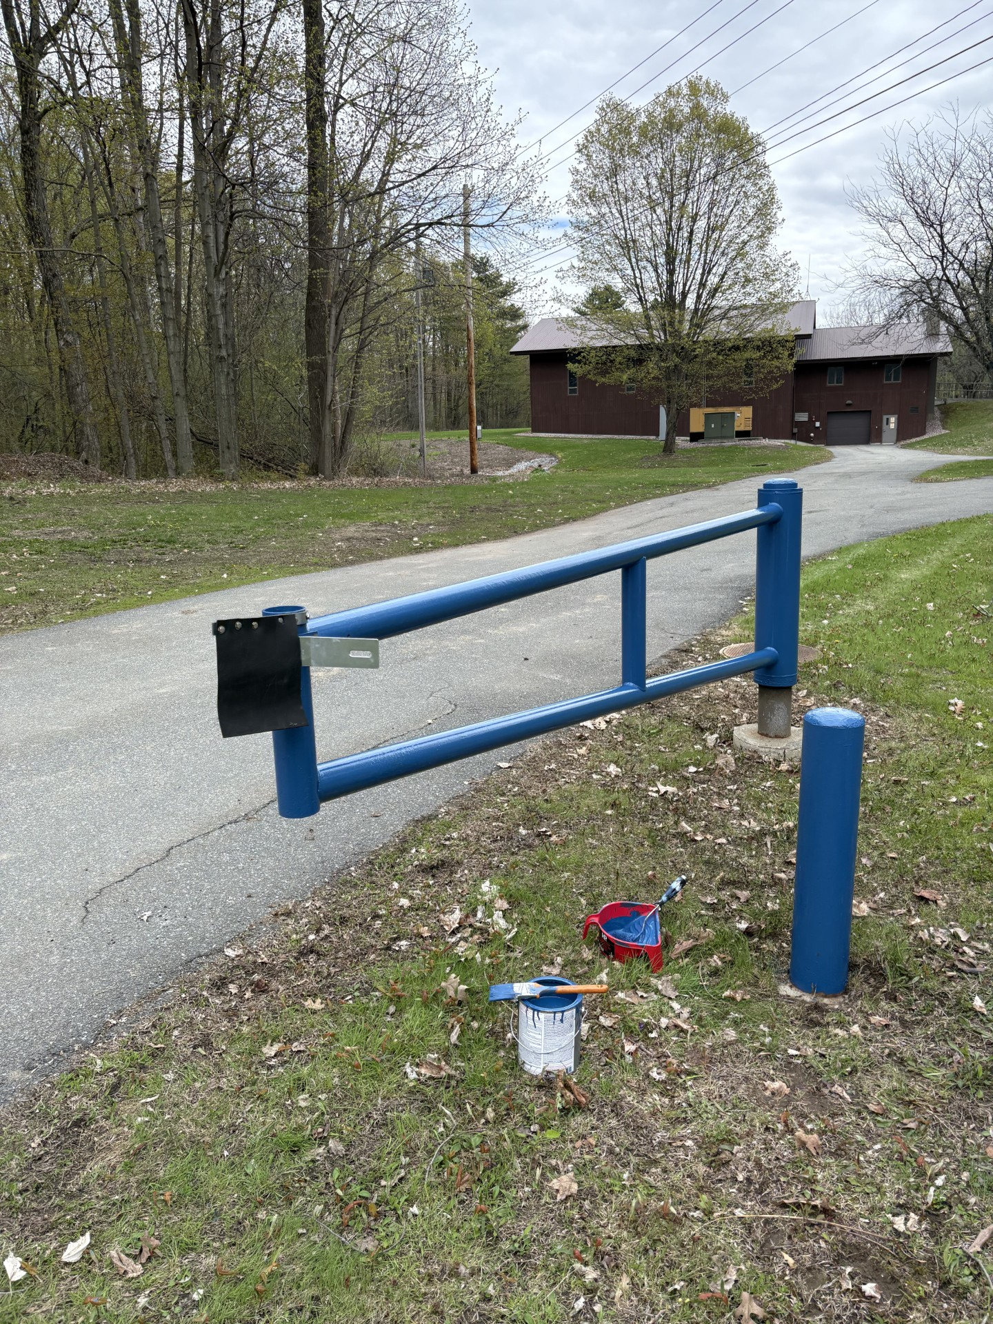
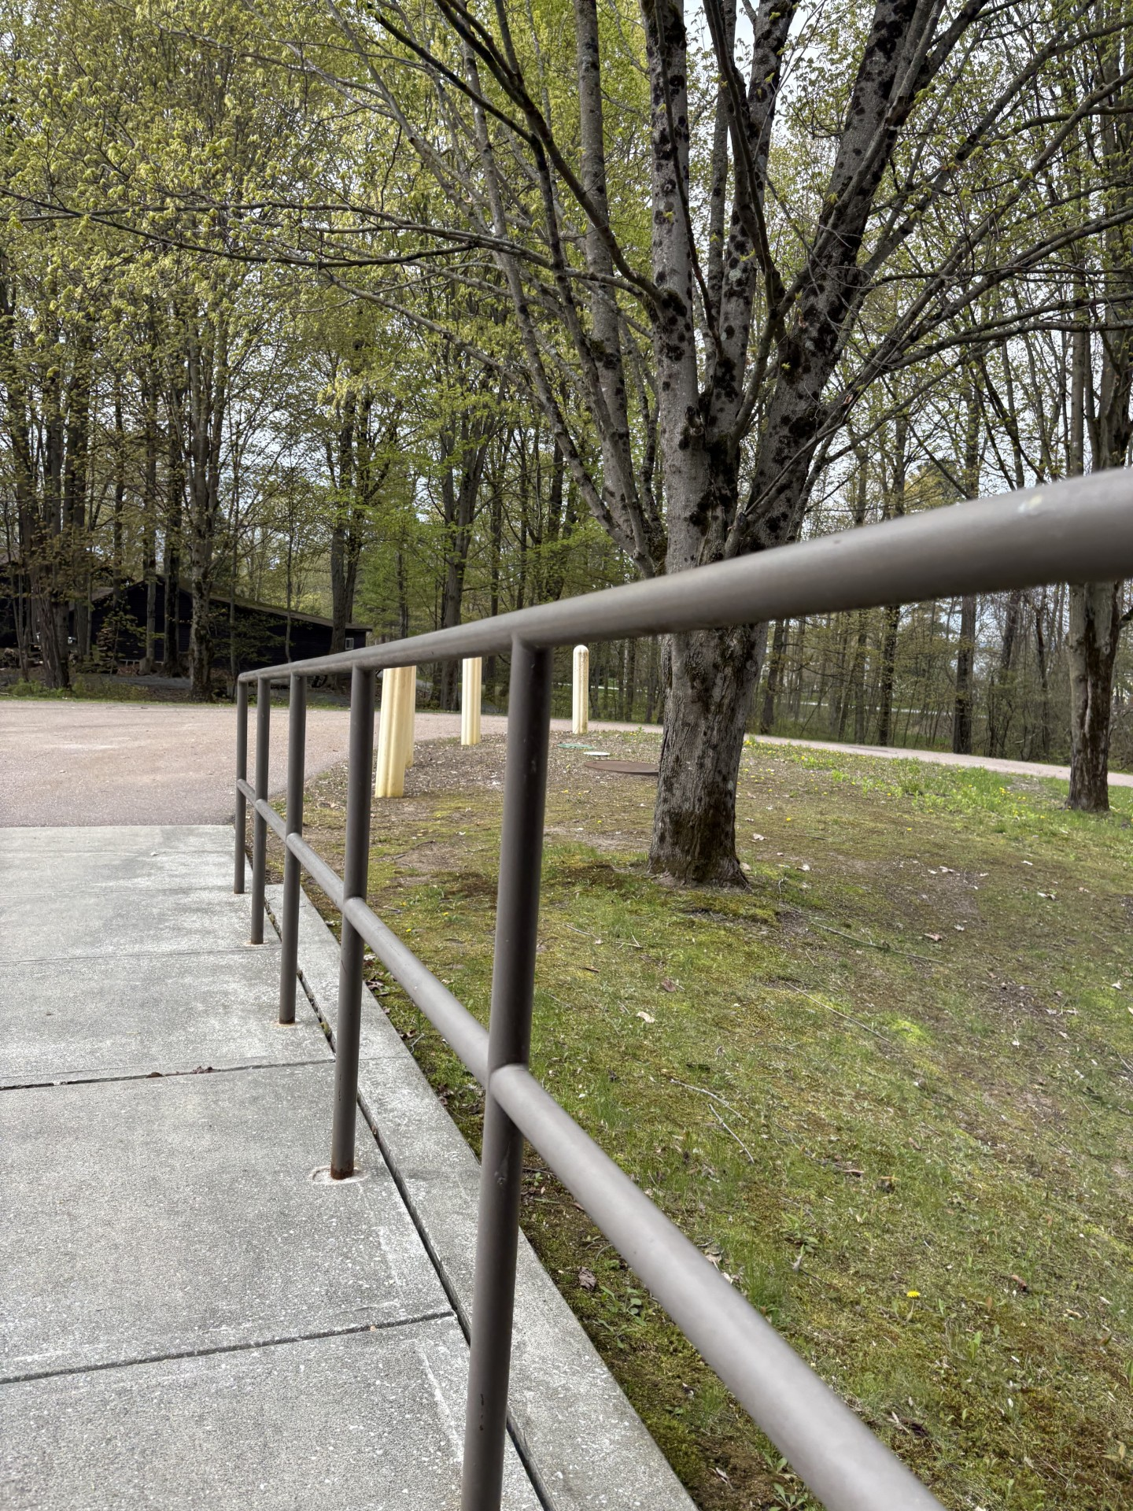
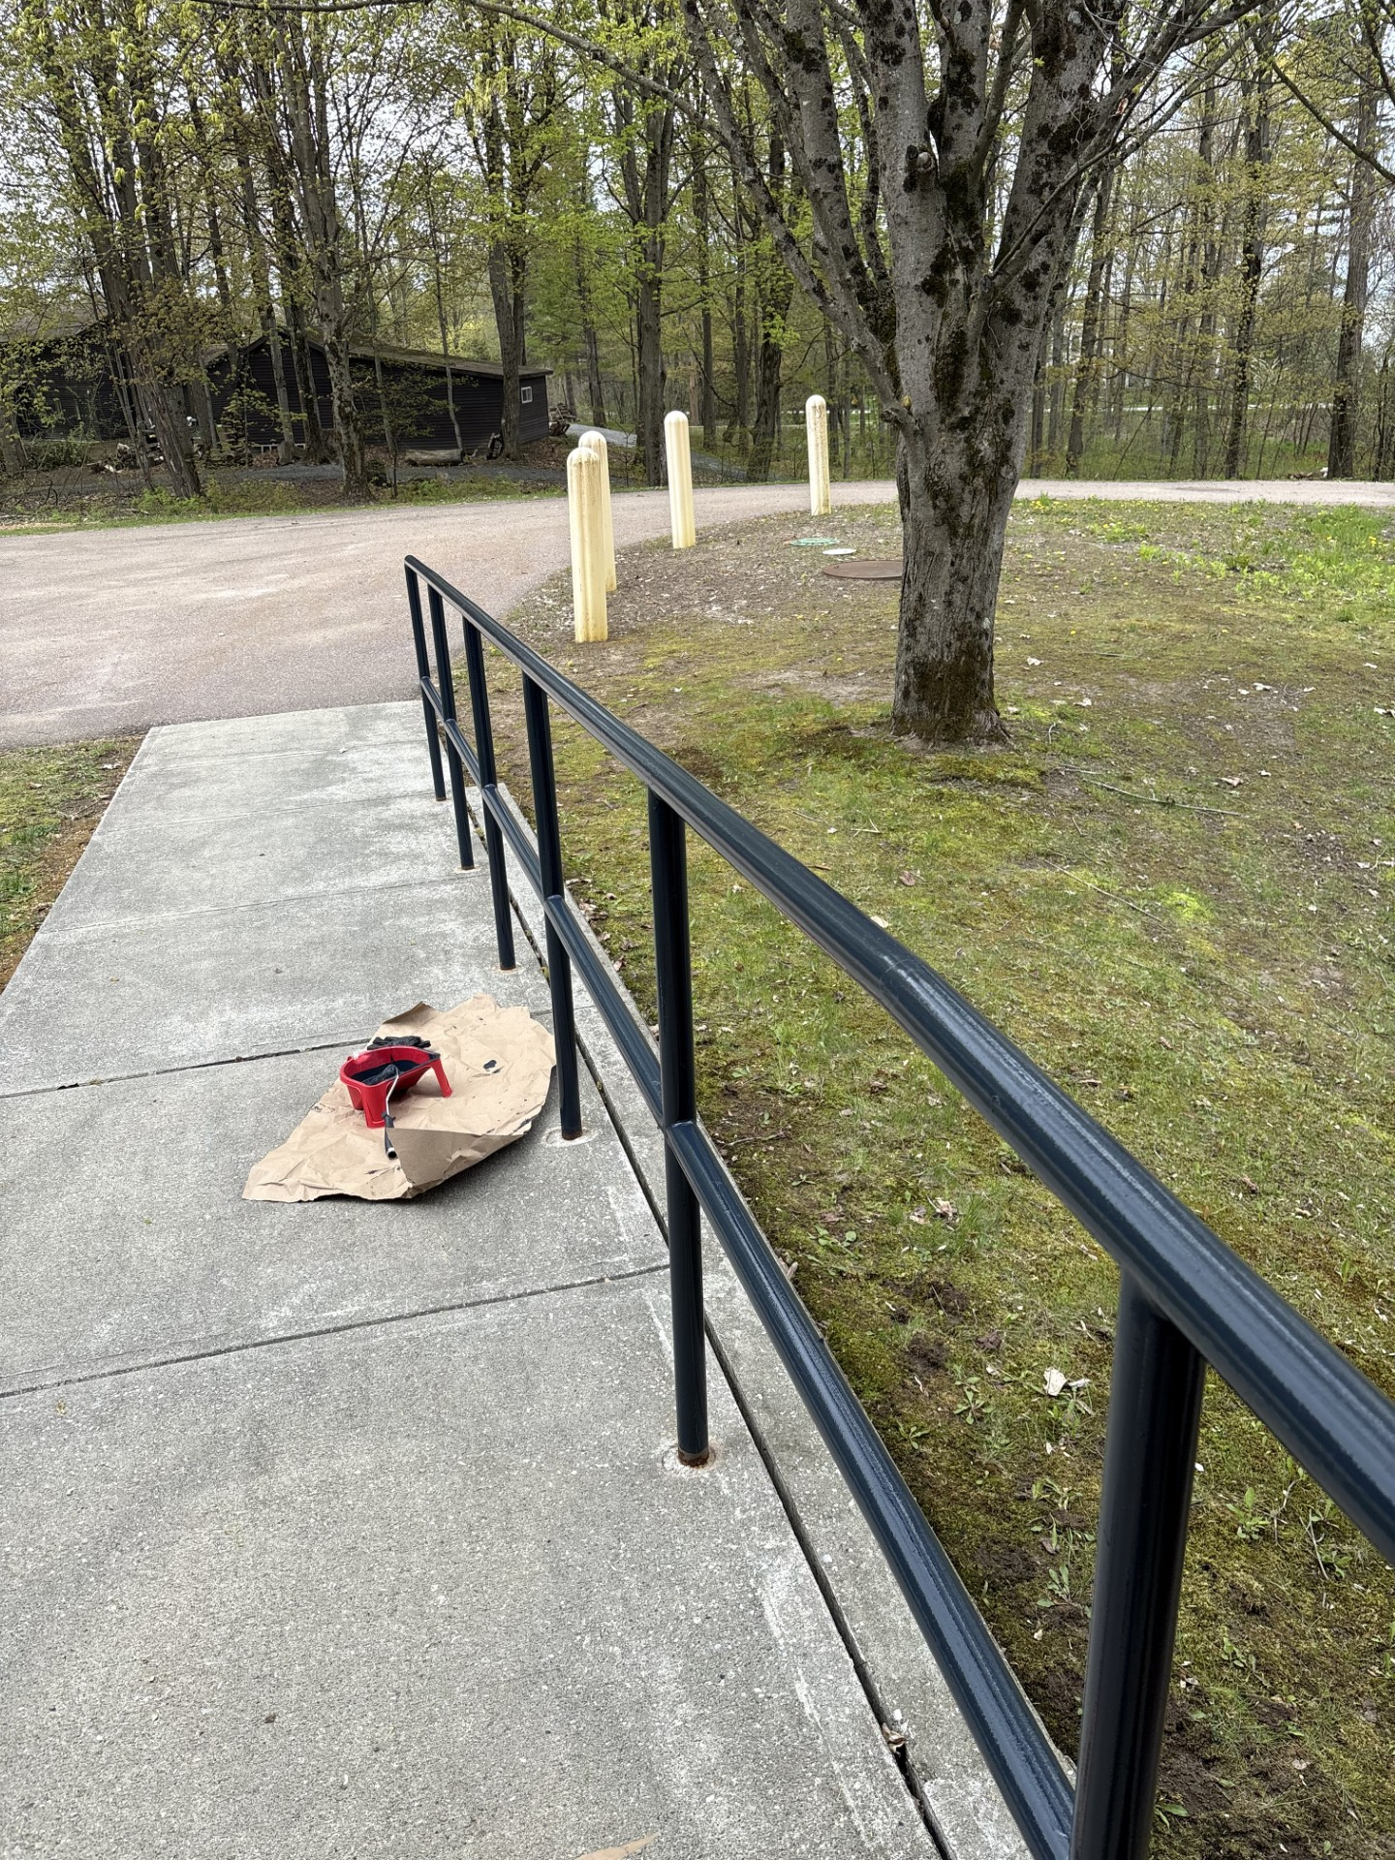
Exterior Updates

Slide 6
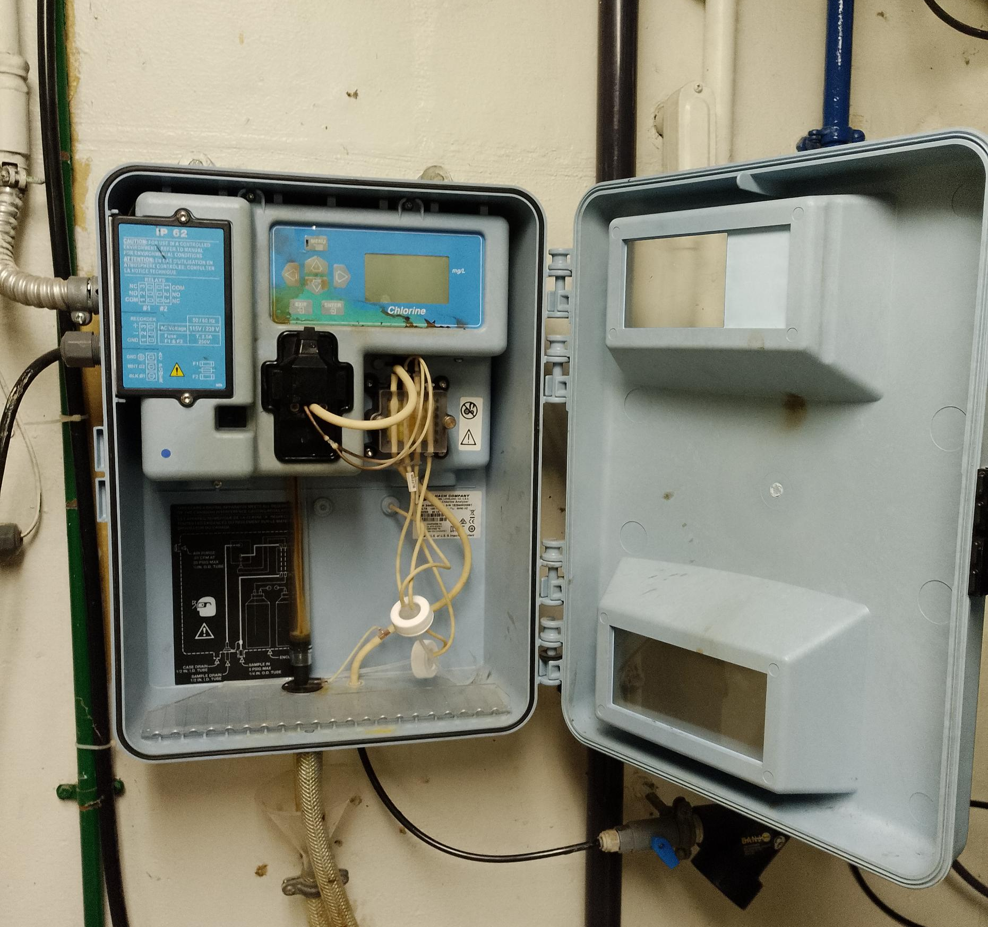
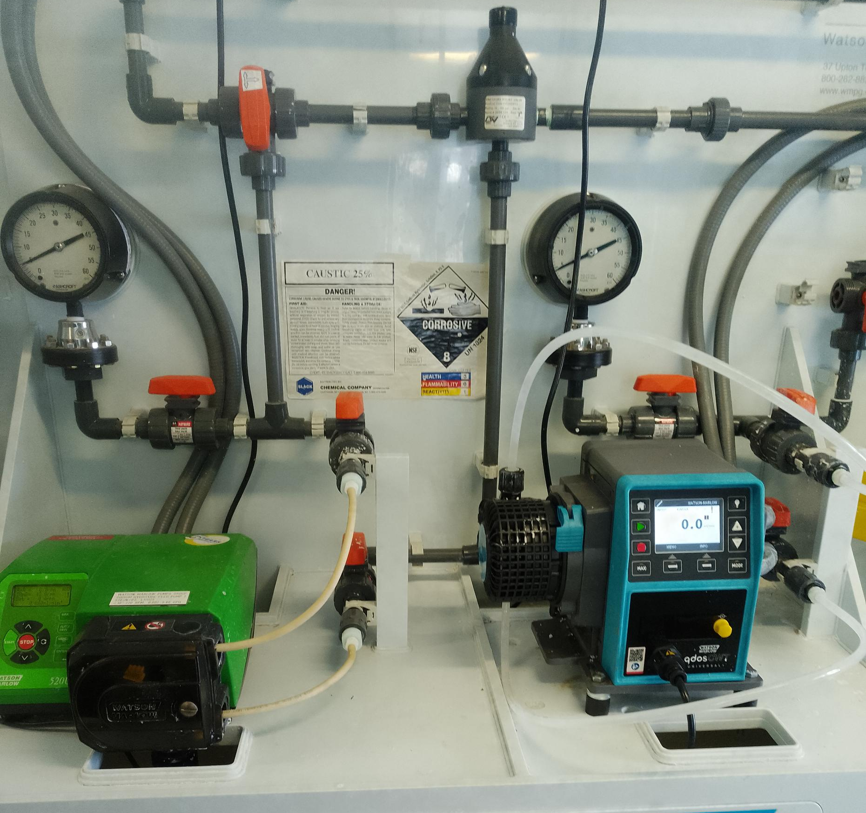
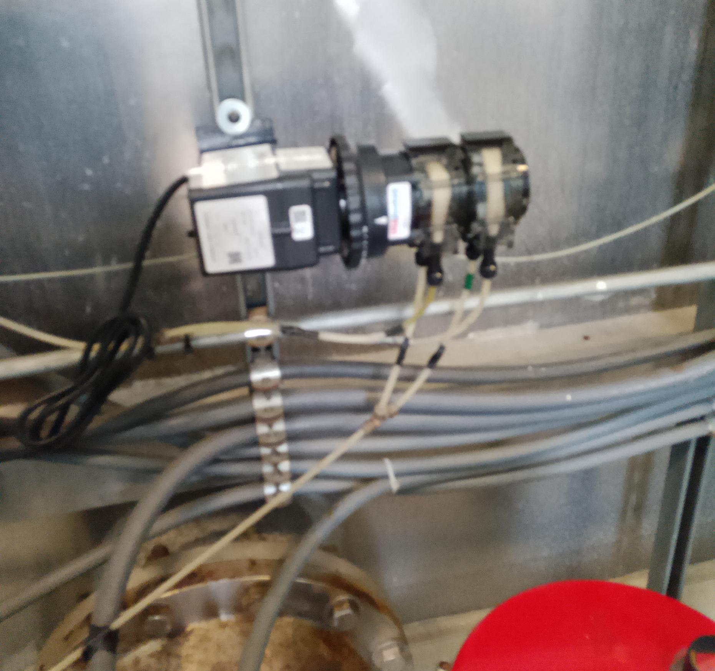
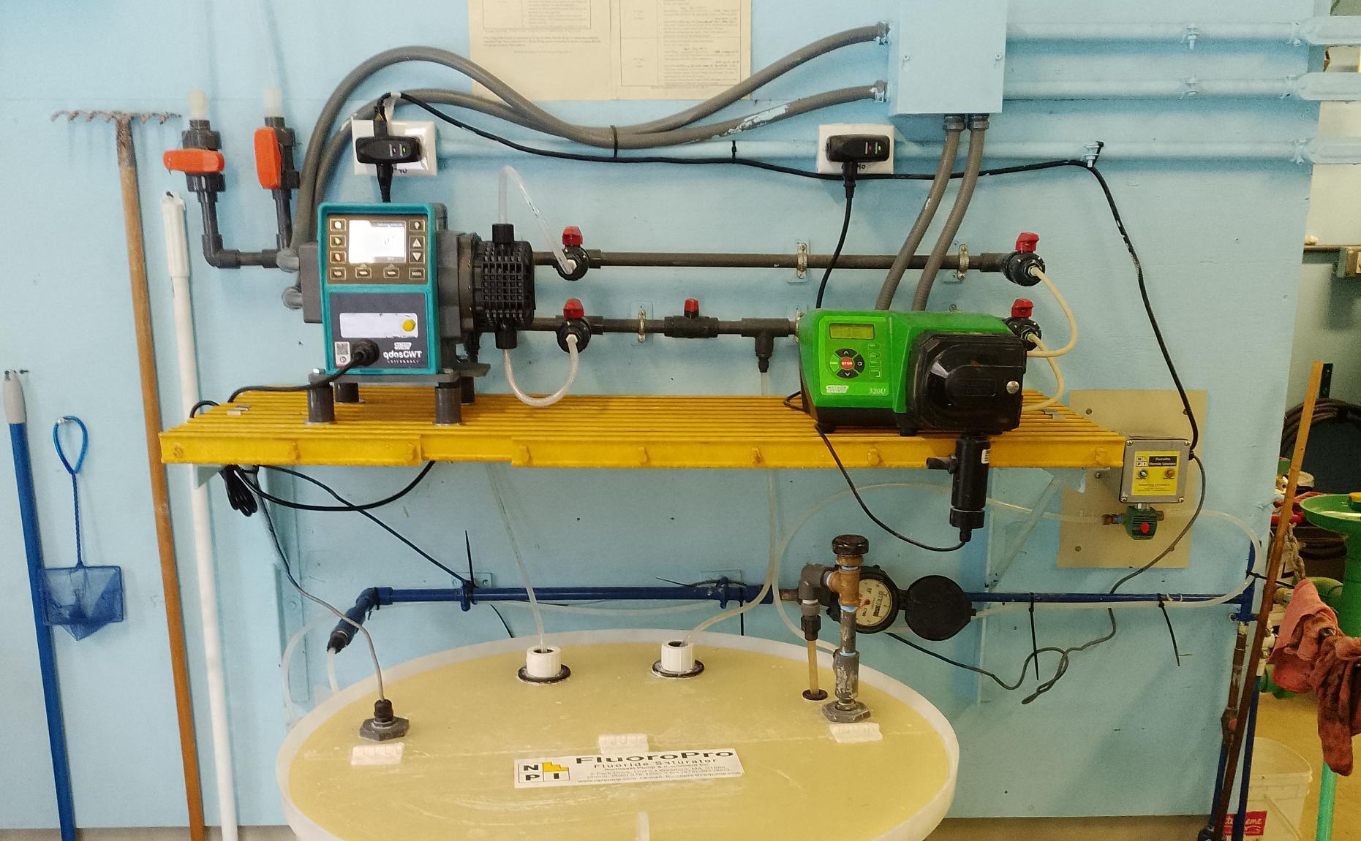
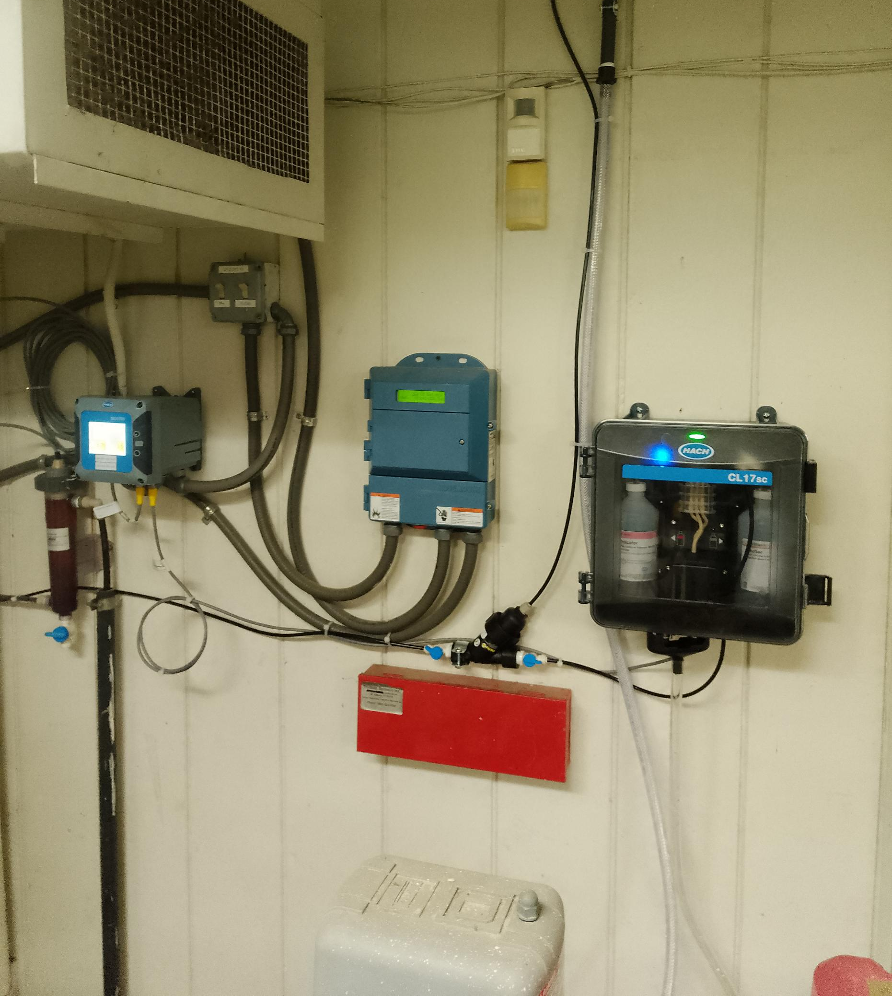
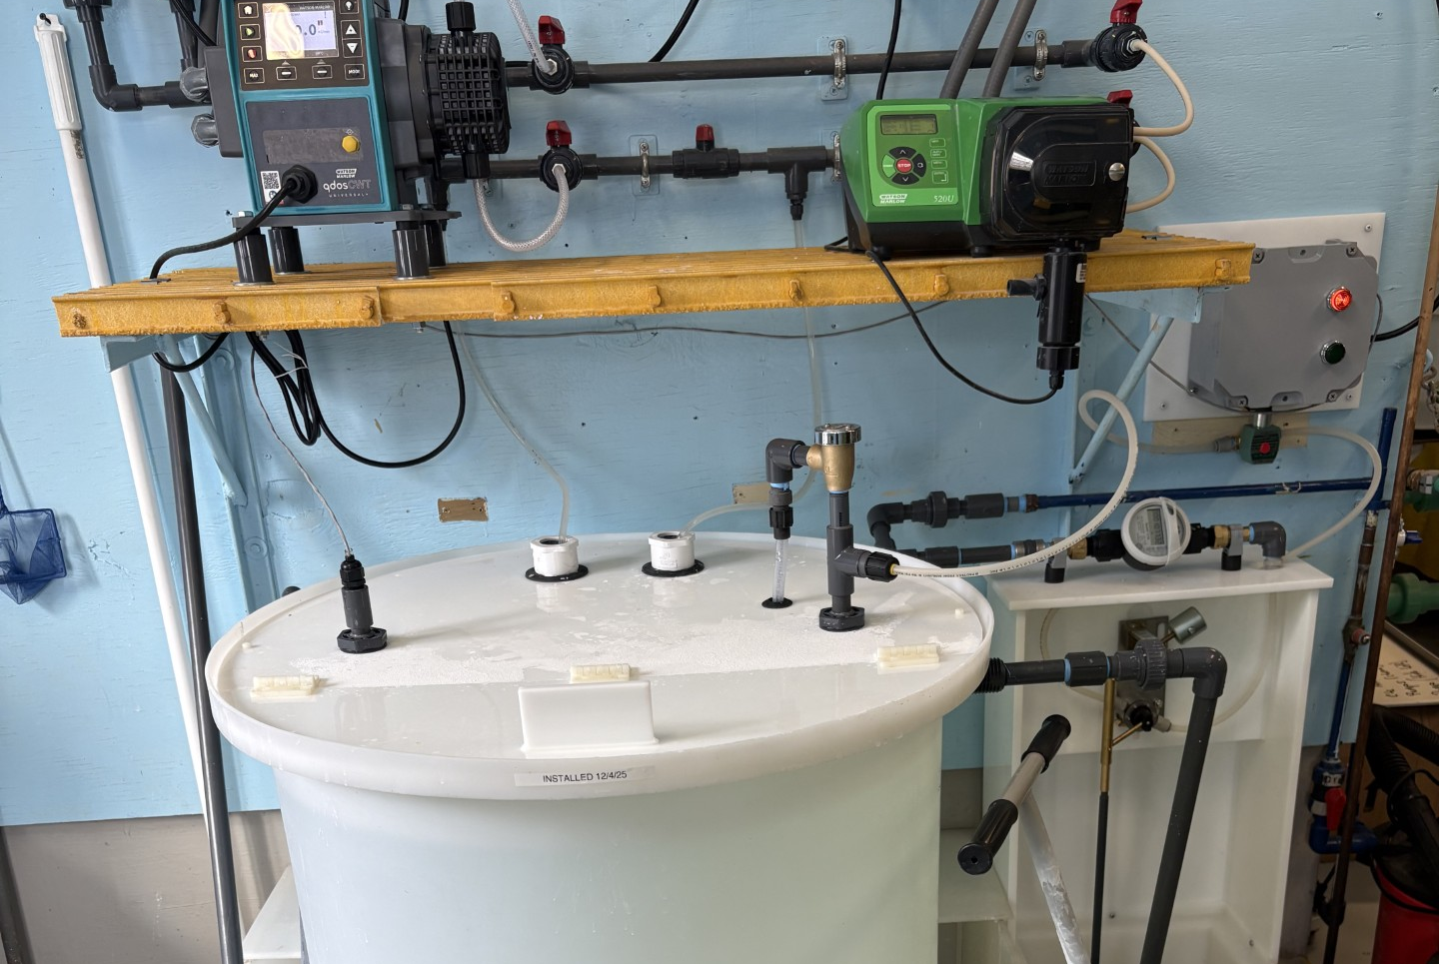
Upgrading Failing Outdated Equipment
The Water Treatment Team has integrated 6 of the 12 newly purchased Watson-Marlow pumps, which are now plumbed and online. Currently, 3 of the 6 pumps are operating as intended with the SCADA system. The remaining 3 pumps are undergoing diagnostics and may require repair or replacement
The Water Treatment Team replaced the old fluoride saturation tank with a new unit provided at no cost through the State of Vermont Fluoride Program, resulting in no expense to the Village.
The Water Treatment Team replaced the chlorine analyzer because the existing unit was outdated and replacement parts were no longer available. A new controller was installed for the chlorine analyzer and pH meter to improve system reliability and performance.
The Water Treatment Team replaced the Stenner Pump on filter two as the old one failed. This is a crucial piece of equipment for our turbidity.

Slide 7

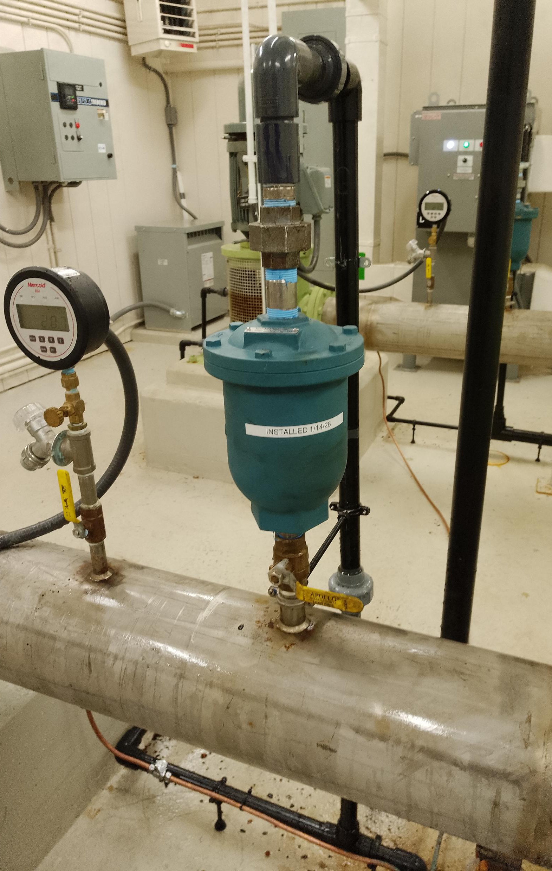
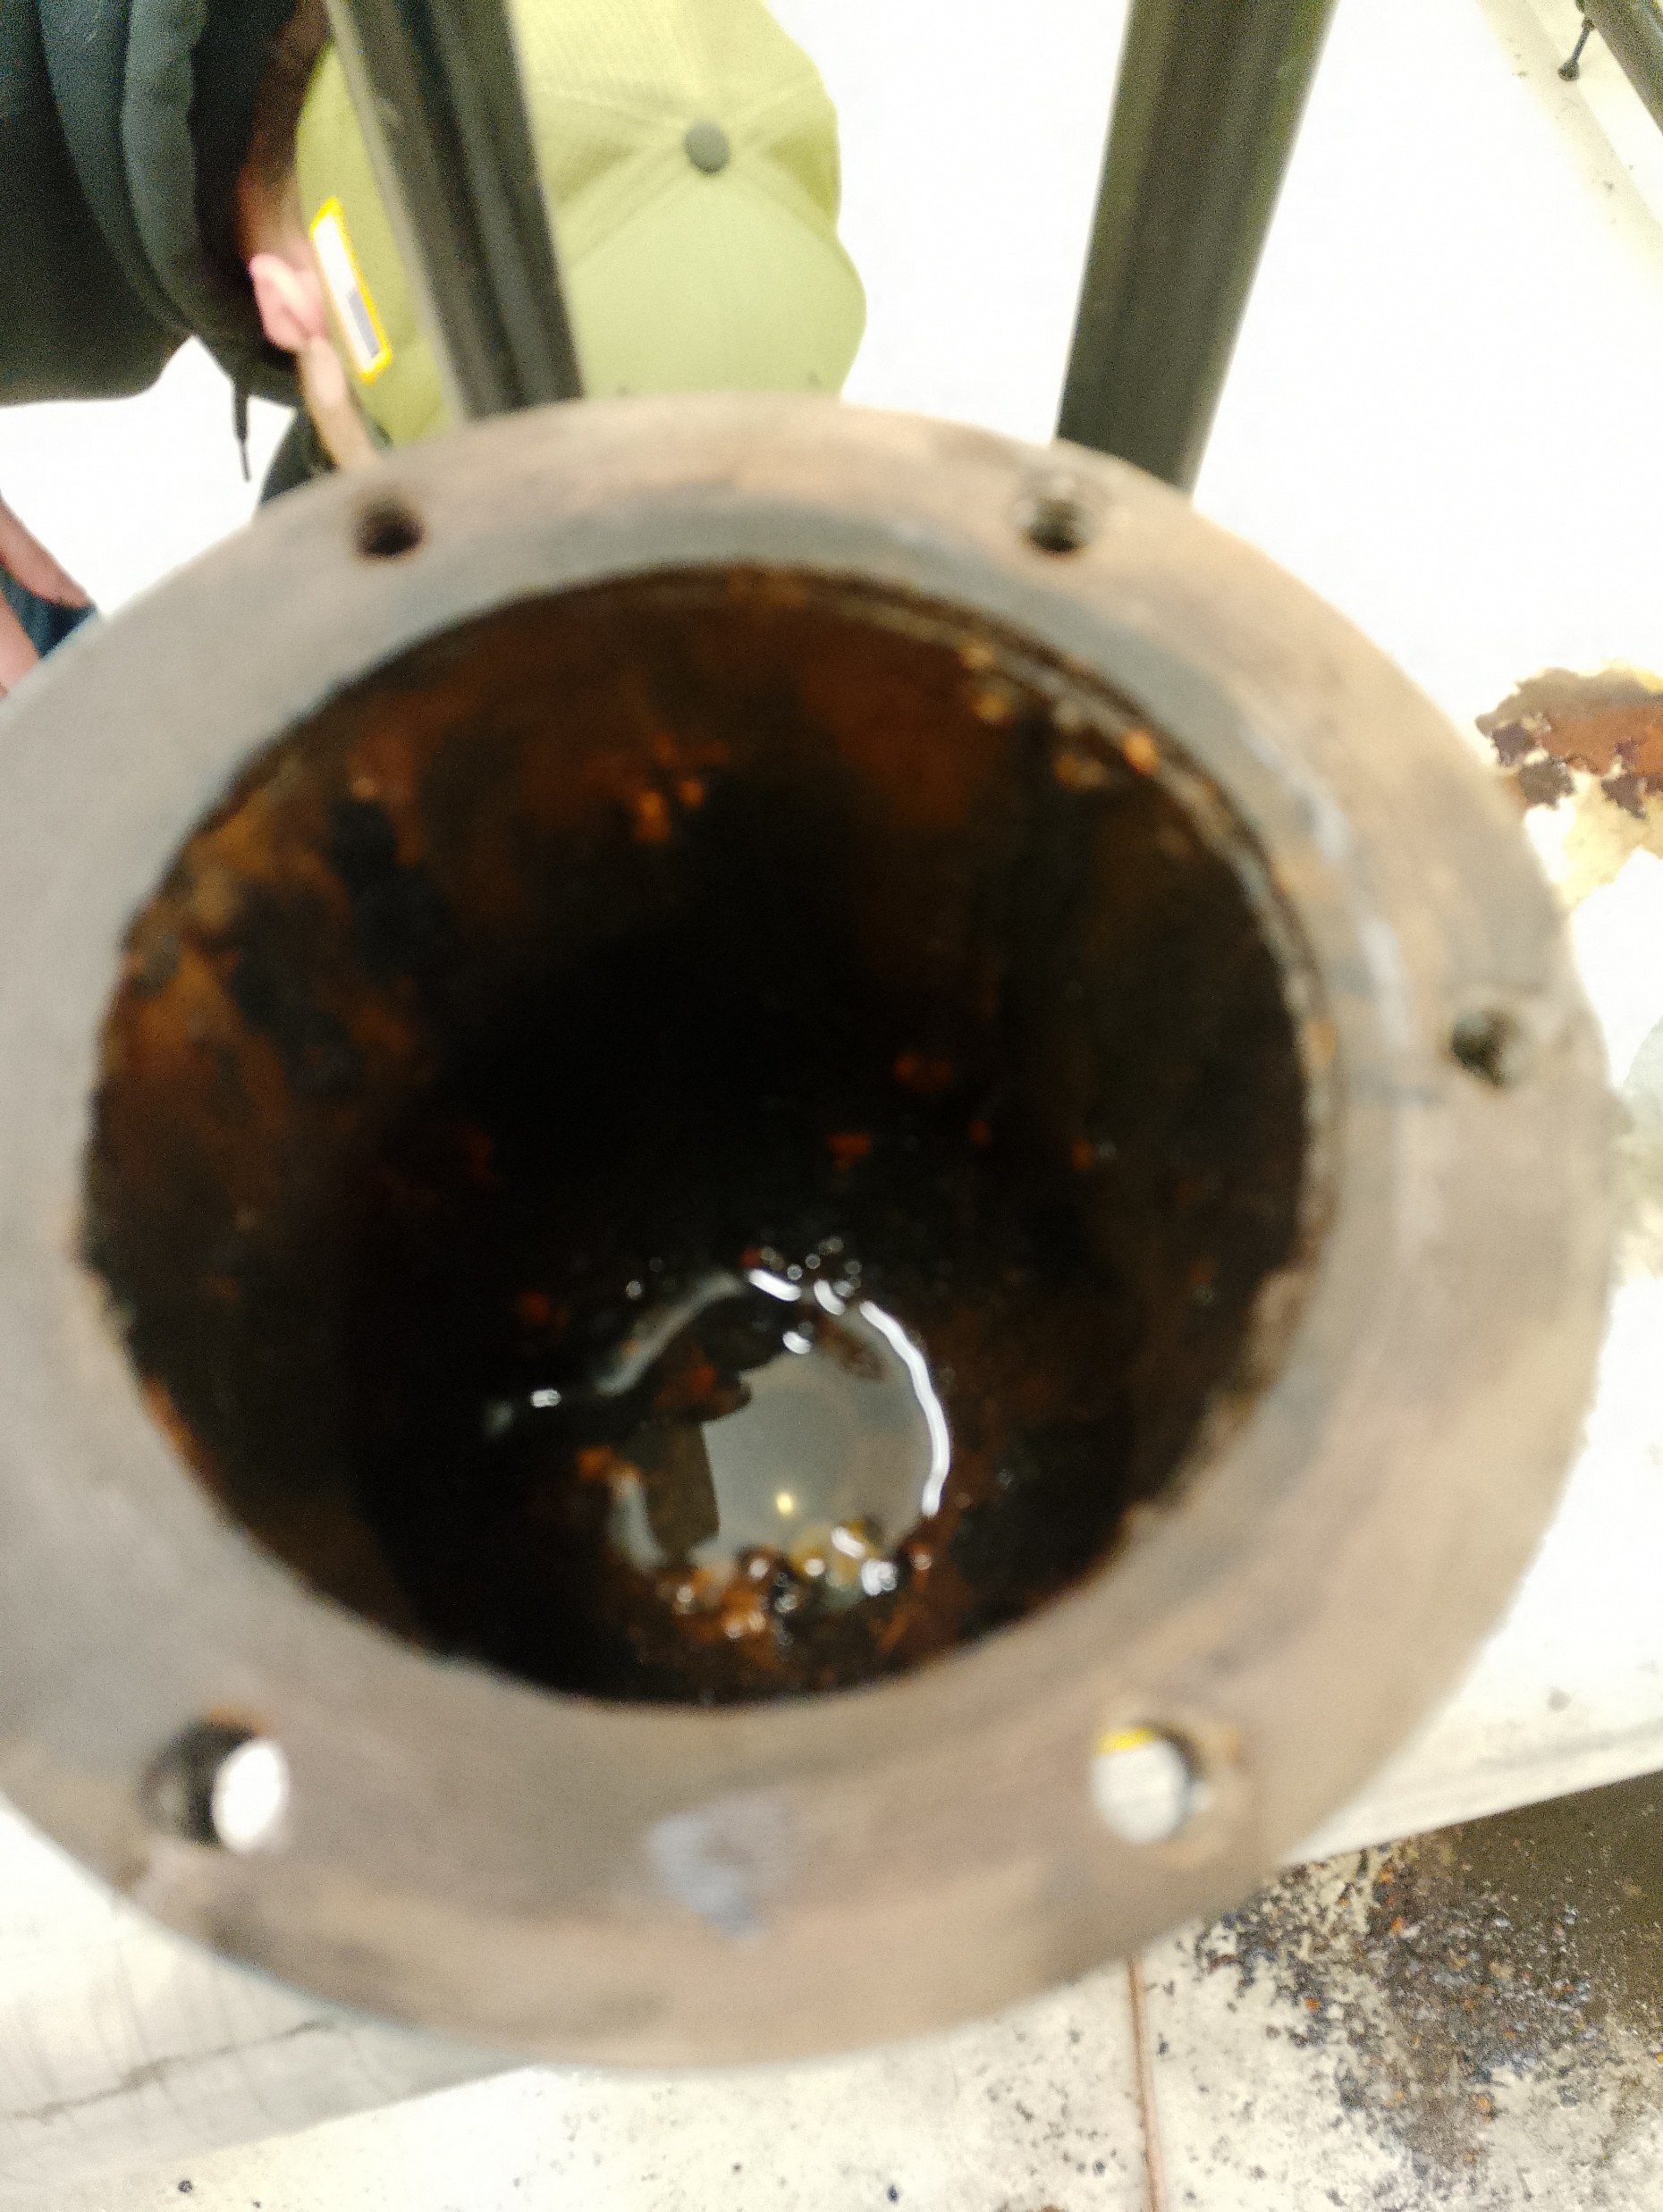
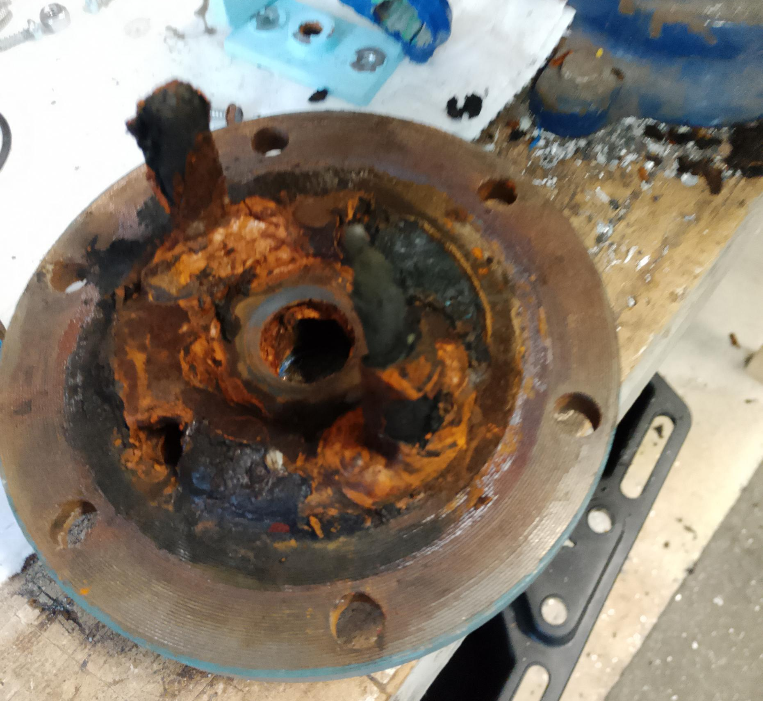
Repairing and Replacing Failing Infrastructure
The Water Treatment Team identified a failed vacuum relief valve in the low lift station. An emergency purchase was made, and repair was made the next day.
The remaining two different sized valves were ordered immediately and are onsite and are ready for install when the existing ones fail.

Slide 8
The Water Treatment Team drained the clarifier portion of the filter. After draining, we unbolted 16 bolts securing five screen grates in place. We then floated all of the beads over to the filter portion of the unit. Once that was complete, we removed all of the air diffusers, exposing the bottom of the tank.
We removed the accumulated 7-8” sludge from the bottom of the clarifier. All removed components were taken outside, scraped clean, and pressure washed. We also scraped the barnacles from the inside of the clarifier base.
After cleaning was completed, we reinstalled the filter components using new gasket tape and returned the filter to service.
This work was completed with assistance from Maintenance Team members Nick Williams and Josh Packard.
Filter # 2 clean and inspection

Slide 9
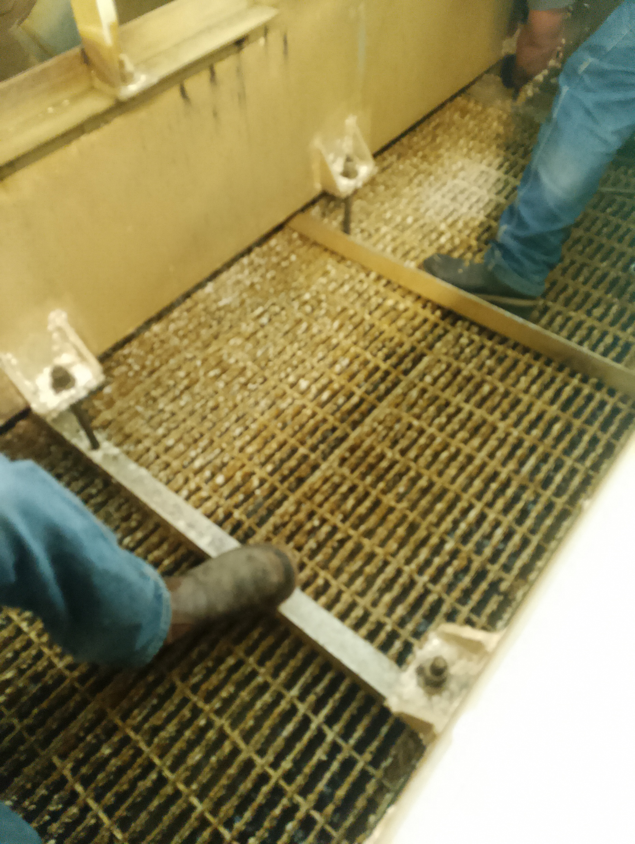
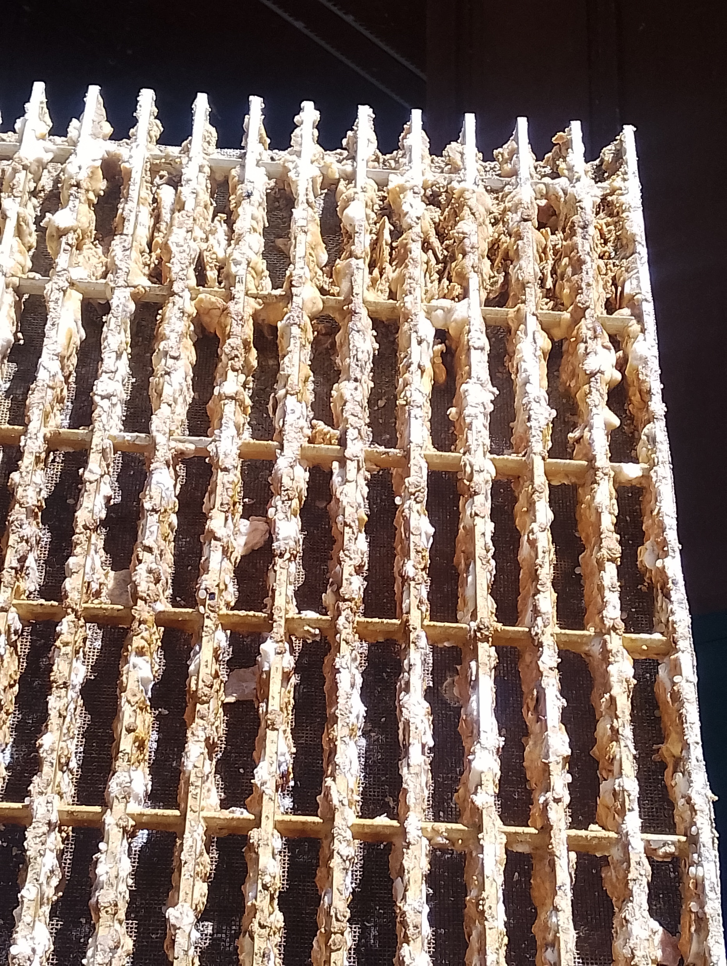
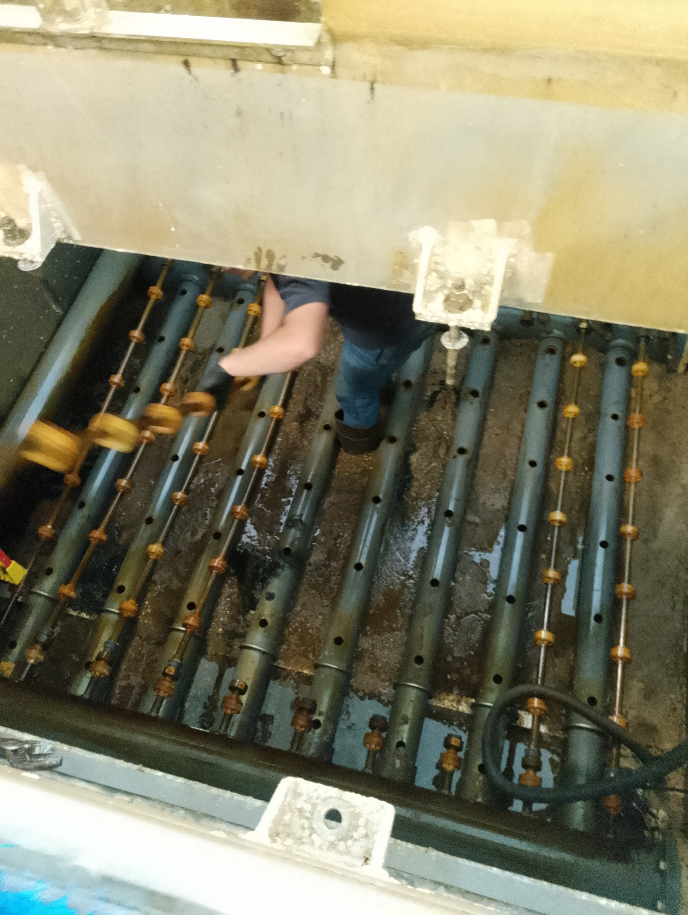
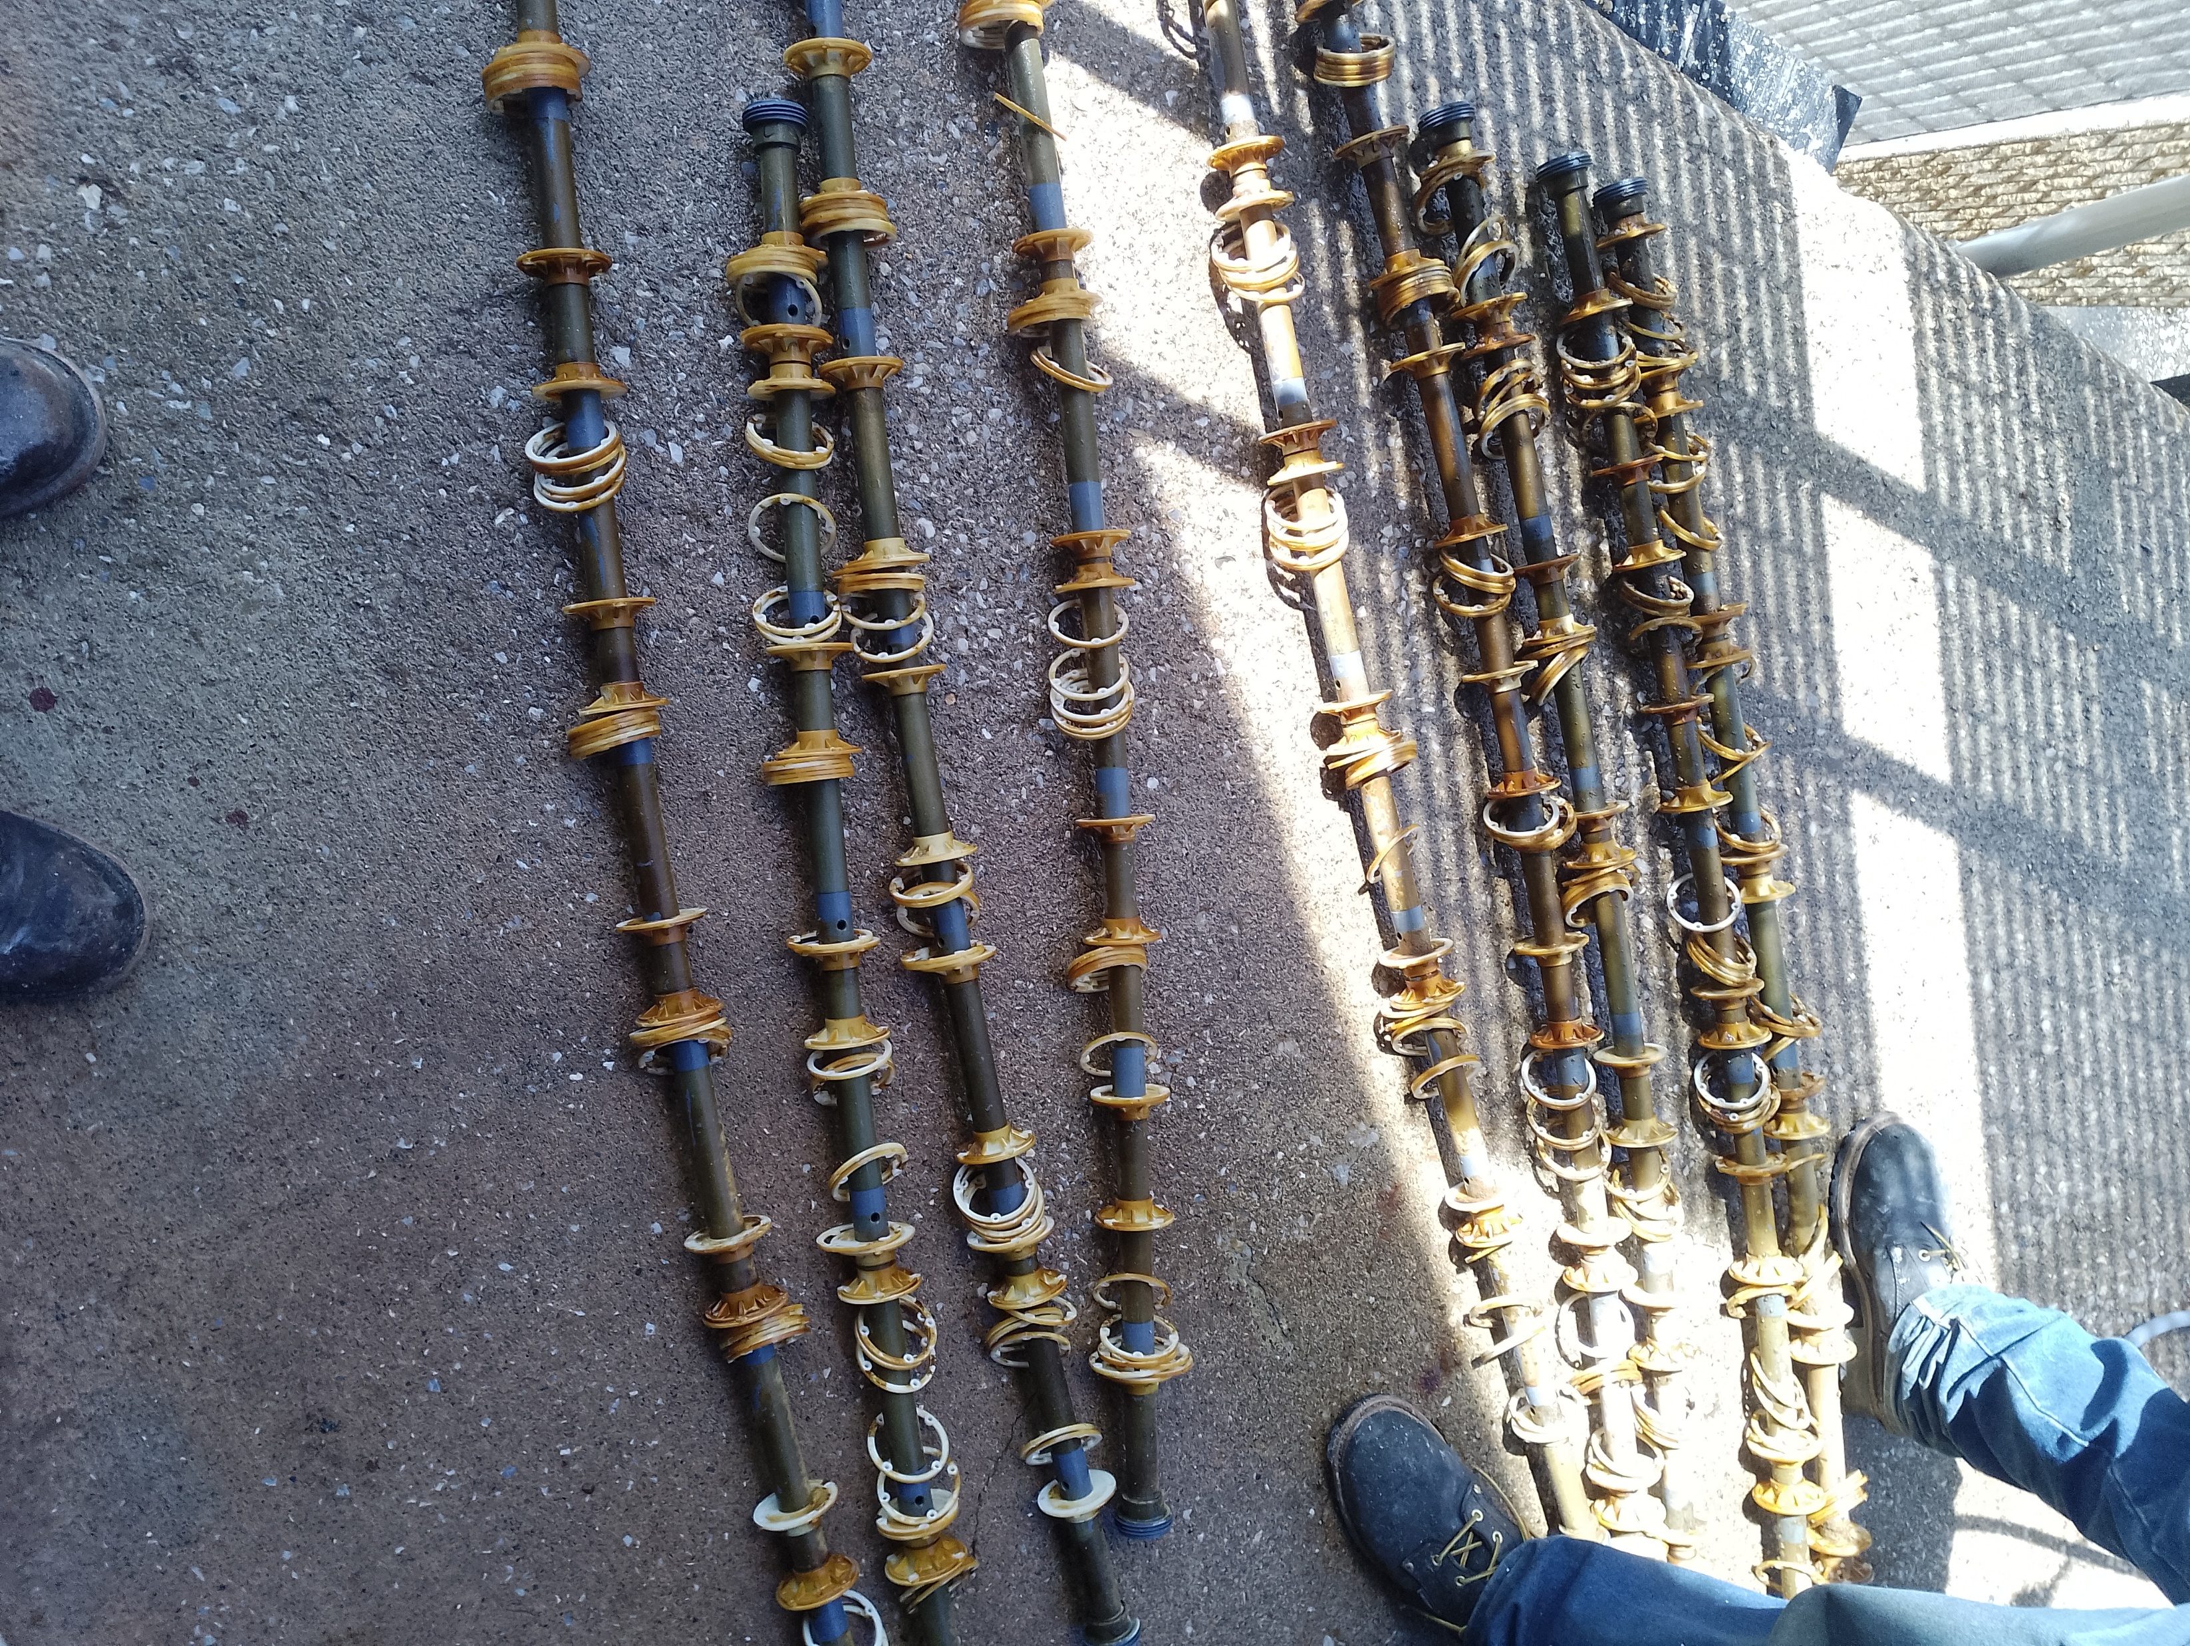
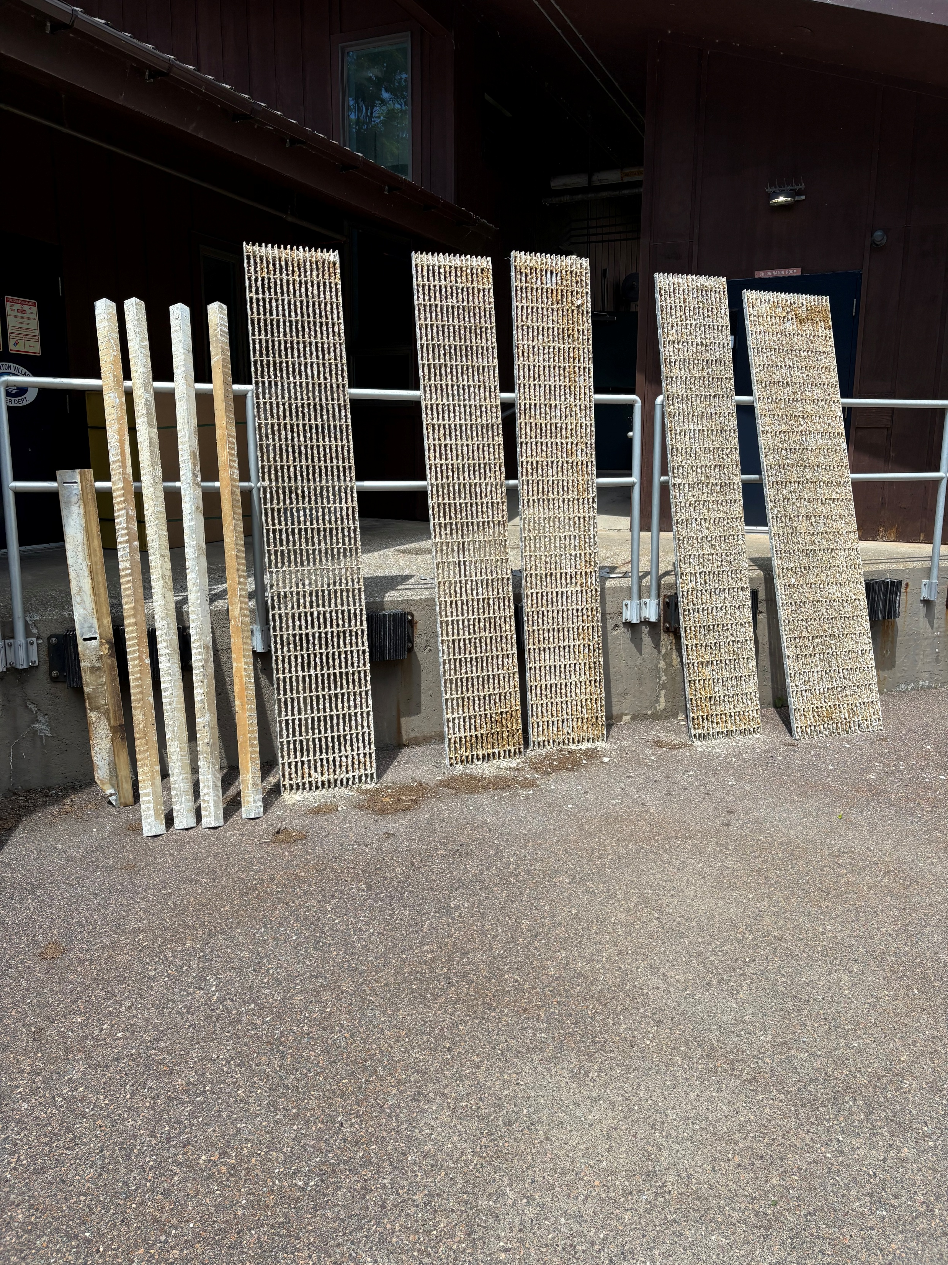
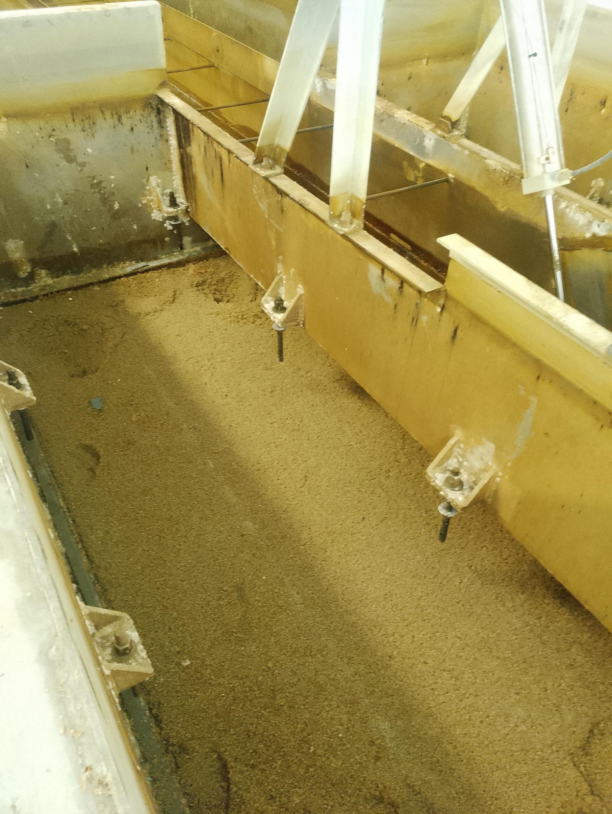
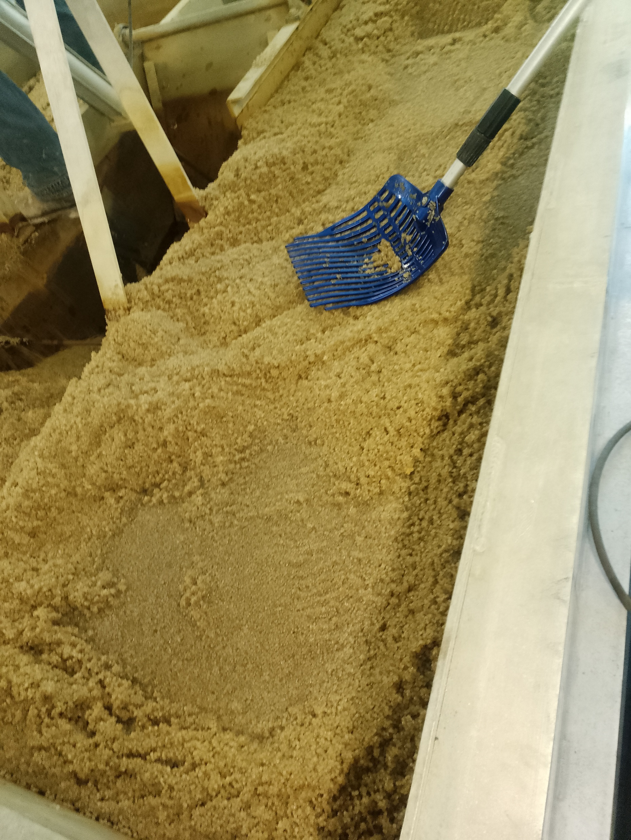
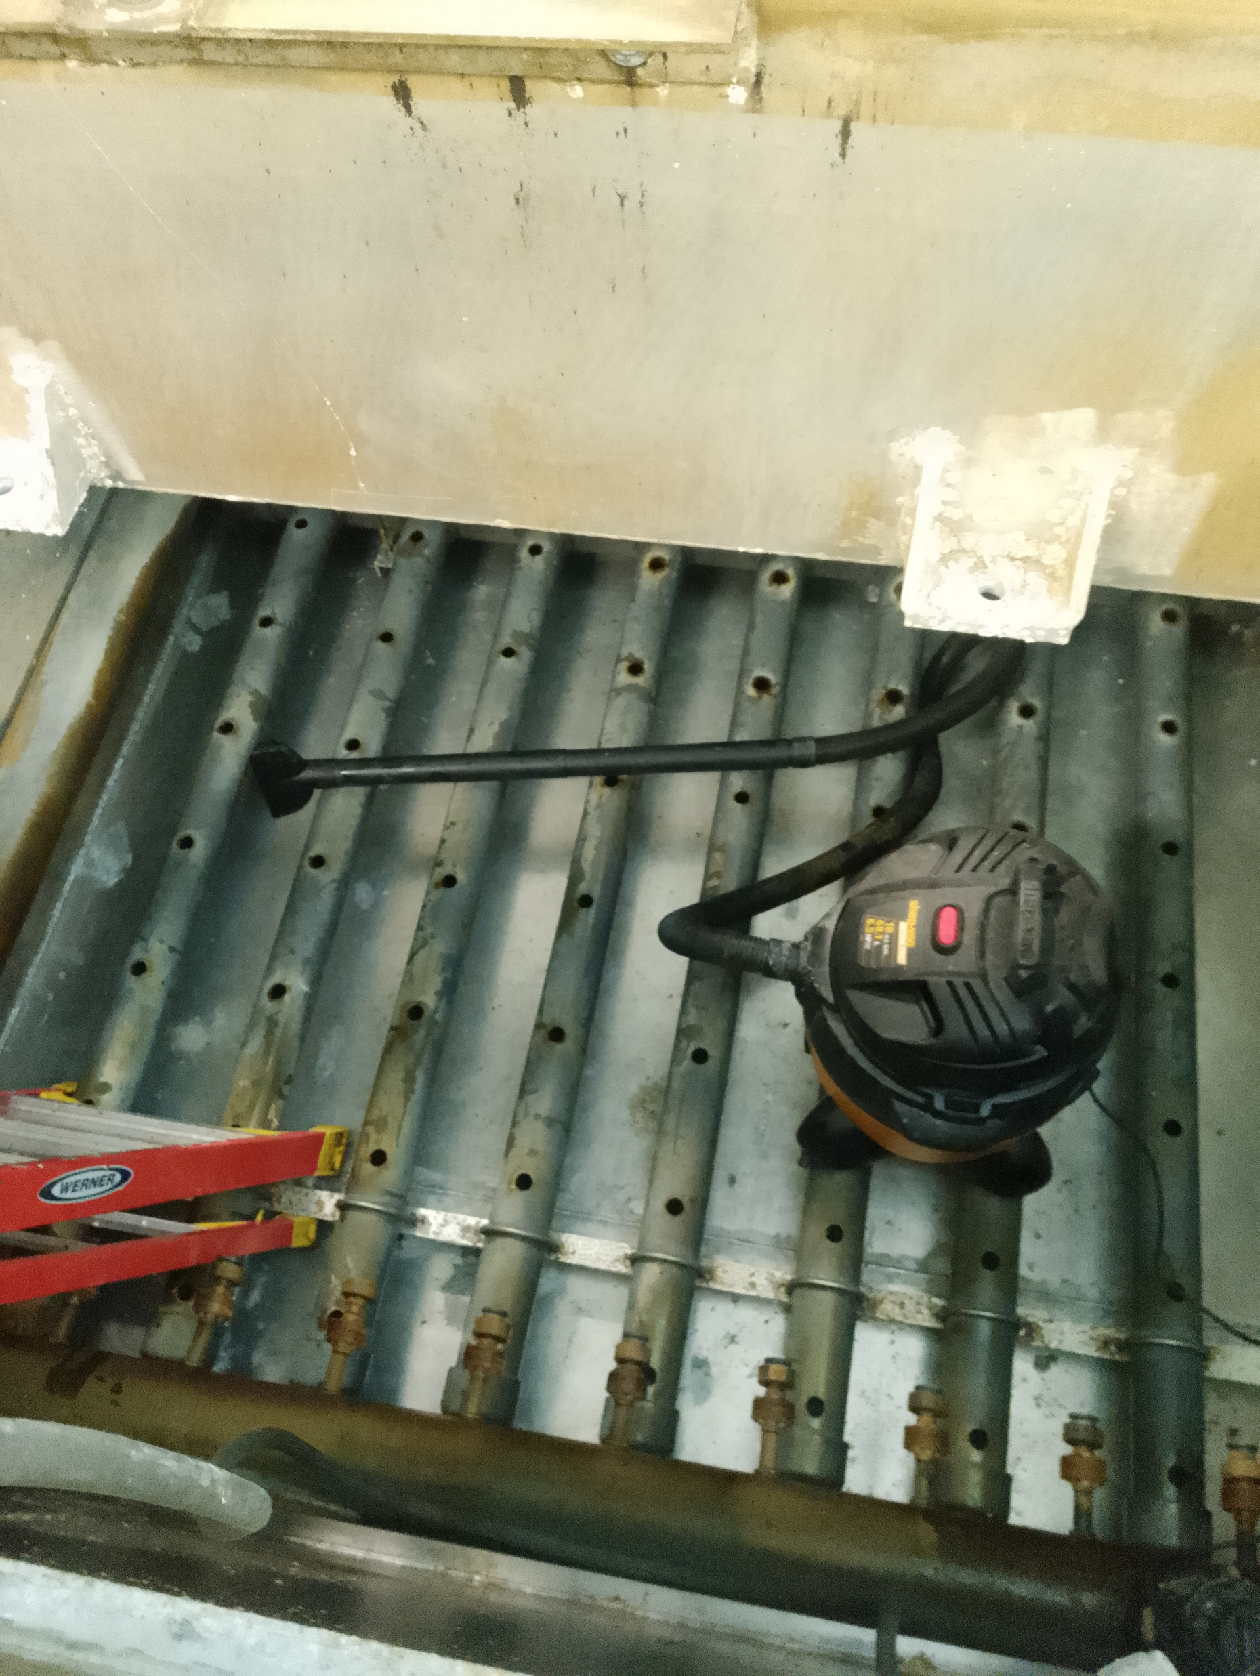
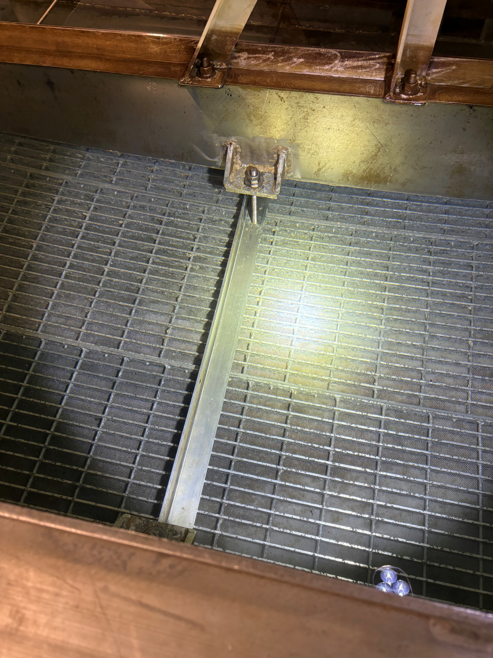
Grates Before
7-8” of Sludge
Air Diffusers
Beads Floated from Clarifier to Filter
Cleaned Clarifier Basin
New cleaned Clarifier Re-installed

Slide 10
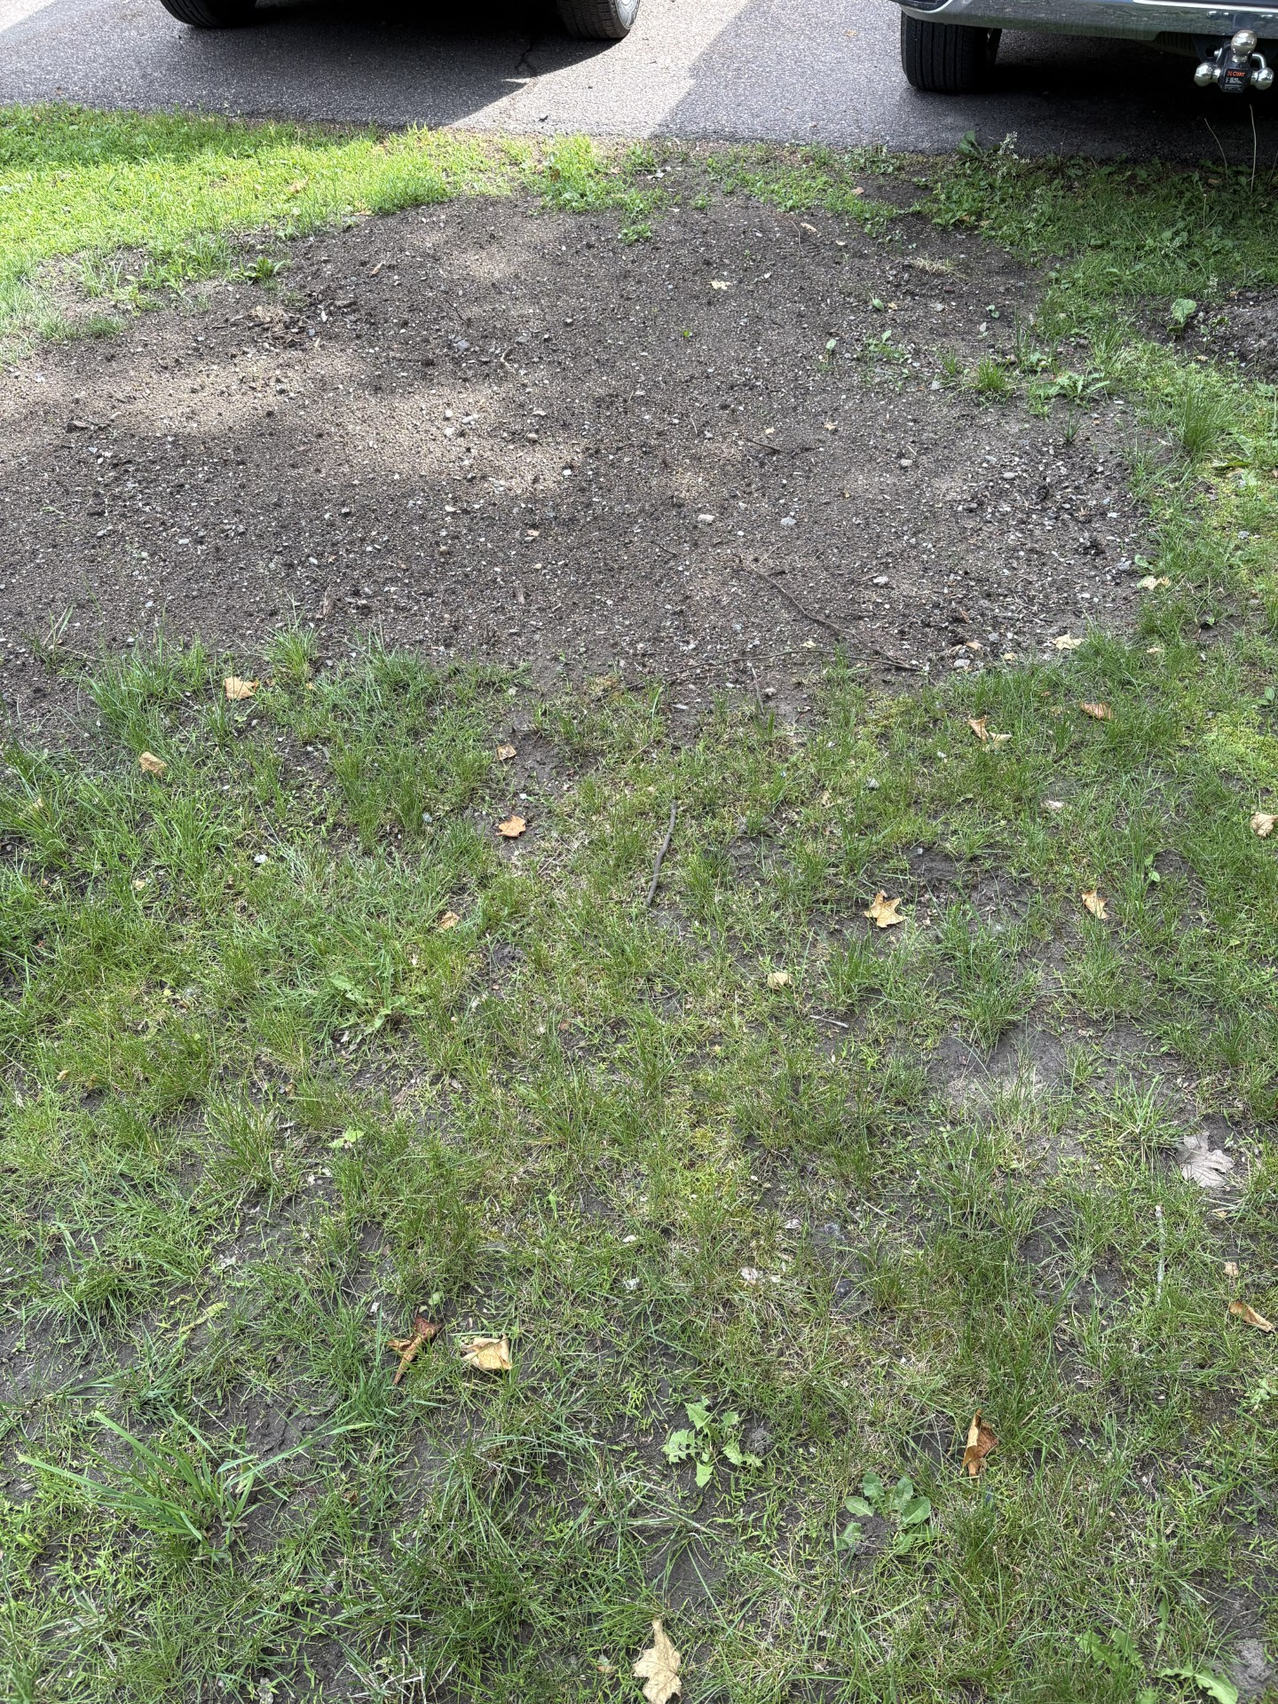
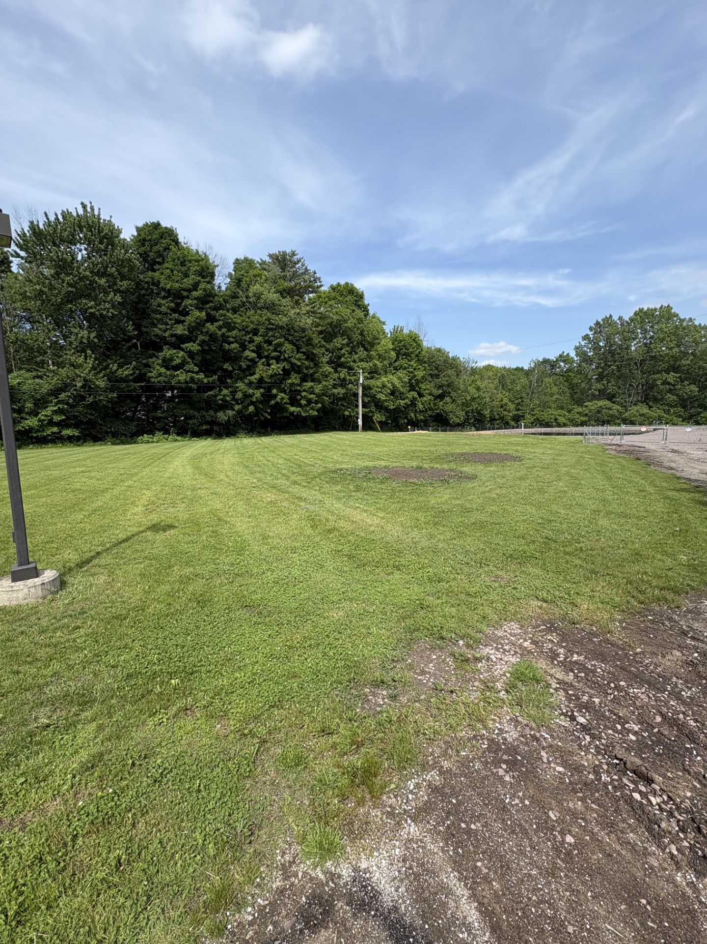
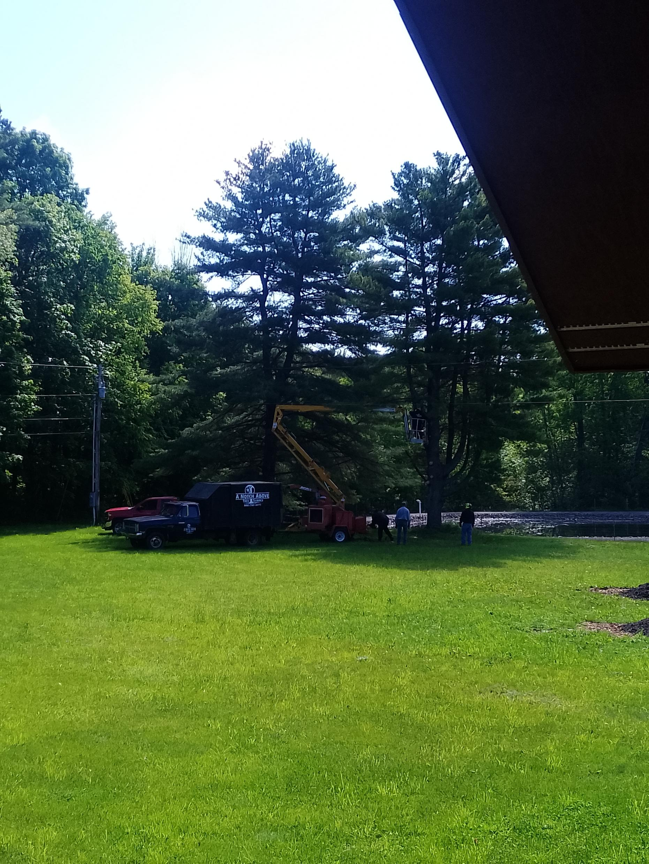
Tree Removal and Stump Grinding
The Water Treatment Team removed 10 problematic trees from the property, including complete stump removal. Two of these trees were exceptionally large and posed a significant risk to a main power line and discharge lagoon. Due to the potential safety hazards and operational impacts, a critical decision was made to obtain quotes and proceed with their removal.

Slide 11
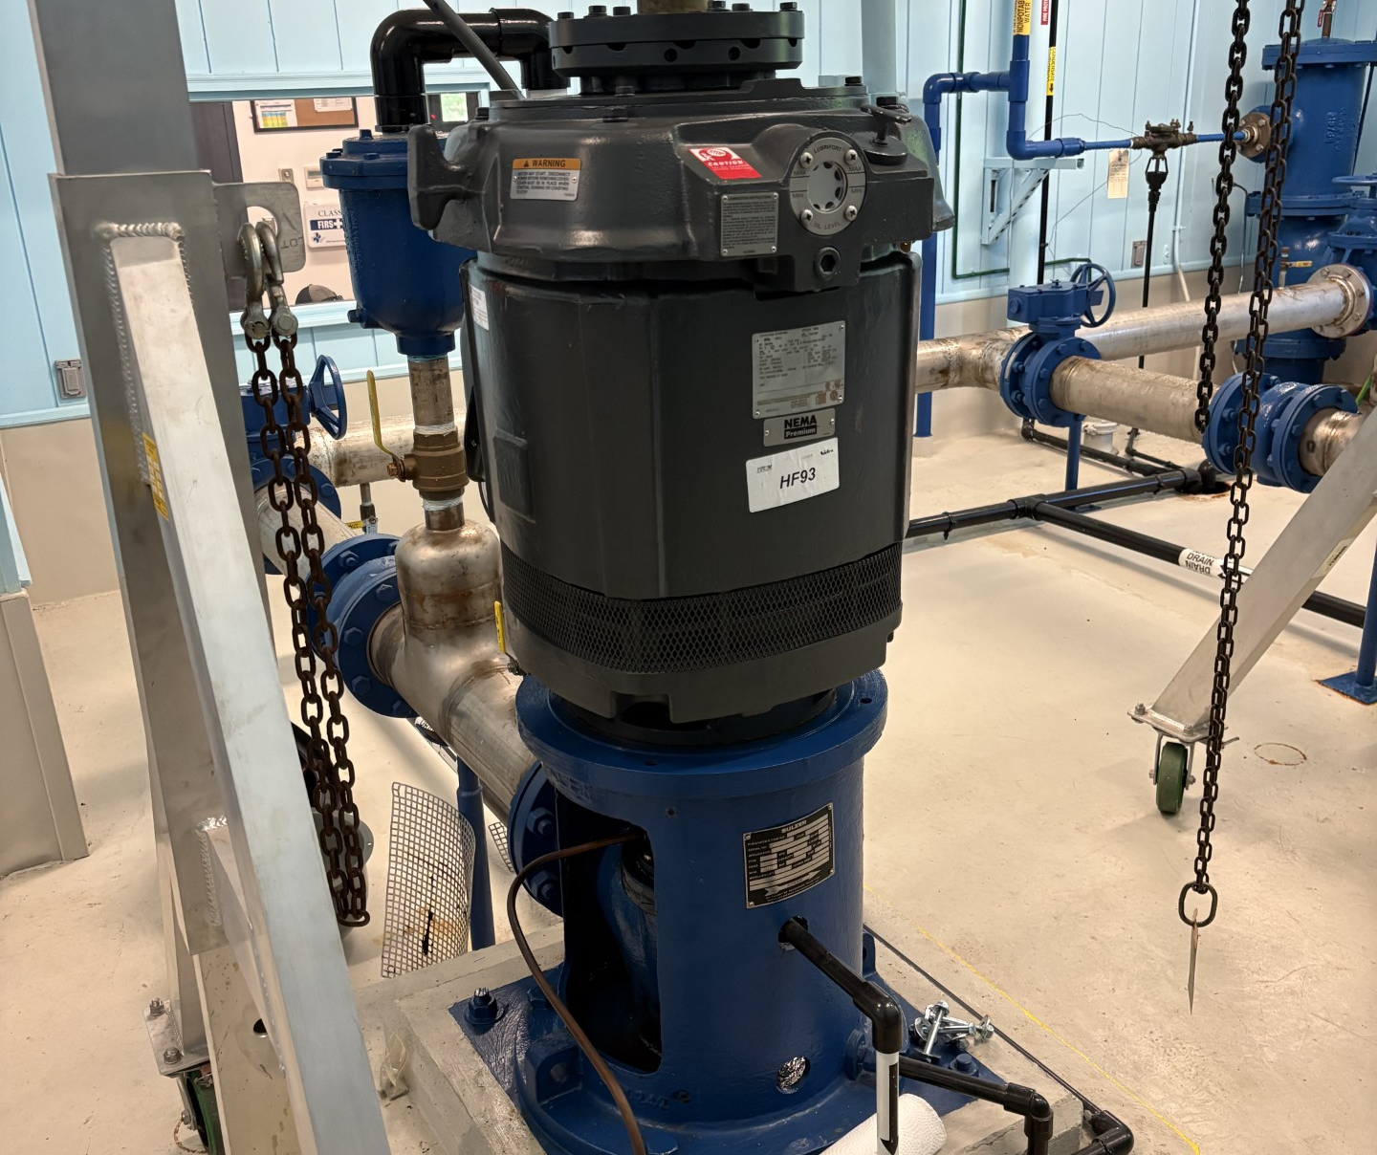
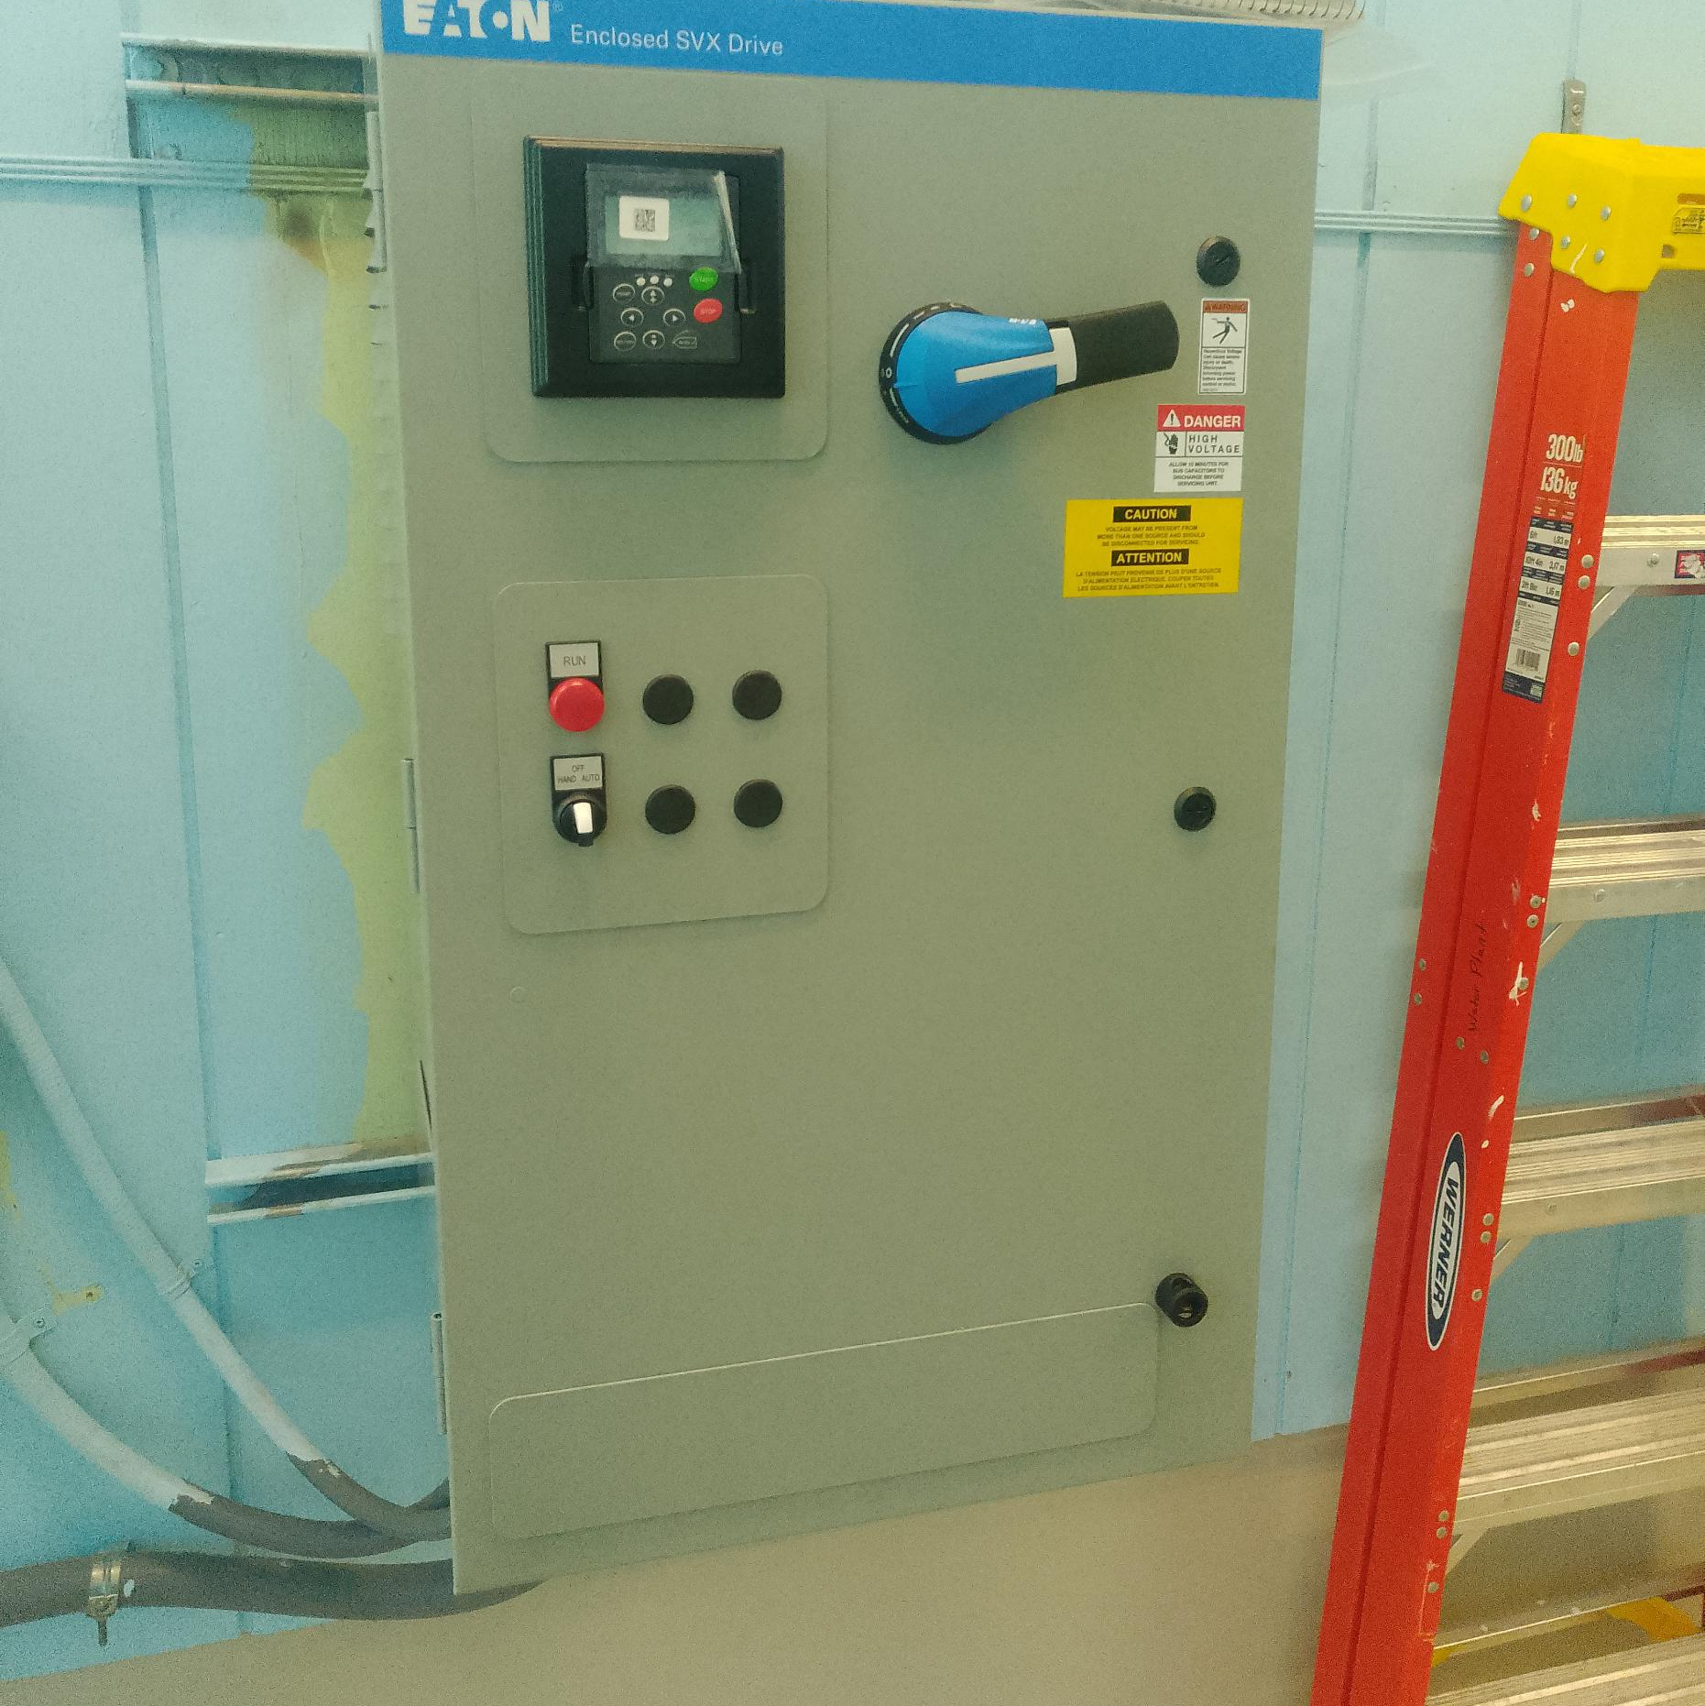
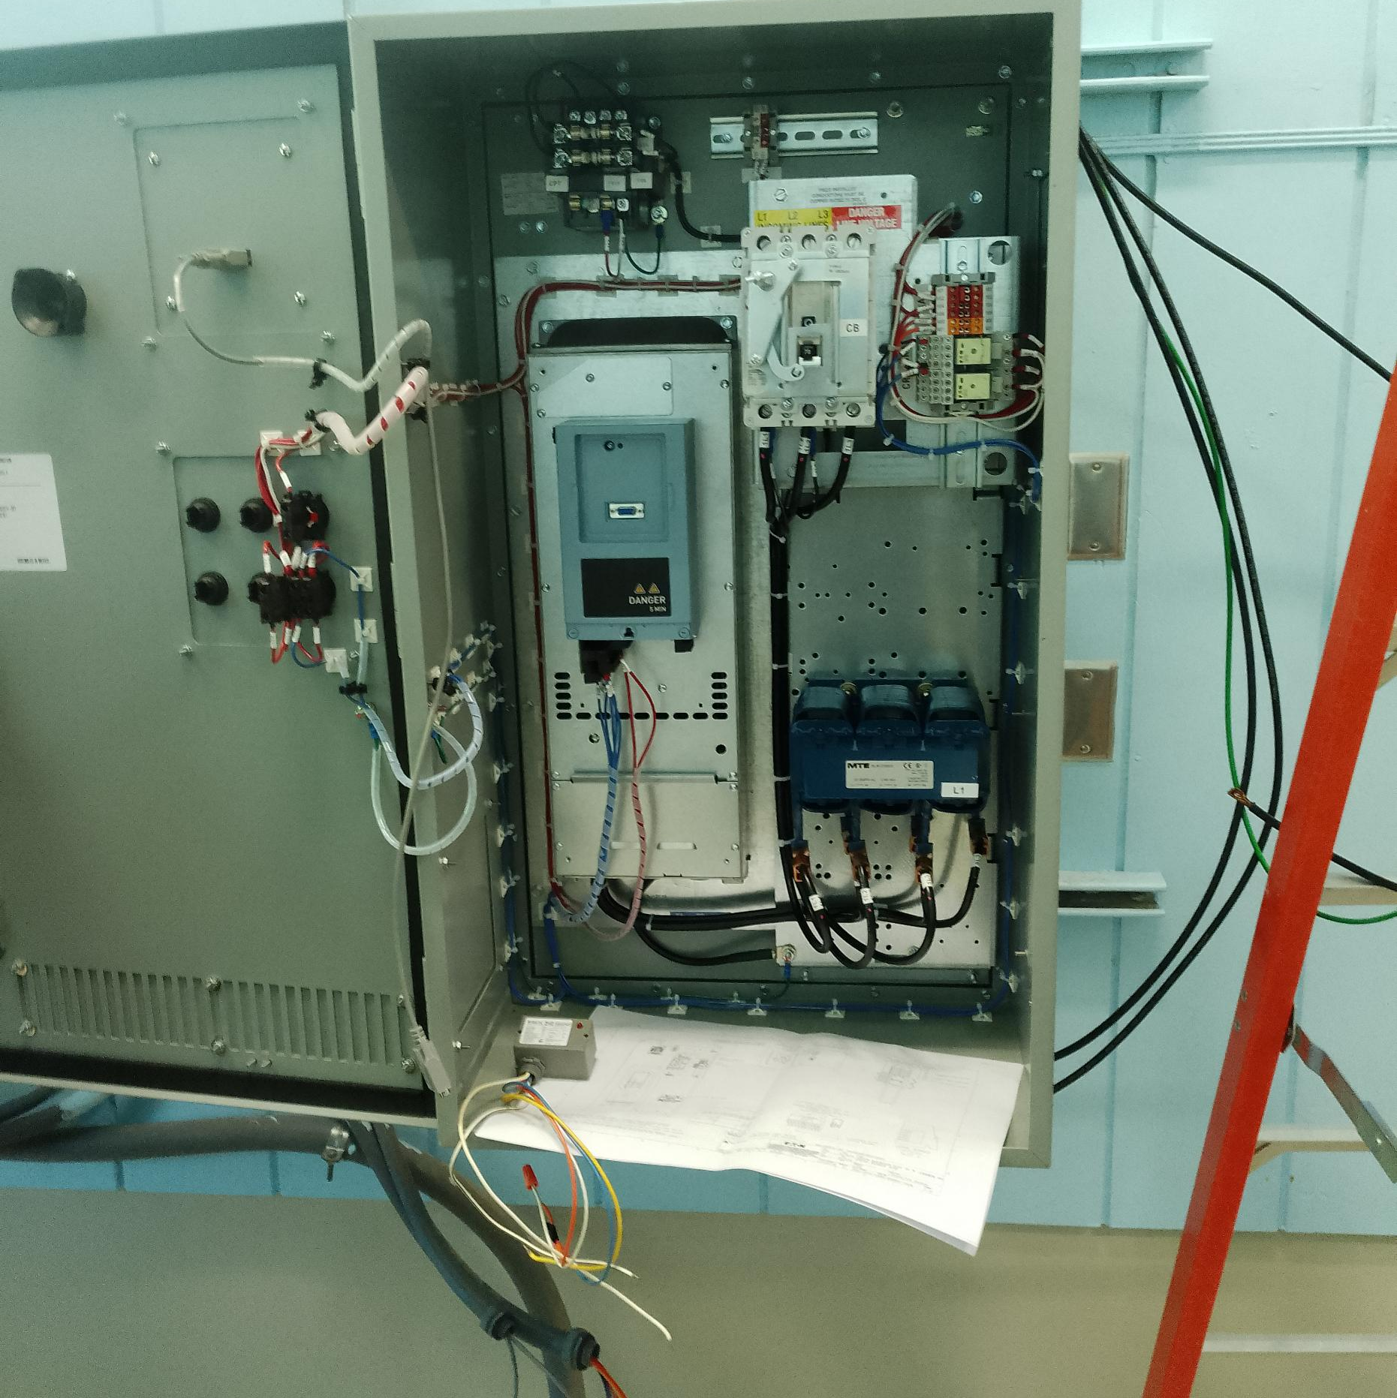
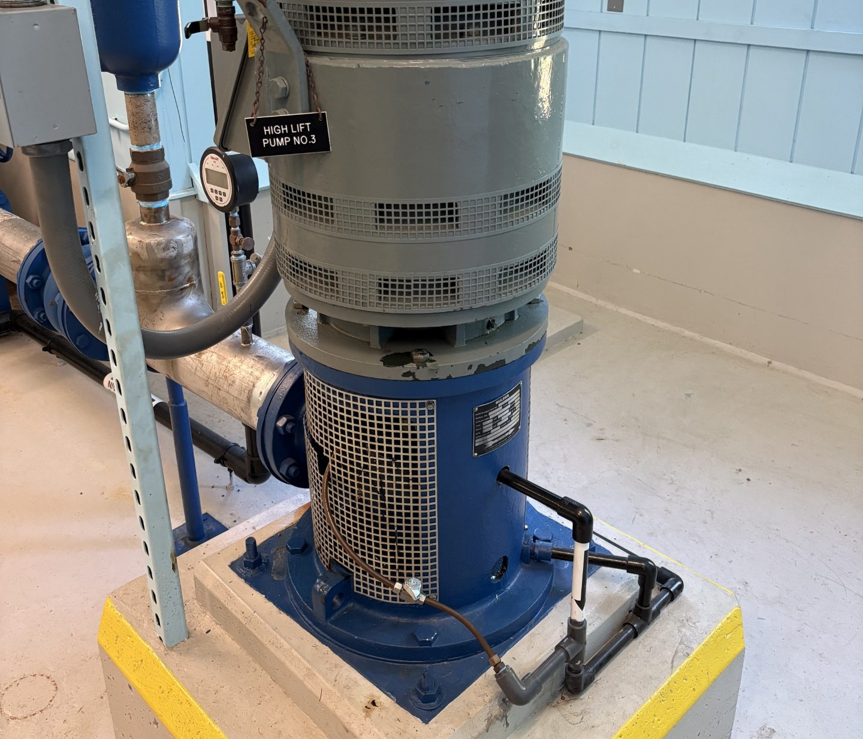
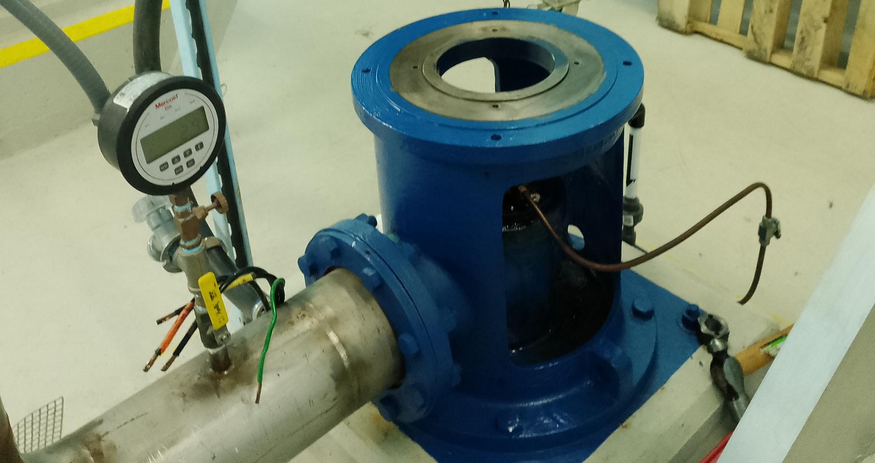
Upgraded VFD Cabinet and High Lift Motors
The Water Treatment Team has budgeted in 2026 for the replacement of one failed and outdated Variable Frequency Drive (VFD) cabinet and two high lift motors. These components were originally installed during the 2012 plant upgrade and have started reaching the end of their service life. Replacement parts are no longer available, making repairs impractical and increasing the risk of operational failure.
The high-lift and low-lift motors are critical to the water production process. Without these assets, the Village would be unable to reliably fulfill its obligation to produce and deliver potable water to customers.

Slide 12
In 2026, the Water Treatment Team budgeted for the replacement of our outdated SCADA software. The new system was purchased through LCS Controls, which designed, implemented an upgraded SCADA platform with enhanced functionality and reliability.
This system is a critical component of the Water Treatment Facility's daily operations, providing essential monitoring and control capabilities that support safe and efficient plant performance. The SCADA system operates on a closed network design that is isolated from external connections, significantly reducing cybersecurity risks and helping to protect the facility from unauthorized access and cyber threats.
New SCADA Computer and Software

Slide 13
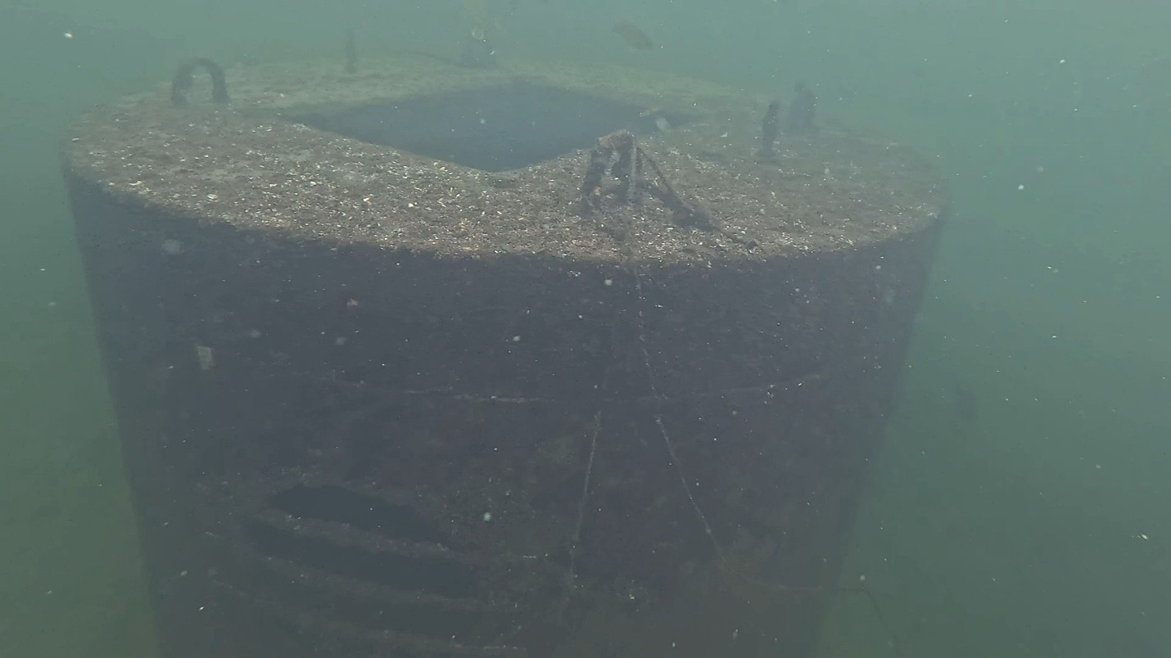
2026 Diving
Clearwell Tank
Backwash Tank
Reservoir
Intake inspected and cleaned
Inspection every 5 years
Cleaning every 10 years

Slide 16
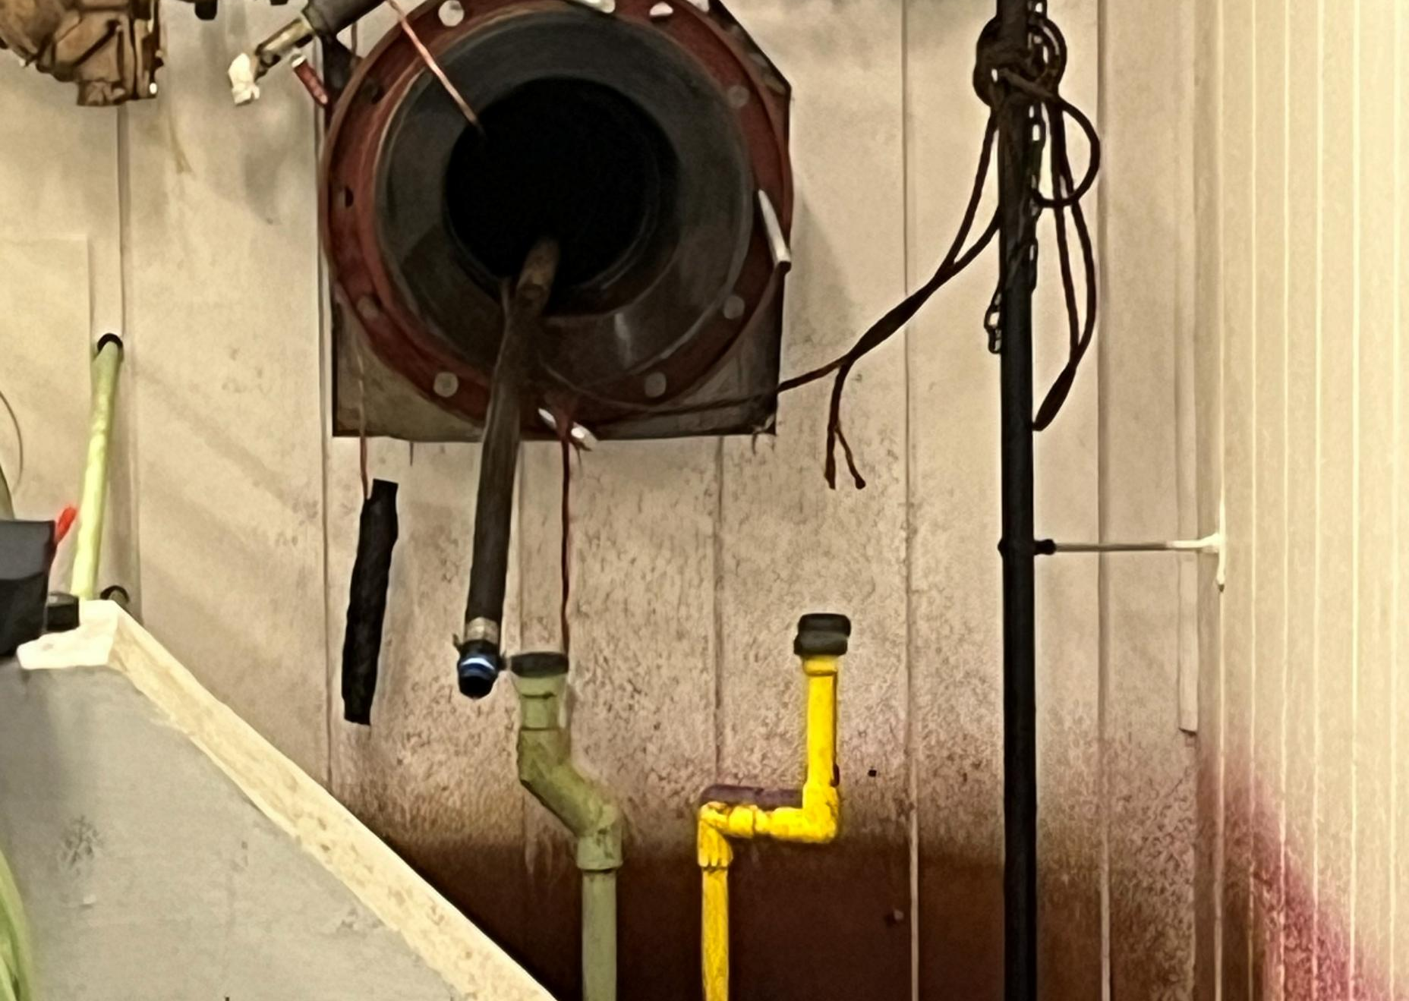
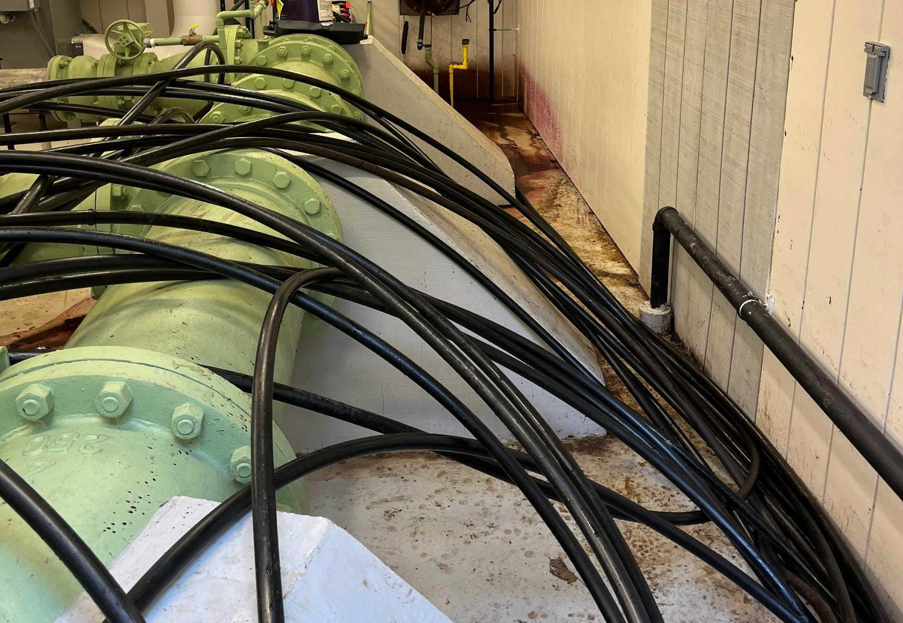
New Potassium Permanganate Chemical Feed Lines
Removed approximately 550 FT of plugged lines feeding from our treatment plant to our low lift where the chemical gets injected into the raw water.
We removed three total lines.
We reinstalled two-brand new ¾” lines .

Slide 17
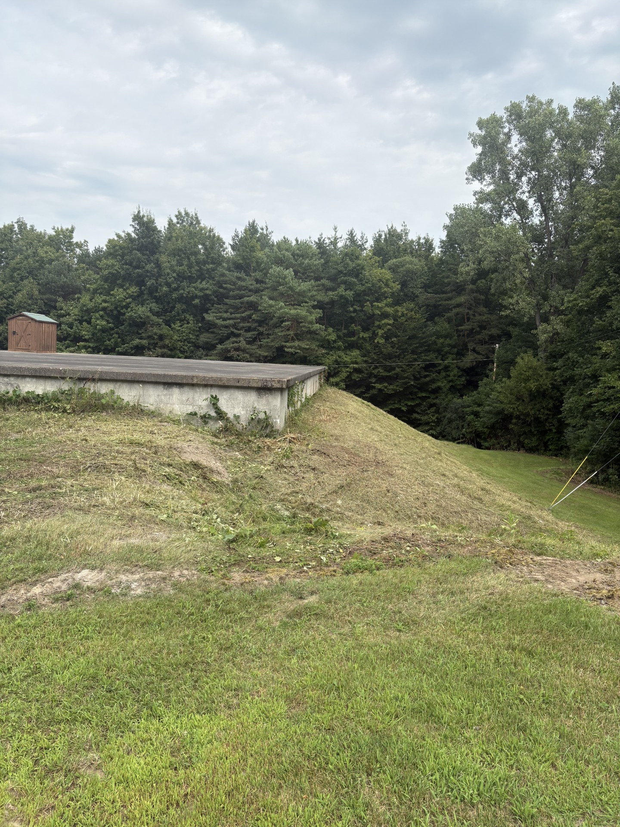
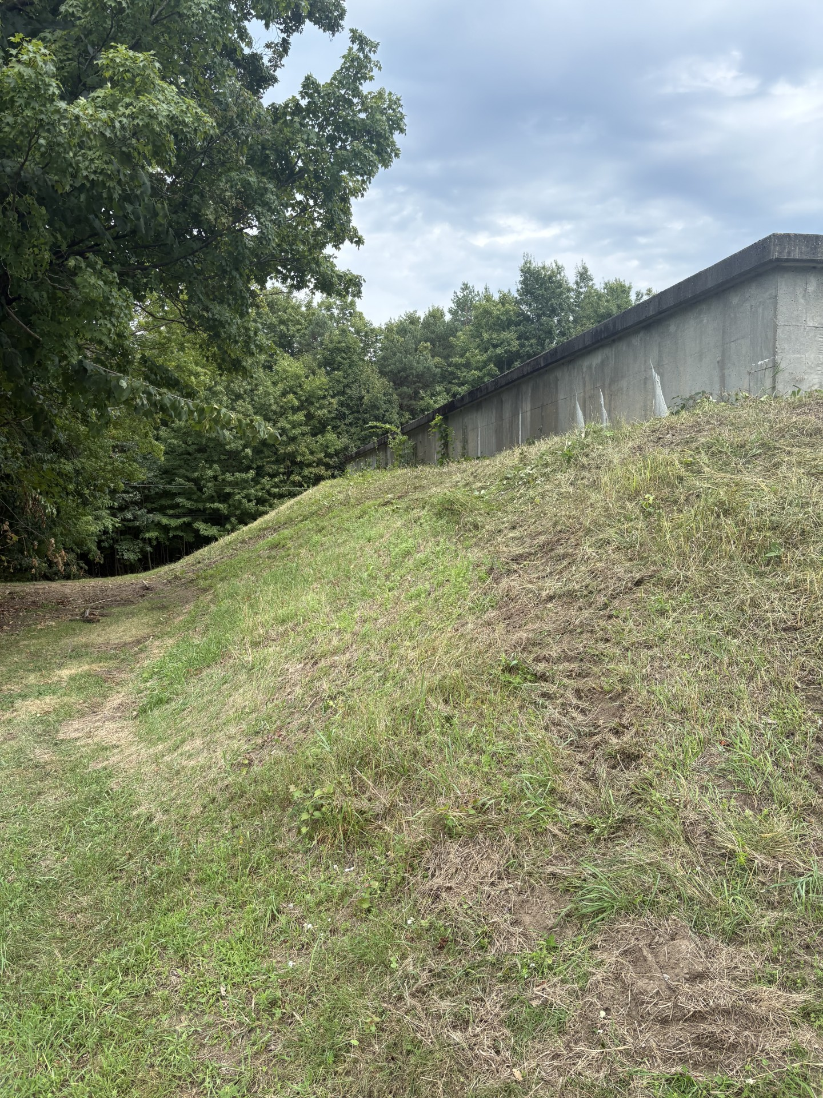
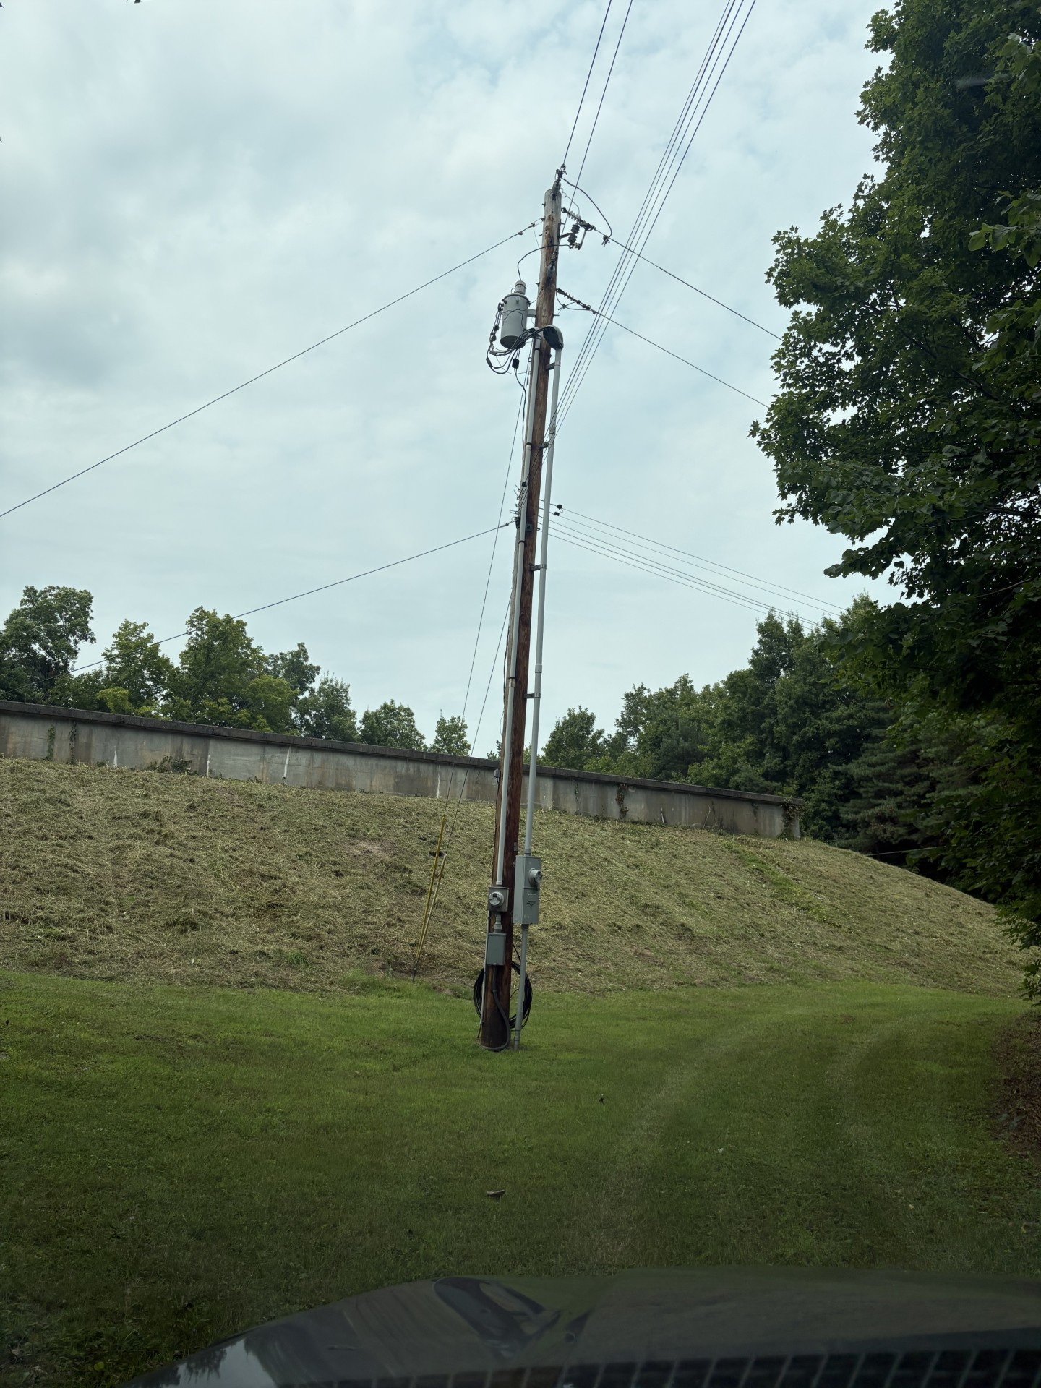
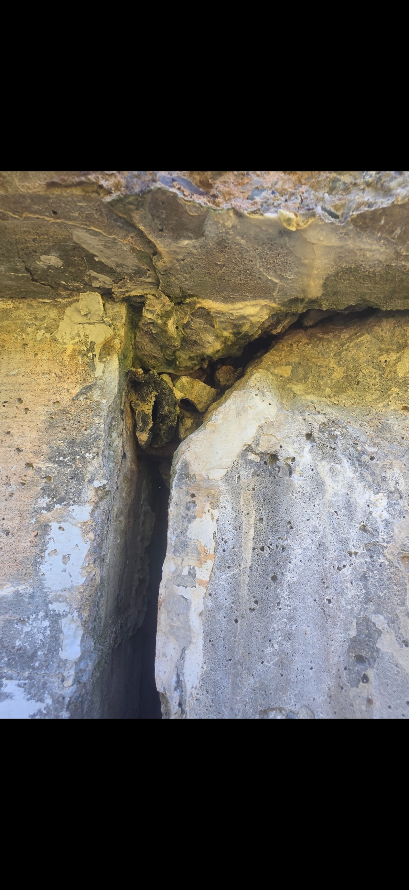
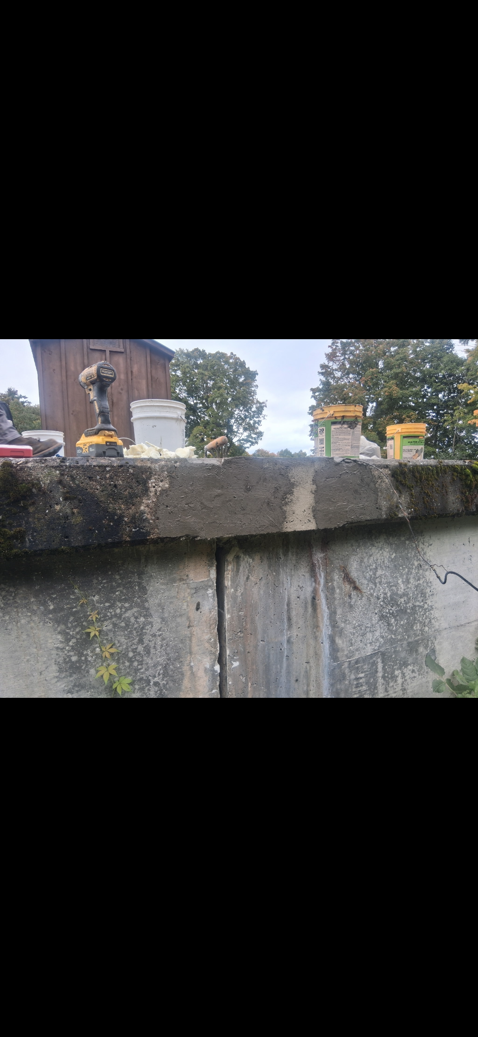
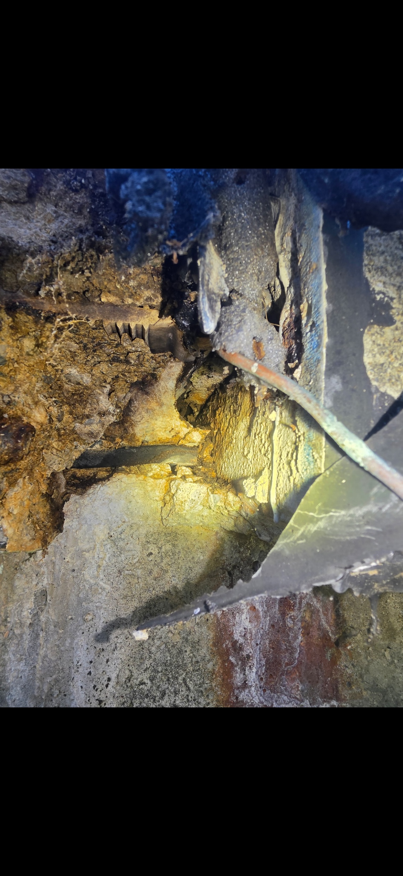
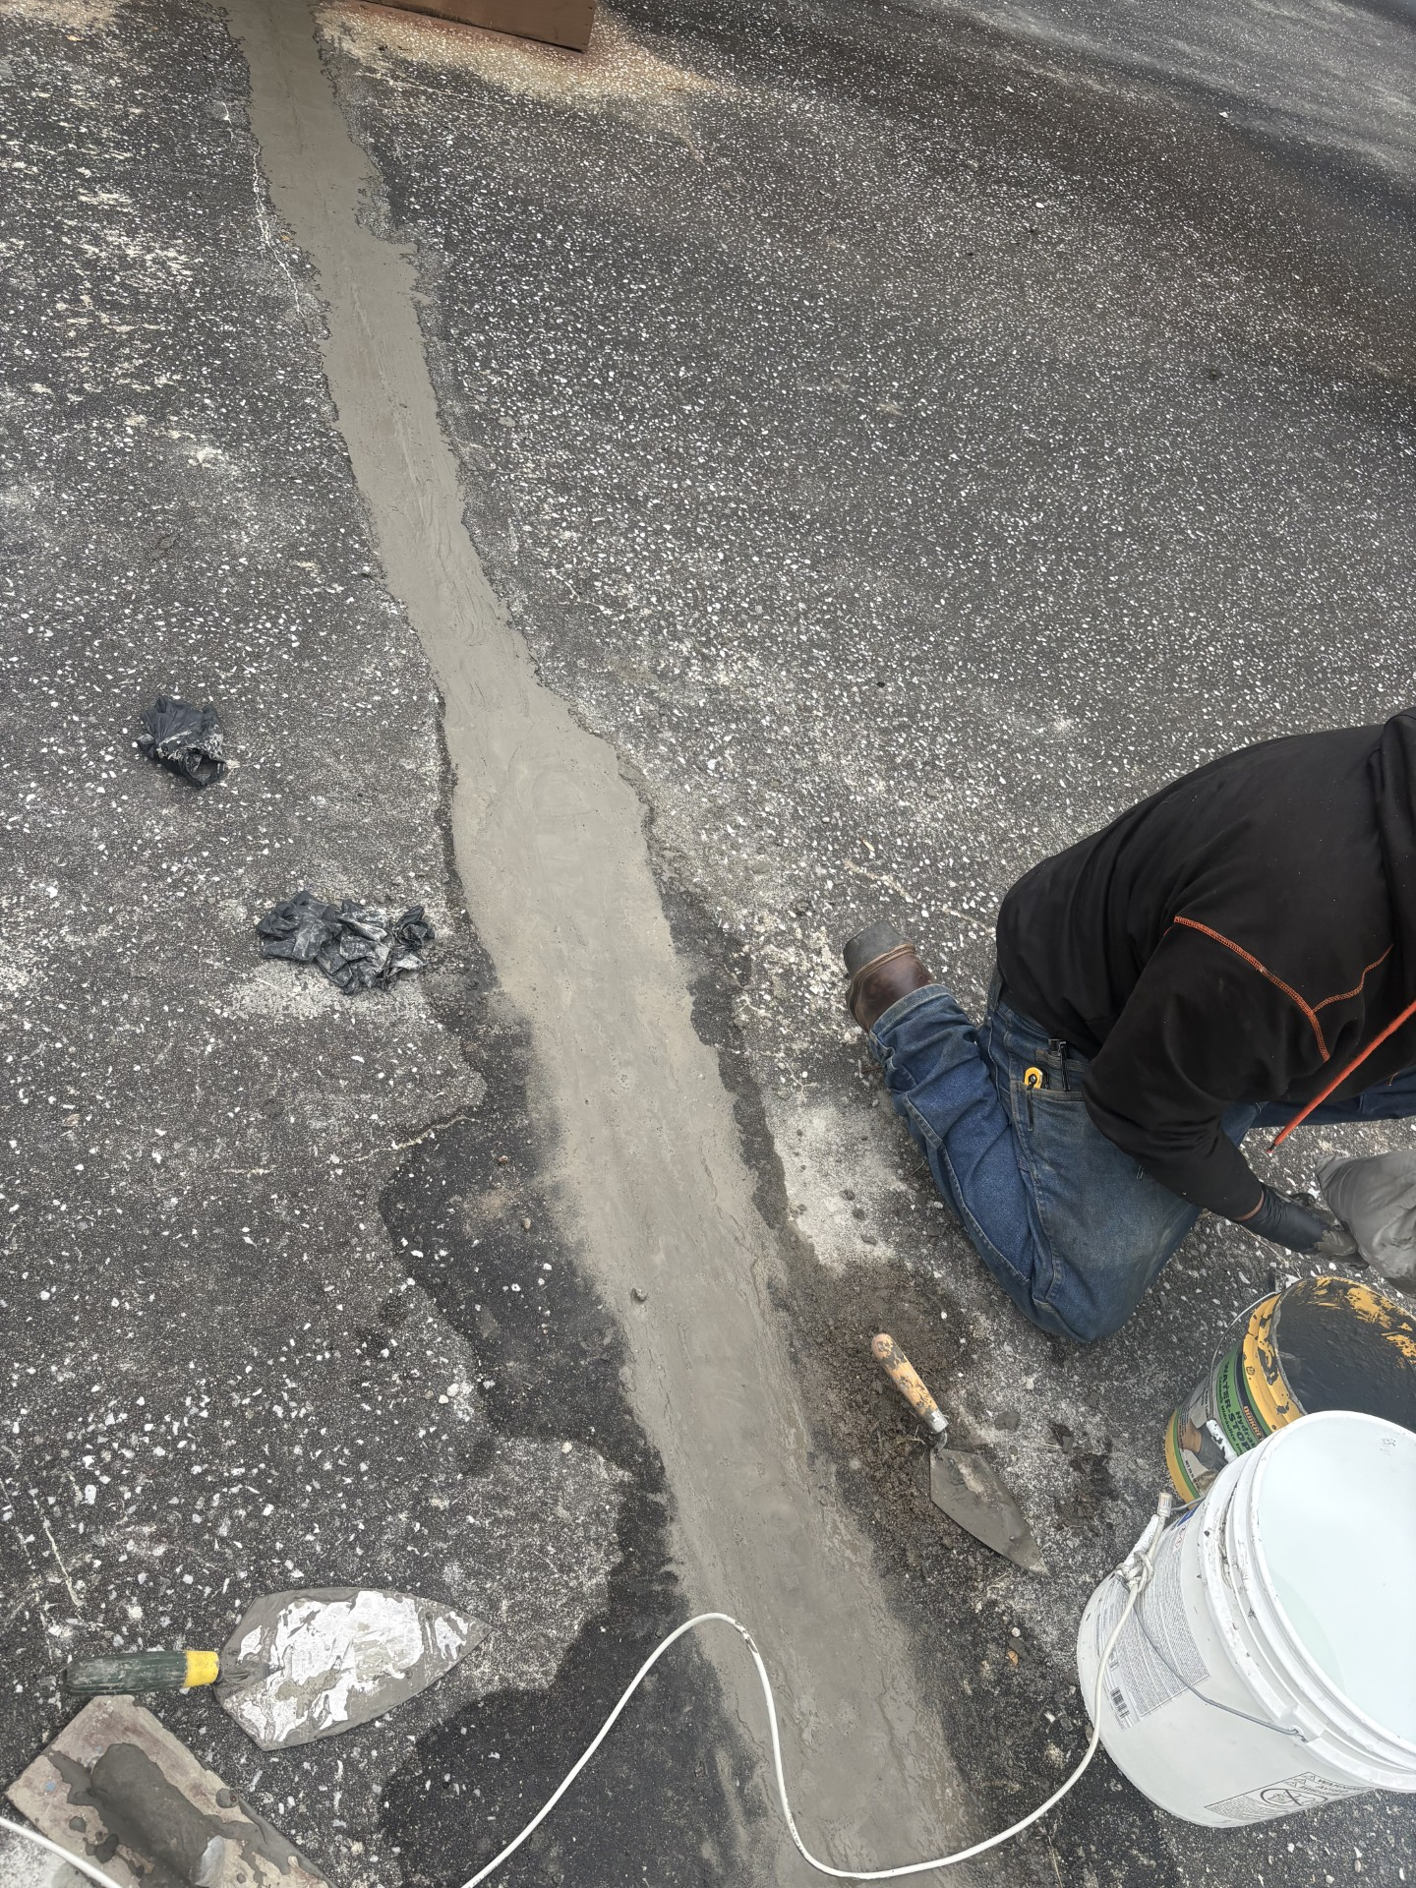


2026 Reservoir Maintenance
Ryan Jordan Mowed the Reservoir
Repairing Reservoir Concrete Structure

Slide 18

2026 Hydrant Flushing
Village of Swanton Public Works Department flushed approximately 150 hydrants throughout a twelve-hour period twice this year. The Water Treatment Team operated the treatment plant monitoring flushes, backwashes and pressures. Both departments worked collaboratively to ensure a smooth and successful operation.

Slide 19
Current projects 2026
The Village of Swanton Water Treatment Facility has applied and been rewarded grants for 2026 to work on the following documents. They all have been started, completed and soon to be accepted.
2026 Source Protection plan was developed and waiting submittal date. This was completed in collaboration with Aldrich and Elliot Team, as well as the Vermont Rural Water Assistance Team.
2026 Asset Management Plan has been updated and currently pending approval. The Village of Swanton Water Treatment Team worked collaboratively with the Aldrich and Elliot team.
2026 Emergency Response Plan has been updated and currently pending approval. The Village of Swanton Water Treatment Facility Team worked collaboratively with the Aldrich and Elliot Team.
2026 Risk and Resiliency Assessment with VRWA.

Slide 20
Some fun facts about the Water Treatment Facility Team…
1. Operator Certification and Staffing
Swanton Village Water Treatment has two fulltime 4c water operators.
There is also two 4c operators cross trained from the Wastewater Treatment Facility. Additionally, there is one employee in the Maintenance Department who has obtained his Operator in Training who is working to obtain his license.
2. Fluoridation Performance (2025–2026)
During the 2025–2026 reporting period, Swanton Village Water Treatment submitted 51 fluoride samples for analysis to the Vermont Department of Health Laboratory. Based on the laboratory's operational target range of 0.6–1.0 mg/L, 96% of all samples were within the recommended limits, demonstrating consistent fluoride dosage control and operational performance.
3. The Lead Line Service Inventory that was started in 2025 is complete. Eight Service lines total were determined to be in question. The Public Works Department Tested them, only two Needed to be replaced due to lead.

Slide 21
Reminder…
Water Treatment Facility open house.
211 Maquam shore road
10/14/2026
1:00pm-3:00pm and 6:00pm-8:00pm

Slide 22

Questions?
Any questions, comments or concerns please don’t hesitate to contact us.
(802) 868-2148
Ddupont@swanton.net

